Slide 1
Wow Assembly:
Friday 14th January

Slide 2
Phrase of the Week:
The harder you work for something, the greater you will feel when you achieve it.

Slide 3
Green Cards!
Ash – Mia
Ash – Teddy
Dylan – Aspen
Lilly Ct – Aspen
Jay – Redwood
Riley WP – Willow
Ava- Spruce
Ezmai- Spruce

Slide 4
Scientists of the Week!
Oak –Fletcher
Ash – Noah
Birch –
Pine – Vinny
Elm – Edward
Willow – Isabella
Spruce – Kara
Maple – Oliver
Redwood – Ruby
Chestnut – Ray
Aspen- Annalia

Slide 5
Weekly Team Points!
Peel | Ethelfleda | Grazier | Offa
340 | 168 | 366 | 244

Slide 6
Oak
Jenson
For
Writing a caption for a picture from Hansel
and Gretel.
Mrs Laffan 14.01.22

Slide 7
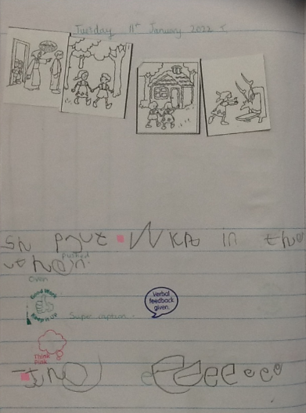
Oak Wow Work

Slide 8
Ash
Ronnie
For super collaging of his chocolate room inspired by Charlie and the Chocolate Factory.
Miss Bailey and Mrs Salt 12.01.22

Slide 9
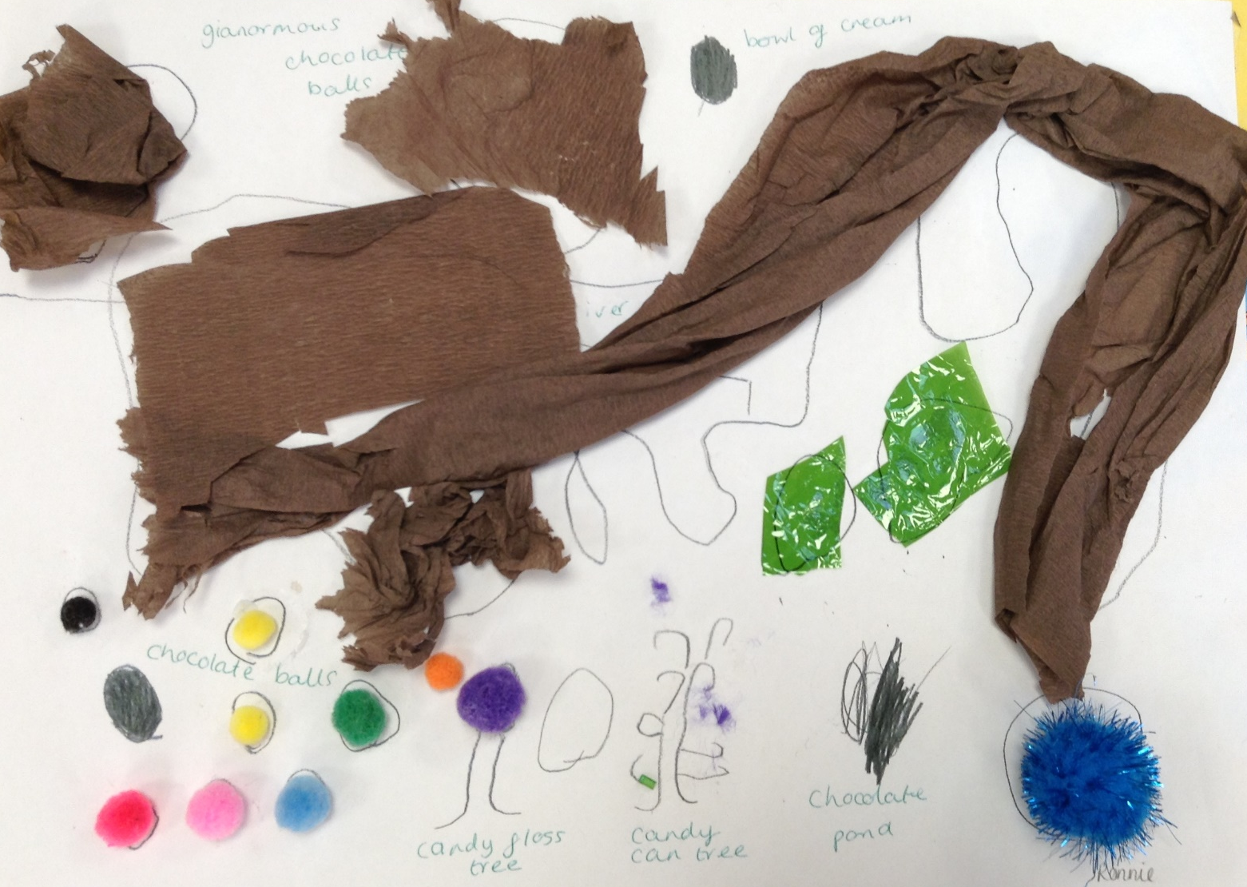
Ash Wow Work

Slide 10
Elm
Margot
For an outstanding piece of poetry. Margot could use her adjectives, nouns, verbs and even adverbs to create a beautiful poem about a butterfly.
‘Pink Butterflies danced happily’
Wow, I am confident you could be a poet!
Mr Grice 14.01.2022

Slide 12
Birch
Poppy
For
A fantastic effort to improve her written presentation. Well done Pops!
Miss Hewitt 14.01.22

Slide 13
Pine
Daniel
For an amazing Internet Safety poster in Computing. Daniel knew how to stay safe online and could create an excellent information poster to share with his friends.
Mrs Goodman 14.01.2022

Slide 14
Maple
David
For working independently to match descriptions of artefacts with the photographs.
Miss Dawson 14.01.2022

Slide 15
Willow
Angel
For persevering in Maths. You were able to use the resources in the classroom to help you continue working on the challenges you were set. I am really proud of you..
Miss Fisher 14.01.22

Slide 16
Spruce
Jacob K
For
Showing brilliant behaviours for learning. Jacob has rose to the challenges set, and strived to succeed even when tasks are tricky. Well Done Jacob!
Mr Draper 14.01.21

Slide 17
Chestnut
Amelia B
For working hard at improving her year 6 spellings over the last two weeks. She has recognised that repeat practise of these spellings has helped her retain them and continue to spell them correctly.
Well done!
Mr Tennuci 14.1.22

Slide 18
Aspen
Eva
For creating a wonderful 3D model of the solar system at home (it even has moving parts).
A great way to show your passion for learning, well done.
Mrs Read & Mrs Cox 10.01.22

Slide 19
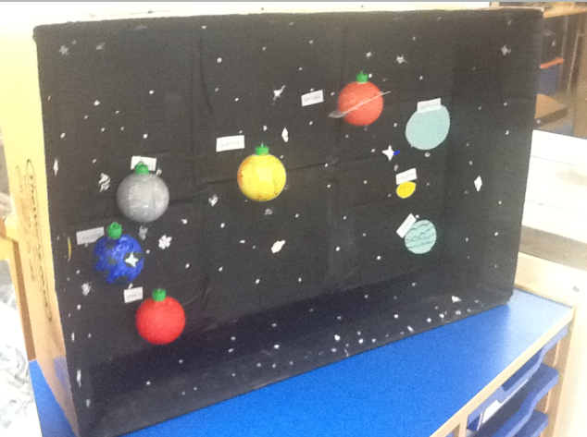

Slide 20
Redwood
Joe W.
For fantastic scientific investigation skills and showing passion in his learning
Miss Shipley 14.01.2022

Slide 22
Next Week’s
Phrase of the Week:
Believe you can and you’re halfway there.

