Slide 1
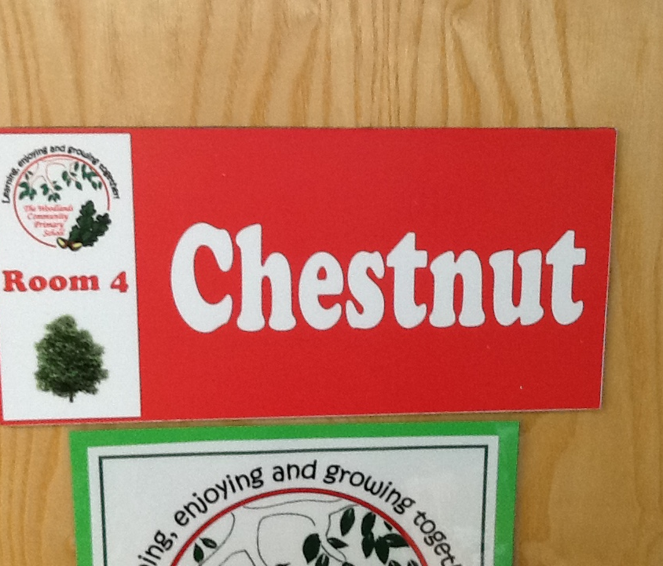
Welcome to Chestnut!
September
2025
Mr Tennuci

Slide 2
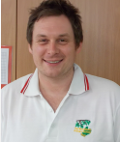
Teacher Profile:
Mr Tennuci
Welcome to Chestnut!
I’m really looking forward to teaching you next year.
Facts about me
I am remaining in Year 6 next year.
I originally come from the south of England.
I love movies from the 1980s (it wasn’t that long ago!) and anything to do with Star Wars and Marvel superheroes.
When I’m not in school, I’m usually entertaining my own three children. I also play in a band, playing either the guitar or bass guitar. Recently, I’ve started coaching football with my eldest daughter’s team.

Slide 3
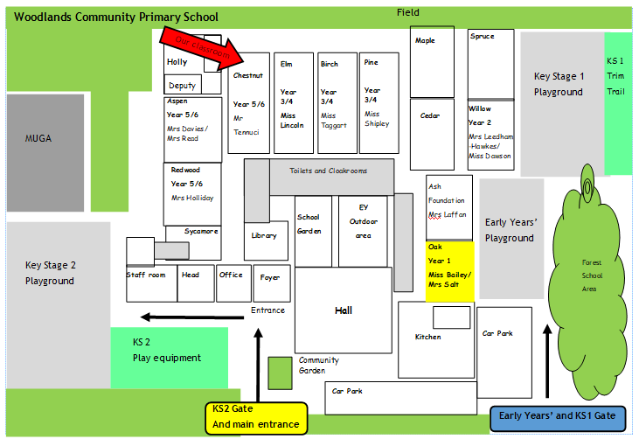
School Map
Elm
Year 4
Mrs Shipley-Smith
Willow
Year 2
Miss Dawson
Mrs Salt
Oak
Year 1
Miss Lincoln
Here is the map of our school site:

Slide 4
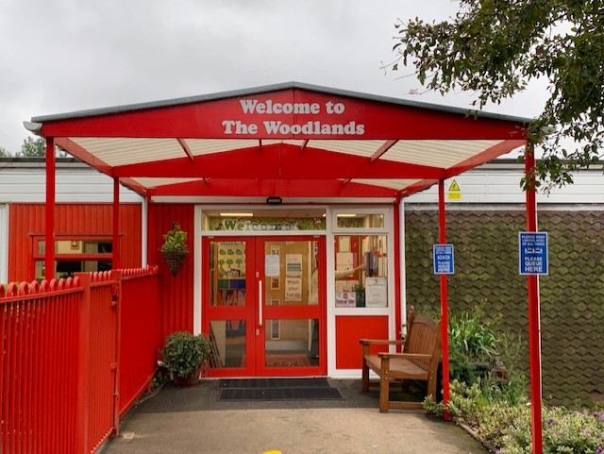
Welcome to Chestnut!
Yellow Gate
Registers close 10 minutes after the class gate time.
8:35 Drop off (straight into class)
3:15 Leave classes
3:20 Parents Collect
PLEASE DO NOT WAIT AT THE GATES

Slide 5
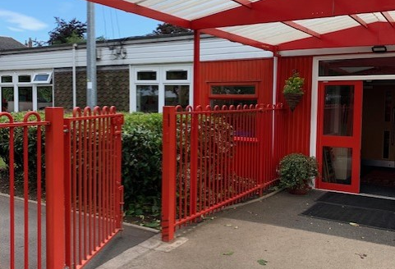
Welcome to Chestnut!
KS2 Gate
Registers close 10 minutes after the class gate time.
8:35 Drop off (straight into class)
3:20 Collect
PLEASE DO NOT WAIT AT THE GATES

Slide 6
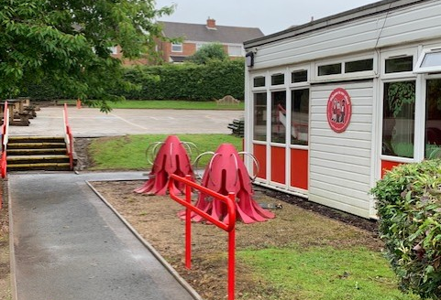
Welcome to Chestnut!

Slide 7
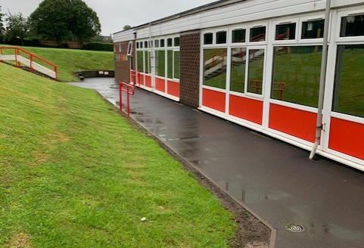
Welcome to Chestnut!

Slide 8
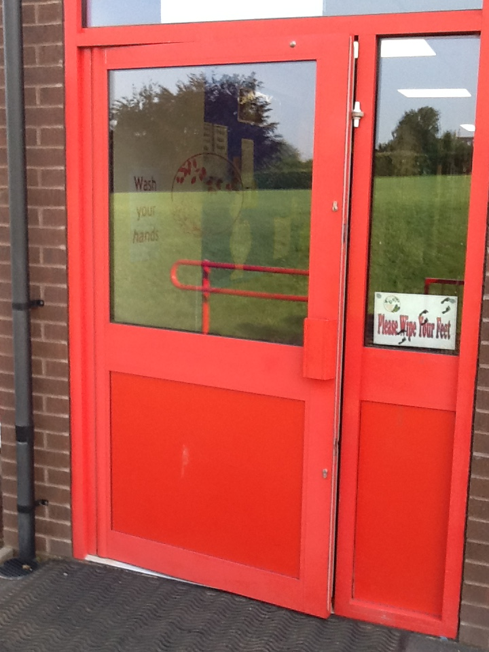
Welcome to Chestnut!

Slide 9
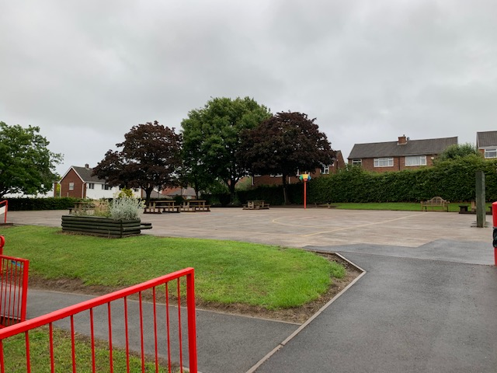
Break time!

Slide 10
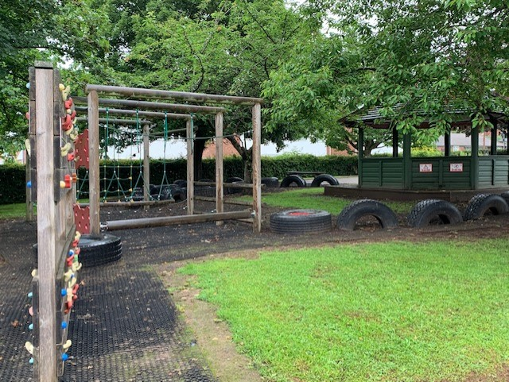
Break time!

Slide 11
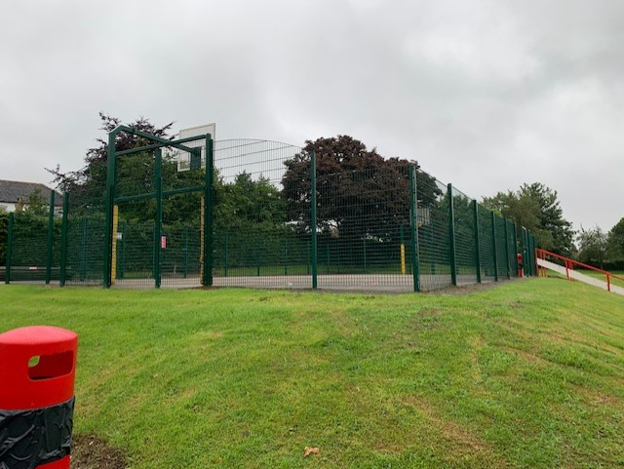
Break time!

Slide 12

Break time!

Slide 13

Timetable
Our timetable will look like this! We have Guided Reading, English and Math every morning and our other subjects in the afternoons.

Slide 14
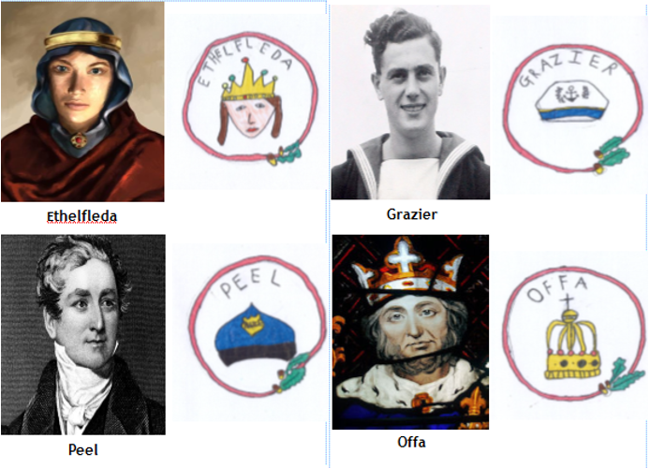
Houses:
Here are our school houses, named after important people from Tamworth’s history.
You will still be in the same house as last year – when you win team points, they all contribute to your team effort!
We will be voting for our new Year 6 House Leaders in September.

Slide 15
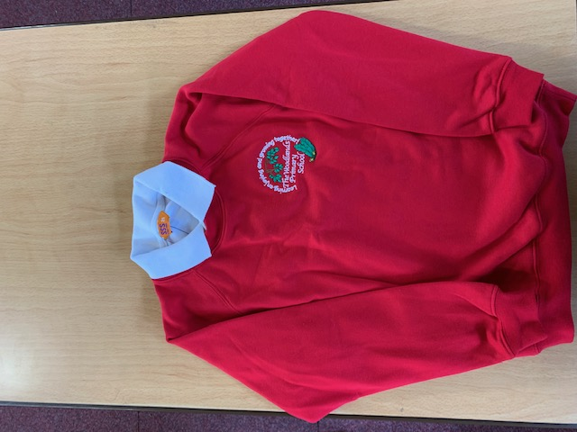
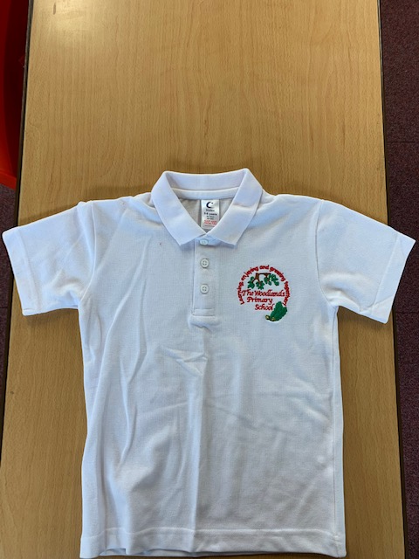
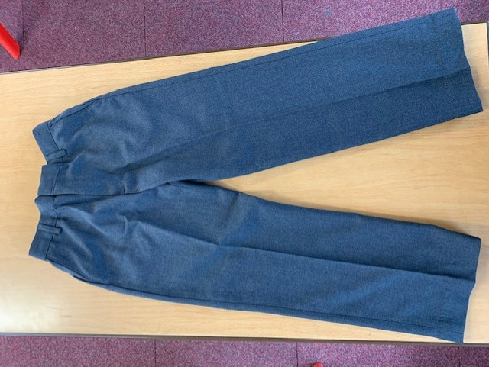
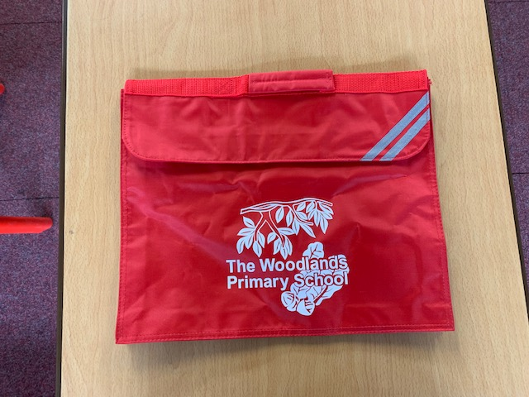
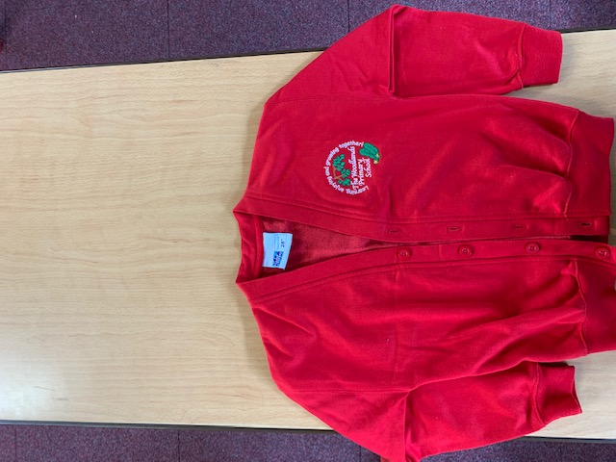
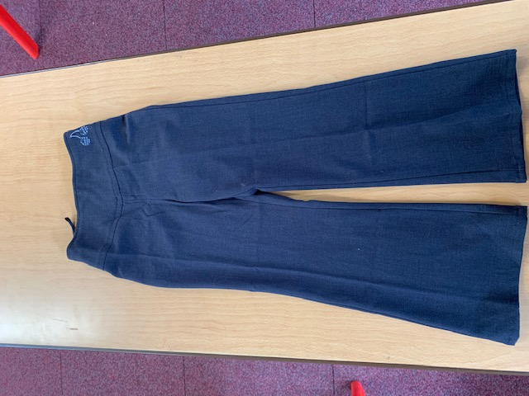
Uniform:
Please wear full school uniform every day.
Please make sure each item of uniform is clearly labelled with your name.
Please wear sensible school shoes – no trainers please.

Slide 16
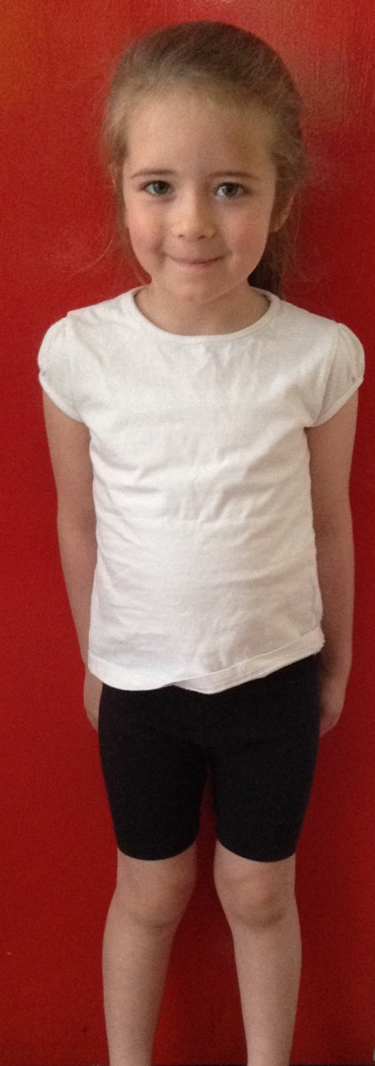
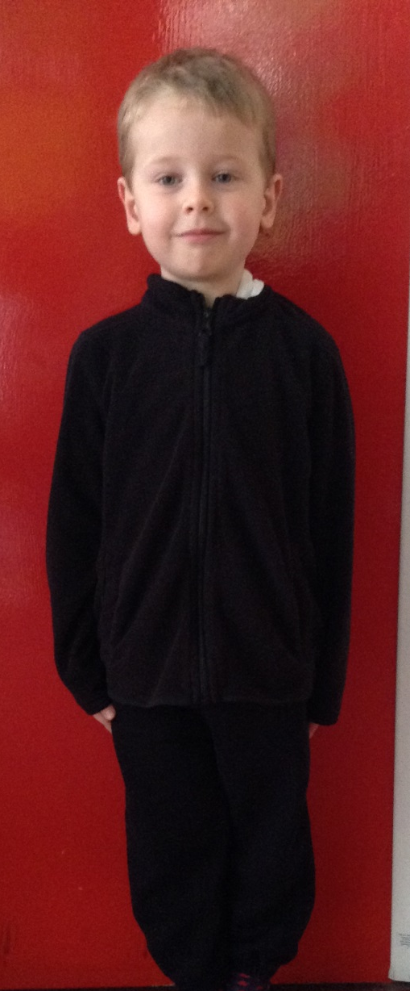
PE Kit:
Please make sure you have your PE kit in school on the days you have PE.
Please make sure each item of kit is clearly labelled with your name.
Please don’t wear earrings on PE days.
If you have long hair, please tie it back on PE days.
Outdoor Kit
White T Shirt
Black jumper/tracksuit top. (No hood)
Black Tracksuit bottoms /Joggers.
Trainers
Indoor Kit
White T Shirt
Black/Navy shorts

Slide 17


W.O.L.F. days
Woodlands Outdoor Learning in the Forest
Children will have at least one whole day of outdoor, woodland learning each half term.
You will be advised of the date for your class the week before.
We ask for £1 contribution on WOLF day to go towards food and resources for the day’s activities.
Your child MUST wear appropriate clothing for the activities and weather conditions.
If not dressed appropriately unfortunately, they will not be able to take part in these exciting days.
Appropriate clothing will include:
A water proof coat
Long sleeves and trousers (Children MUST have long sleeves and covered legs when near the campfire)
Outdoor waterproof footwear (Boots, wellies, walking shoes, old trainers etc.)
A second pair of shoes for when indoors (school shoes, trainers etc.)
Warm clothing
A plastic bag to put wet boots/clothes in.
Your child should come to school dressed in their outdoor learning clothes and will stay in them all day.

Slide 18


Every day, please bring:
A water bottle with your name on
Your coat
Your reading book
Your reading diary
A school bag to hold all your belongings

Slide 19
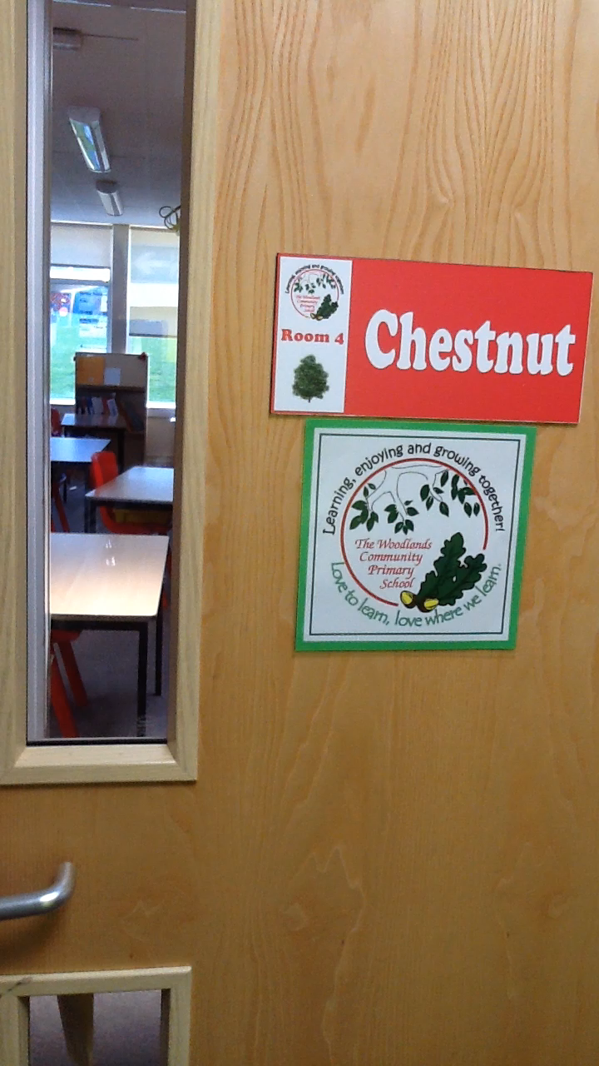
Have a lovely summer and see you soon!
Mr Tennuci ☺

