Slide 1
Welcome to Redwood!
September
2020
Miss A. Shipley

Slide 2
Teacher Profile:
Miss Shipley
Welcome to Rewood!
I am really looking forward to being your teacher next year! ☺
Facts about me:
I really love music and singing
I’m from Manchester.
I like learning about history, especially the Tudors and the Vikings
My favourite subject is Science.
My favourite colour is purple.
My favourite sweets are marshmallows and Squashies.
I have two cats one who is wild (called Martie) and one who is very friendly (called Ella).
I am often caught singing to myself in the classroom.

Slide 3
School Map
Your classroom is here!
Here is the map of our school site:

Slide 4
Welcome to Redwood!

Slide 5
Welcome to Redwood!

Slide 6
Welcome to Redwood!

Slide 7
Welcome to Redwood!

Slide 8
Welcome to Redwood!

Slide 9
Welcome to Redwood!

Slide 10
Welcome to Redwood!

Slide 11
Welcome to Redwood!

Slide 12
Play time!

Slide 13
Play time!

Slide 14
Play time!

Slide 15
Timetable
Our timetable will look like this! We have Guided Reading, English and Maths every morning and our other subjects in the afternoons.

Slide 16
Learning Overview: Autumn 1
Here is an overview of what we will be learning during the first half term!

Slide 17
Houses:
Here are our school houses, named after important people from Tamworth’s history.
You will still be in the same house as last year – when you win team points, they all contribute to your team effort!
We will be voting for our new Year 6 House Leaders in September.

Slide 18
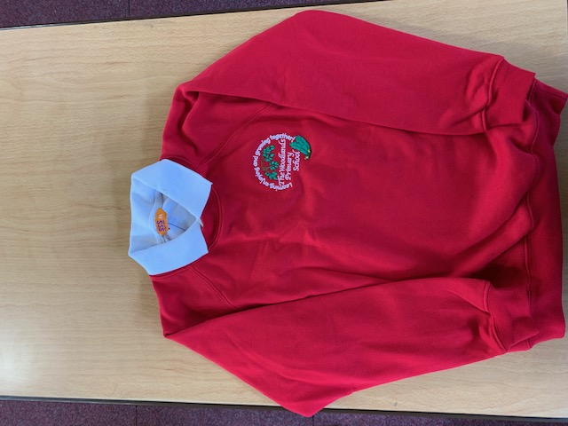
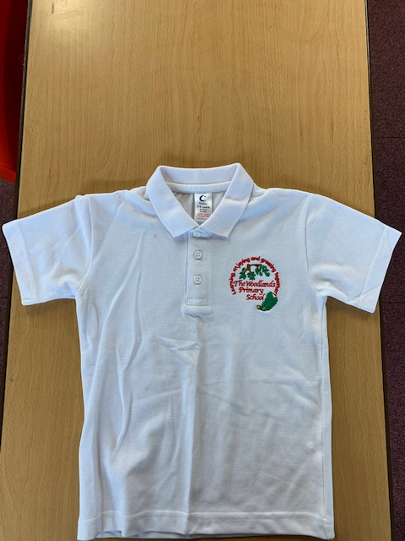
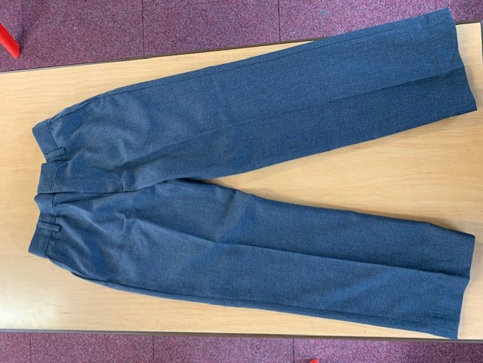
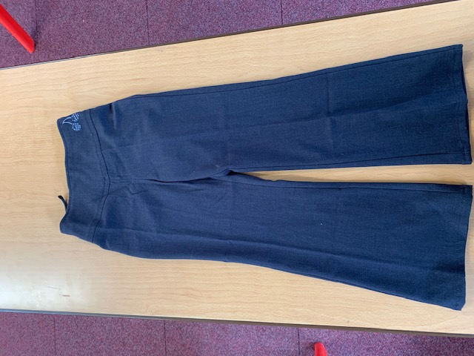
Uniform:
Please wear full school uniform every day.
Please make sure each item of uniform is clearly labelled with your name.
Please wear sensible school shoes – no trainers please.

Slide 19
PE Kit:
Please make sure you have your PE kit in school on the days you have PE.
Please make sure each item of kit is clearly labelled with your name.
Please don’t wear earrings on PE days.
If you have long hair, please tie it back on PE days.
Outdoor Kit
White T Shirt
Black jumper/tracksuit top. (No hood)
Black Tracksuit bottoms /Joggers.
Trainers
Indoor Kit
White T Shirt
Black/Navy shorts

Slide 20
Every day, please bring:
A water bottle with your name on
Your coat
Your reading book
Your reading diary
A school bag to hold all your belongings

Slide 21
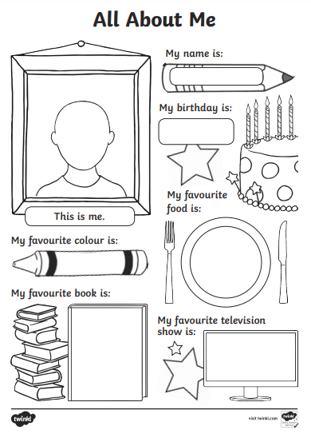
Please send us your ‘All About Me’ profiles !

Slide 22
Have a lovely summer! See you soon ! ☺

