Slide 1
Wow Assembly:
Friday 4th September

Slide 2
Phrase of the Week:
Education is the most powerful weapon that you can use to change the world.

Slide 3
Weekly Team Points!
Peel | Ethelfleda | Grazier | Offa
36
65
36
31

Slide 4
Elm
Felicity
For
A super start to Year 1. Very kind, helpful and hard working!
Miss Brady 04.09.20

Slide 5
Birch
Kara
For
Completing lots of home learning during the summer holidays.
Miss Hewitt 04.09.20

Slide 6
Birch
Isabel
For
Completing lots of home learning during the summer holidays.
Miss Hewitt 04.09.20

Slide 7
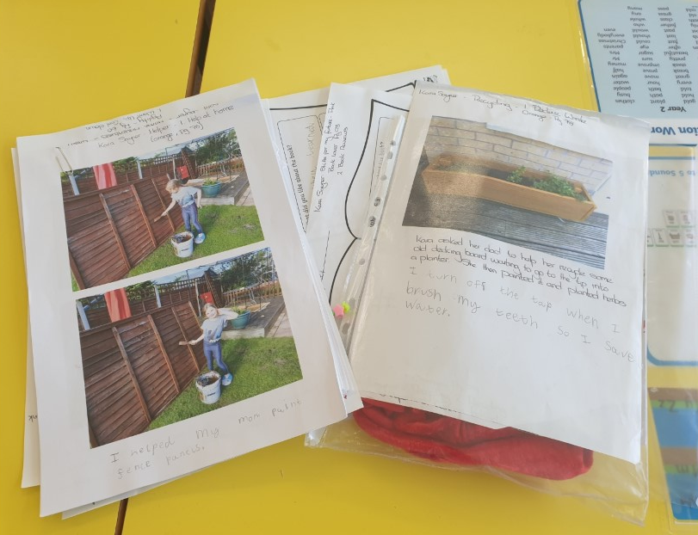
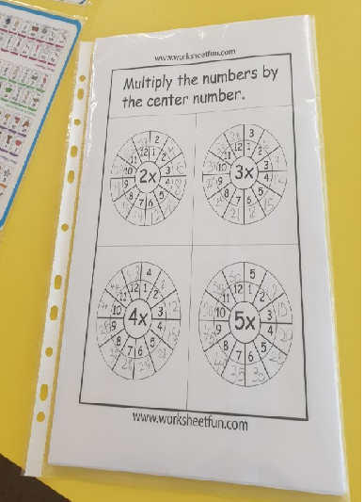
Birch Wow Work

Slide 8
Pine
Orla
For being so helpful in class, supporting others and having a lovely smile on her face each day.
Mrs Leedham-Hawkes 04.09.20

Slide 9
Maple
Toriey
For arriving everyday with a huge smile and helping others in the classroom.
Miss Dawson 04.09.20

Slide 10
Maple Wow Work
Toriey

Slide 11
Willow
Roux
For coming back to school with such a mature and sensible attitude to learning and settling so well into being a Year 3!
Mrs Maiden and Miss Higgins 04.09.20

Slide 12
Willow Wow Work
Roux created a fantastic tangram of a cowboy!
Roux chose a challenging reading book and read it really well!
Roux has been showing excellent listening skills!
Roux has been a kind and caring class member!

Slide 13
Spruce
Poppy
For
Fantastic work ethic. A super writer. I look forward to seeing what else Poppy can do during the year.
Mr Tennuci 04.09.20

Slide 14
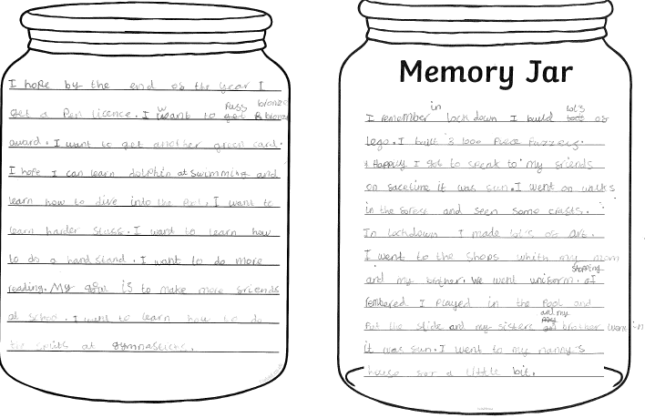
Spruce Wow Work

Slide 15
Chestnut
Alfie S
For a super start to year 5. Alfie has been very polite and has been sharing his wonderful ideas with the class. Well done Alfie. Keep it up!
Miss Fisher 04.09.20

Slide 16
Aspen
Jayden
For a super start to year 6 and helping to create a wonderful team atmosphere.
Jayden generated great rules for our class and has consistently shown a superb attitude.
Mrs Davies 04.09.20

Slide 17
Redwood
Amy
For starting Year 5 with an amazing attitude towards her learning and a lovely respect for others.
Miss Shipley 04.09.20

Slide 18
Next Week’s
Phrase of the Week:
Difficult roads often lead to beautiful destinations. Do not quit!

