Slide 1
Wow Assembly:
Friday 13th November

Slide 2
Phrase of the Week:
I can accept failure, but I cannot accept not trying.

Slide 3
Green Cards!
Alfie-Ray – Willow
Kody – Birch
Tyler – Birch
Ollie – Birch
Oliver - Spruce

Slide 4
Scientists of the Week!
Oak – Bethany
Ash – Alaina
Willow –Isabella
Birch – Faith
Pine – Sienna
Elm – Paddy F
Redwood – Reilly
Chestnut – Jake M
Aspen-Madison

Slide 5
Woodlands Eco Leaders
Pine- Daisy
Elm-Felicity
Birch- Nevaeh
Willow- Jay
Spruce- Ellie
Redwood- Liam
Aspen- Madison
Chestnut- Amira
Well done to everyone
who was nominated!

Slide 6
Weekly Team Points!
Peel | Ethelfleda | Grazier | Offa
254
240
210
202

Slide 7
Oak
Callum
For
Fantastic writing about what he could see in the Arctic.
Mrs Laffan 13 /11 /20

Slide 8
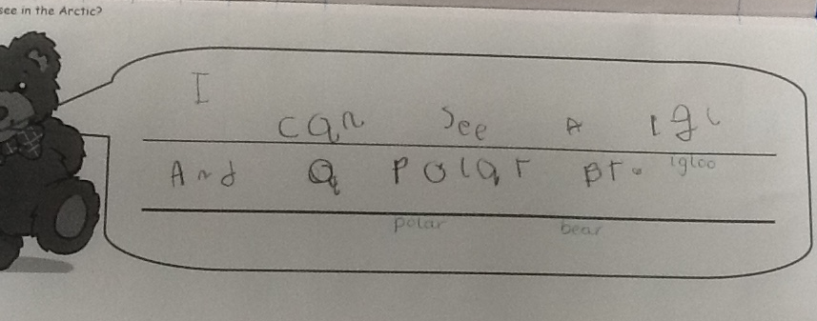
Oak Wow Work

Slide 9
Ash
Ella
For superb firework art on the laptop.
Miss Bailey 13/11/20

Slide 10
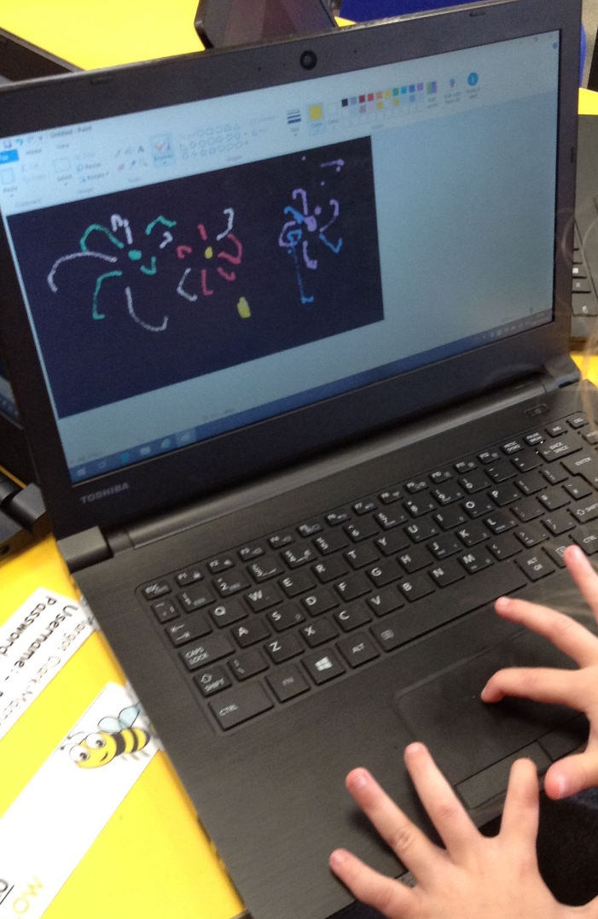
Ash Wow Work

Slide 11
Elm
Lucas P
For
A super piece of English work. Lucas tried hard with his handwriting, showing excellence and resilience!
Miss Brady 13 /11 /20

Slide 12
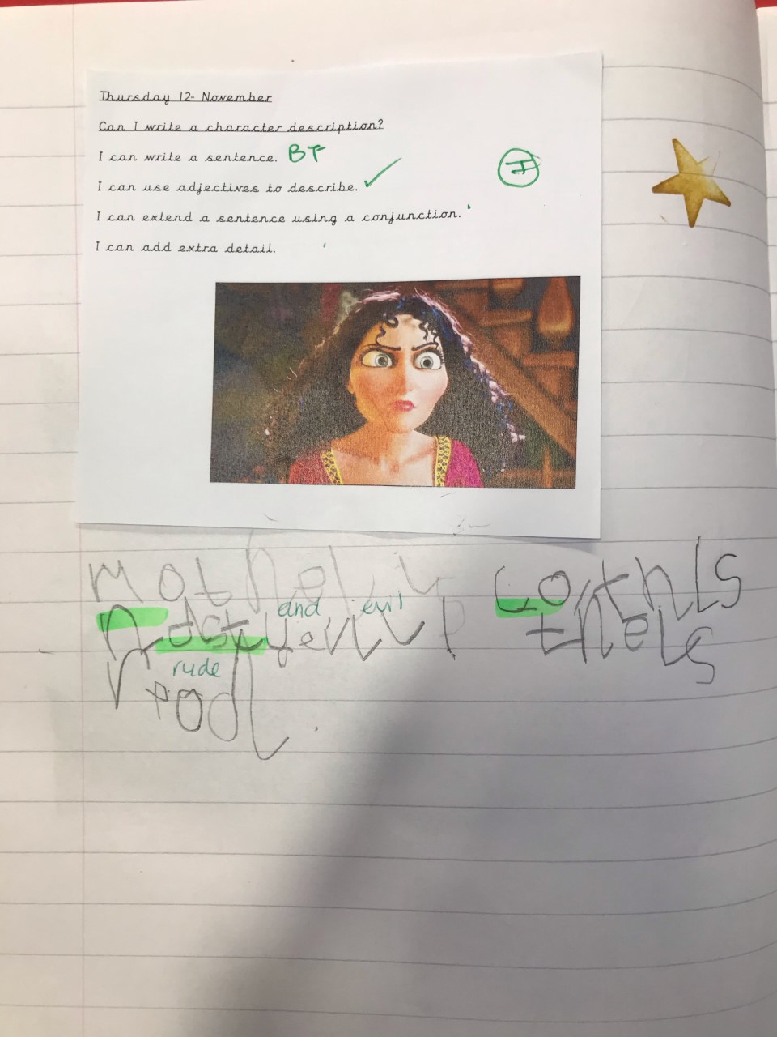
Elm Wow Work

Slide 13
Birch
Ella
For
Settling back into school superbly and being an all round fantastic learner!
Miss Hewitt 13 /11 /20

Slide 14
Pine
Tymon
For using resilience and self awareness to write a character description. Tymon used excellent adjectives and a conjunction. Super use of phonics to write words. Well done.
Mrs Leedham-Hawkes 13 /11/20

Slide 15
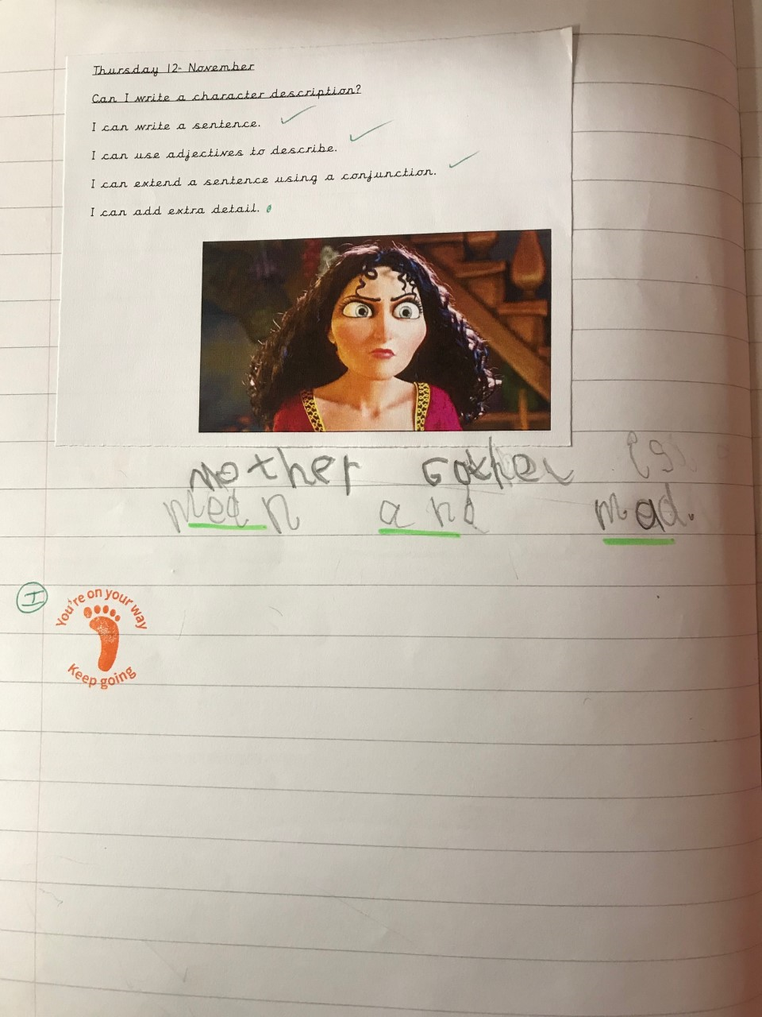
Pine Wow Work

Slide 16
Willow
Liam
For learning to tell the time in maths ☺
Mrs Maiden and Miss Higgins 13 /11 /20

Slide 17
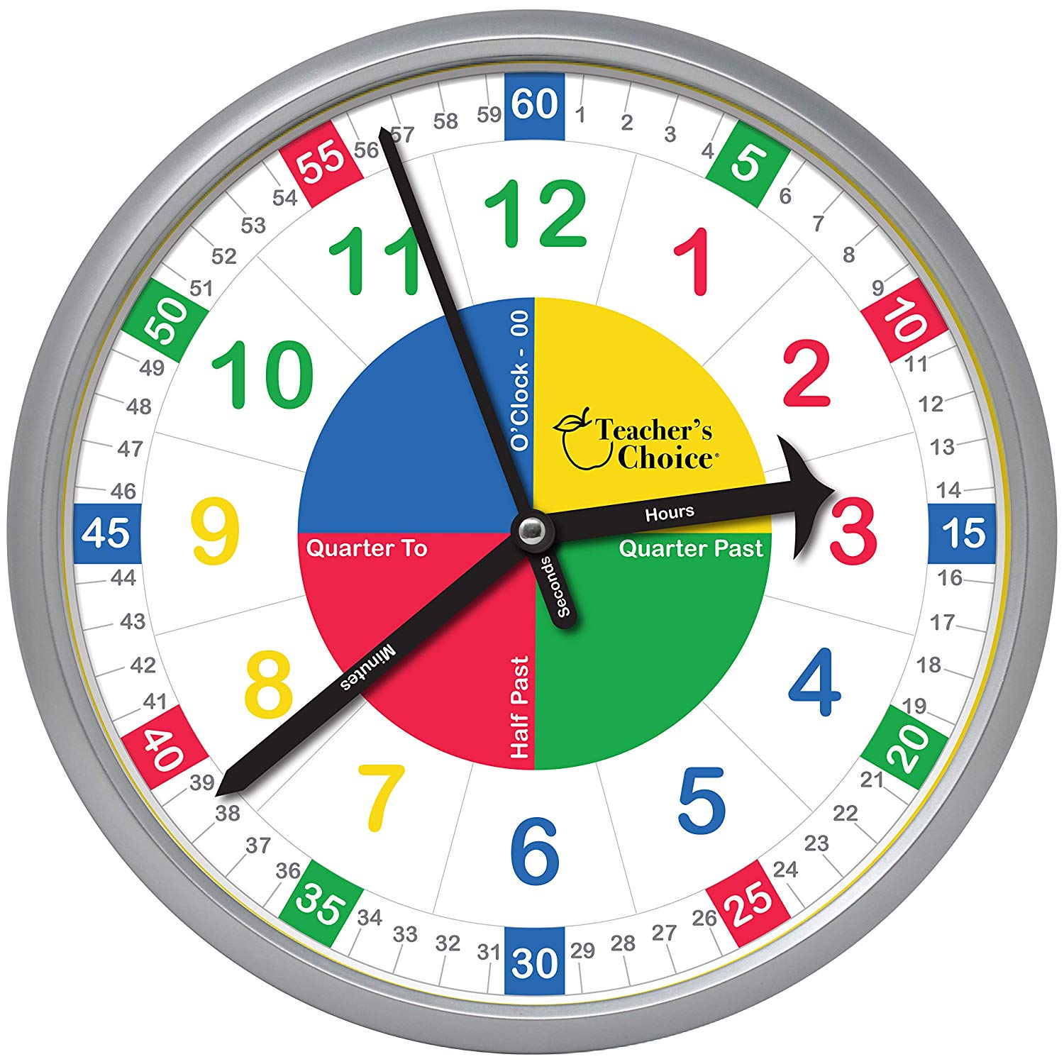
WillowWow Work
Liam worked really well yesterday with his handmade clock to show different times by moving the hands around.
We even began to look at 5 minute intervals!
We’re really proud of you Liam. Well done ☺

Slide 18
Spruce
Amber
For
Always having a positive attitude to everything she does and bringing a smile to the classroom. Thank you Amber!
Mr Tennuci 13 /11 /20

Slide 19
Chestnut
Amira
For delivering a fantastic speech in the hopes of becoming the Eco Leader for Chestnut.
Miss Fisher 11/11/20

Slide 20
Aspen
Eddie
For showing excellence during equivalent fraction learning. Always rising to the challenge. Keep it up!
Mrs Davies 13 /11 /20

Slide 21
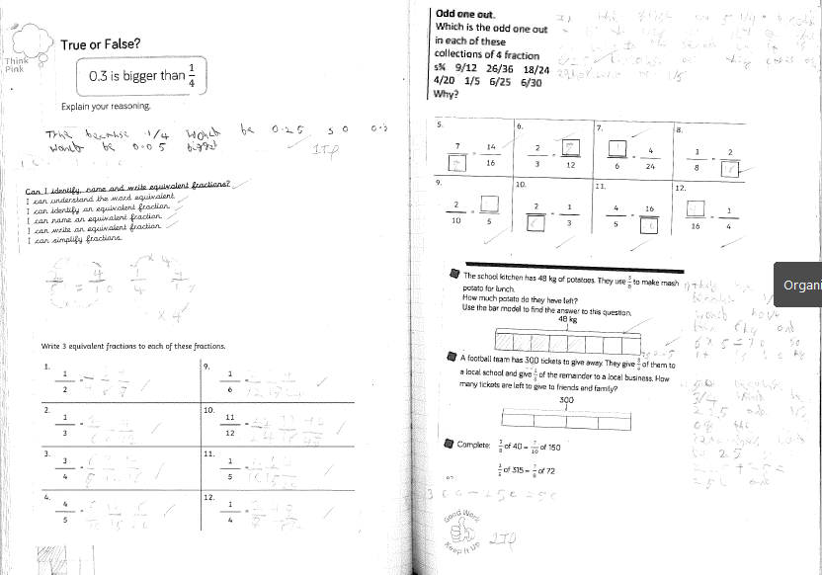
Aspen Wow Work

Slide 22
Redwood
Molly R
For a wonderful presentation during our race for Eco Leader
Miss Shipley 13 /11 /20

Slide 23
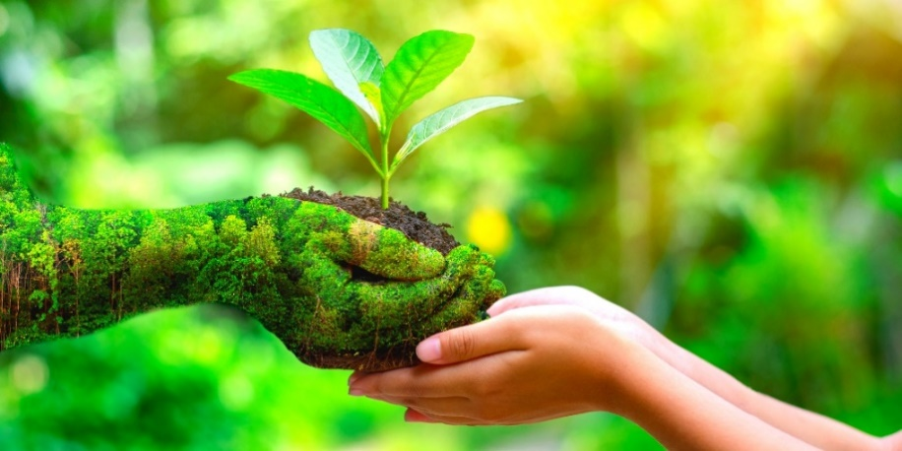
Redwood Wow Work
Molly created a wonderful poster and gave a passionate presentation during our class vote for Eco Leader. Although she wasn’t voted in she worked incredibly hard and communicated her ideas and knowledge beautifully.

Slide 24
Next Week’s
Phrase of the Week:
The quickest way to fail is not to try.

