Slide 1



Wow Assembly:
Friday 21st January

Slide 2
Phrase of the Week:
Believe you can and you’re halfway there

Slide 3
Green Cards!
Roxy – Aspen
Leo – Willow
Charlie W – Redwood
Emily E – Chestnut
Harley- Spruce

Slide 4
Scientists of the Week!
Oak – Brody
Ash – Monty
Birch – Remy
Pine – Darcey
Elm – Margot
Willow –
Spruce – Joshua
Maple – Brandon
Redwood – Izzy
Chestnut – Alfie S
Aspen- Bella

Slide 5
Weekly Team Points!
Peel | Ethelfleda | Grazier | Offa
250 | 320 | 290 | 332

Slide 6
Oak
Isabelle B
For
For super sounding out when writing about the Gingerbread Man.
Mrs Laffan 21.01.2022

Slide 7
Ash
Matthew
For super Maths work!
Matthew was able to explore all of the different ways to partition 5 and then write the number sentences.
He even completed a challenge!
Miss Bailey and Mrs Salt 21.01.22

Slide 8
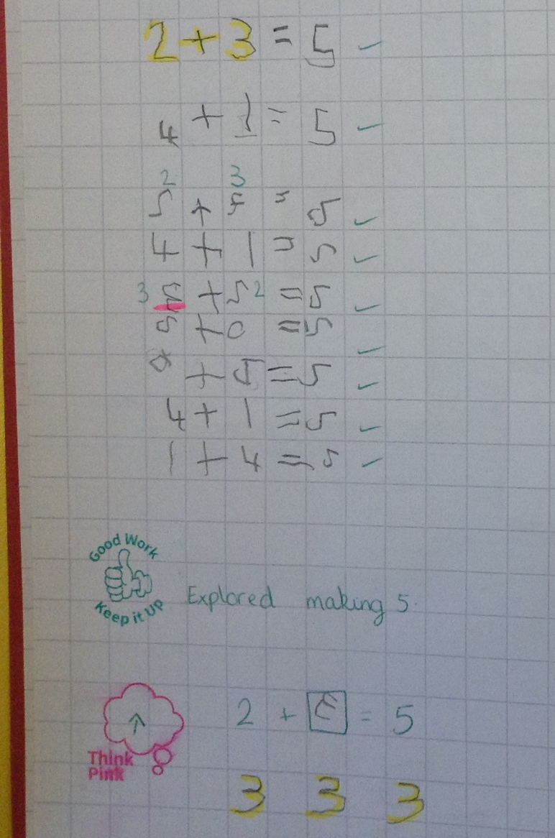
Ash Wow Work

Slide 9
Elm
Ella
For a brilliant introduction to your retell of Maui and the magic of fire! You worked really hard to craft your best sentences using adjectives, similes and adverbs.
Great work Ella, Well Done!! ☺
Mr Grice 21.01.2022

Slide 10
Birch
Idris
For
Trying hard in writing to improve his punctuation and spelling. Idris has also had a fantastic attitude during spelling accelerate group.
Miss Hewitt 21.01.22

Slide 11
Pine
Whole Class
For using resilience and excellence for others when they had a couple of teacher changes. I have returned to Pine this week and was amazed by all of the positive comments from how well Pine behaved and how they took their learning. I am so proud. ☺
Mrs Leedham-Hawkes 21.01.2022

Slide 12
Maple
Mollie
For using a range of sketching techniques to improve her cave art drawings.
Miss Dawson 21.01.2022

Slide 13
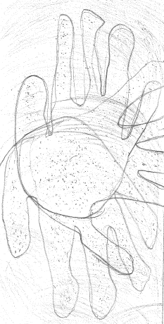

Slide 14
Willow
Oscar
For showing super enthusiasm in all lessons with thoughtful contributions.
Mrs Read 21.01.22

Slide 15
Spruce
Ezmai
For
Showing resilience when writing her setting description. Fantastic work!
Mr Draper 21.01.2022

Slide 16
Chestnut
George
For showing maturity towards advice given and acknowledging why he needs to be involved in particular learning he understands, but must revisit to improve on what he already knows.
Mr Tennuci 21.1.22

Slide 17
Aspen
Lily Cmb
For making a real effort to concentrate in Maths this week. She has worked so hard on using the part-whole method for division and has shown a really good understanding – well done!
Mrs Read & Mrs Cox 21.01.22

Slide 18
Redwood
Caeden F.
For using multiple sources of information to identify physical and human features on satellite images
Miss Shipley 21.01.2022

Slide 20
Next Week’s
Phrase of the Week:
Failing to try is like trying to fail.

