Slide 1
Wow Assembly:
Friday 12th November

Slide 2
Phrase of the Week:
Mistakes are proof you are trying.

Slide 3
Green Cards!
Aspen – Amber
Aspen – Annalia
Aspen – Sophia G
Aspen – Tobias
Aspen – Kacper
Aspen - Roxy
Oak-Jenson
Willow – Angel Willow – Leo
Elm – Alfie
Elm - Ella
Chestnut – Olivia
Chestnut – Charlie A
Chestnut – Amelia M.
Chestnut – Lauren
Chestnut – Ray

Slide 4
Scientists of the Week!
Oak –Isla Rose
Ash –
Birch – Lilly
Pine – Maxwell
Elm –
Willow – Phoebe
Spruce Ruby D
Maple – Oliver
Redwood – Robbie
Chestnut – Charlie A
Aspen-

Slide 5
Weekly Team Points!
Peel | Ethelfleda | Grazier | Offa
236 | 246 | 239 | 260

Slide 6
Oak
Lola
Lola has shown her Elliott Excellence skills through her home reading and reading in class. Lola is beginning to segment and blend words for reading.
Mrs Laffan 12.11.21

Slide 7
Elm
Alfie
For your attitude for learning. You have worked exceptionally hard in maths all week earning yourself both a green card and now star of the week. Alfie I am so proud of the mathematician you're developing into. Keep up this excellent behaviour and work!
Mr Grice 12.11.2021

Slide 8
Birch
Neve
Neve has worked extremely hard to improve the presentation of her writing and her spellings during independent writing pieces. Keep up the hard work Neve! You are a superstar!
Miss Hewitt 12.11.21

Slide 9
Pine
Rocco
Rocco used resilience and excellence to make and create a poppy during a remembrance day lesson to show respect to those who fought for us. Rocco listened and followed instructions so well! He then helped others.
Mrs Leedham-Hawkes 12.11.21

Slide 10
Maple
Frankie
For a fantastic attitude to learning. I am so impressed with your effort in all areas of the curriculum. You are showing determination, resilience and a great deal of pride in your work.
Miss Dawson 12.11.2021

Slide 11
Willow
Riley C
For a huge improvement in his handwriting and spelling and his attitude towards his learning. You are putting such a lot of effort into all areas of your learning and I am really impressed. Well done Riley.
Miss Fisher 12.11.21

Slide 12
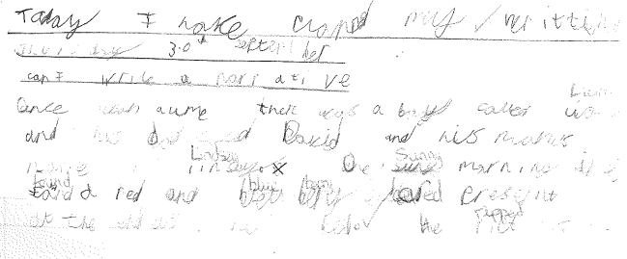
Willow

Slide 13
Spruce
Josh K
For a brilliant attitude to learning, supporting his peers and using his addition and subtraction understanding to help him reason.
Mr Draper 12.11.21

Slide 14
Chestnut
Ray
For brilliant report writing. I have been very impressed by the style he has adopted and has continued to use this during the week to strengthen this style.
Mr Tennuci 12.11.21

Slide 15
Aspen
Antonio
For settling in brilliantly to his new class and making a great start to his reading.
Mrs Read & Mrs Cox 12.11.21

Slide 16
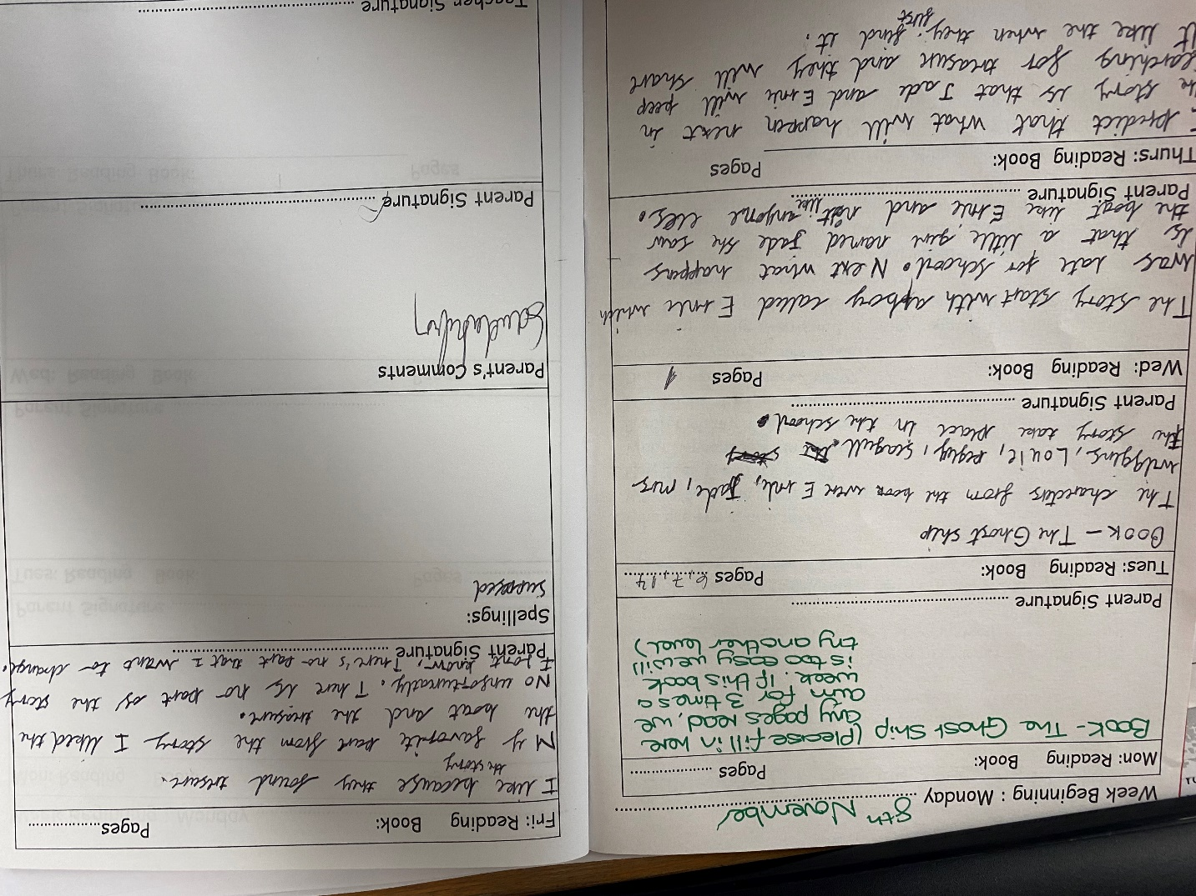
Aspen Wow Work

Slide 17
Redwood
Natalia
For fantastic self-awareness and perseverance in her English work – challenging herself everyday and trying to improve her writing
Miss Shipley 12.11.21

Slide 18
Super sentence starters
Excellent reported speech
Using powerful verbs

Slide 19
Next Week’s
Phrase of the Week:
Be the reason someone smiles today

