Slide 1
Welcome to Chestnut!
September
2020
Miss Fisher

Slide 2
Teacher Profile:
Miss Fisher
Welcome to Chestnut!
I am really looking forward to being your teacher next year! ☺
Facts about me:
I’m a Year 5/6 teacher at Woodlands.
I’m from Burntwood.
I like to go camping and spending time with my family!
My favourite subject is PE.
My favourite colour is blue.
My favourite films are The Harry Potter Films.
My favourite sport is karate. I am a black belt 2nd Dan.

Slide 3
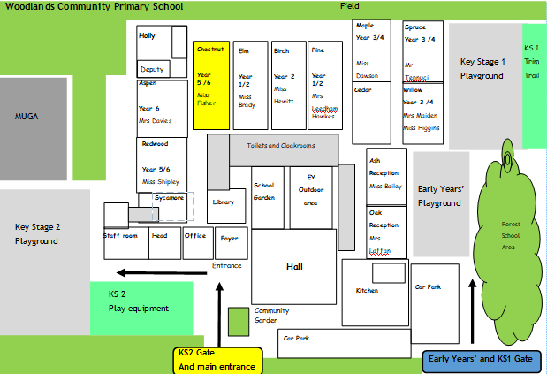
School Map
Your classroom is here!
Here is the map of our school site:

Slide 4
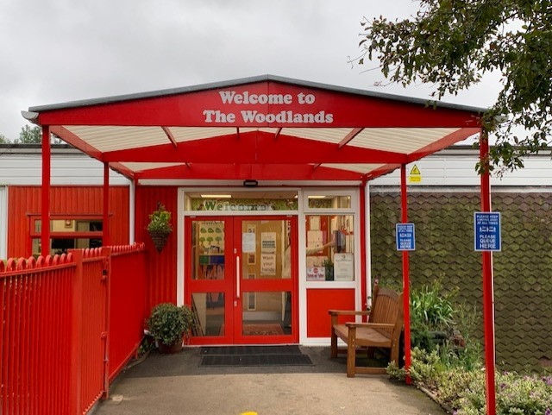
Welcome to Chestnut!
Come into school through the KS2 gate, walk towards the office and but turn left through this gate:

Slide 5
Welcome to Chestnut!

Slide 6
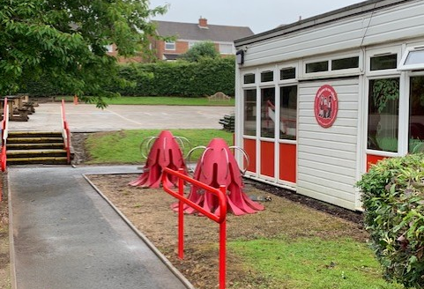
Welcome to Chestnut!

Slide 7
Welcome to Chestnut!

Slide 8
Welcome to Chestnut!

Slide 9
Welcome to Chestnut!

Slide 10
Play time!

Slide 11
Play time!

Slide 12
Play time!

Slide 13
Timetable
Our timetable will look like this! We have Guided Reading, English and Maths every morning and our other subjects in the afternoons.

Slide 14
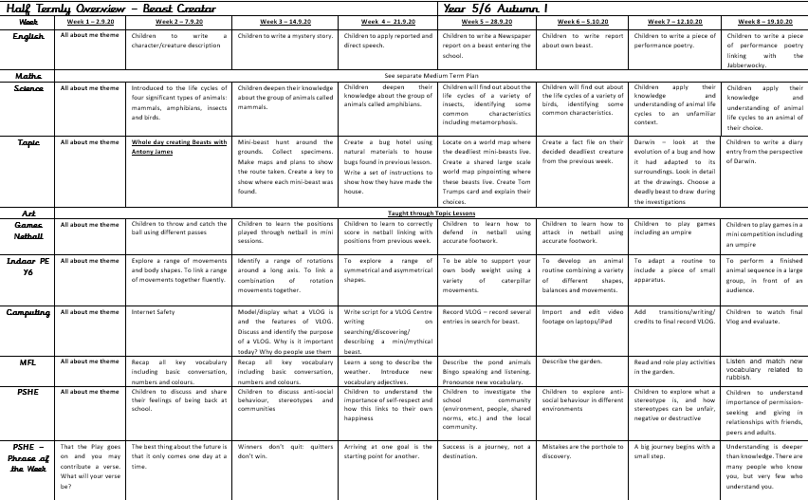
Learning Overview: Autumn 1
Here is an overview of what we will be learning during the first half term!

Slide 15
Houses:
Here are our school houses, named after important people from Tamworth’s history.
You will still be in the same house as last year – when you win team points, they all contribute to your team effort!
We will be voting for our new Year 6 House Leaders in September.

Slide 16
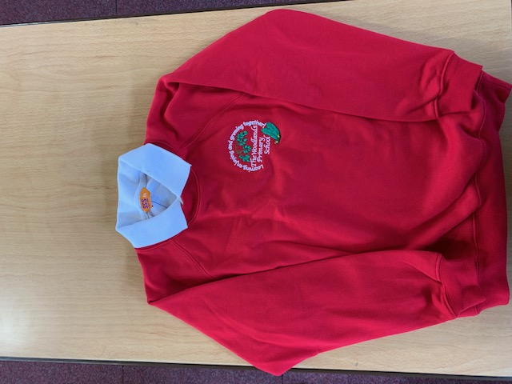
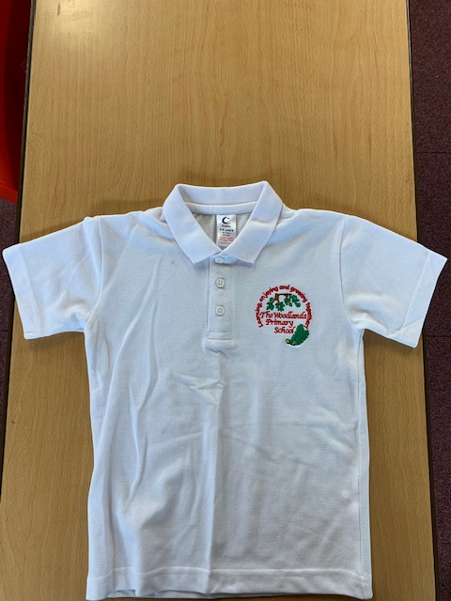
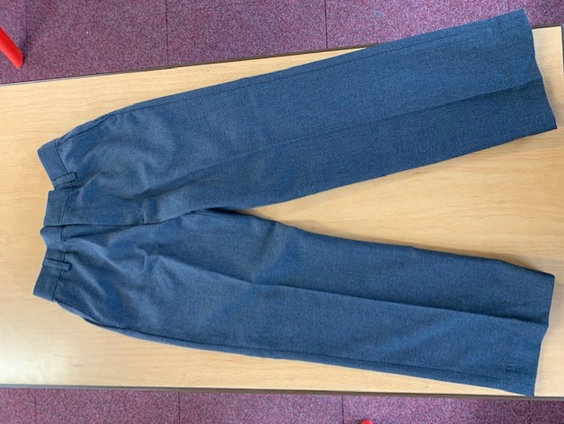
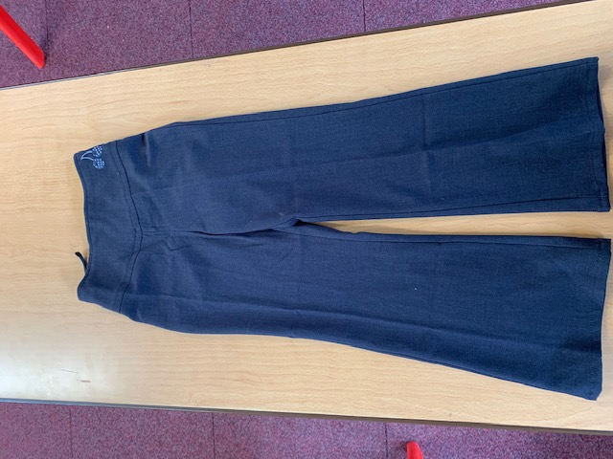
Uniform:
Please wear full school uniform every day.
Please make sure each item of uniform is clearly labelled with your name.
Please wear sensible school shoes – no trainers please.

Slide 17
PE Kit:
Please make sure you have your PE kit in school on the days you have PE.
Please make sure each item of kit is clearly labelled with your name.
Please don’t wear earrings on PE days.
If you have long hair, please tie it back on PE days.
Outdoor Kit
White T Shirt
Black jumper/tracksuit top. (No hood)
Black Tracksuit bottoms /Joggers.
Trainers
Indoor Kit
White T Shirt
Black/Navy shorts

Slide 18
Every day, please bring:
A water bottle with your name on
Your coat
Your reading book
Your reading diary
A school bag to hold all your belongings

Slide 19
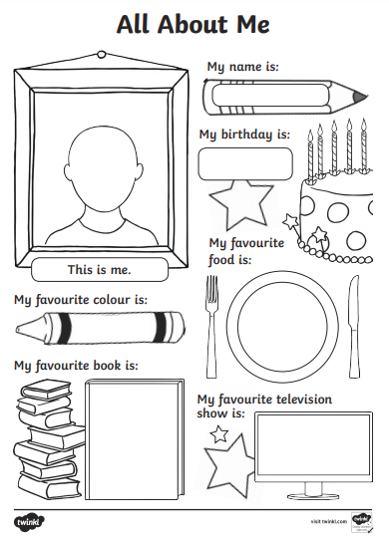
Please send us your ‘All About Me’ profiles !

Slide 20
Have a lovely summer and see you soon!
Miss Fisher ☺

