Slide 1
Wow Assembly:
Friday 22nd October

Slide 2
Green Cards!
Matthew – Ash Nina T- Birch
Lincoln-Oak Celia – Elm
Orla- Spruce Thomas – Elm
Eydie – Aspen Phillip – Elm
Natalia – Redwood Codi-Lee – Elm
Jimi – Redwood Layla – Elm
Jay – Redwood Austin – Elm
Charlie S – Redwood
Reilly - Chestnut
Olivia - Chestnut
Natasha - Chestnut

Slide 3
Scientists of the Week!
Oak – Olivia
Ash – Matthew
Birch – Veer
Pine – Noel
Elm – Austin
Willow – Oscar
Spruce – Tyler
Maple – Malakai
Redwood – Jax
Chestnut – George
Aspen-

Slide 4
Weekly Team Points!
Peel | Ethelfleda | Grazier | Offa
136
171
201
223

Slide 5
Oak
Ansel
For
Sorting the clothes into Winter and Summer and for using his Romeo Resilience skills to complete the activity.
Mrs Laffan 22.10.21

Slide 6
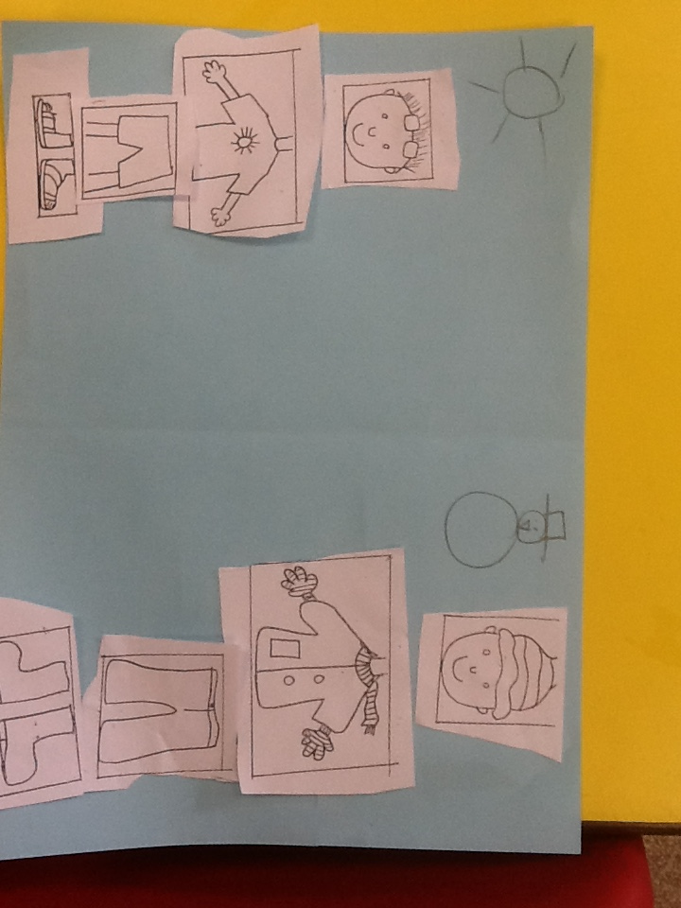
Oak Wow Work

Slide 7
Ash
Osian
For super skeleton art
Miss Bailey and Mrs Salt 22.10.21

Slide 8
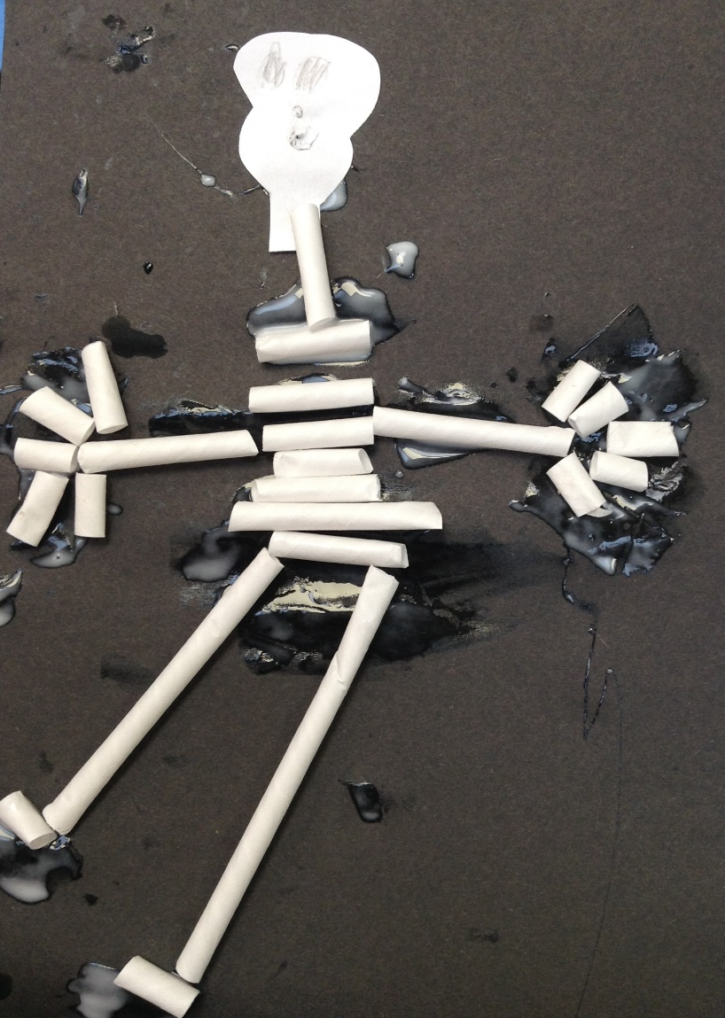
Ash Wow Work

Slide 9
Elm
Edward-Daniel
For displaying excellent perseverance within his science starter this week! Edward worked effectively within his group and contributed to their great achievement of building the tallest tower out of cups. Well Done ☺
Mr Grice 21.10.2021

Slide 10
Birch
Sienna
For
Sienna has shown resilience in maths. This week she was challenged to add multiples of ten to a two-digit number. Sienna asked for help when she was struggling and used the resources in the classroom to help her. Well done Sienna. Keep it up ☺
Miss Hewitt 21.10.21

Slide 11
Pine
Daniel
For using passion in phonics, completing extra home phonics work independently and applying it in school. Well done!!!
Mrs Leedham-Hawkes 22.10.21

Slide 12
Maple
Freya
For subtracting four digit numbers using the column method including calculations that require more than one exchange. Well done Freya.
Miss Dawson 22.10.2021

Slide 13
Willow
Liam
For a fantastic week. You have shown excellence in a wide range of subjects this week. I am so proud of your fabulous attitude. Keep it up Liam!!
Miss Fisher 22.10.21

Slide 14
Spruce
Oliver
The resilience and dedication you have shown throughout this week. You have shown pride in your work, and have produced super maths.
Mr Draper 20.10.21

Slide 15
Chestnut
Olivia
For
Showing a growing resilience towards certain apects of her learning at the Woodlands. This is especially tru of her maths and is demonstrating an attitude and belief she can do the learning given to her.
Well done!
Mr Tennuci 22.10.21

Slide 16
Aspen
Toriey, Jake & Jaxson
For working really well as a team to make their long ship by communicating and listening to each other. Well done!
Mrs Read & Mrs Cox 22.10.21

Slide 17
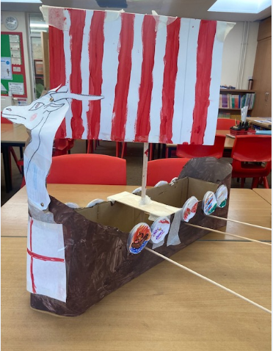

Slide 18
Redwood
Jimi
For using wonderful drama skills and passion in his role as King Canute, when performing his original play script.
Miss Shipley 22.10.21

