Slide 1
Wow Assembly:
Friday 4th February

Slide 2
Phrase of the Week:
The way you treat yourself sets the standards for others.

Slide 3
Green Cards!
Lexie – Ash
Halle – Ash
Lola-Oak
Amber – Aspen
Jaxson - Aspen
Ellie-Mae – Redwood
Riley – Redwood
Charlie S - Redwood
Veer- Birch
Paddy- Birch
Leo- Birch
Darci- Birch
Evelyn- Birch
Mollie – Maple
David – Maple
Ayla - Maple
Isabella – Willow
Evie – Willow
Oscar – Willow
Esme – Willow
Philippa – Willow
Leo - Willow

Slide 4
Scientists of the Week!
Oak –Madison
Ash – Teddy
Birch – Freddie
Pine – Carterose
Elm – Celia
Willow – Kyron
Spruce – Iyla
Maple –
Redwood – Ellie-Mae
Chestnut –
Aspen- Kade

Slide 5
Weekly Team Points!
Peel | Ethelfleda | Grazier | Offa
208 | 196 | 205 | 179

Slide 6
Oak
Henry
For joining in with the discussions about the vanishing rainforest and sharing his idea.
Mrs Laffan 04.02.22

Slide 7
Ash
Parker
For creating an amazing observational drawing of a rainforest animal.
Miss Bailey and Mrs Salt 04.02.22

Slide 8
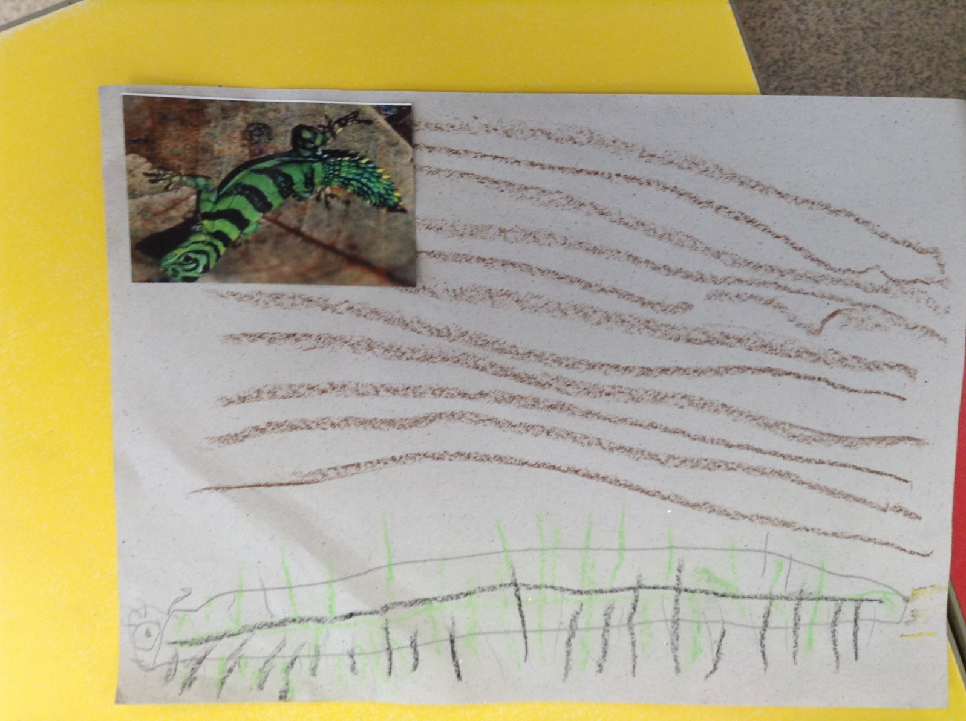
Ash Wow Work
Oak
Ansel
For
For creating a fantastic mosaic of an Aztec mask.
Mrs Laffan 28.01.2022

Slide 9
Elm
Adam Bonas
For his excellent work in maths. Adam has been able to represent numbers to 50 and has supported peers within the classroom. Great Work Adam!
Mr Grice 04.02.22

Slide 10
Birch
Ryan
Ryan has written a fantastic list using bullet points. He included a heading and tried hard to use his phonics knowledge to sound out unfamiliar words. Well done Ryan! Keep up the hard work!
Miss Hewitt 04.02.22

Slide 11
Pine
Jensen
For using excellent communication. Jensen is able to use a wide and exciting vocabulary to talk about his learning. Well done ☺
Mrs Leedham-Hawkes 04.02.22

Slide 12
Maple
Alex
Fantastic work in maths this week. Alex has worked out the fractions of shapes including unit and non unit fractions.
Miss Dawson 04.02.22

Slide 13
Willow
Riley WP
For working hard to use a variety of resources to create different textures in Art. Well done Riley.
Miss Fisher 04.02.22

Slide 14
Spruce
Orla
For showing resilience and determination in Maths. Even when learning has been a challenge, Orla has pushed herself to do the best she can. Well Done Orla, keep it up!
Mr Draper 04.02.22

Slide 15
Chestnut
Lauren & Amelia. D
For super teamwork during Gymnastics. Some great counter balances performed ☺
Well done!
Miss Higgins 04.02.22

Slide 16
Aspen
Cian
For trying really hard to punctuate dialogue accurately using inverted commas.
Mrs Read & Mrs Cox 04.02.22

Slide 17
Redwood
Sophie K
For demonstrating amazing reliance during History and not giving up on a tricky task
Miss Shipley 04.02.22

Slide 18
Next Week’s
Phrase of the Week:
Without challenge, there is no achievement.
.

