Slide 1



Wow Assembly:
Friday 10th July

Slide 2
Phrase of the Week:
With ordinary talent and extraordinary perseverance,
many things are achievable.

Slide 3
Green Cards!
First name – class
Sophia – Ash
Vinny – Ash
Beau- Willow
Damian- Spruce
Amira – Holly
Amelia - Holly

Slide 4
Scientists of the Week!
Oak –Harrison
Ash - Sophia
Cedar - Emily
Birch – Ayla
Pine – Lily-Belle
Elm – Frankie
Willow – Lily- Rose
Spruce –Jayden
Maple – Liam
Holly -
Redwood – Abigail
Chestnut – Alfie
Aspen- Noah

Slide 5
Weekly Team Points!
Peel | Ethelfleda | Grazier | Offa
132
252
140
121

Slide 6
Oak
Eli
For
Mr Seahorse art and his exploration of colour mixing. Eli was able to describe what happened when he mixed the primary colours.
Mrs Laffan 10.07.20

Slide 7
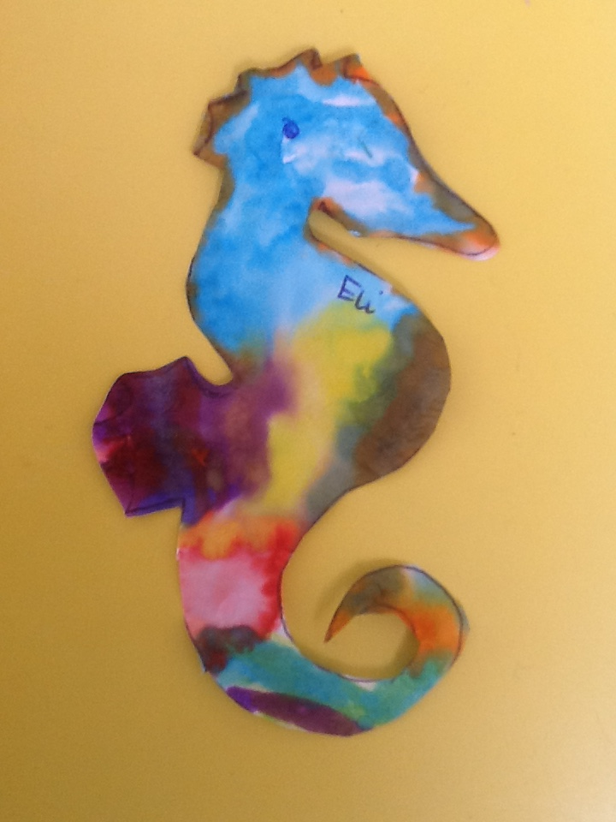
Oak Wow Work

Slide 8
Ash
Darci
For super fact writing about seahorses.
Well done Darci!
Miss Bailey 10.07.20

Slide 9
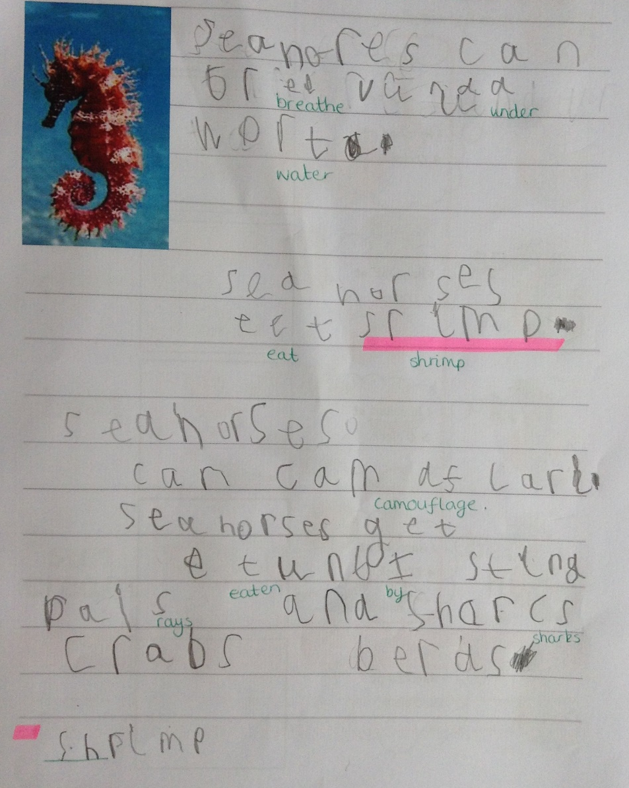
Ash Wow Work

Slide 10
Cedar
Lilly
For fantastic work in reading.
Well done Lilly!
Mrs Scott 10.07.20

Slide 11
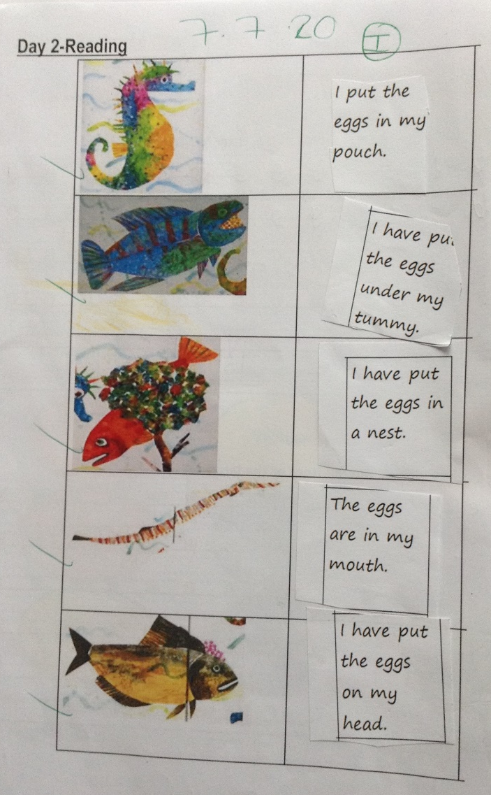
Cedar Wow Work

Slide 12
Pine
Ella A
For completing Purple level guided reading texts over the past 6 weeks. Ella uses excellent word reading, fluency and expression. Well done!
Mrs Leedham-Hawkes 10.07.20

Slide 13



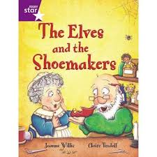
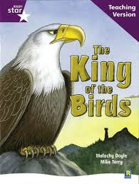
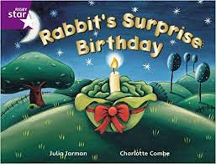
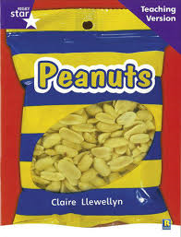

Pine Wow Work

Slide 14
Elm
Nevaeh
For
A superb collage of a minibeast! Nevaeh used cutting, texture, line and shape techniques to create a beautiful butterfly.
Miss Brady 10.07.20

Slide 15
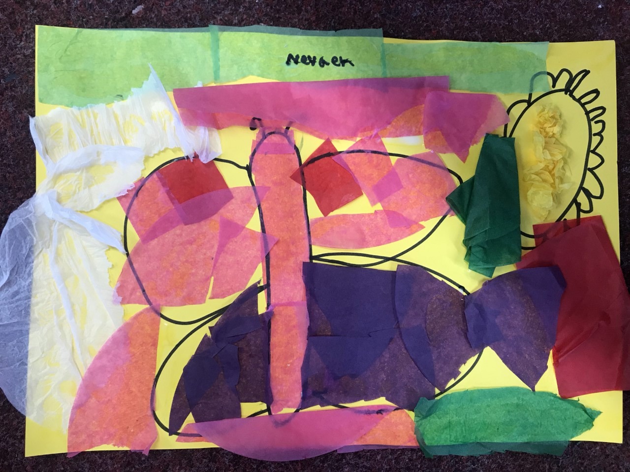
Elm Wow Work

Slide 16
Birch
Ollie
For trying so hard to improve his handwriting and writing a fantastic story!
Miss Hewitt 10.07.20

Slide 17
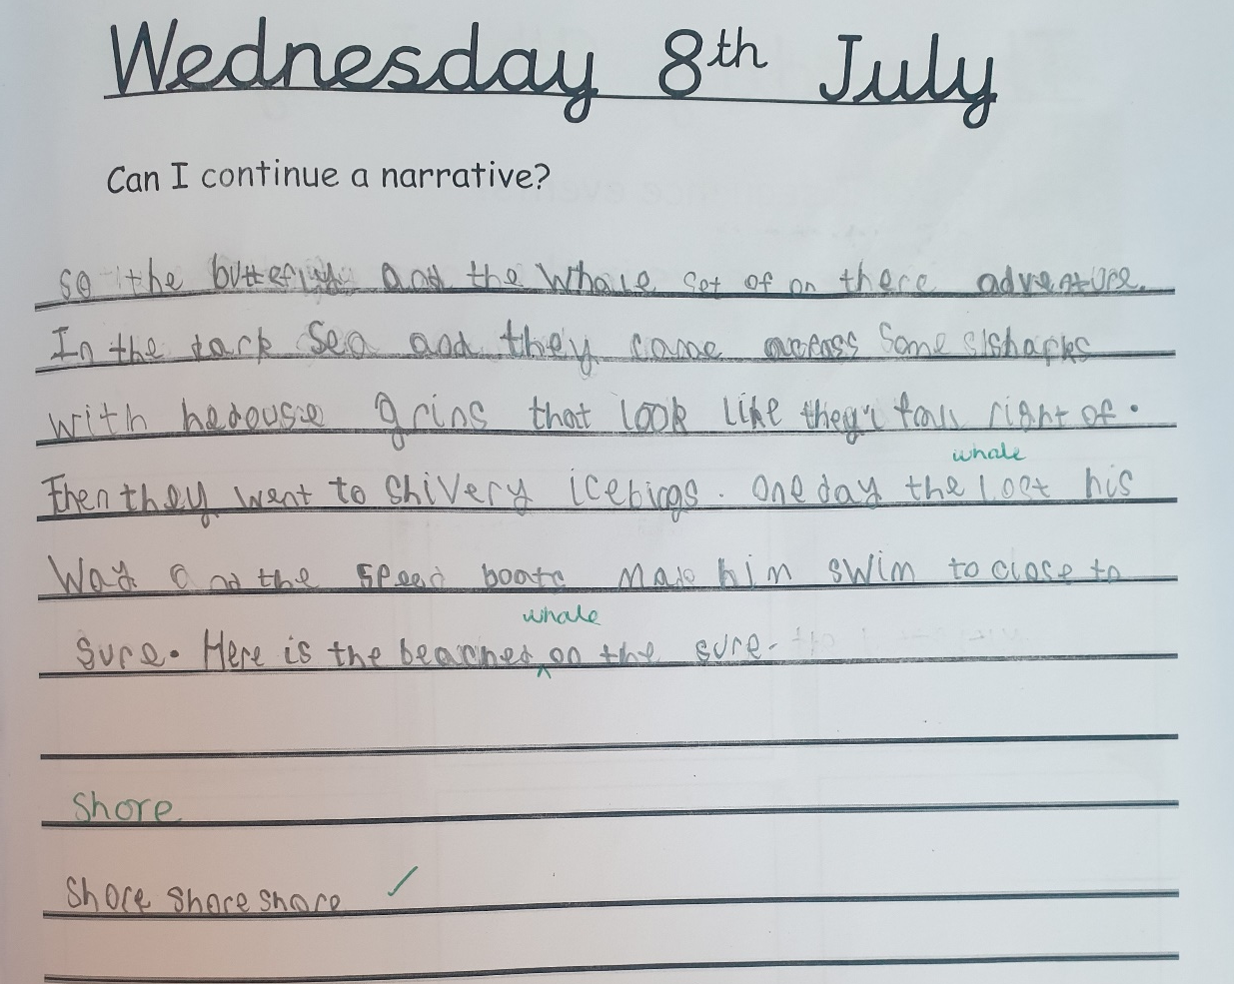
Birch Wow Work

Slide 18
Willow
Jayden
For your non-chronological report on Spiders!
You carried out some fantastic research about spiders and your layout was lovely too. Well done Jay!!
Miss Higgins 10.07.20

Slide 19
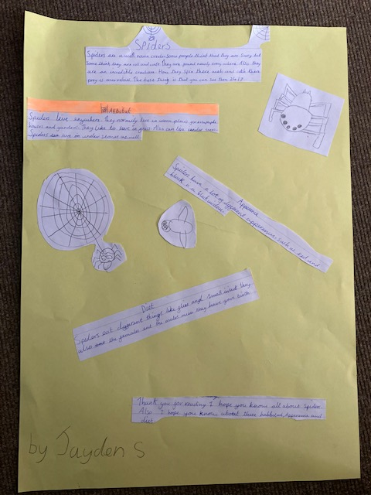
Willow Wow Work

Slide 20
Spruce
Roux
For
A fantastic drawing of a lion’s eye.
Miss Dawson 10.07.2020

Slide 21
Spruce Wow Work

Slide 22
Holly
Amelia
For
A wonderful, creative imagination which always shines through in her writing
Mr Tennuci 10.07.2020

Slide 23
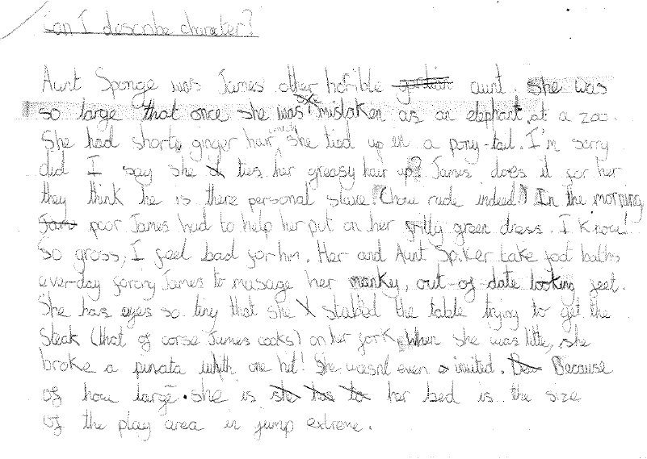
Holly Wow Work

Slide 24
Maple
Joe
For his consistently super attitude to learning, listening carefully and challenging himself (particularly in English) ☺
Mrs Maiden and Mrs Pritchard 10.07.2020

Slide 25
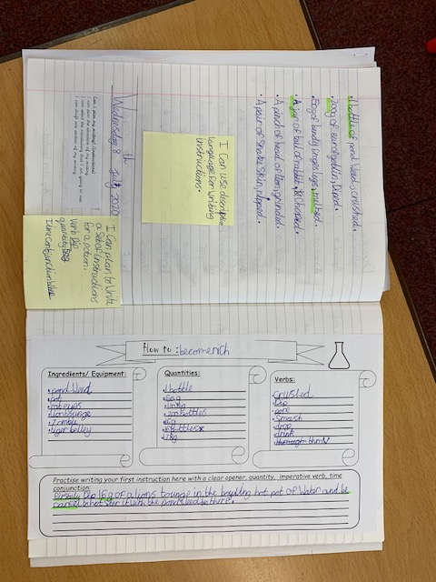
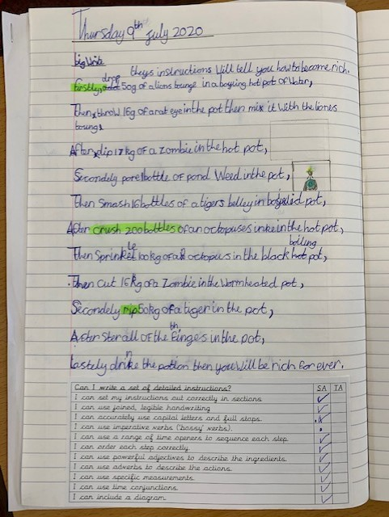
Maple Wow Work

Slide 26
Chestnut
Louie
For fantastic perseverance in Maths. You have continued to work through some challenging tasks and complete them to the best of your ability. Well Done
Miss Fisher 10.07.20

Slide 27
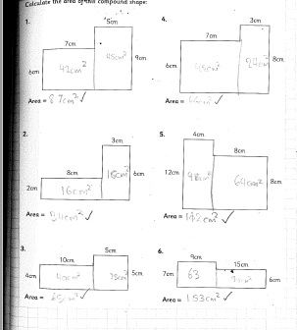
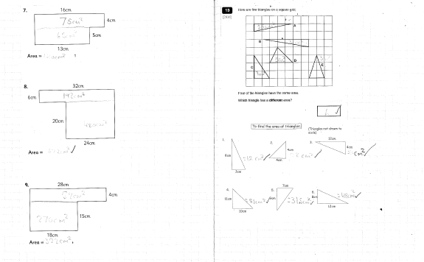
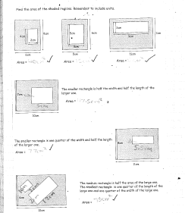
Chestnut Wow Work

Slide 28
Aspen:
Lola
For superb questioning about our Tudor topic.
It is clear Lola wants to learn and always shows excellence, enthusiasm and perseverance.
Mrs Davies 10.07.20

Slide 29
Aspen Wow Work

Slide 30
Redwood
Rebecca
Rebecca has such a positive ,super ,attitude to her learning. She consistently contributes to the class discussions with a very interesting and valuable content.
Rebecca you are a star!
Mrs Goodman 10.07.20

Slide 31
Redwood Wow Work

Slide 32
Next Week’s
Phrase of the Week:
You get the best out of others when you give the best of yourself.

