Slide 2
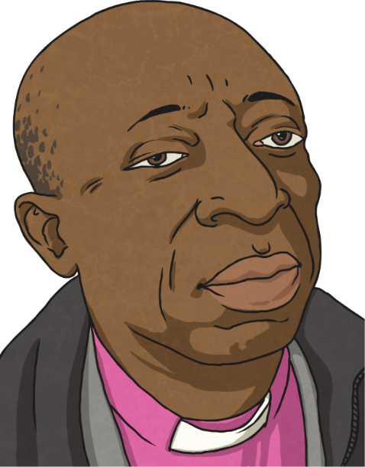
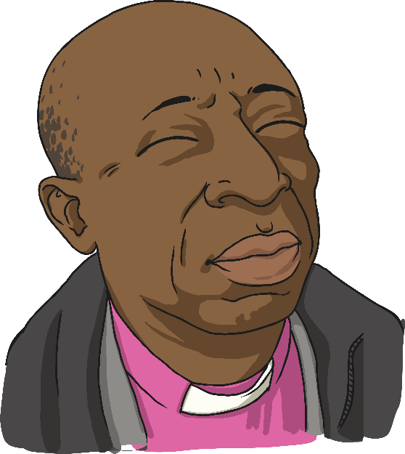
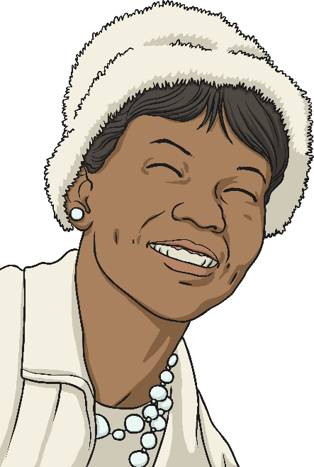
What is Black History Month?
Black History Month is a time set aside each year to celebrate the achievements of black men and women in the past and today.

Slide 3
Why Do We Have Black History Month?
Why do you think we have Black History month?
Black people have not always been treated equally simply because of the colour of their skin.
Do you know of any examples or stories of when black people have been treated unfairly in the past?
One example is that in America, black and white people had to sit in different seats on a bus or public places like the cinema.

Slide 4
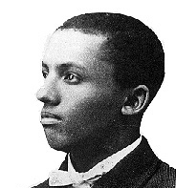
Why Do We Have Black History Month?
Lots of people knew that this was wrong and wanted things to change.
In 1926, in America, a man called Carter G. Woodson
introduced a “Negro History Week,” which later turned
into Black History Month.
In 1987, the first Black History Month took place in the UK.
How do you think this made black people feel?
Carter G. Woodson

Slide 5
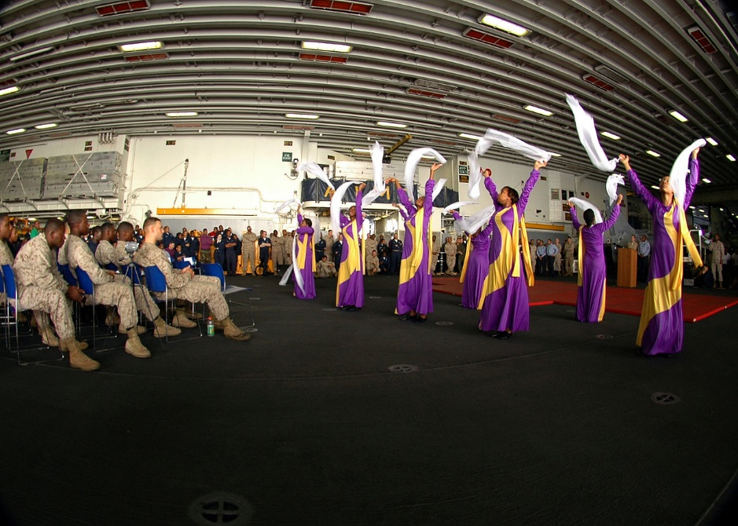
When is Black History Month?
Black History Month takes place annually in October in the UK and in February in America.
There is a different theme each year. The theme for 2020 is the achievements of black women and different events are planned to take place throughout the month.

Slide 6
Famous Black Men and Women
What famous black people do you know about?
The following slides will introduce you to some key black figures, both from history and in the present day, some of whom you may have heard about and some whom you may not have.

Slide 7
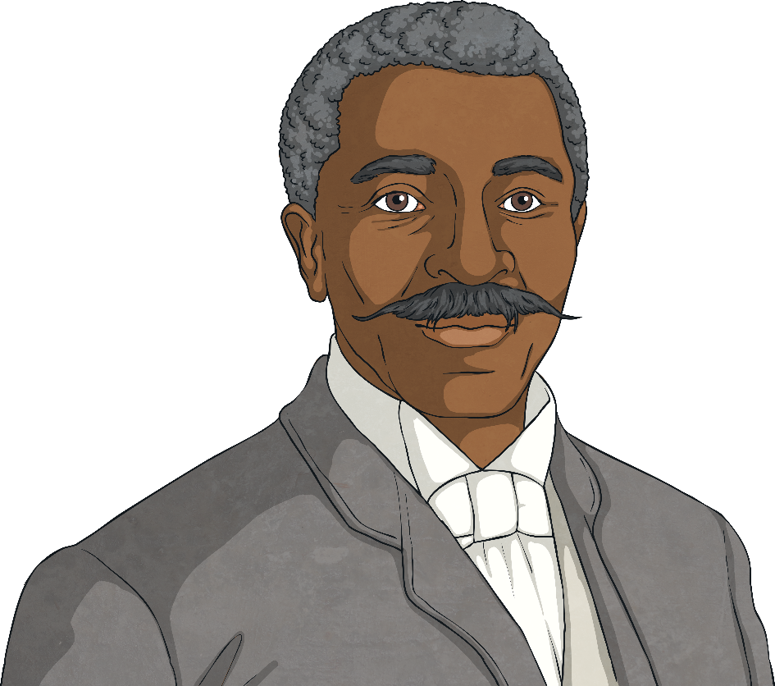
Famous Black Men and Women
George Washington Carver
1861-1943
George Washington Carver was born as a slave in Missouri, America. He became an agricultural scientist and inventor and helped poor farmers improve the soil on their land in order to grow better crops. Carver also developed hundreds of products using peanuts, sweet potatoes and soybeans.

Slide 8
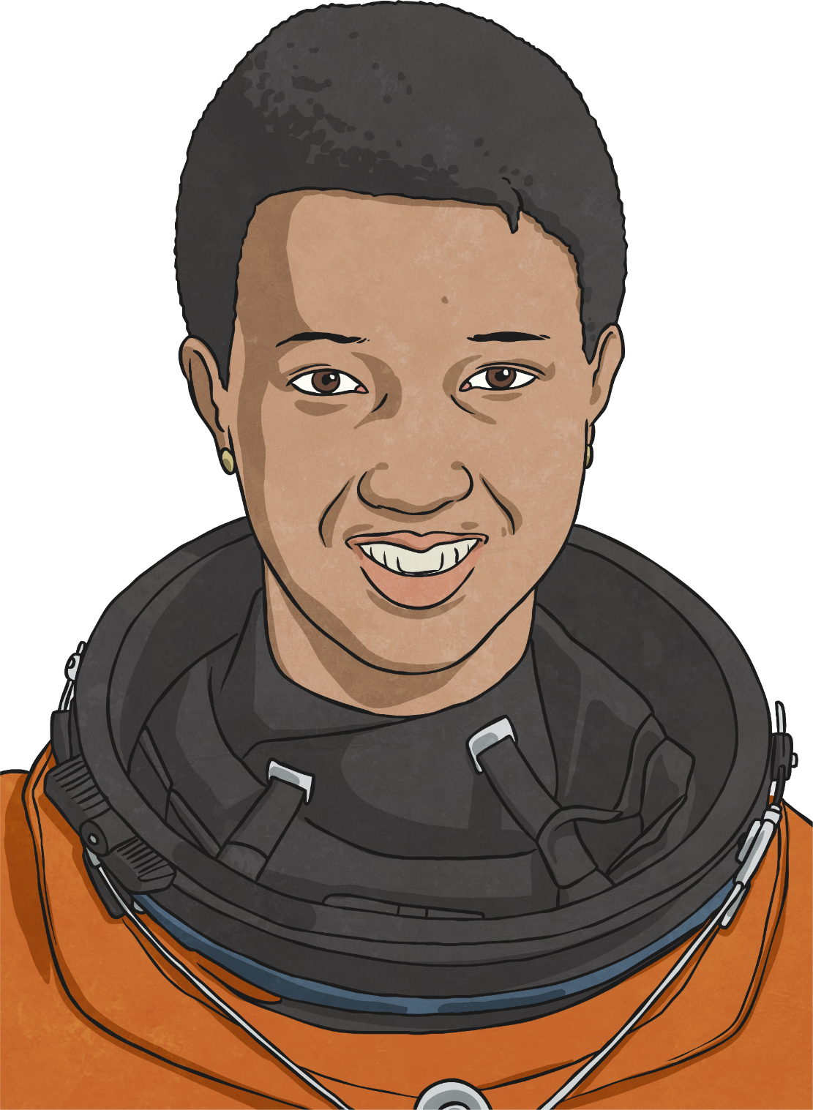
Famous Black Men and Women
Dr Mae Jemison
1956 – present day
Dr Mae Jemison was born in Alabama, USA. Mae developed an interest in science from a very early age. Following a career in medicine, she was selected by NASA for astronaut training. Mae became the first African American woman to travel in space when she went into orbit aboard the Space Shuttle Endeavour on the 12th September, 1992.

Slide 9
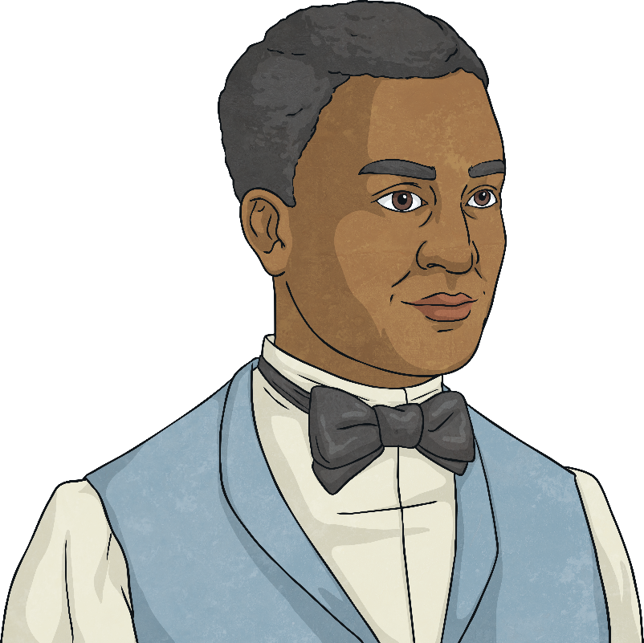
Famous Black Men and Women
John Edmonstone
1793 – ???? (date of death unknown)
John Edmonstone was a freed black slave from Guyana, South America. He lived in Edinburgh and taught the art of taxidermy* to students at Edinburgh University. One of his students was Charles Darwin. The taxidermy skills and knowledge of the natural world that Darwin learned from John were essential during his voyage aboard H.M.S. Beagle in 1831, allowing Darwin to study animals in close detail.
*taxidermy is the art of preparing, stuffing, and mounting the skins of dead animals to look lifelike.

Slide 10
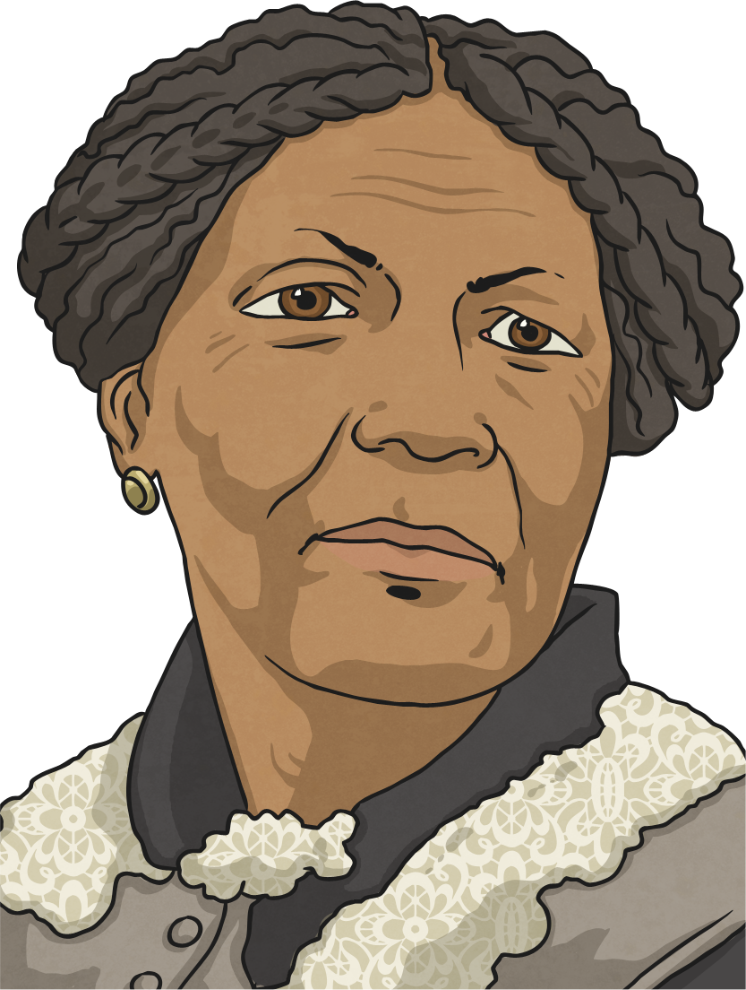
Famous Black Men and Women
Mary Seacole
1805-1881
Mary Seacole went to help soldiers in the Crimean War. Because of all her efforts, the soldiers called her “Mother Seacole,” as she comforted them, nursed them back to health and was always there if they needed clothes, blankets and kindness.

Slide 11
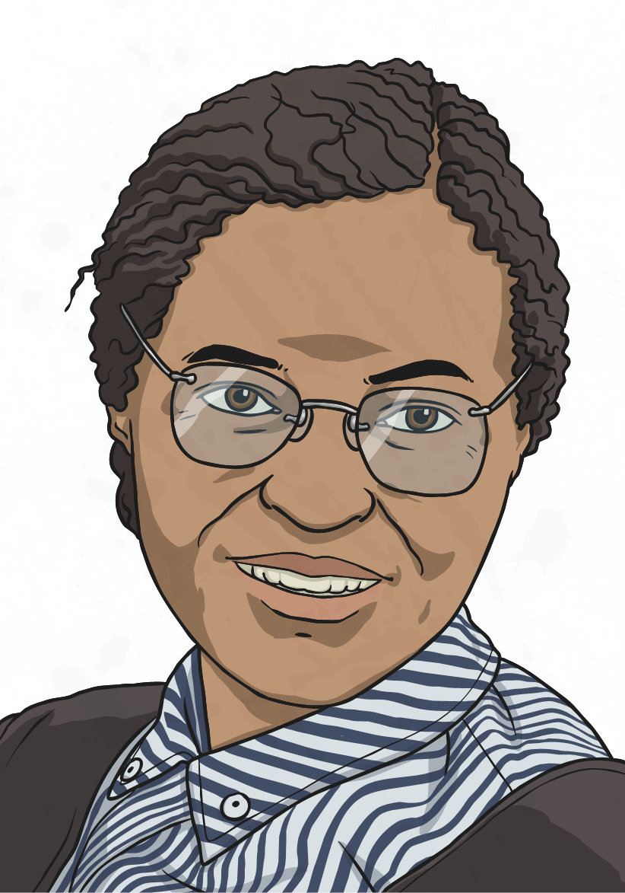
Famous Black Men and Women
Rosa Parks
1913-2005
Rosa Parks was born in America and, as a child, she was used to having to sit at the back of a bus because she had black skin, but she didn’t think that this was fair. One day on a bus, she refused to give her seat to a white person just because she was black. She was arrested by the police and fined for breaking the rules, but other black people and some white people as well, agreed with Rosa and made this clear to the American government. Eventually, they changed the rule and black people no longer had to sit in a separate section of the bus or give up their seat to someone just because of the colour of their skin.

Slide 12
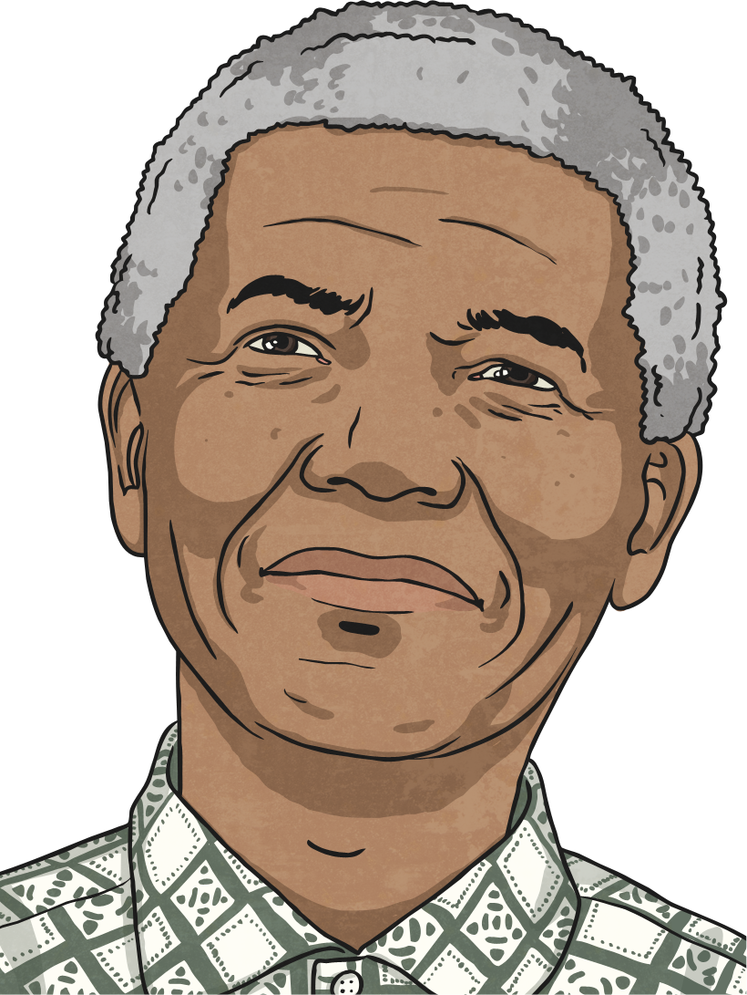
Famous Black Men and Women
Nelson Mandela
1918-2013
Nelson Mandela was the first black South African President. He spent 27 years in prison for trying to change things so that they were equal for both black and white people. Many people around the world thought he was a hero and respected him for his courage and wisdom in bringing people together and living in peace.

Slide 13
Famous Black Men and Women
Alice Coachman
1923 - 2014
Alice Coachman was an African American athlete, who specialised in the high jump. In London in 1948, she became the first black woman to win an Olympic gold medal.

Slide 14
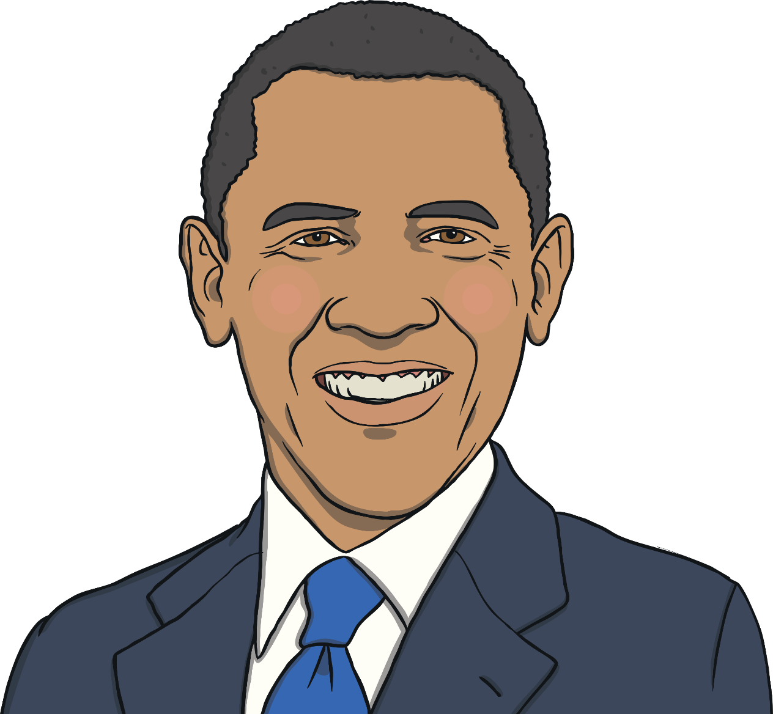
Famous Black Men and Women
Barack Obama
1961 – present day
Barack Obama was born in Hawaii on 4th August 1961. His father is from Kenya and his mother is from Kansas.
On 4th November 2008, he became the 44th American President. He is the first African-American president in the United States of America.

Slide 15
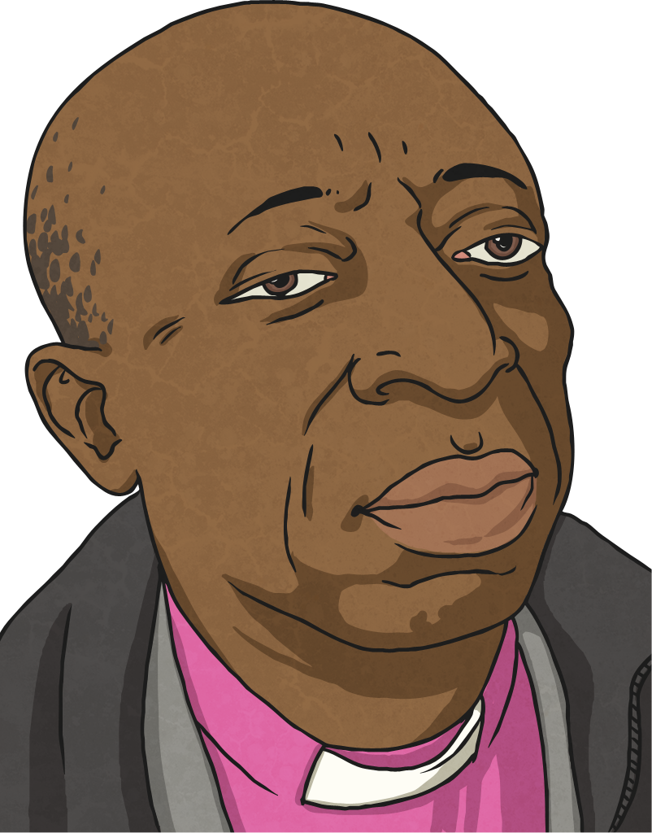
Famous Black Men and Women
Bishop Wilfred Wood
1936 – present day
Wilfred Wood became the first black Bishop in the Church of England. He was Bishop of Croydon from 1985 to 2003.
In 2004, the British people voted him second in the 100 “Great Black Britons” list.
Bishop Wilfred Wood worked hard to help with the relationships between people of different races living in the United Kingdom.

Slide 16
