Slide 1
Wow Assembly:
Friday 3rd July

Slide 2
Phrase of the Week:
A ship is safe in the harbour, but that is not what it is built for.

Slide 3
Pine
Elyza F.
For amazing hard work and creativity on her Great Fire of London video
Miss Shipley 26.06.2020

Slide 4
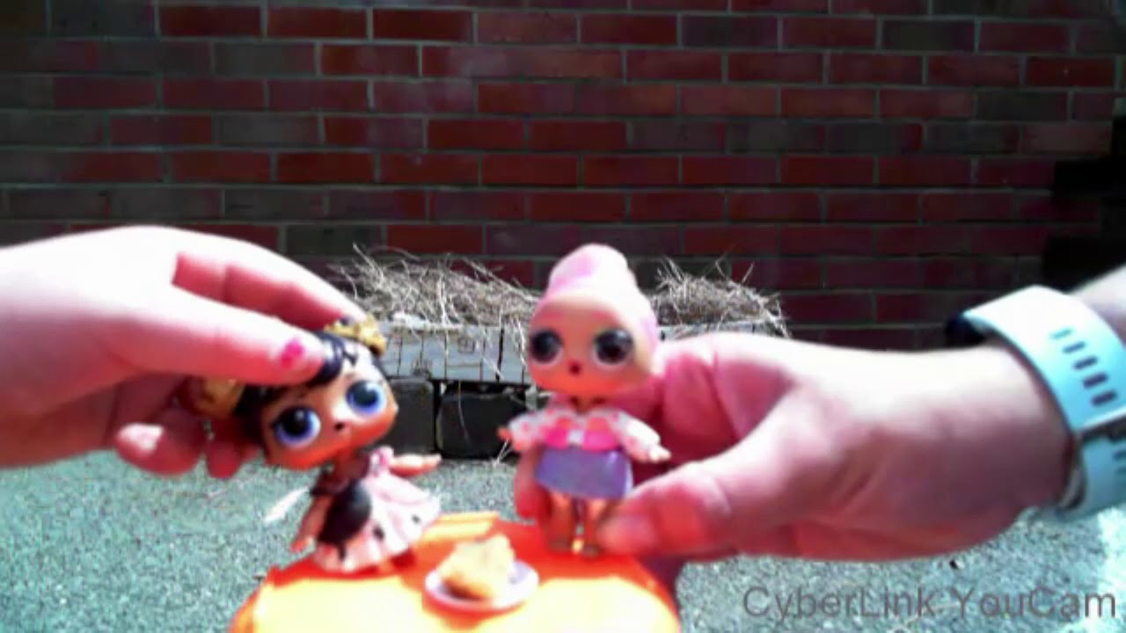

Slide 5
Birch
Max W.
For applying scientific investigation skills on a bug hunt and showing wonderful creature care
Miss Shipley 03.07.20

Slide 6
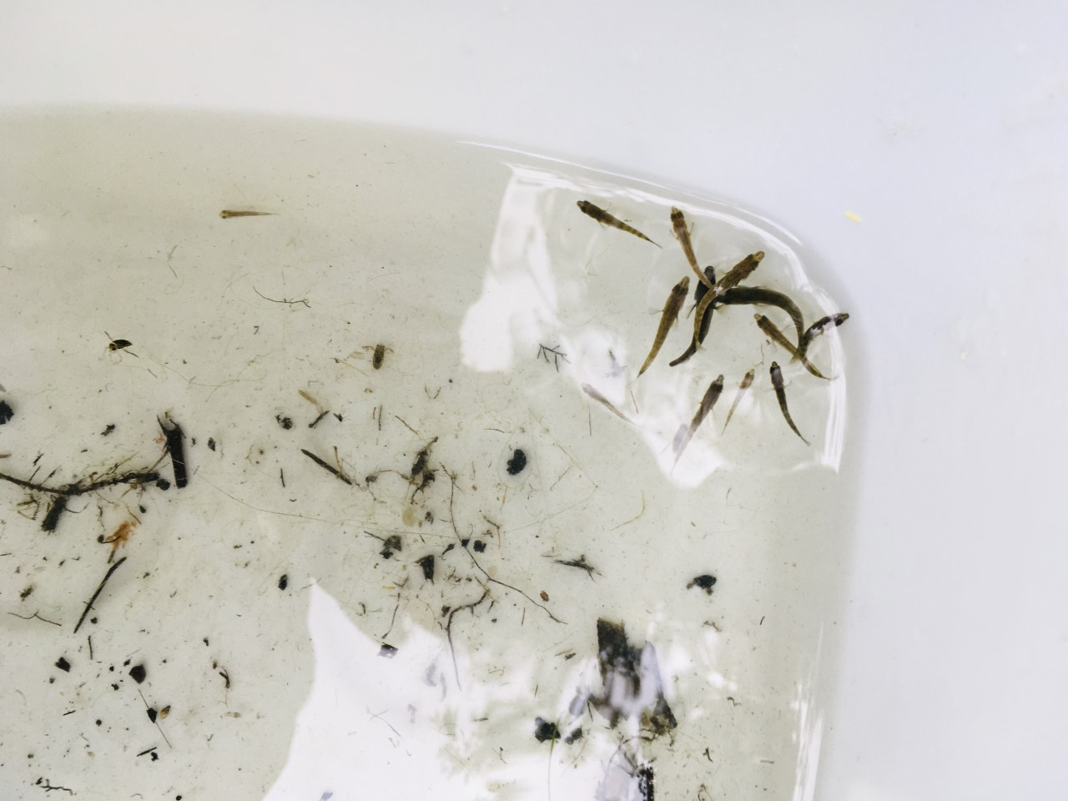

Slide 7
Willow
Jake D.
For showing outstanding commitment and determination to learn a new skills during lockdown.
Miss Shipley 26.06.2020

Slide 8
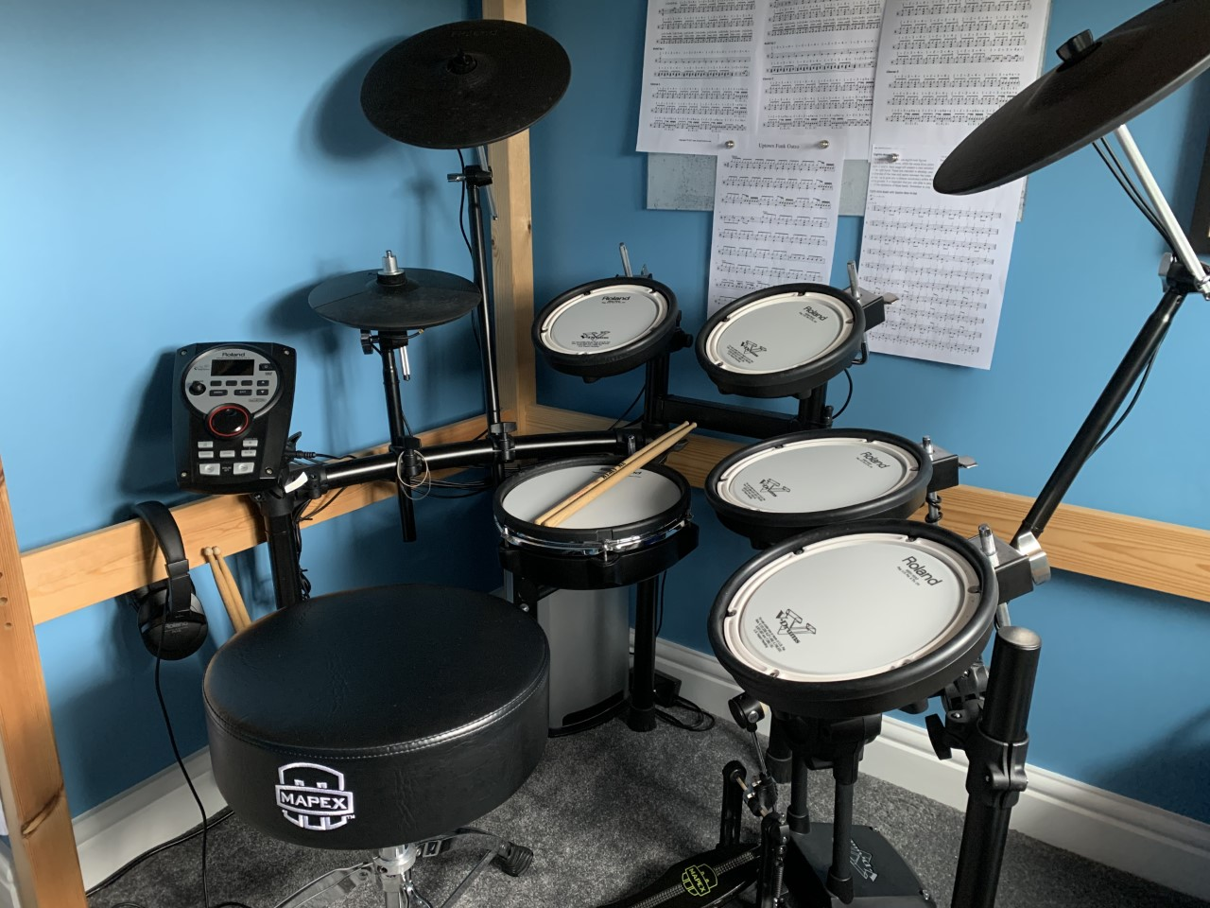

Slide 9
Spruce
Wiktoria W
For outstanding effort and resilience in completing her home learning project.
Miss Shipley 26.06.2020

Slide 10
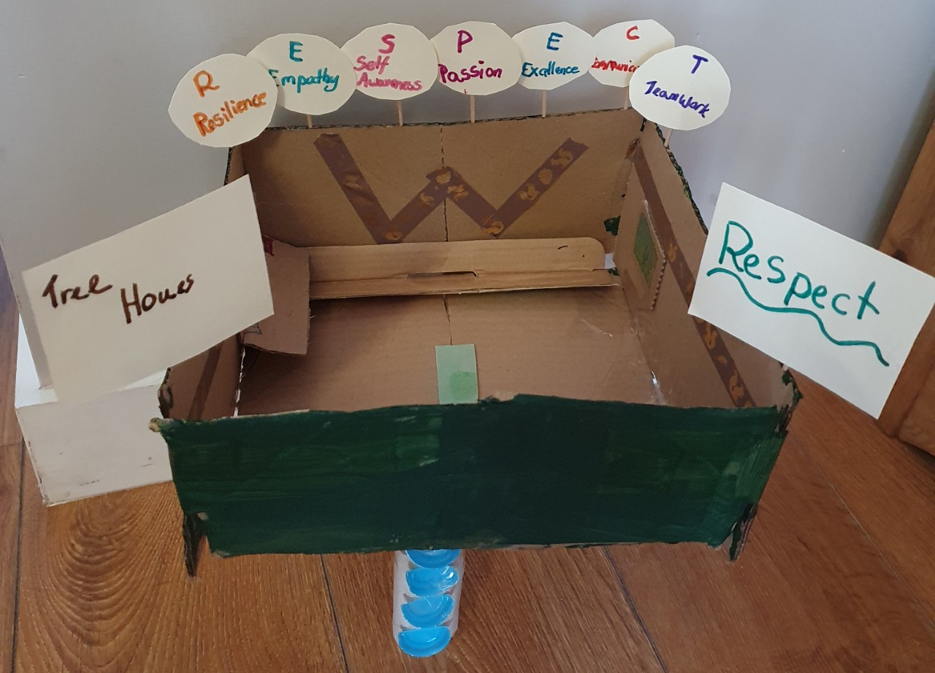

Slide 11
Maple
Caeden F.
For amazing imagination and hard work creating his Road Trip USA video
Miss Shipley 26.06.2020

Slide 12
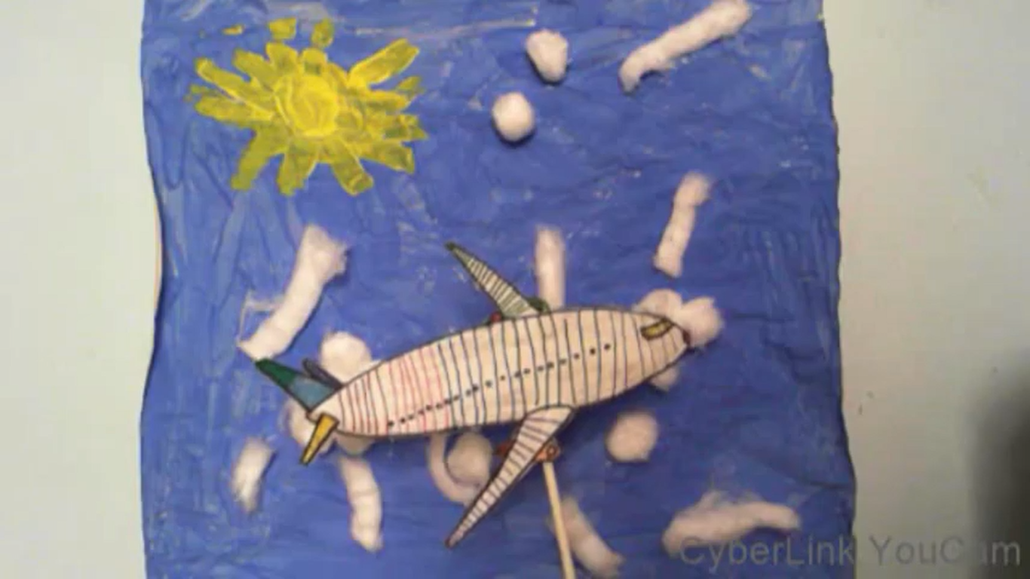

Slide 13
Maple
Annalia C.
For outstanding effort and attention to detail in her written work
Miss Shipley 26.06.2020

Slide 14
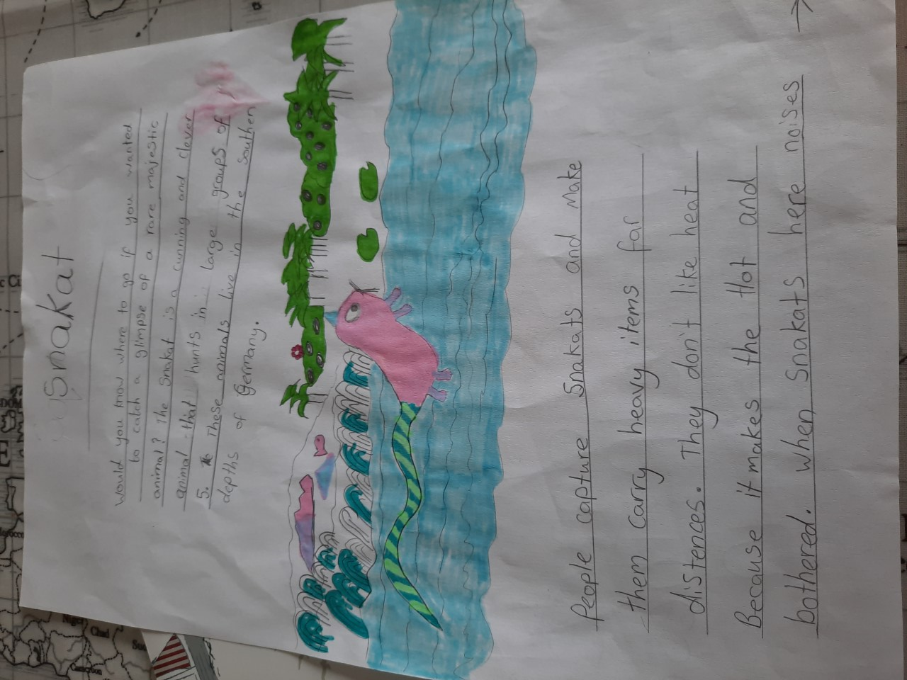

Slide 15
Chestnut
Karina M.
For amazing resilience and determination to continue home learning every day!
Miss Shipley 26.06.2020

Slide 16
Redwood
Harry W.
For amazing effort with his golf and competitions
Miss Shipley 26.06.2020

Slide 17
Next Week’s
Phrase of the Week:
With ordinary talent and extraordinary perseverance,
many things are achievable.

