Slide 1
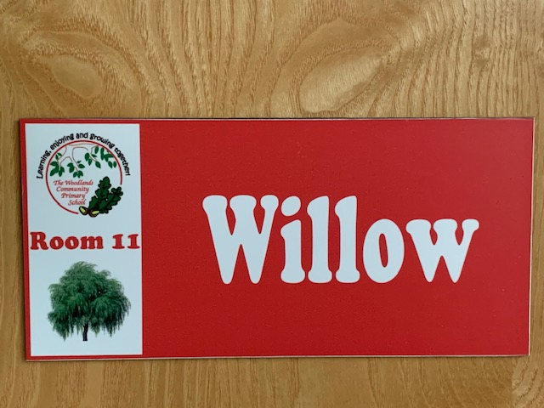
Welcome to Willow!
September
2020
Mrs J. Maiden
Miss S. Higgins

Slide 2
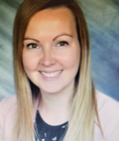
Teacher Profile:
Mrs Maiden
Welcome to Willow!
I am really looking forward to being your teacher next year! ☺
Facts about me:
I’m the Deputy at Woodlands.
I’m from London.
I like to write stories and illustrate them with my doodles!
My favourite subject is Maths.
My favourite colour is blue.
My favourite sweets are Jelly Tots.
I have a large, fluffy cat called Mr Cuddles.

Slide 3
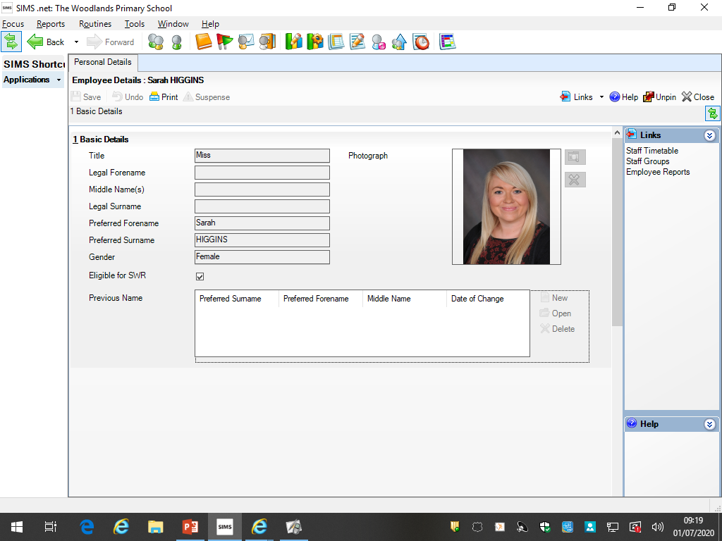
Teacher Profile:
Miss Higgins
Welcome to Willow!
I am super excited to be teaching you next year! ☺
Facts about me:
I’m a HLTA at Woodlands.
I’m from Birmingham originally but now live in Tamworth.
I love to explore new places, camping is my favourite!
My favourite subjects are Maths and Art.
My favourite colour is yellow.
I have two older sisters and a brother.
I have a little dog called Frankie.

Slide 4
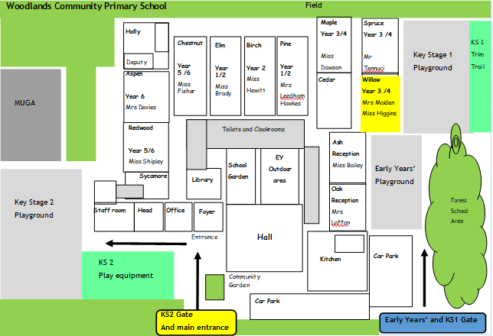
School Map
Your classroom is here!
Here is the map of our school site:

Slide 5
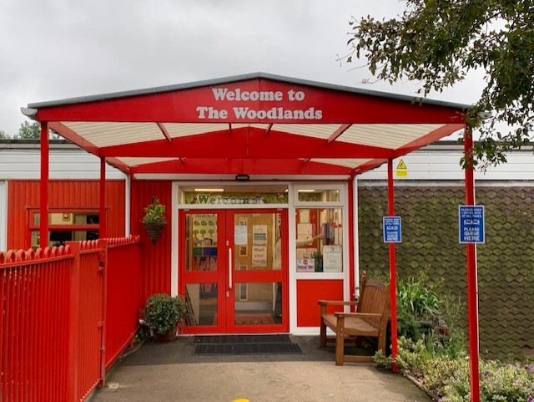
Welcome to Willow!

Slide 6
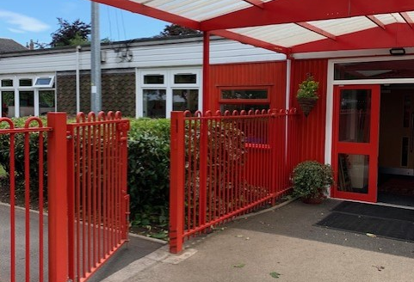
Welcome to Willow!

Slide 7
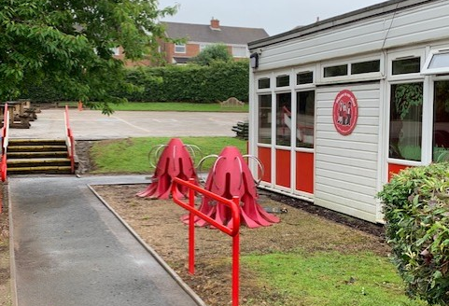
Welcome to Willow!

Slide 8
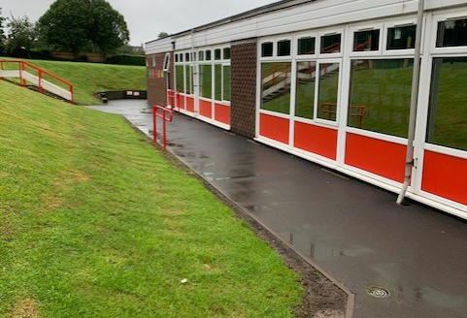
Welcome to Willow!

Slide 9
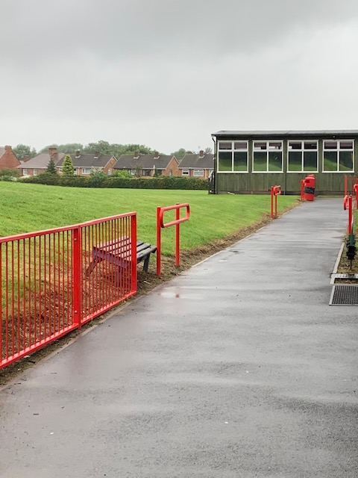
Welcome to Willow!

Slide 10
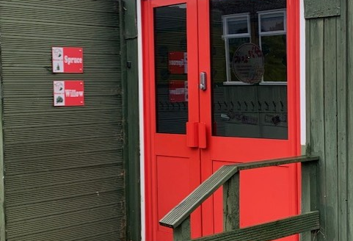
Welcome to Willow!
Come into your classroom through this entrance:

Slide 11
Welcome to Willow!
Come on in !

Slide 12
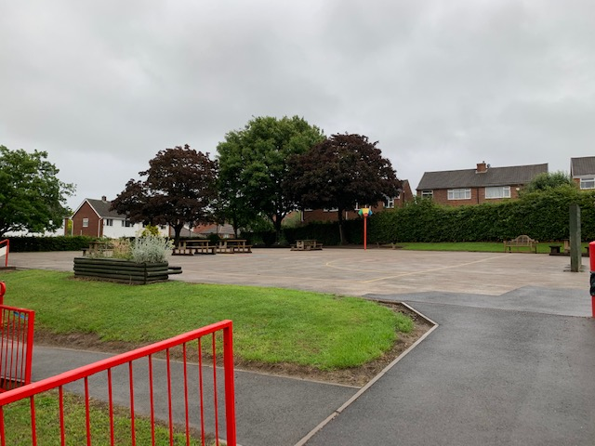
Play time!

Slide 13
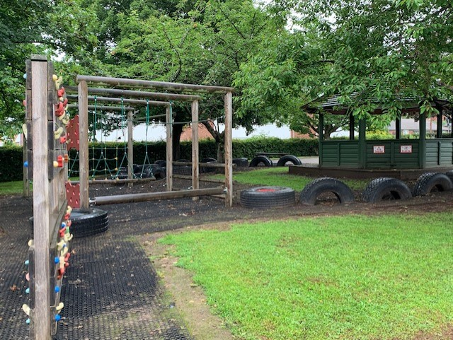
Play time!

Slide 14
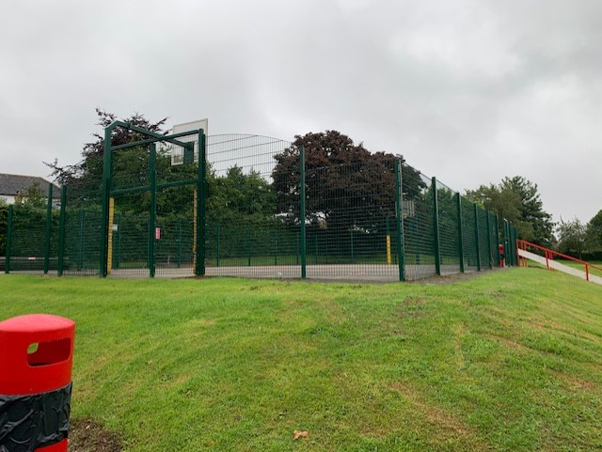
Play time!

Slide 15
(Insert picture of parent overview, adapted from Aut 1 MTP)
Here is an overview of what we will be learning during the first half term!

Slide 16
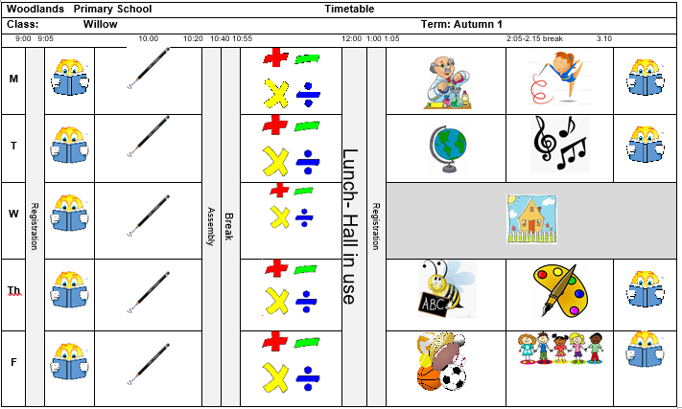
Timetable:
Our timetable will look like this! We have Guided Reading, English and Maths every morning and our other subjects in the afternoons.

Slide 17
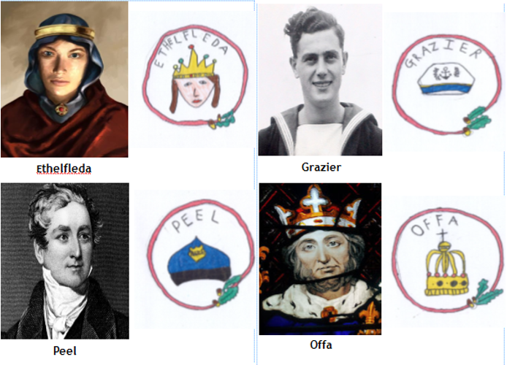
Houses:
Here are our school houses, named after important people from Tamworth’s history.
You will still be in the same house as last year – when you win team points, they all contribute to your team effort!
We will be voting for our new Year 6 House Leaders in September.

Slide 18
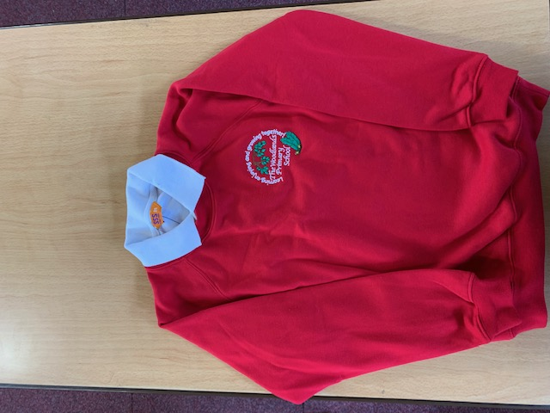
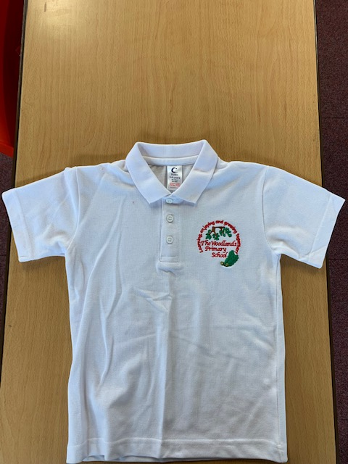
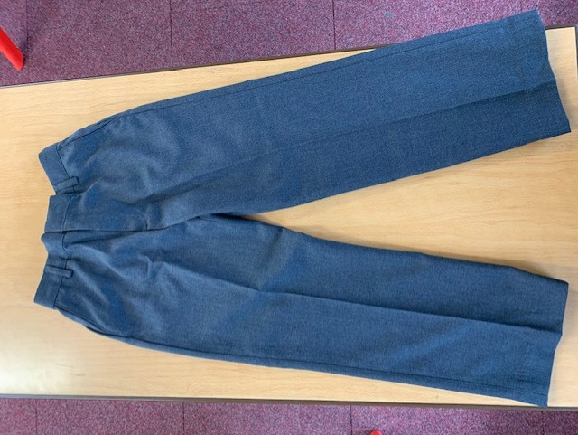
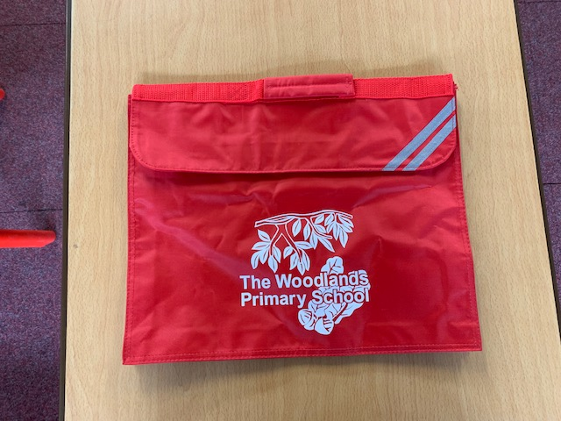
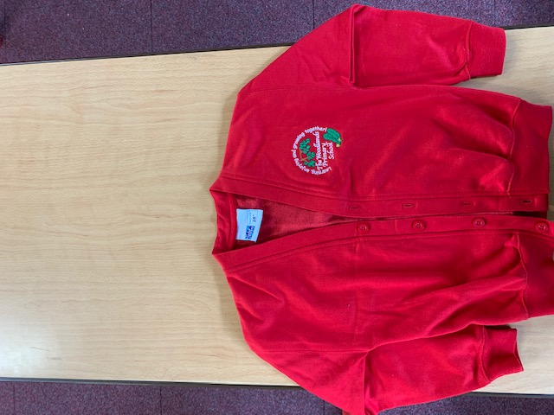
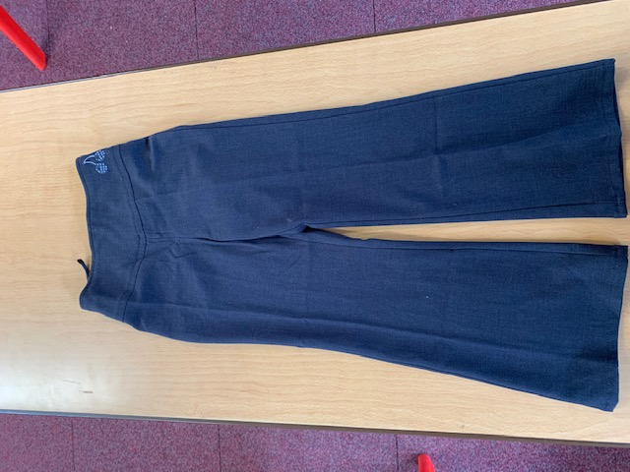
Uniform:
Please wear full school uniform every day.
Please make sure each item of uniform is clearly labelled with your name.
Please wear sensible school shoes – no trainers please.

Slide 19
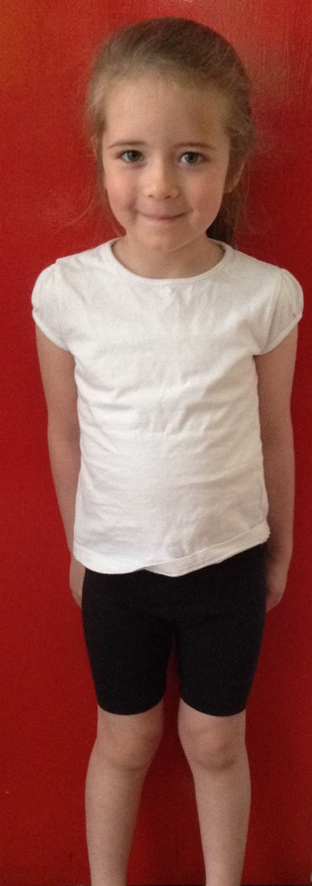
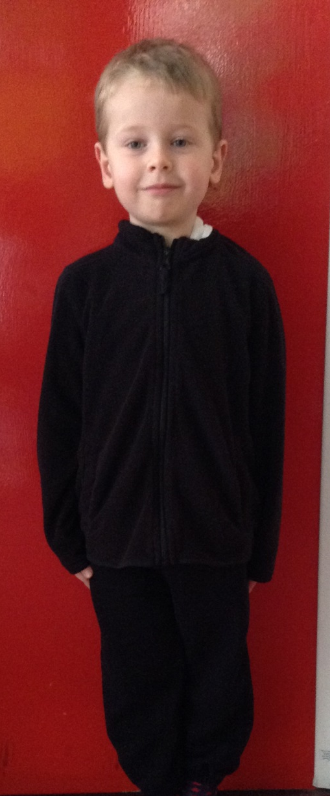
PE Kit:
Please make sure you have your PE kit in school on the days you have PE.
Please make sure each item of kit is clearly labelled with your name.
Please don’t wear earrings on PE days.
If you have long hair, please tie it back on PE days.
Outdoor Kit
White T Shirt
Black jumper/tracksuit top. (No hood)
Black Tracksuit bottoms /Joggers.
Trainers
Indoor Kit
White T Shirt
Black/Navy shorts

Slide 20
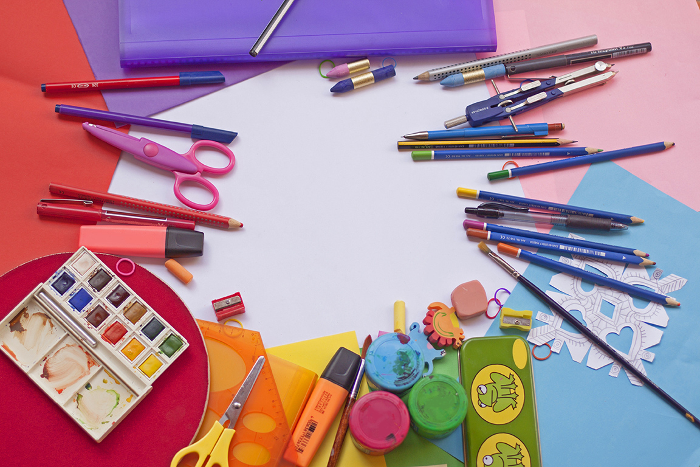
Every day, please bring:
A water bottle with your name on
Your coat
Your reading book
Your reading diary
A school bag to hold all your belongings

Slide 21
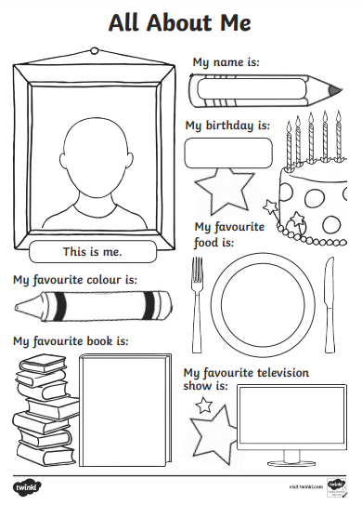
Please send us your
‘All About Me’ profiles !

Slide 22
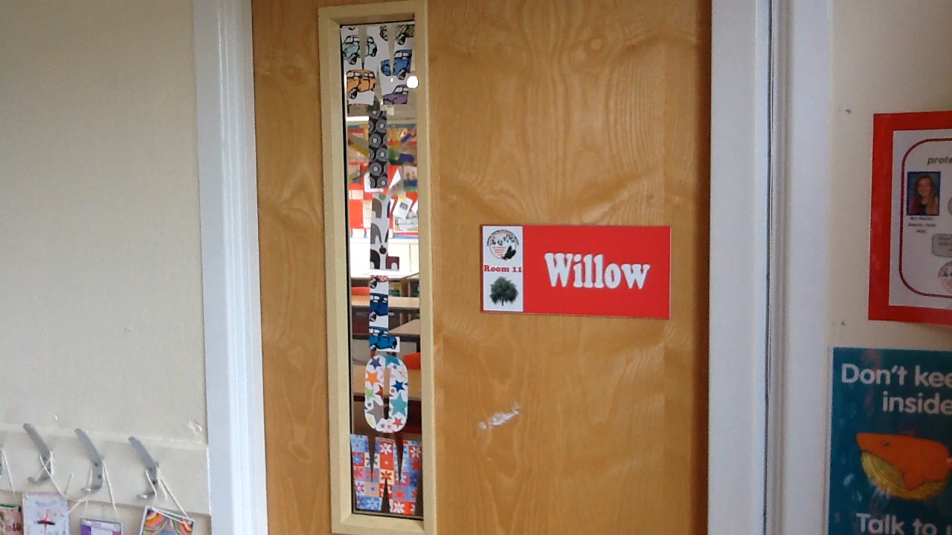
Have a lovely summer!
See you soon!

