Slide 1
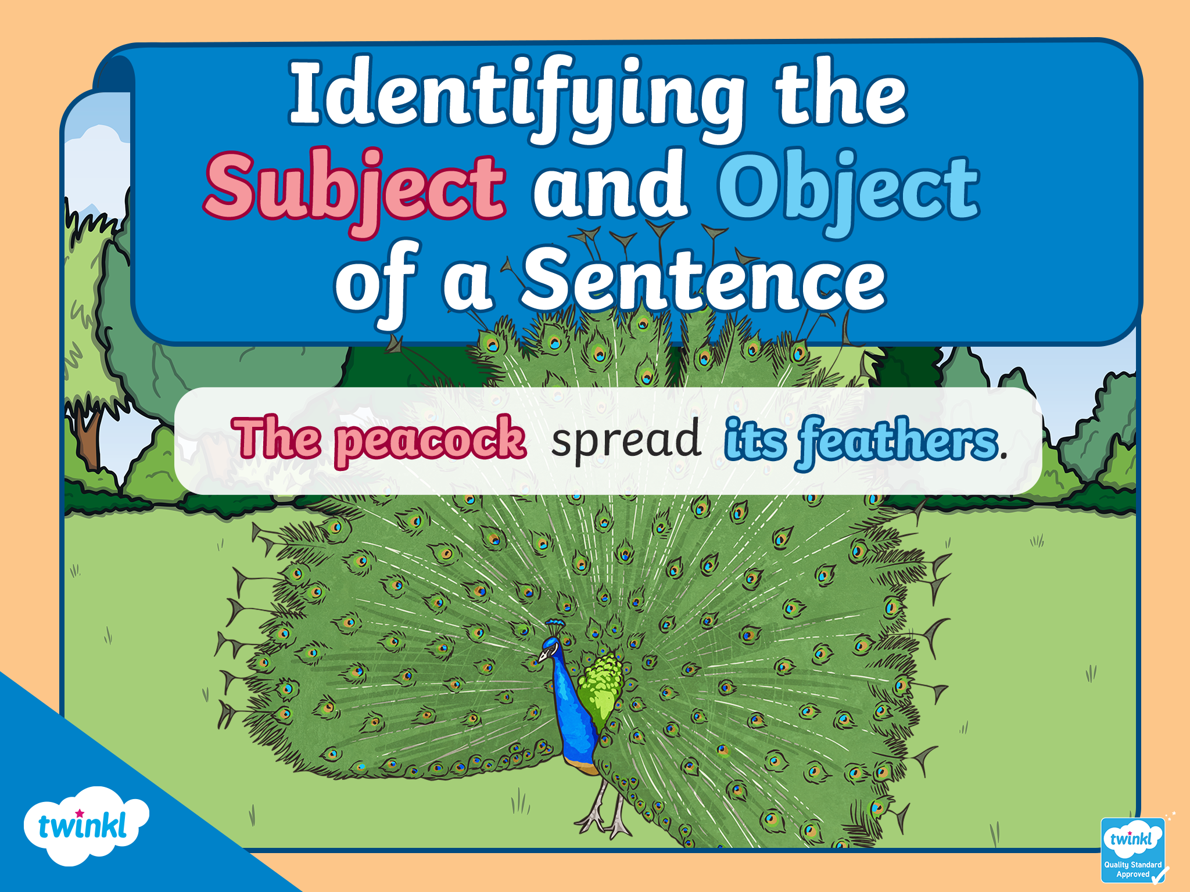

Slide 2
Starter
Can you match the boxes with their definitions?
nouns
noun phrases
pronouns
verbs
Hammer, tree, car and Timmy.
The tree in the distance. The car I bought.
It, she, us, them, you, we and he.
Wave, clean, stretch, sit and walk.

Slide 3

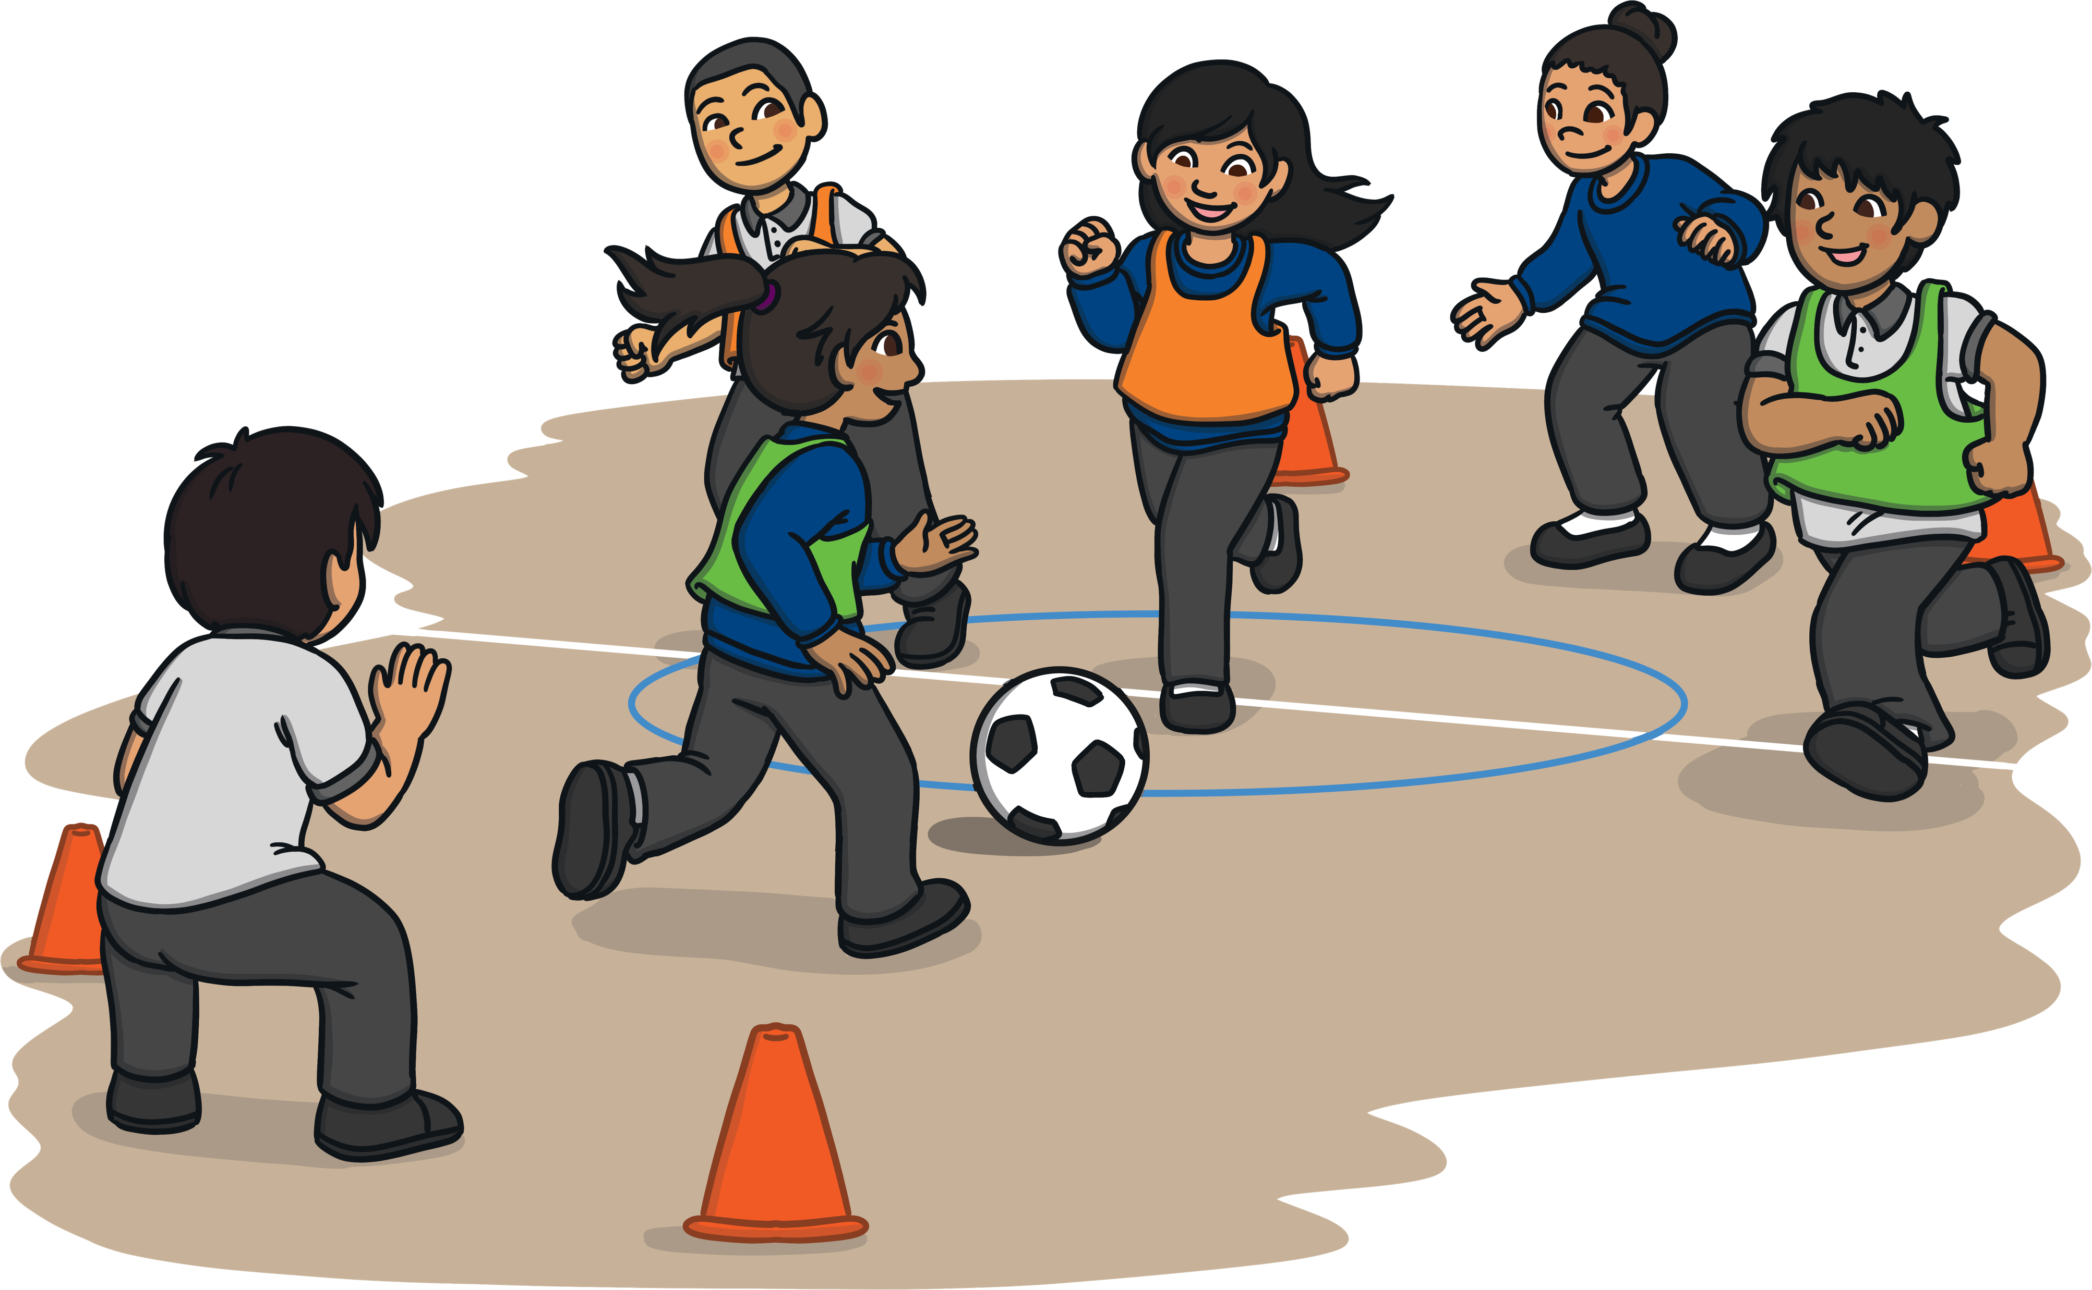
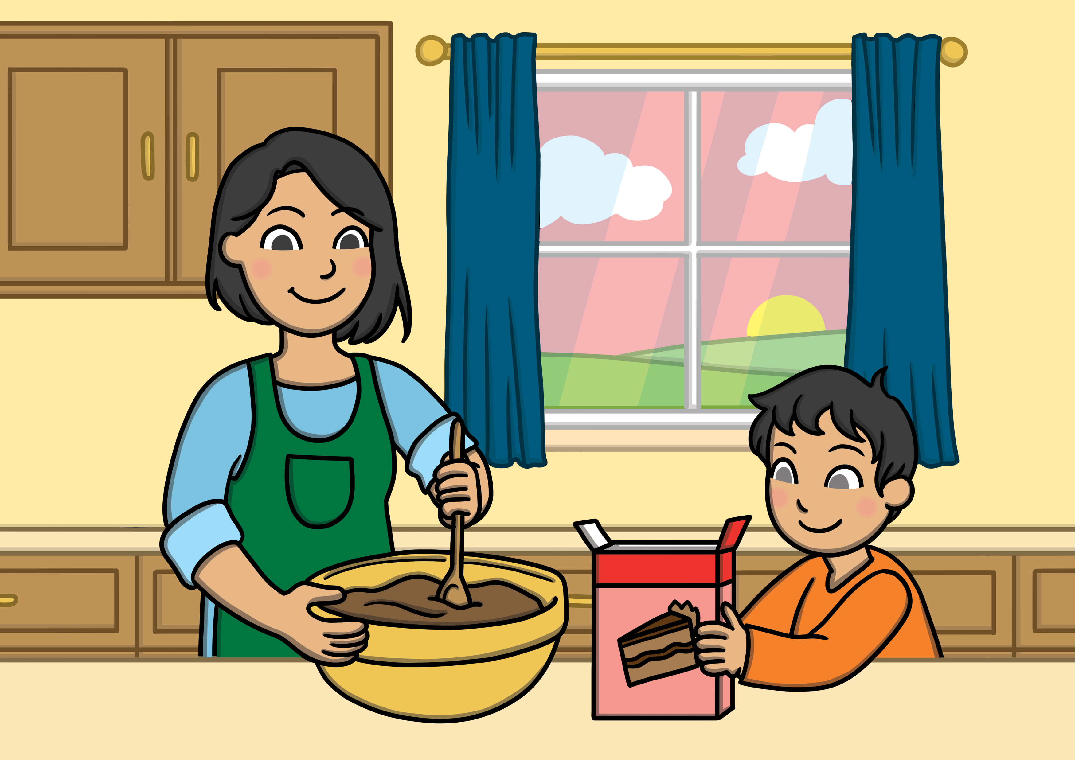
What is an object?
In a sentence, the object is having something done to it.
This is usually a noun, pronoun or noun phrase telling us what the verb is acting on.
For example:
He kicked the ball.
They baked some cakes.
Katherine opened her bag.

Slide 4
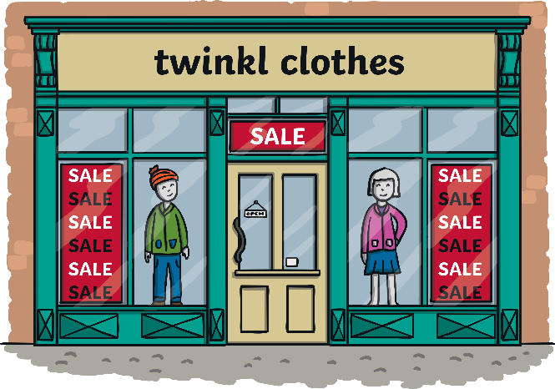
What is the object of this sentence?
Jim bought a shirt.
The shirt is the object because it was bought by Jim.

Slide 5




What is a subject?
In a sentence, the subject is the person, animal or thing or doing or being the verb. This is also usually a noun, pronoun or noun phrase.
subject
He played the guitar.
They wore skis.
Katherine watched the performance.
object

Slide 6


Identifying subjects and objects
Can you identify the subjects and the objects of these sentences?
subject
object
The brave woman entered the cave.
The boy picked the flower.

