Slide 1



Wow Assembly:
Friday 11th February

Slide 2
Phrase of the Week:
The way you treat yourself sets the standards for others.

Slide 3
Green Cards!
Finley – Elm
Harvey – Maple
Mollie – Maple
Joe – Redwood
Lily-Rose – Redwood
Charley W - Redwood

Slide 4
Scientists of the Week!
Oak –Casper
Ash –
Birch –
Pine – Freya
Elm – Thomas
Willow – Issac
Spruce – Lucy-Mae
Maple – Max
Redwood – Charlie S
Chestnut –
Aspen- Kade

Slide 5
Weekly Team Points!
Peel | Ethelfleda | Grazier | Offa
369 | 374 | 337 | 352

Slide 6
Oak
Lacey-Louise
For writing some super instructions for making a chocolate cake.
Mrs Laffan 11.02.22

Slide 7
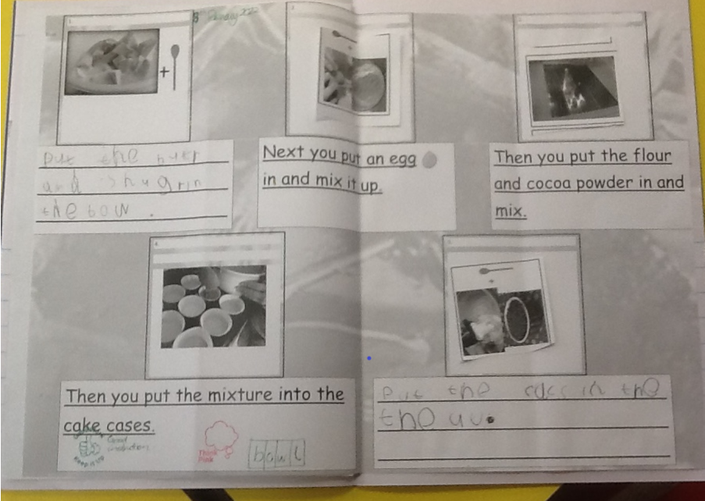
Oak Wow Work
Oak
Ansel
For
For creating a fantastic mosaic of an Aztec mask.
Mrs Laffan 28.01.2022

Slide 8
Ash
Mollie
For superb writing.
Mollie wrote a set of instructions to bake a cake.
Miss Bailey and Mrs Salt 11.02.22

Slide 9
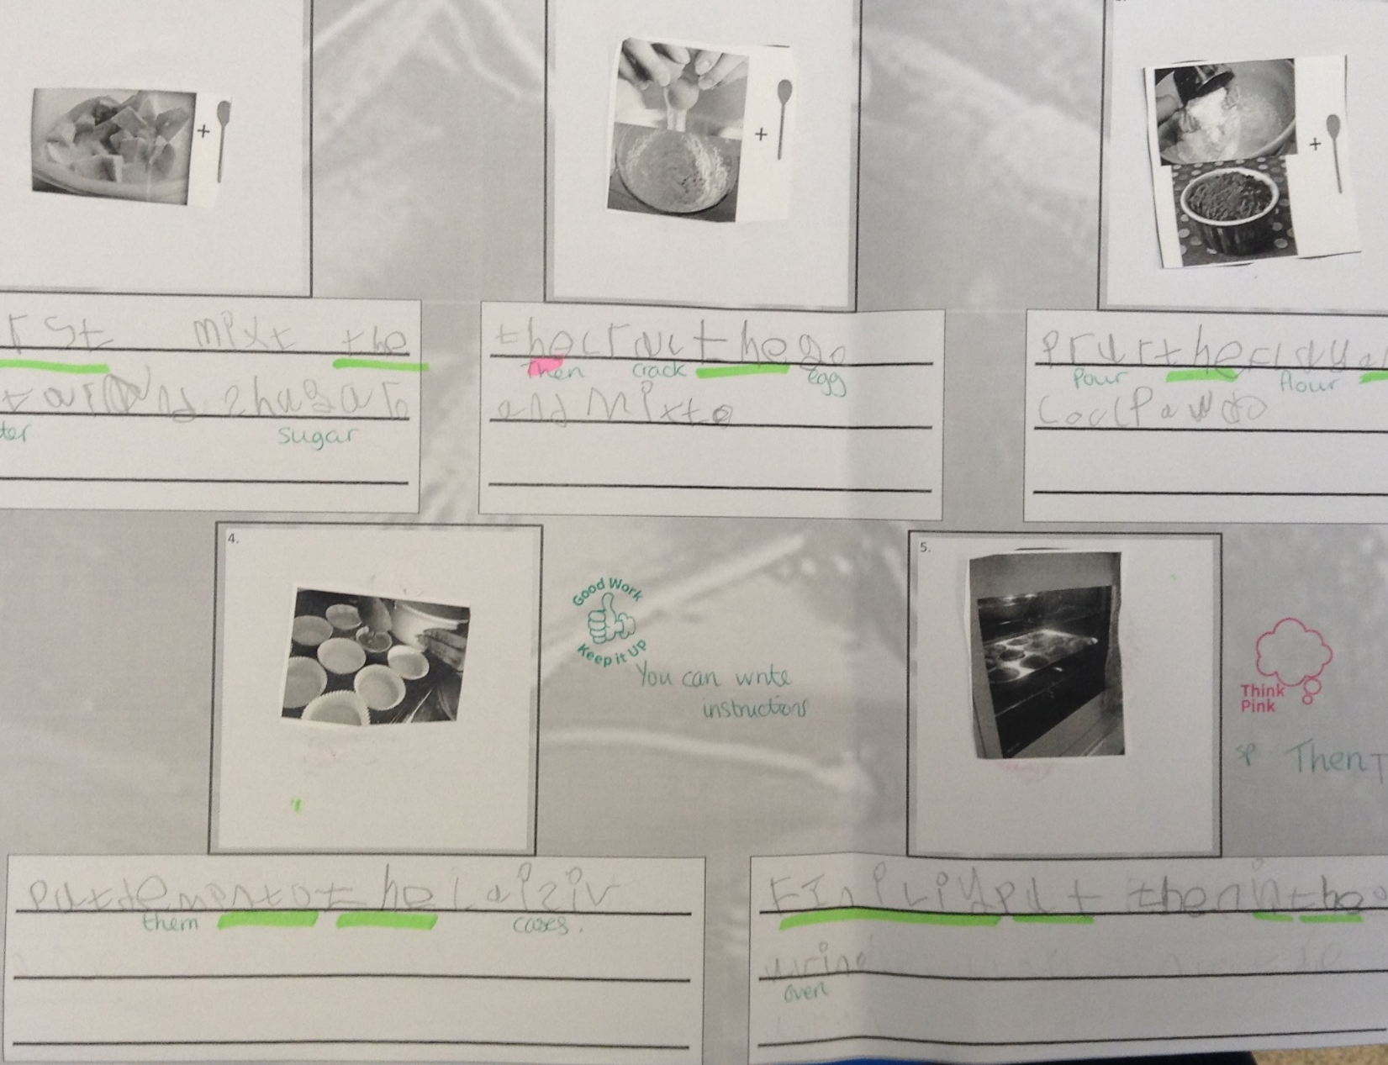
Ash Wow Work
Oak
Ansel
For
For creating a fantastic mosaic of an Aztec mask.
Mrs Laffan 28.01.2022

Slide 10
Elm
Codi-Lee
Codi-Lee has worked especially hard to apply his work on a bullet point list into his Rio information booklet this week! Great work Codi-Lee!
Mr Grice 11.02.22

Slide 11
Birch
Robyn
Robyn has made a fantastic start to her carnival mask. He has thought really carefully about the colours she wanted to use. She showed passion and excellence and I can’t wait to see the finished article! Well done Robyn. Keep shining bright!
Miss Hewitt 11.02.22

Slide 12
Pine
Carterose
For using empathy to support our new pupil in Pine. Carterose helped Jaycee to show her areas of the classroom and played with her outside. Such kindness.
Mrs Leedham-Hawkes 11.02.22

Slide 13
Maple
Harvey
For working independently to solve addition and subtraction calculations.
Miss Dawson 11.02.22

Slide 14
Willow
Betsy
For showing resilience when faced with different challenges in Maths. Betsy has worked hard when finding equivalent fractions and has persevered when things got challenging. Well done Betsy. Keep up the great work.
Miss Fisher 11.02.22

Slide 15
Spruce
Oliver J
For persevering in being the best that he can be within maths. Oliver is willing to ask adults for help when he gets stuck, but only after exploring other avenues of support.
Mr Draper 11.02.22

Slide 16
Chestnut
Aimee J.
For continuing to show a positive attitude towards her maths this week and continuing to persevere with new and unfamiliar learning including algebra.
Mr Tennuci 11.02.22

Slide 17
Aspen
Alfie
For persevering with his handwriting and now enjoying amazing results! A Beautiful attitude to learning, well done.
Mrs Read 08.02.22

Slide 18
Redwood
Ruby C
For demonstrating amazing self-awareness in Maths this week and taking on the tricky task of mastering algebra – I am so proud of how hard you have worked
Miss Shipley 11.02.22

Slide 19
Next Week’s
Phrase of the Week:
Without challenge, there is no achievement.
.

