Slide 2
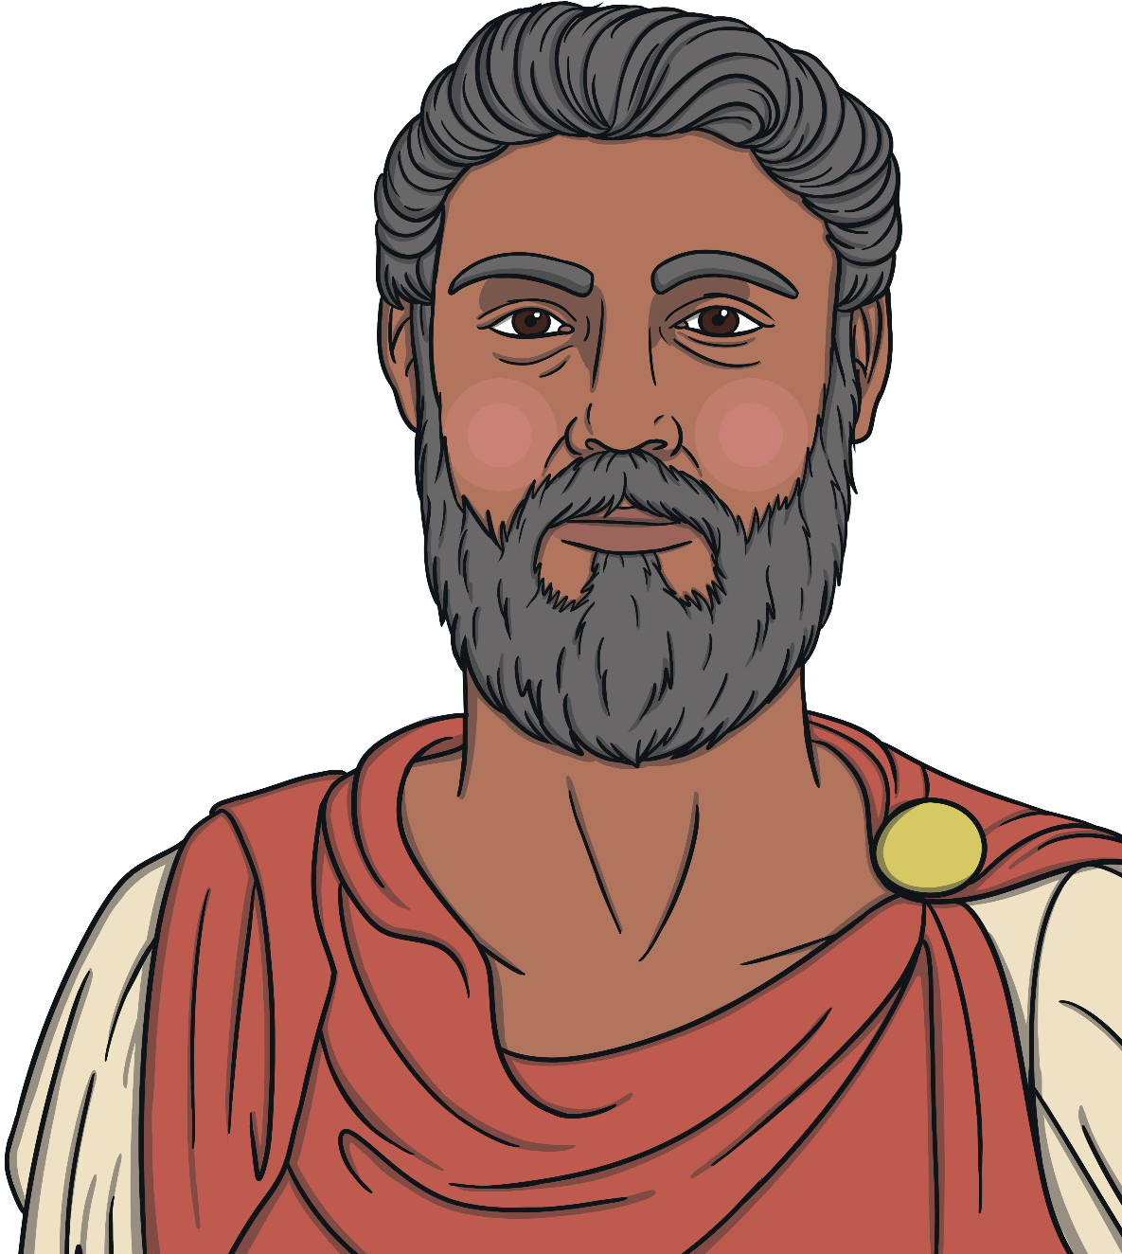
193
Septimius Severus becomes the first Black emperor of Rome.
He lived in York for three years and died there in 211.
emperor – Ruler or leader.
“Title of Image Used” by [Author] is licensed under CC BY 2.0

Slide 3
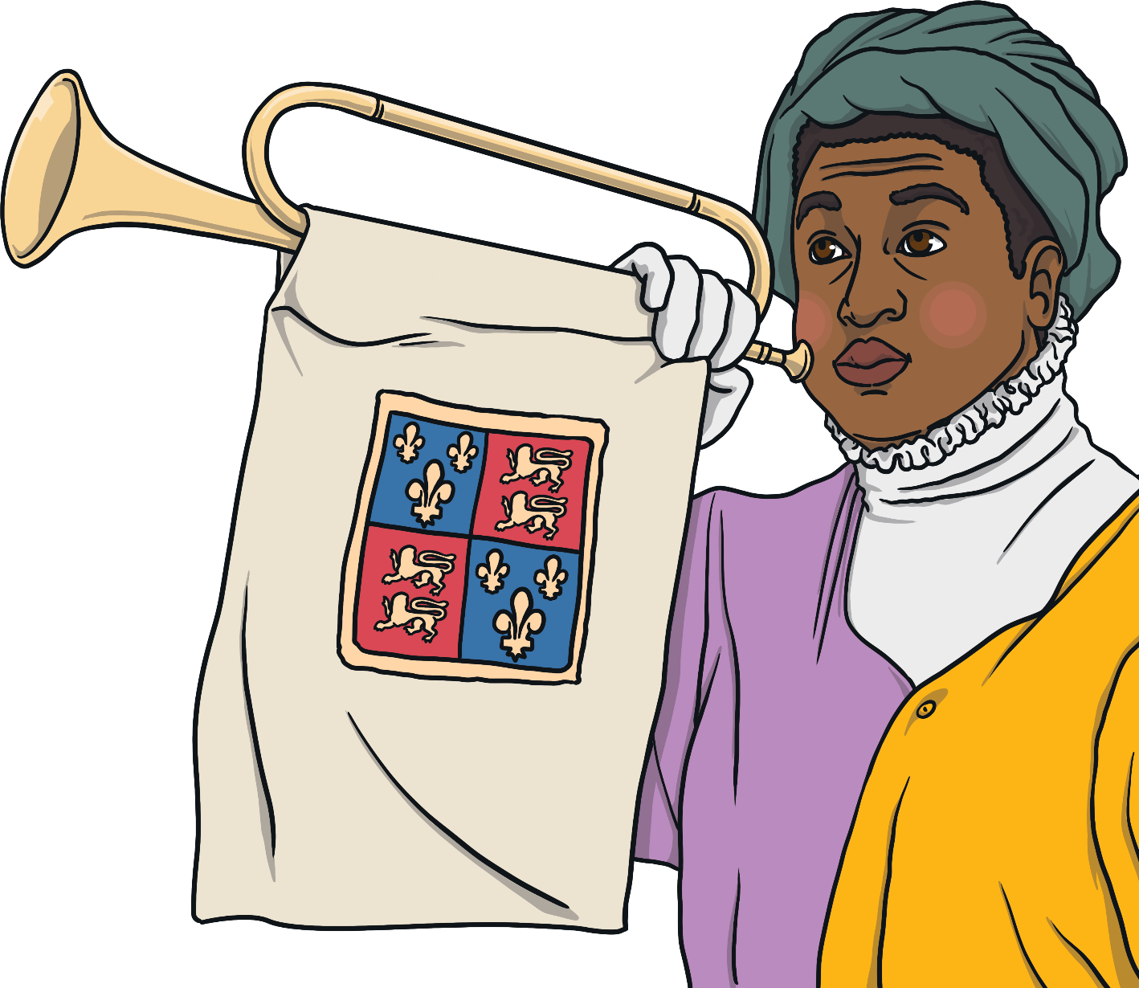
1507
John Blanke is mentioned for the first time in The King's records.
John Blanke worked for Henry VII and Henry VIII as a royal trumpeter. This was an important job.
John would have been part of important royal events, such as the funeral of Henry VII and the coronation of Henry VIII. At one point, he asked the king for more money and the king agreed.
coronation – A special ceremony where a new king or queen is crowned.
“Title of Image Used” by [Author] is licensed under CC BY 2.0

Slide 4
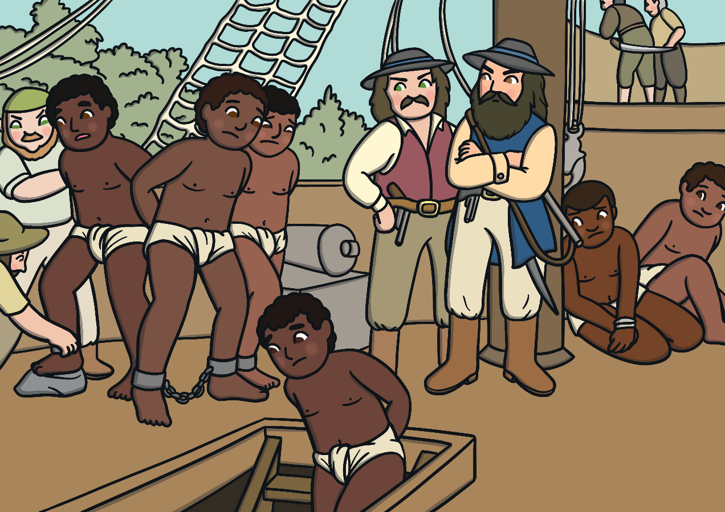
1562
A ship’s captain called John Hawkins travels to Sierra Leone in Africa. He kidnaps 300 men, women and children and takes them to the Caribbean where they are forced to work as enslaved people.
enslaved – Someone who belongs to another person and has to work for no money. They have no freedom.
“Title of Image Used” by [Author] is licensed under CC BY 2.0

Slide 5
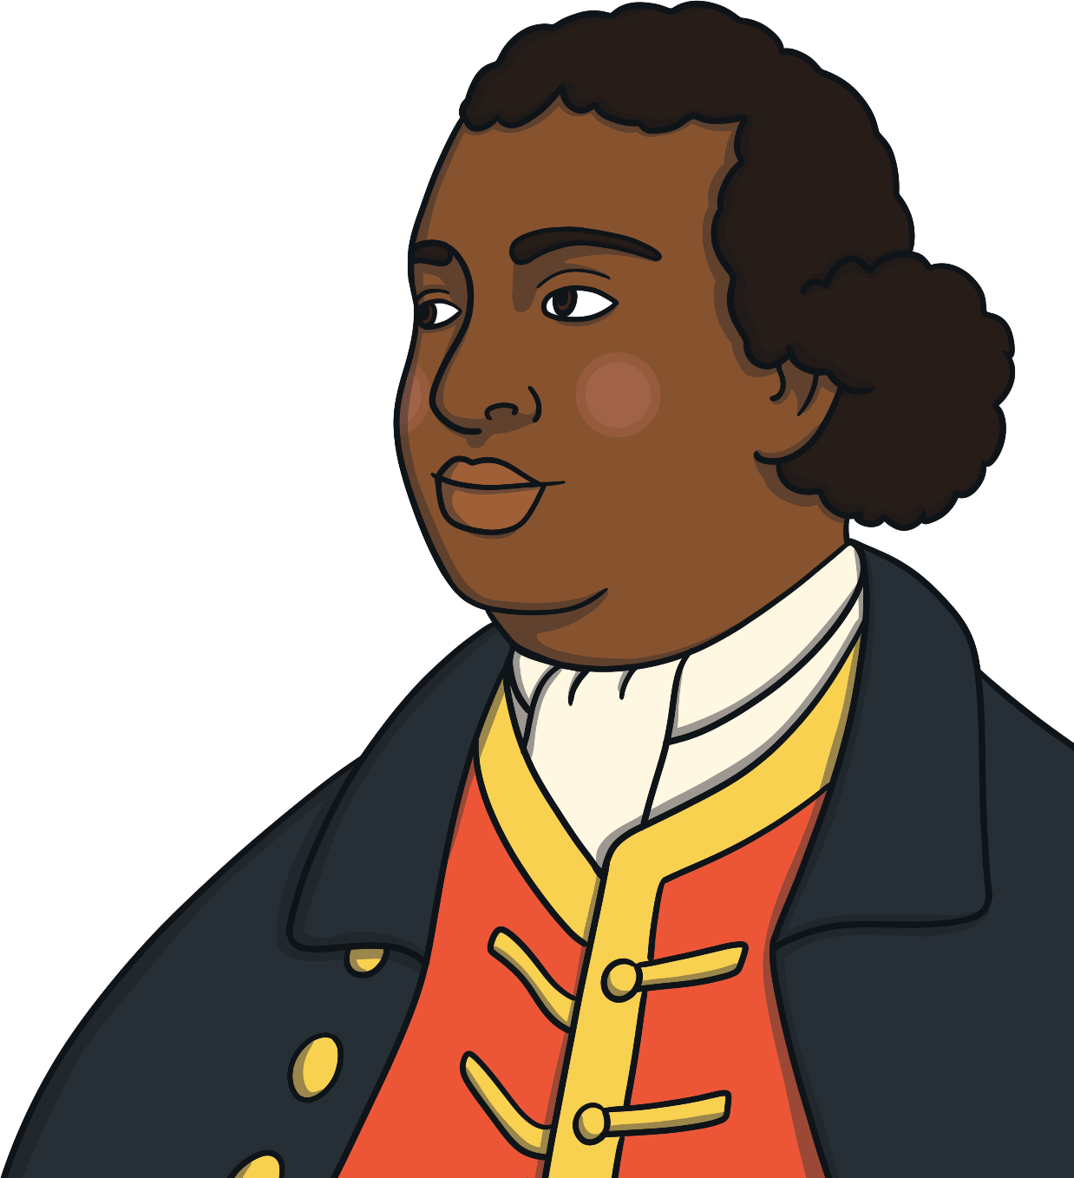
1774
Ignatius Sancho becomes the first Black person to vote in a British election.
Ignatius Sancho was born in around 1729 on a ship carrying enslaved people to the Caribbean. His parents died when he was very young and he was sent to London and forced to work as an enslaved person.
Eventually, Ignatius was freed. He opened a shop in London which became a popular place for people to meet. Ignatius wrote letters to newspapers telling people how difficult his life in enslavement was and saying that all people should be free.
“Title of Image Used” by [Author] is licensed under CC BY 2.0

Slide 6
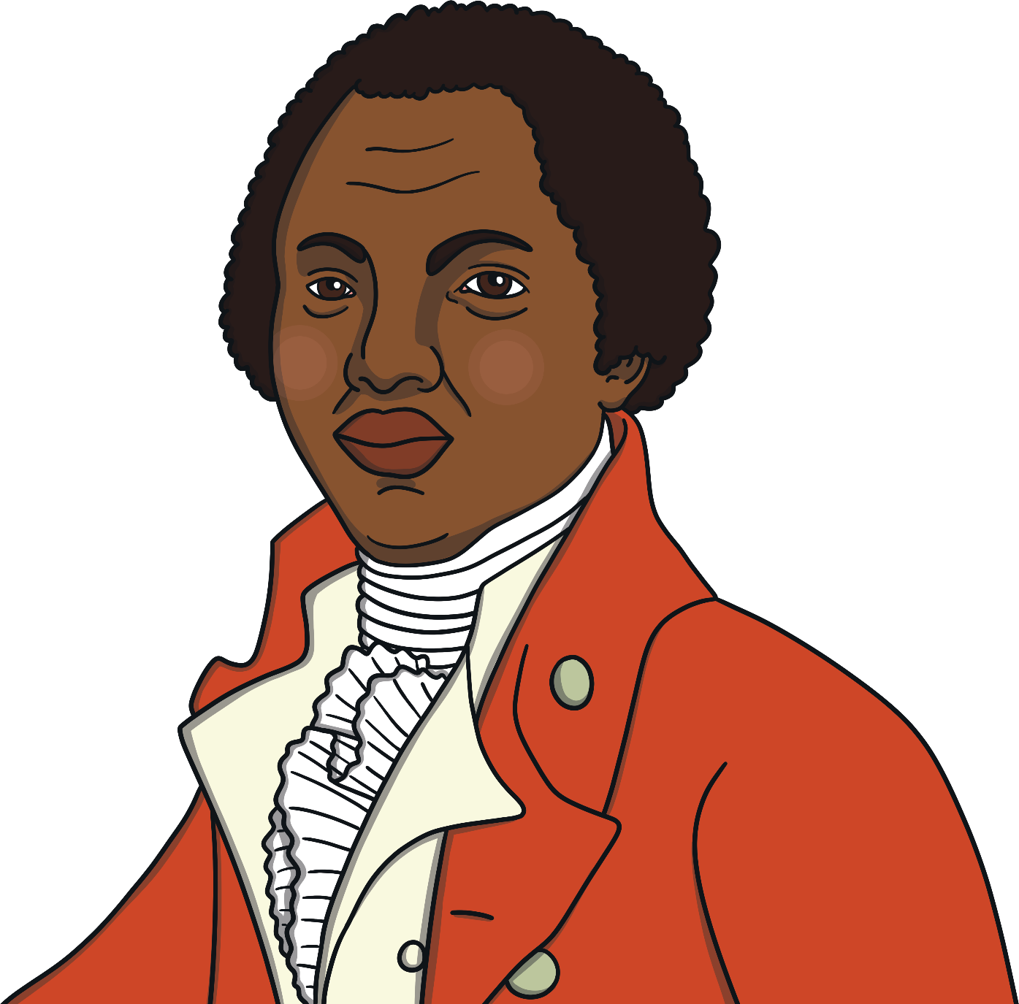
1789
Olaudah Equiano publishes a book about his life. It is one of the first books to be published by a Black writer.
Olaudah Equiano was born around 1745. He was kidnapped and forced into enslavement. Eventually, Olaudah earned his freedom. Sadly, this wasn’t possible for most enslaved people.
Olaudah lived in London. He became part of a group who wanted to end enslavement. His book explained how bad life was for enslaved people and why they should be freed.
“Title of Image Used” by [Author] is licensed under CC BY 2.0

Slide 7
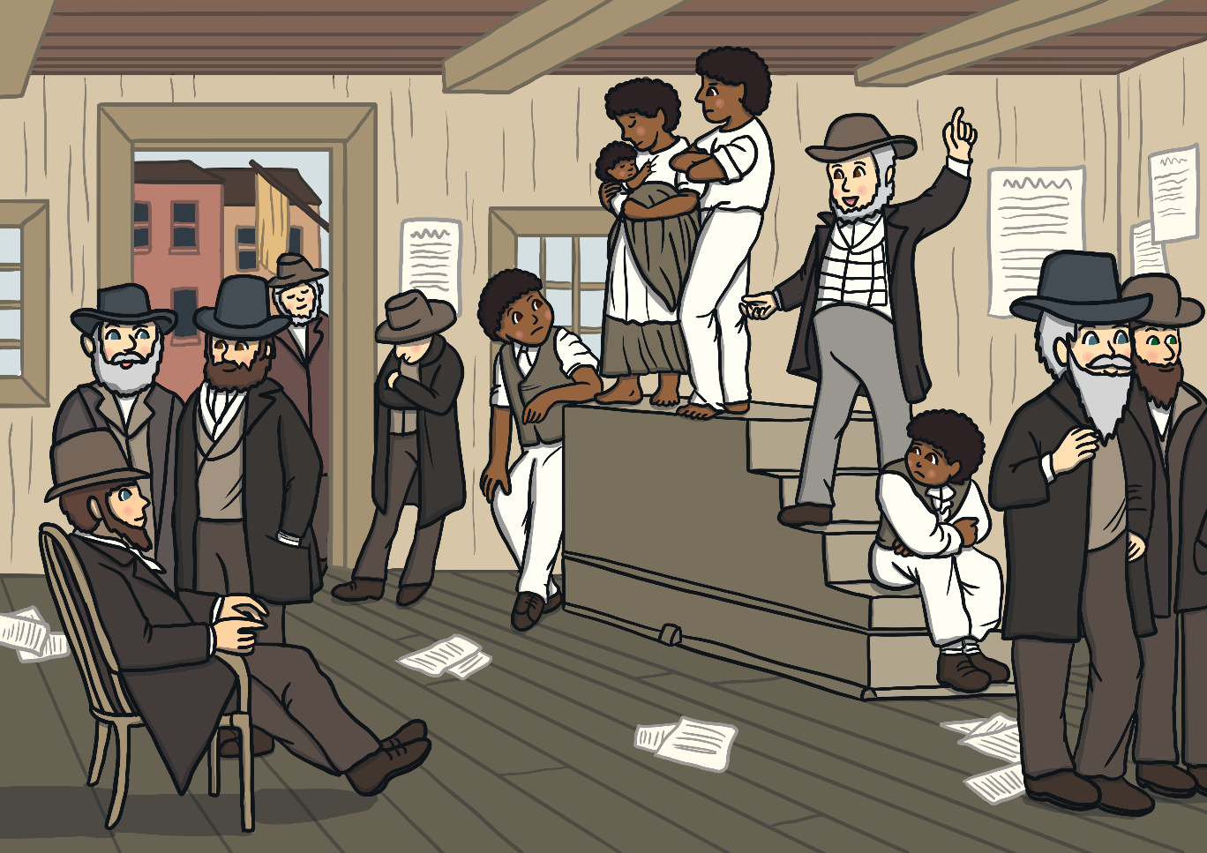
1807
The buying and selling of enslaved people is abolished. Sadly, enslaved people are still not free and are still forced to work in bad conditions for no money.
abolished – Ended.
“Title of Image Used” by [Author] is licensed under CC BY 2.0

Slide 8
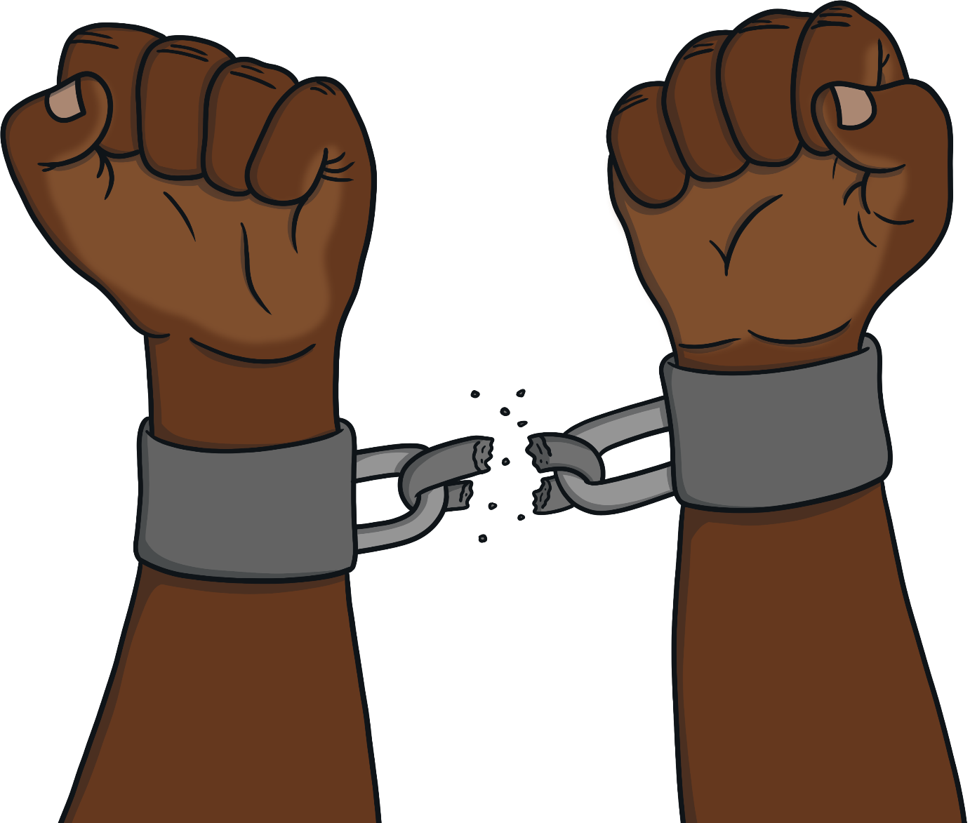
1834
Enslaved people in Britain are freed.
They still have to work for the people who have enslaved them for another four years for very little money.
“Title of Image Used” by [Author] is licensed under CC BY 2.0

Slide 9
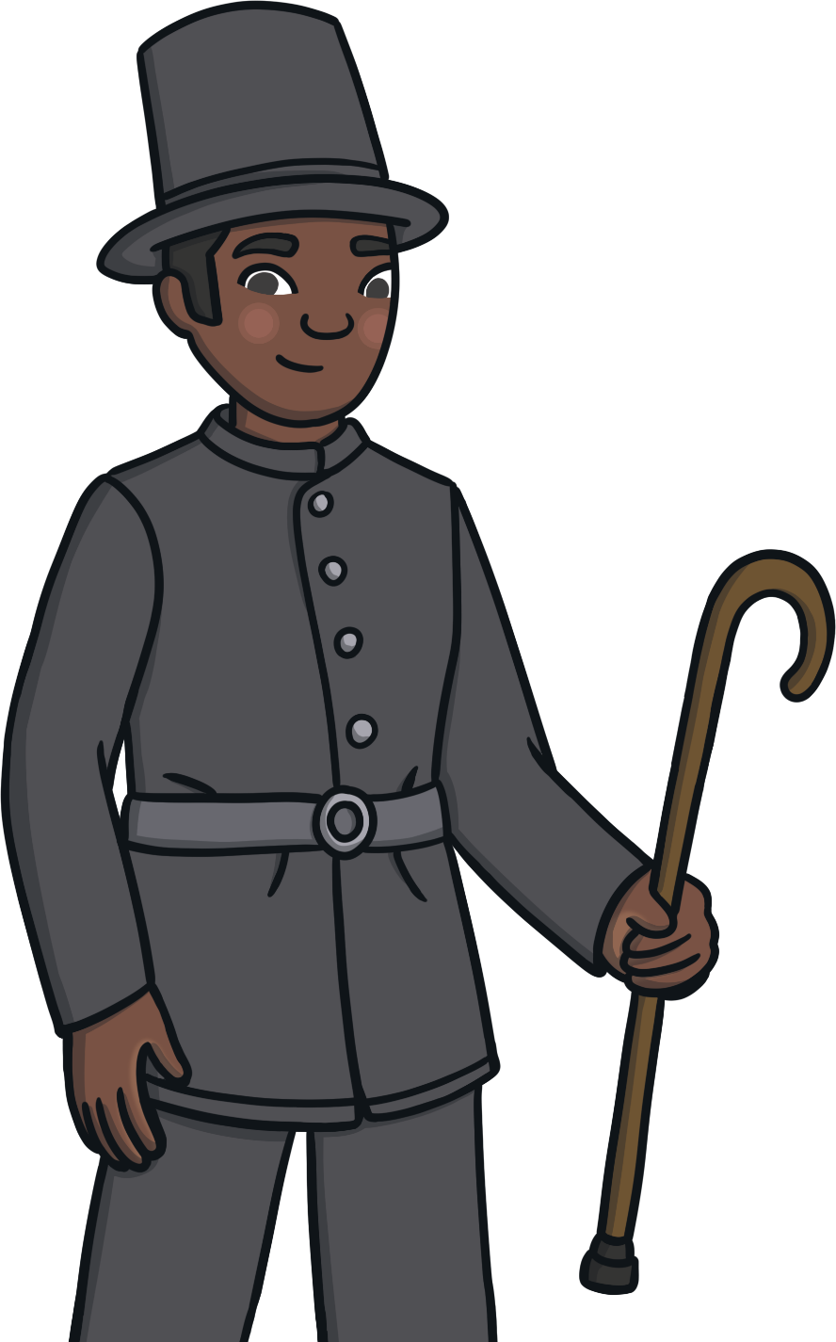
1835
John Kent becomes the first Black police officer in Britain.
John’s dad had lived in enslavement. John did many great things while serving as a police officer including saving someone from drowning, fighting off a man who was attacking him with a knife and rescuing another police officer who was being attacked.
“Title of Image Used” by [Author] is licensed under CC BY 2.0

Slide 10
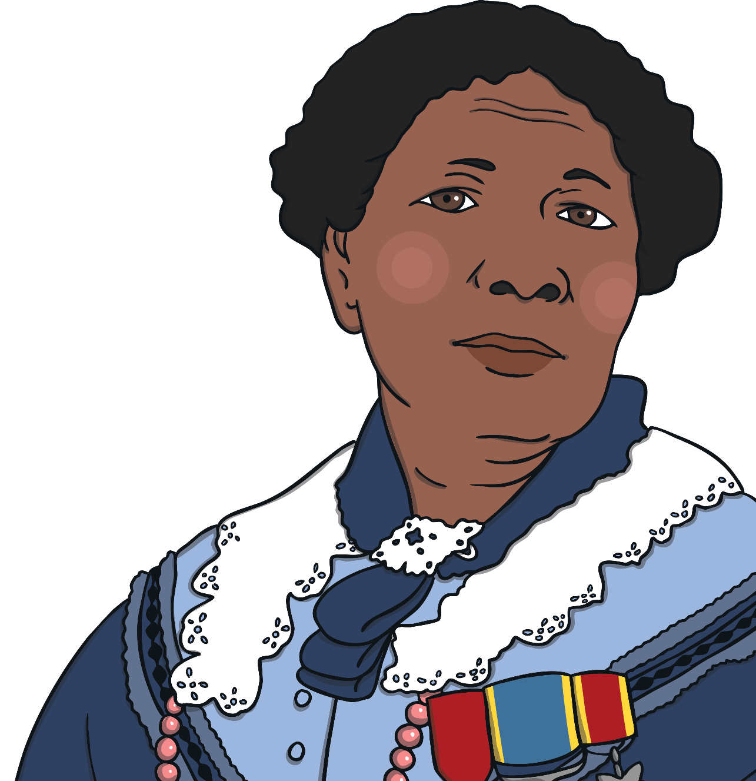
1855
Mary Seacole travels to the Crimea to care for wounded soldiers.
Mary Seacole was a nurse who was born in Jamaica in 1805. In 1854, she travelled to Britain. Mary asked the government to send her to the Crimea where a war was being fought so she could look after soldiers who had been hurt. The government said no. Mary used her own money to travel to the Crimea and opened a hospital for soldiers. She also visited battlefields to help nurse wounded soldiers. Mary became known as ‘Mother Seacole’. After the war, Mary returned to Britain.
“Title of Image Used” by [Author] is licensed under CC BY 2.0

Slide 11
1901
The skeleton of a Black woman is found in York.
Experts believe the woman lived there in the 4th century. She becomes known as the Ivory Bangle Lady because of the jewellery she was buried with. The jewellery suggests she was from a rich family.
“Title of Image Used” by [Author] is licensed under CC BY 2.0

Slide 12
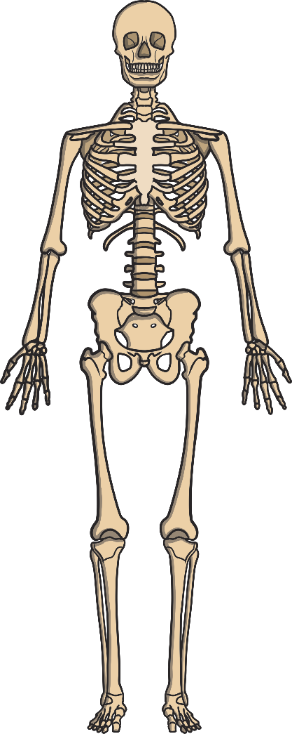
1903
The skeleton of a person who lived in Britain 10,000 years ago is found in Cheddar Gorge in Somerset.
He was given the nickname Cheddar Man and is thought to have had dark skin and hair. Scientists think that other people who lived in the area may also have had a similar skin and hair colour.
“Title of Image Used” by [Author] is licensed under CC BY 2.0

Slide 13
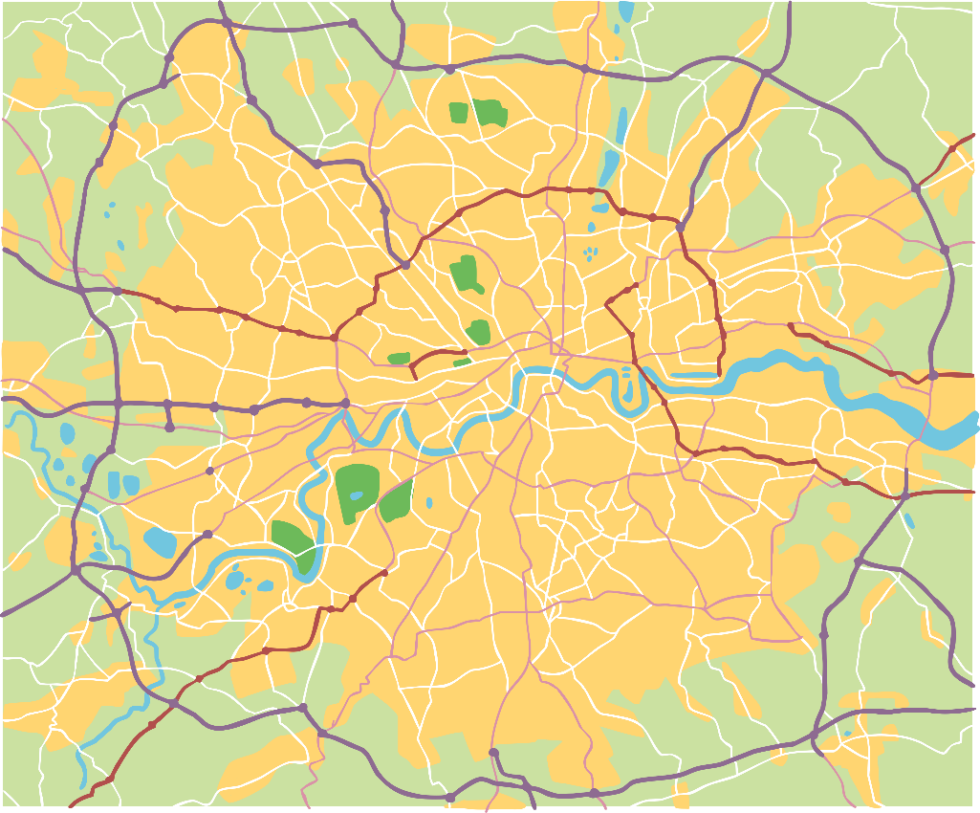
1913
John Archer becomes the first Black mayor in London when he is voted as the Mayor of Battersea.
He won by just one vote.
London
“Title of Image Used” by [Author] is licensed under CC BY 2.0

Slide 14
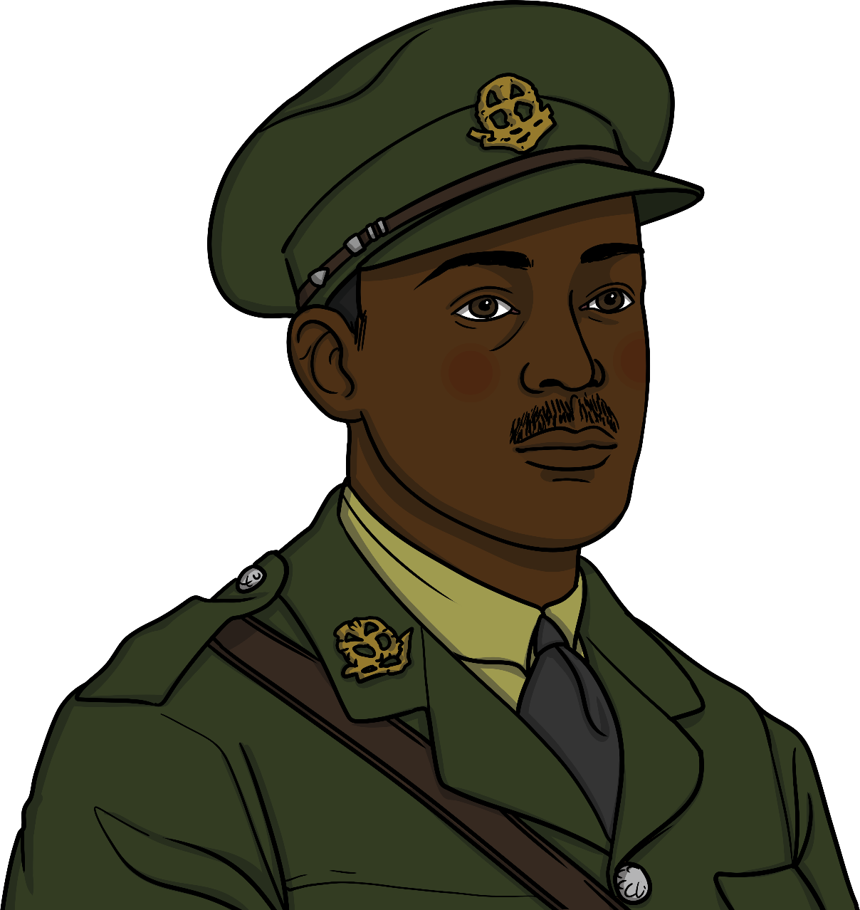
1917
Walter Tull becomes the first Black Officer in the British Army.
Walter was born in Kent. He was a football player for Tottenham Hotspur and Northampton. When the First World War started in 1914, he joined the army to fight for Britain.
Walter started his training to become an officer in 1916. At the time, there was a rule that only White soldiers, who were born in Britain, could become an officer.
Walter was the first Black soldier to be allowed to carry on with his training. He was a brilliant leader and led his men bravely.
“Title of Image Used” by [Author] is licensed under CC BY 2.0

Slide 15
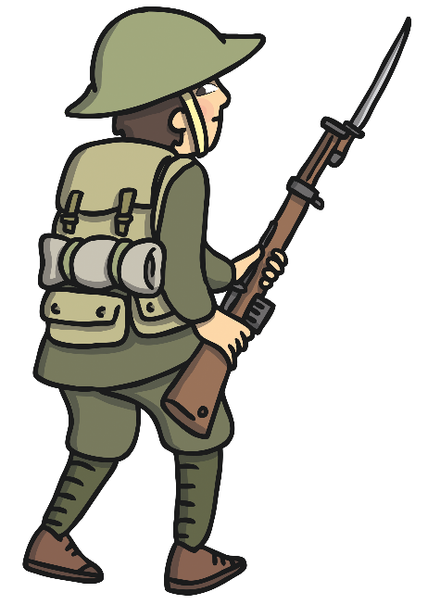
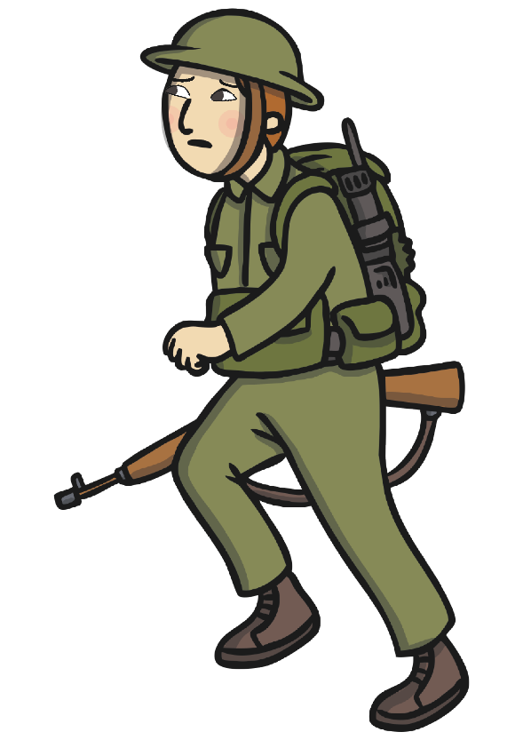
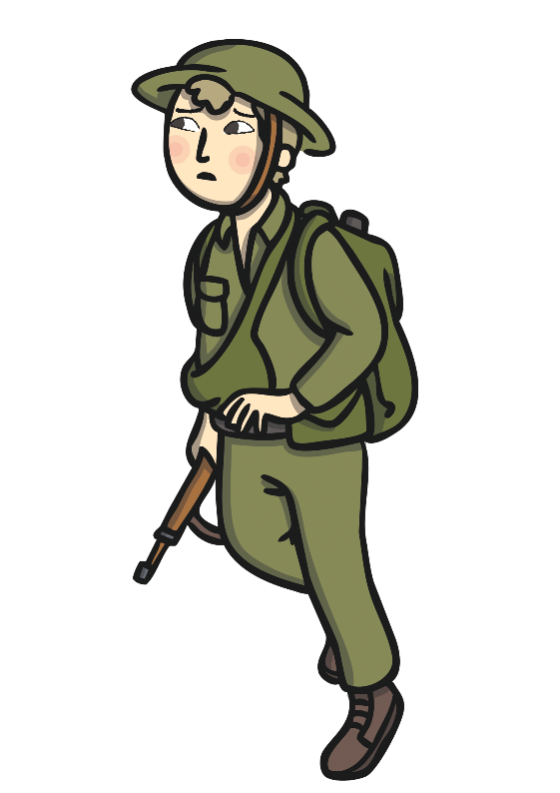
1939-1945
Over 10,000 people from the Caribbean volunteered to fight for Britain in the Second World War.
“Title of Image Used” by [Author] is licensed under CC BY 2.0

Slide 16
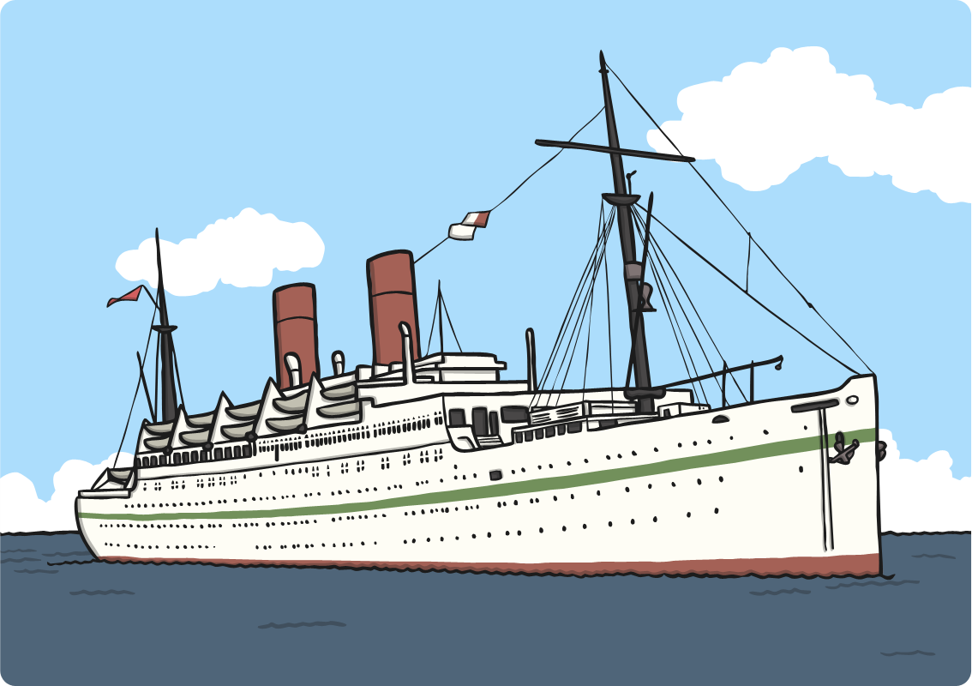
1948
On 21st June 1948, The Empire Windrush docks in Britain.
There were hundreds of people from the Caribbean onboard the ship. The British government had asked them to come to Britain and help to rebuild the country after the Second World War.
Thousands of others from the Caribbean also travelled to Britain. These people are sometimes known as the Windrush Generation. They worked in hospitals, in mines, on farms or as electricians and plumbers. When they arrived, they were often treated unfairly and couldn’t find places to live.
“Title of Image Used” by [Author] is licensed under CC BY 2.0

Slide 17
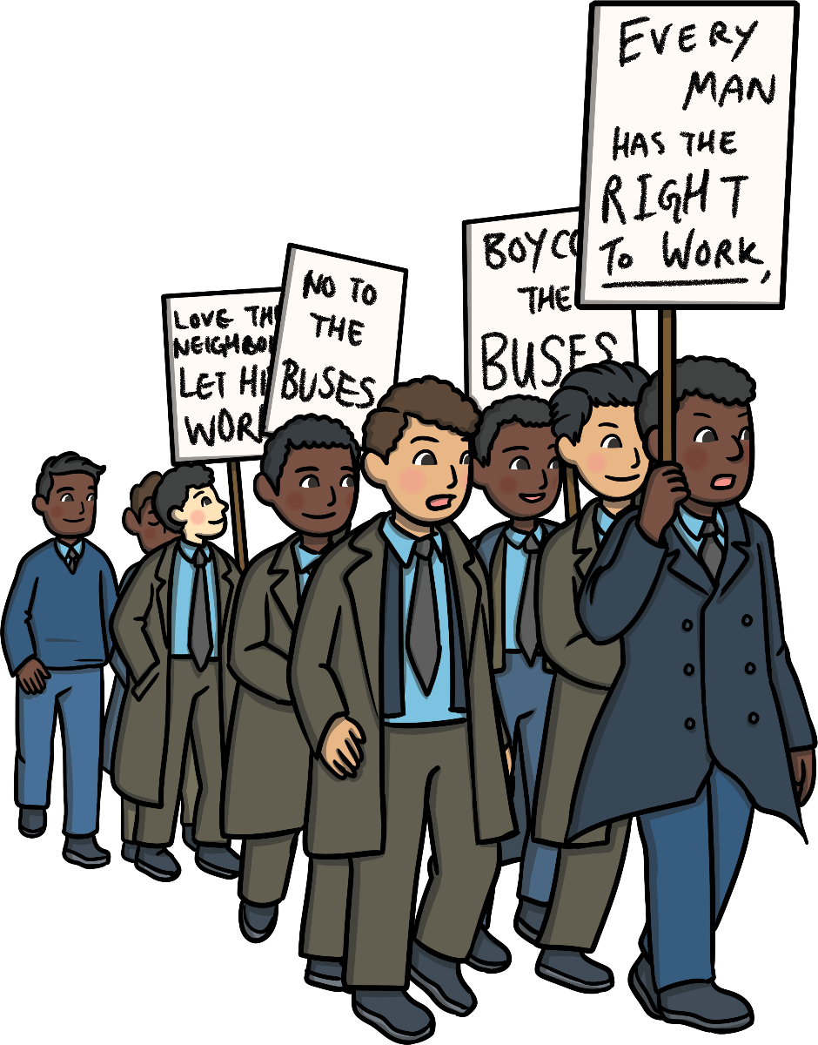
1963
The Bristol Bus Boycott begins.
A bus company in Bristol would not let Black people work for them so a group of people decided to organise the Bristol Bus Boycott. A boycott is when people refuse to use something. For four months, many people refused to travel on the buses. In the end, the company decided to start giving jobs to Black people.
“Title of Image Used” by [Author] is licensed under CC BY 2.0

Slide 18
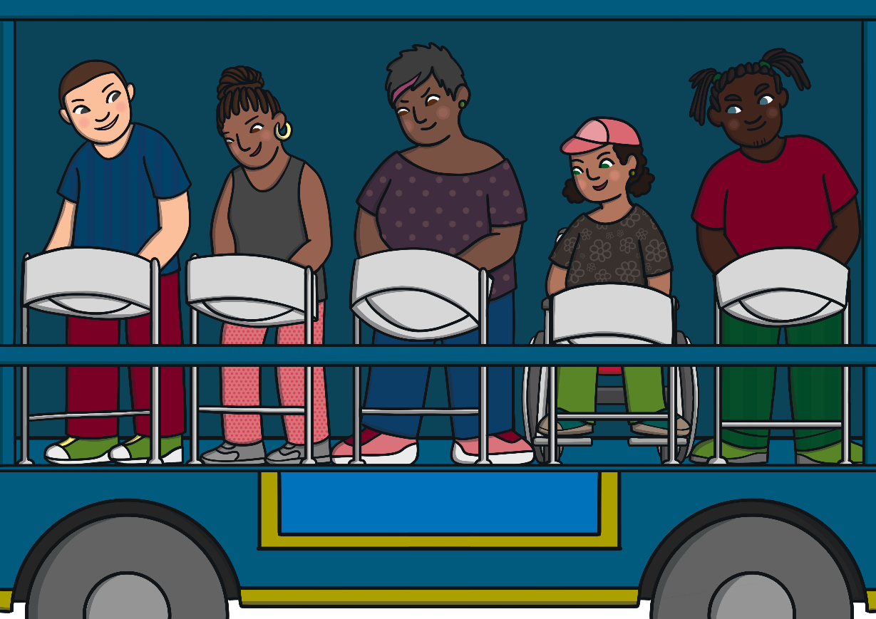
1966
The first Notting Hill Carnival is held.
This was a combination of festivals started by Claudia Jones and Rhaune Laslett. They wanted to bring communities together and celebrate different cultures. The carnival consists of music, dancing, food and street parades and is one of the biggest carnivals in the world.
“Title of Image Used” by [Author] is licensed under CC BY 2.0

Slide 19
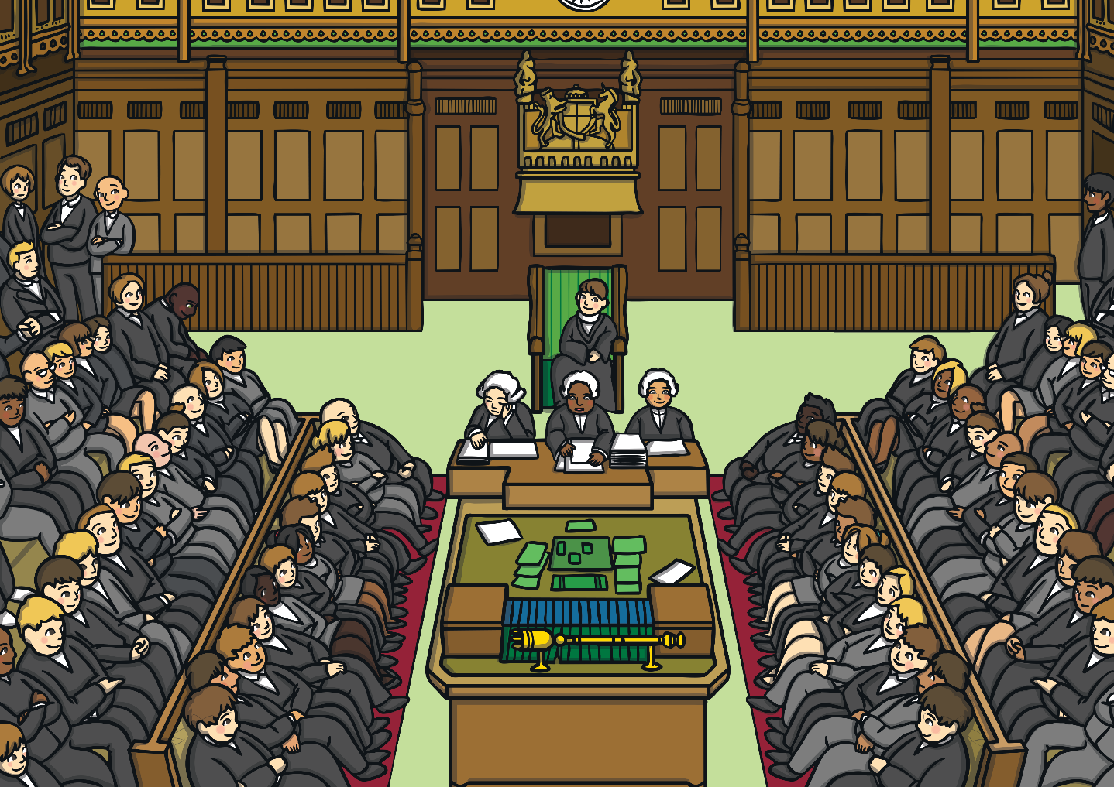
1987
Bernie Grant, Diane Abbott and Paul Boateng become the first Black MPs.
“Title of Image Used” by [Author] is licensed under CC BY 2.0

Slide 20
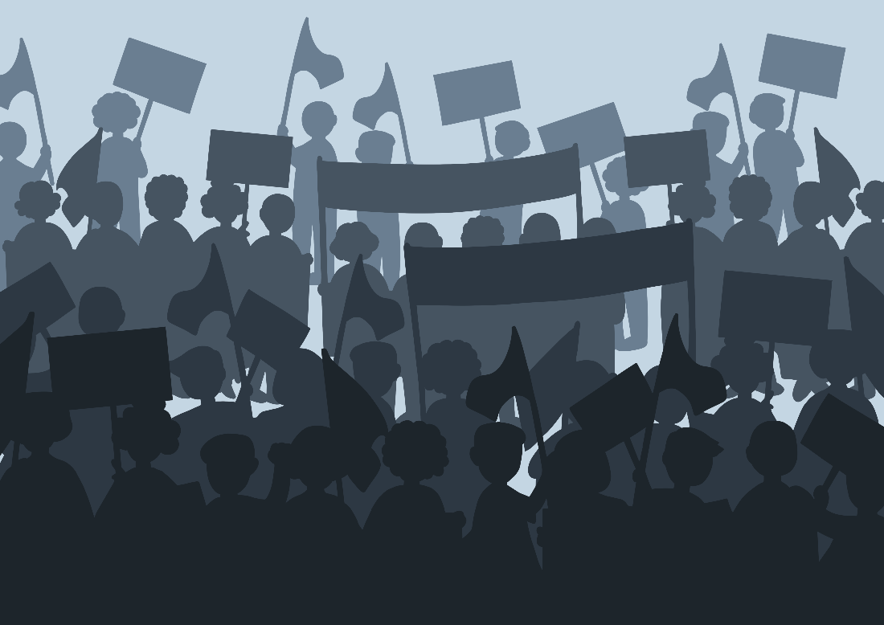
2020
Thousands of people march through the streets after the death of George Floyd in the USA.
They carried signs asking for racism to stop and for everyone to be treated equally.
“Title of Image Used” by [Author] is licensed under CC BY 2.0

Slide 21
“Title of Image Used” by [Author] is licensed under CC BY 2.0

