Slide 1
Wow Assembly:
Friday 1st April

Slide 2
Phrase of the Week:

Slide 3
Green Cards!
Finley – Elm
Alfie – Elm
Duke – Elm
Alaina – Elm
Ronnie- Elm
Codi-Lee –Elm
Austin-Elm
Toby - Elm
Aspen-Anaya
Aspen-Violet

Slide 4
Scientists of the Week!
Oak –Casper
Ash – Parker
Birch – Felicity
Pine – Freddie.S
Elm – Jaeden
Willow – Riley WP
Spruce – Ava
Maple – Brandon
Redwood – Charley W
Chestnut – Amelia B
Aspen-Sophia E

Slide 5
Weekly Team Points!
Peel | Ethelfleda | Grazier | Offa
154 | 176 | 172 | 158

Slide 6
Oak
Maisie
For
Writing super instructions to help Humpty Dumpty get changed for PE.
Mrs Laffan 01.04.22

Slide 7
Ash
Halle
For confidently creating number bonds to 10.
Miss Bailey and Mrs Salt 01.04.22

Slide 8
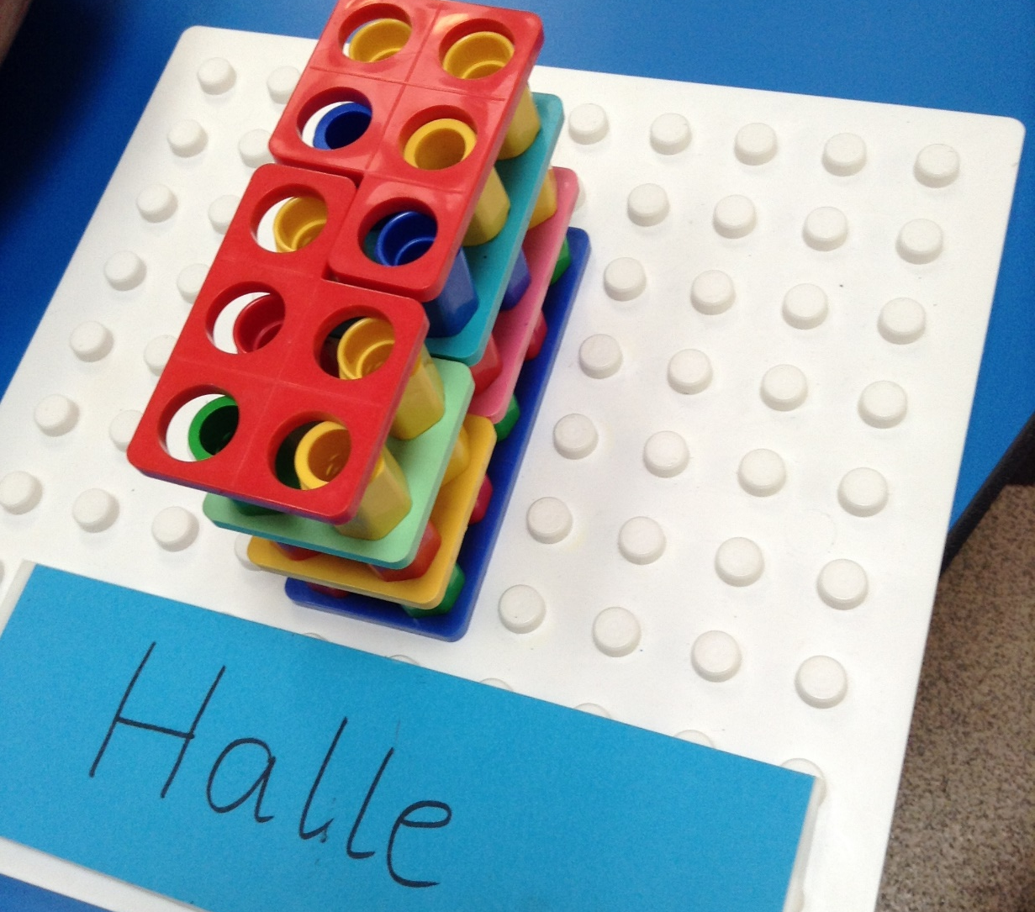
Ash Wow Work

Slide 9
Elm
Esme
For showing passion when reading within Guided Reading. Esme always puts great effort into all of her tasks and takes great pleasure in reading a book within the classroom!
Well Done Esme. ☺
Mr Grice 01.04.2022

Slide 10
Birch
For
Emily
Emily has worked so hard to improve the quality and quantity of her writing. I’m so proud of you Emily! Well done! ☺
Miss Hewitt 01.04.22

Slide 11
Pine
Nikola
For using excellence to improve handwriting and fine motor skills. Well done ☺
Mrs Leedham-Hawkes 01.04.22

Slide 12
Maple
Lennon
For showing resilience and perseverance when learning about fractions and decimals. Well done Lennon.
Miss Dawson 01.04.2022

Slide 13
Willow
Kacey
For her super work in maths and showing her understanding when reasoning about decimals.
Miss Fisher 01.04.2022

Slide 14
Spruce
Iyla
Iyla always pushes herself to be the best she can be, and is a role model to everyone in Spruce. She works hard, and shows both passion and pride in her work. Keep up the hard work, Iyla!
Mr Draper 01.04.22

Slide 15
Spruce Wow Work

Slide 16
Chestnut
Cody
For displaying a good attitude towards his assessments this week and proved how well he can achieve when he puts his mind to the task set.
Well Done!
Mr Tennuci 1.4.22

Slide 17
Aspen
Jake
For showing great respect and attitude towards his learning/peers this week.
Miss Bennett & Mrs Read 01.04.2022

Slide 18
Redwood
Everyone!
For showing amazing resilience, empathy and commitment to learning through this week. Thank you to you all for treating each other with respect and kindness
Miss Shipley 01.04.22

Slide 19
Next Week’s
Phrase of the Week:
!

