Slide 1
Wow Assembly:
Friday 1st October

Slide 2
Green Cards!
Zac B - - Chestnut
Amelia M - Chestnut
Reilly T - Chestnut
Jayden H-H – Chestnut
Molly R. – Chestnut
Wiki W. - Chestnut

Slide 3
Scientists of the Week!
Birch – Eli
Pine – Callum
Elm – Thomas
Willow – Kacey
Spruce – Ava
Maple – Ellie
Redwood – Lily-Rose B
Chestnut – Liam Hands
Aspen- Kacper

Slide 4
Weekly Team Points!
Peel | Ethelfleda | Grazier | Offa
30 | 34 | 48 | 20

Slide 5
Oak
Ella-Rose
For
Ella-Rose used her resilience super power to carefully cut out a tiger and attach a tail using a split pin.
Mrs Laffan 01/10/21

Slide 6
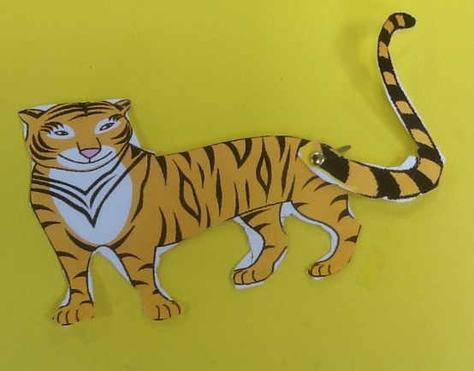
Oak Wow Work

Slide 7
Ash
Isabelle
For
Isabelle was able to explain to her group ways that we could sort the items in the home corner.
Miss Bailey Mrs Salt 1.10.21

Slide 8
Elm
Jimmy
For displaying excellent expression and engagement during the role play of a scene from ‘Eric the Lion Tamer’. Jimmy used his voice and actions to produce a convincing and dramatic performance. Excellent acting Jimmy, Keep up your hard work!
Mr Grice 01.10.2021

Slide 9
Birch
For
Lilly
Lilly has shown perseverance and resilience when completing her home learning. She has listened to feedback and is trying hard to get her reading, spellings and timetables practice done. Well done! Very proud of you! Keep it up ☺
Miss Hewitt 01.10.21

Slide 10
Pine
Freddie. S
For using passion and excellence in his learning. Since starting year 2 I have noticed Freddie’s amazing attitude to learning and I am so proud. Keep it up!
Mrs Leedham-Hawkes 1.10.21

Slide 11
Maple
Jack
For an amazing effort in maths this week. Jack has been rounding 3 and 4 digit numbers to the nearest 10, 100 and 1000.
Well done Jack.
Miss Dawson 01.10.2021

Slide 12
Willow
Evie
For wonderful work in maths. You are working really hard and persevering with challenges. Keep up the great work.
Miss Fisher 1.10.21

Slide 13
Spruce
Tobias
The behaviours for learning you have shown this week have been exemplary, especially in Maths and English. Keep up the hard work!
Mr Draper 01.10.21

Slide 14
Chestnut
Aimee and Mimi
For
showing excellent resilience and perseverance with their maths this week. They both overcame their difficulties and their positive responses to developing their understanding was fantastic to see. Well done girls!
Mr Tennuci 1.10.21

Slide 15
Aspen
Alfie
For
Always having an amazing attitude towards his learning and being an excellent role model for others!
Mrs Read & Mrs Cox 01.10.21

Slide 16
Redwood
Ellie-Mae E
For always demonstrating resilience and passion in her learning. Ellie has really impressed me with her English and Guided Reading understanding this week
Miss Shipley 01.10.21

Slide 17
Next Week’s
Phrase of the Week:

