Slide 1
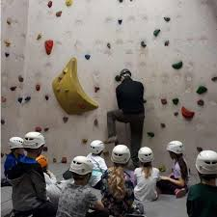
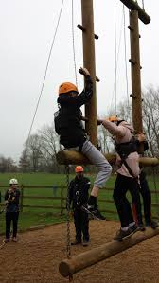

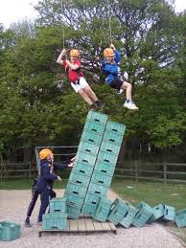
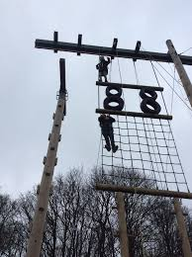

Year 5 Sleep Over 2025
and
Laches Wood 2026

Slide 2

Year 5 Sleep Over will be the evening and night of Thursday 11th June 2025.
The children will sleep over one night in school, giving the children a taste of staying away from home in preparation for the Year 6 residential next year.

Slide 3
How it works on the day.
The children will go home on Thursday 11th June as usual from school.
After tea at home, they will return to school from 6pm to set up their beds (with parent assistance).
At 7pm, the children will be left in the care of the Woodlands team.
The children will take part in outdoor activities, campfire, hot chocolate and then bed. Boys and girls will be in separate classrooms.

Slide 4
On the Friday, the children will have breakfast in the hall before Breakfast Club.
They will then join in WOLF day and other activities.
Friday will be normal school times and the children and bedding etc can be collected at 3.15pm.
In order to give the children an enjoyable experience and a variety of activities during the camp over, we are asking for £10 payment.

Slide 5
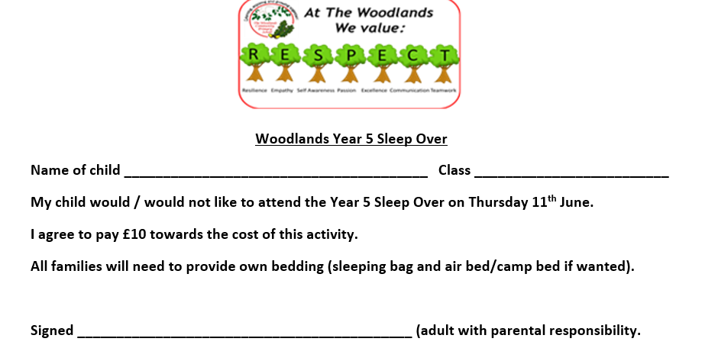

Slide 6
Laches Wood 2026

Slide 7
Our Year 6 residential trip to Laches Wood will be
Wednesday 16th – Friday 18th September 2026
The cost of the trip is heavily subsidised by school and payments can be made over time as needed via ParentPay.
The accommodation, food, travel and activities will cost the school £190 per child.
The cost per child to families will be £130.

Slide 8
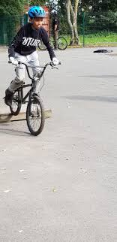



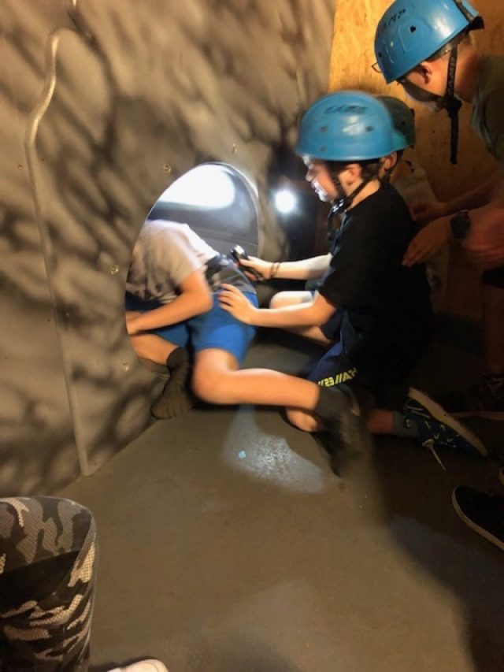
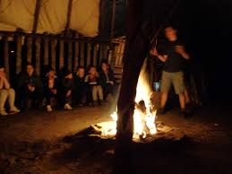
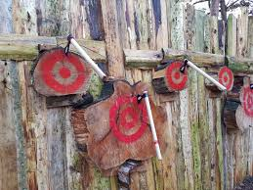
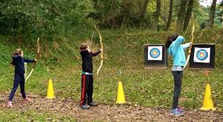
Some of the activities may include;
We will be advised closer to the time of our exact itinerary.

Slide 9
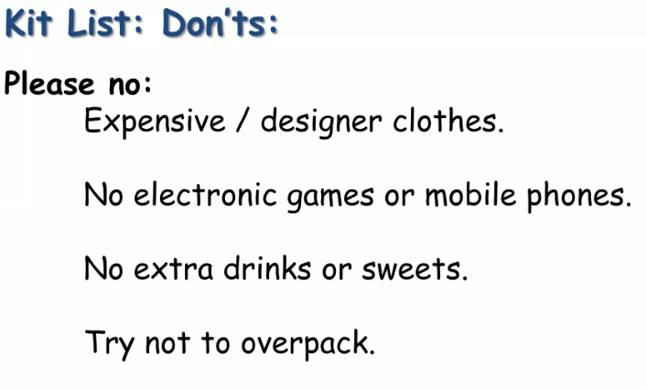
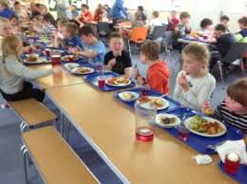
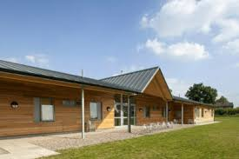
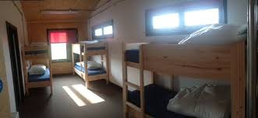
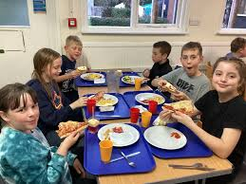
Other arrangements
What to take
Full kit list and detailed information will be sent to you as we get closer to the trip.
Dormitories
Food

Slide 10
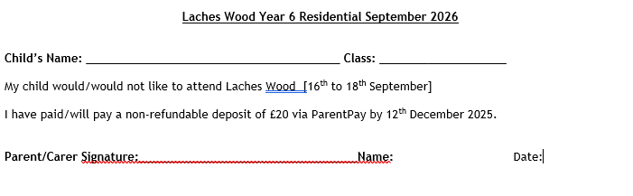
Please confirm your interest so that we can reserve numbers.

Slide 11


