Slide 1
Wow Assembly:
Friday 5th November

Slide 2
Phrase of the Week:
Success is the result of small efforts, repeated day in and day out.

Slide 3
Green Cards!
Layla – Elm
Phillip – Elm
Celia - Elm
Faal – Elm
Remey-Lei – Elm
Thomas – Elm
Eli-Birch

Slide 4
Scientists of the Week!
Oak – Maisie
Ash – Jaxon
Birch – Theo
Pine – Francesca
Elm – Charley
Willow – Roux
Spruce – Orla
Maple – Kai
Redwood – Ziva
Chestnut –
Aspen- Avie

Slide 5
Weekly Team Points!
Peel | Ethelfleda | Grazier | Offa
79 | 72 | 71 | 85

Slide 6
Oak
Lincoln
For
Selecting and using a range of materials to create a firework picture.
Mrs Laffan 05.11.21

Slide 7
Ash
Mia
For a beautiful and independent piece of firework art
Miss Bailey 05.11.21

Slide 8
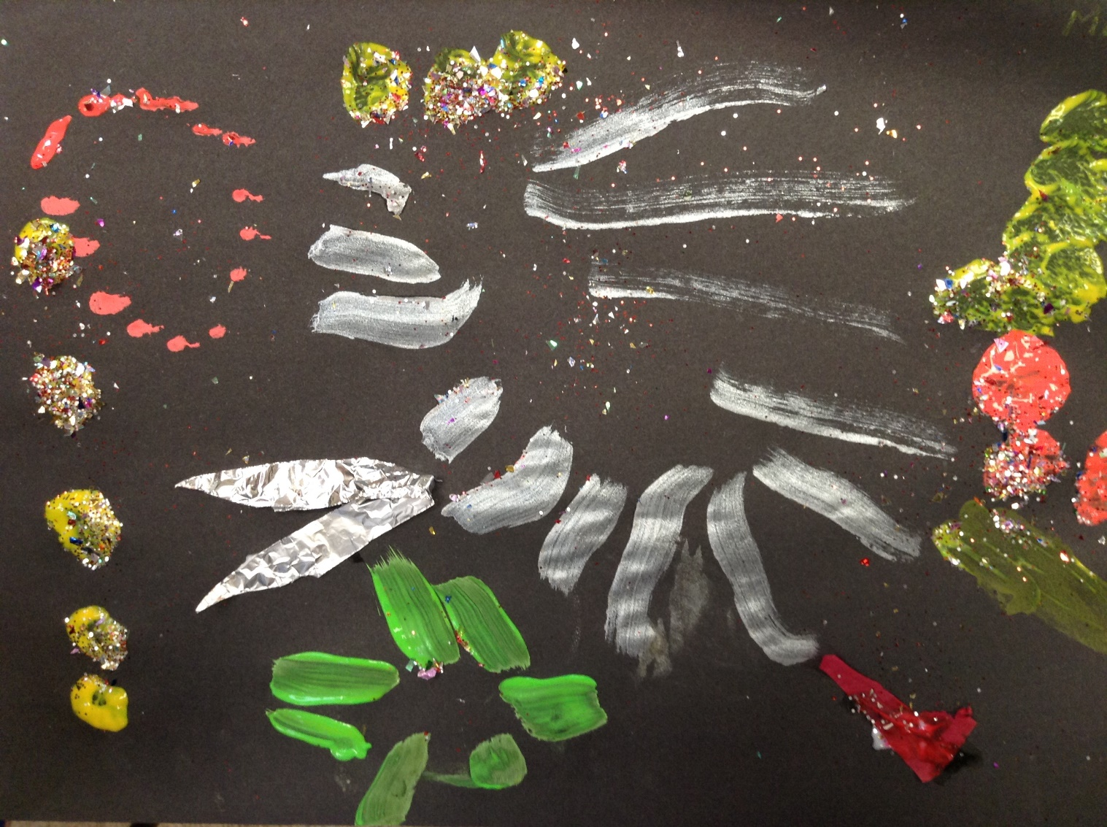
Ash Wow Work

Slide 9
Elm
Austin
For being resilient and putting in lots of effort within his work in science this week. Austin sorted classroom objects based upon their material they are made from. Austin tried especially hard to use his phonics to help spell the word ‘trousers’. Well Done Austin! ☺
Mr Grice 05.11.2021

Slide 10
Birch
Finley
Finley has been a super star in maths this week. He has challenged himself to add multiples of one crossing ten and can use reasoning to explain his answers. Well done Fin! ☺
Miss Hewitt 05.11.21

Slide 11
Pine
Callum
For using passion and excellence in completing extra maths homework as well as his homework book. So proud of your work ethic! Keep it up!
Mrs Leedham-Hawkes 5.11.21

Slide 12
Maple
David
For using scientific vocabulary to explain the results from an investigation.
Miss Dawson 05.11.2021

Slide 13
Willow
Oscar W
For his fantastic understanding about our new topics and being able to talk about how they link together. Oscar has asked lots of questions to extend his learning.
Miss Fisher 05.11.21

Slide 14
Spruce
Harley W
For brilliant work in Maths when using exchanging in column addition and column subtraction.
Mr Draper 05.11.21

Slide 15
Chestnut
Grace
For
Always showing a determination to persevere with her work. She won’t complain or let something defeat her. She will always try work through her difficulties and this is especially true of her maths this week.
Well done!
Mr Tennuci 5.11.21

Slide 16
Aspen
Jake
For working incredibly hard on his presentation, showing a commitment to his learning.
Mrs Read & Mrs Cox 05.11.21

Slide 17
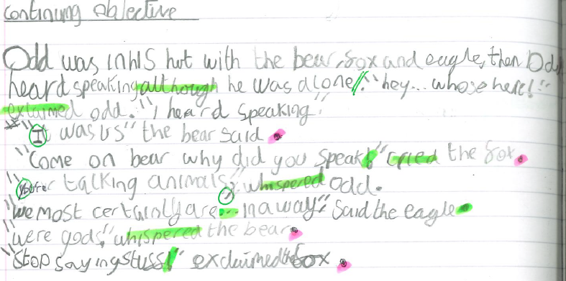
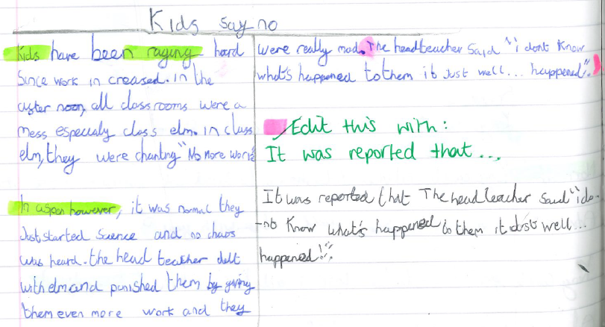
Aspen Wow Work
September
November

Slide 18
Redwood
Joe W
For showing passion in History as we begin learning about WWII. Joe has shared some amazing facts and interesting stories with us
Miss Shipley 05.11.21

Slide 20
Next Week’s
Phrase of the Week:
Do what is right, not what is easy.

