Slide 1



Wow Assembly:
Friday 18th March

Slide 2
Green Cards!
Ash – George
Aspen – Annalia
Aspen – Dylan
Redwood – Ellie
Redwood – Ruby
Pine – Harriet
Elm - Faal

Slide 3

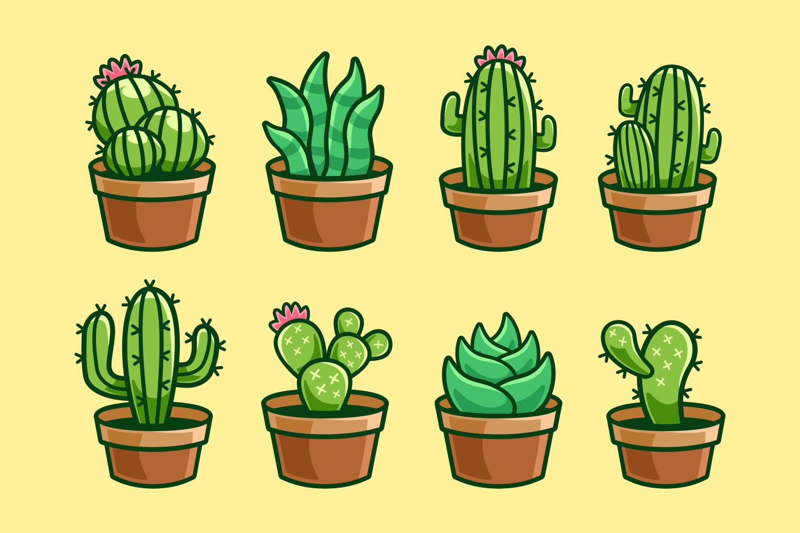


Slide 4
Scientists of the Week!
Oak –Olivia
Ash – Jaxon
Birch – Callum
Pine – Daniel
Elm – Ronnie
Willow – Ashley
Spruce – Cleo
Maple – Ollie
Redwood – Robbie
Chestnut – Amy R
Aspen- Amber

Slide 5
Weekly Team Points!
Peel | Ethelfleda | Grazier | Offa
476 | 503 | 458 | 446

Slide 6
Oak
Brody
For
Creating a lifecycle of a butterfly.
Mrs Scott 18.03.22

Slide 7
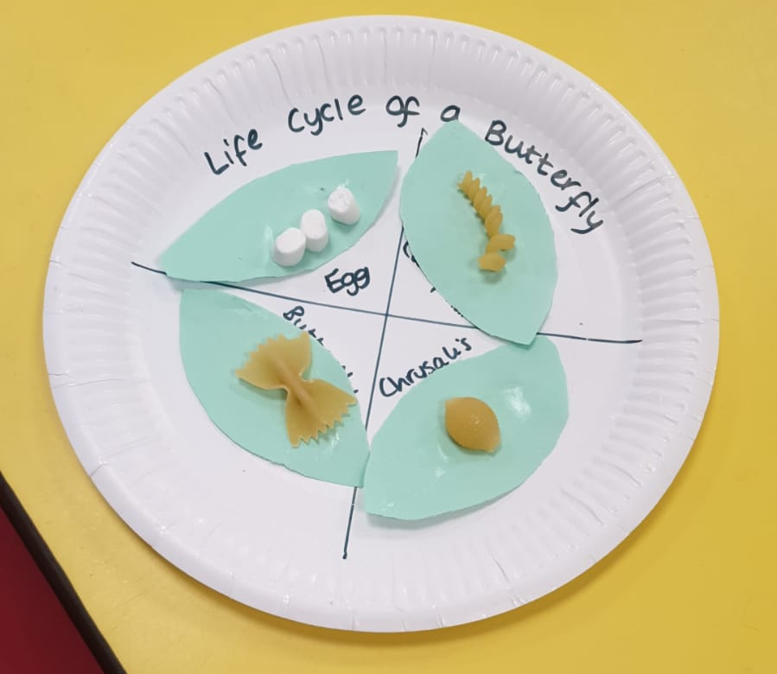
Oak Wow Work

Slide 8
Ash
Teddy
For super work explaining and labelling the lifecycle of a butterfly.
Miss Bailey and Mrs Salt 18.03.22

Slide 9
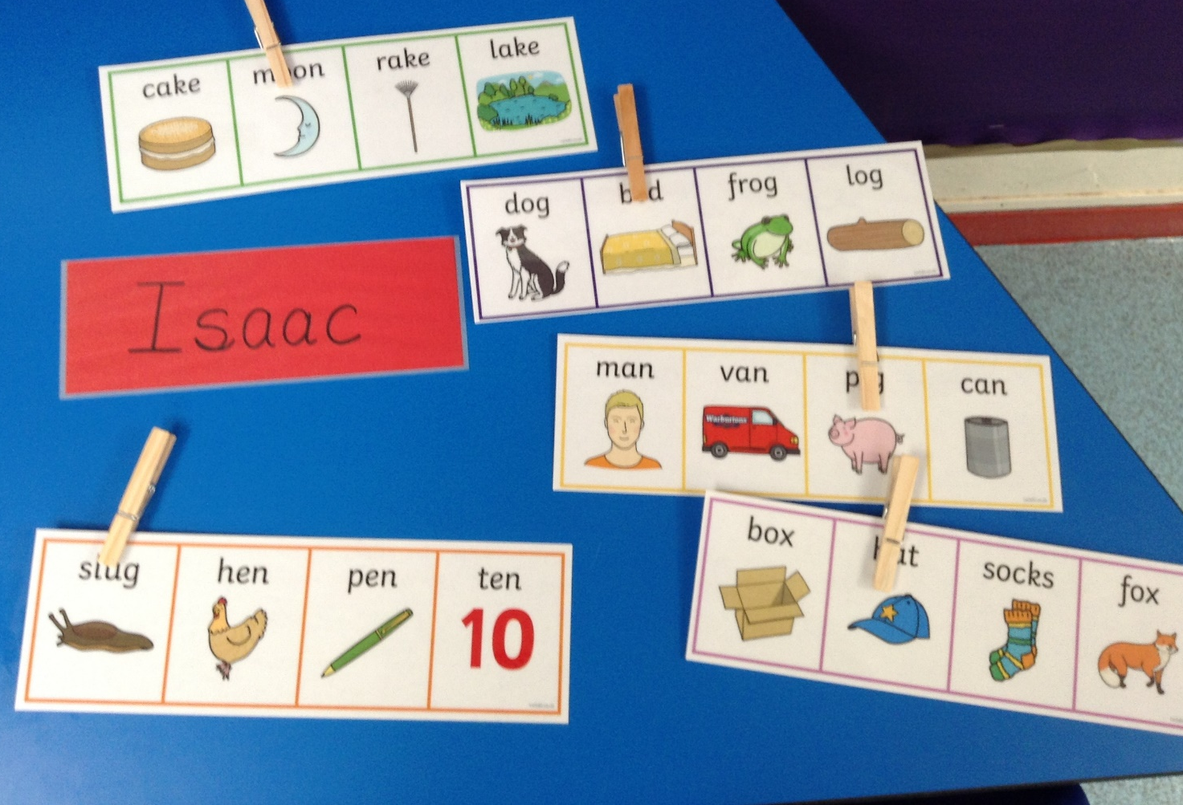
Ash Wow Work

Slide 10
Elm
Esme
For fantastic observation skills when looking everyday to see if her Cress and Bean’s have started to grow since our fun Science Day.
Great work Esme!
Mr Grice 18.03.2022

Slide 11
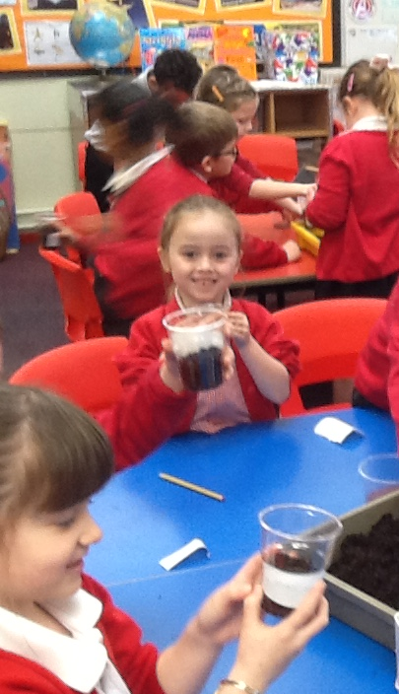

Slide 12
Birch
Nina T
During science day we explored the growth of plants. We conducted an investigation to see how plants grow in different conditions. We planted seeds and will be monitoring the growth of the seeds. Nina used excellent scientific language and was able to explain the needs of a plant.
Miss Hewitt 18.03.22

Slide 13
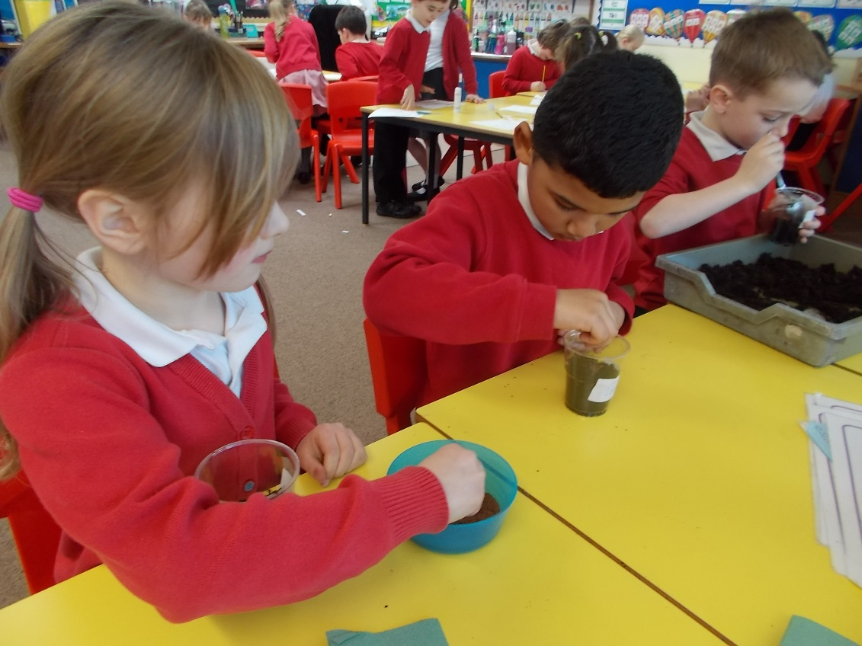
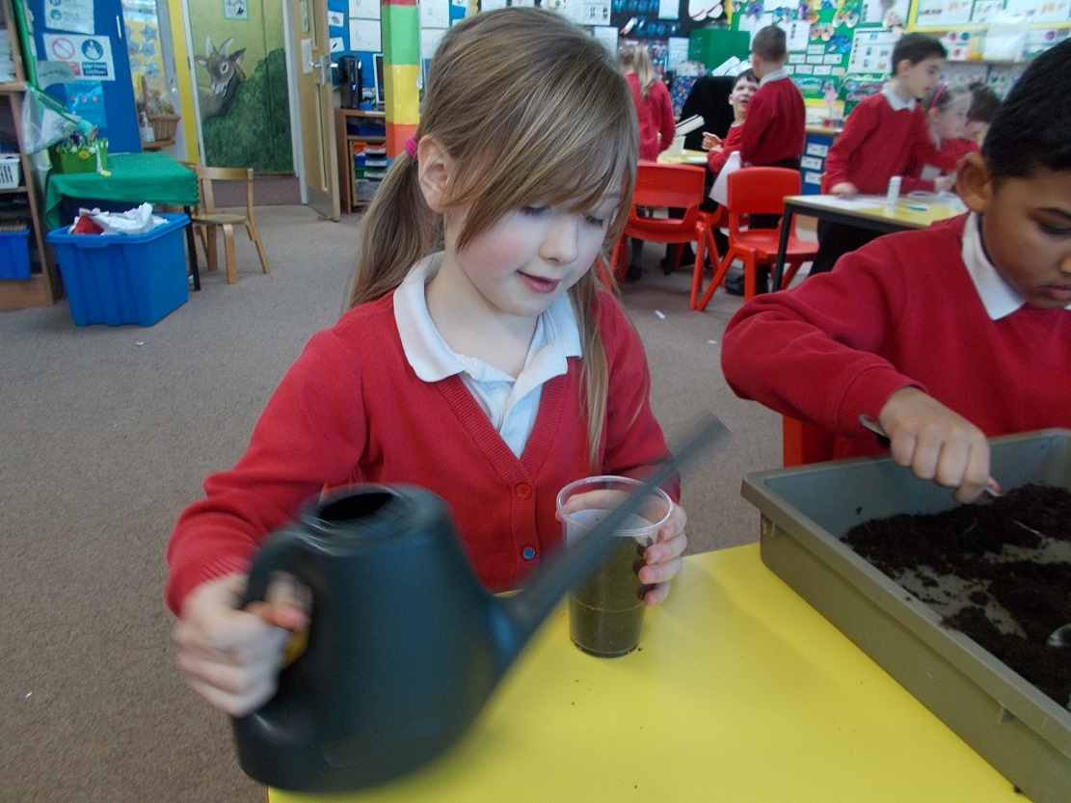

Slide 14
Pine
Francesca
For using excelling to follow instructions for planting a bean. Francesca has been watering her bean plant and observing it everyday. Well done ☺
Mrs Leedham-Hawkes 18.03.22

Slide 16
Maple
Finley
For fantastic measuring when exploring the height of shadows.
Miss Dawson 18.03.2022

Slide 17
Willow
Oscar
For showing passion and enthusiasm during Science Day.
Miss Fisher 18.03.22

Slide 18
Spruce
Oliver J
Oliver did a brilliant practical work all through science day. He found solutions to problems when making playdough and verbalised this well. He also measured shadows accurately.
Mr Draper 18.03.33

Slide 19
Chestnut
Amelia M
Amelia continued to make brilliant contributions to the investigations we carried out during the day along with making sensible predictions based on her own real life experiences.
Mr Tennuci 18.03.22

Slide 20
Aspen
Toriey
For excellent teamwork, investigating and recording observations on science day. Well done.
Mrs Read & Miss Bennett 17.03.22

Slide 21
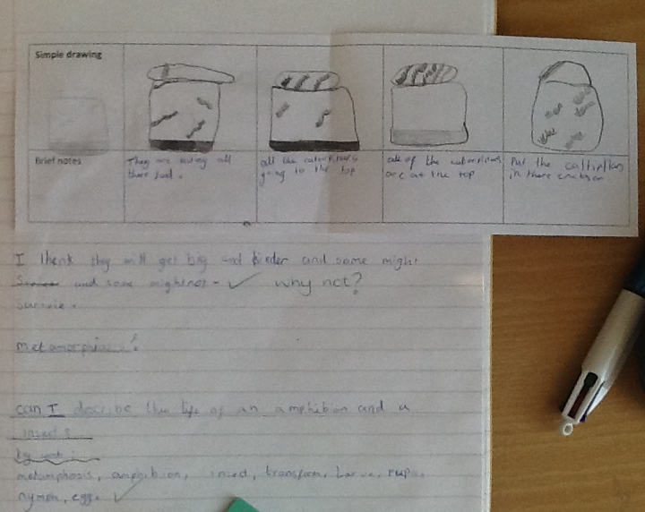


Slide 22
Redwood
Lily-Rose
For being an amazing investigator during the 5/6 Science Day; asking super questions, making careful observations and challenging herself to go the extra mile.
Miss Shipley 18.03.22

Slide 23
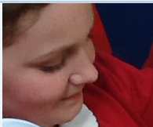

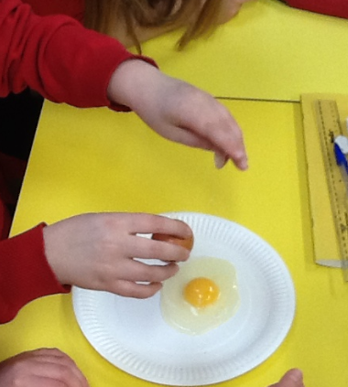
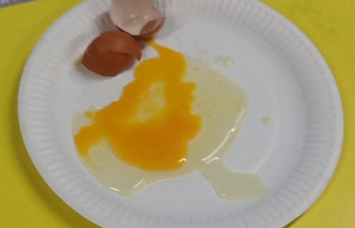

Slide 24
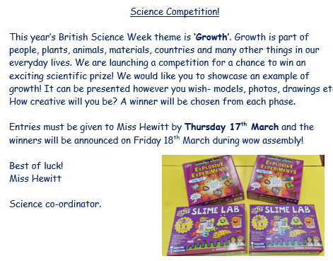

Slide 25
Well done to all that entered! The entries were outstanding and it was so difficult to choose a winner!

Slide 26
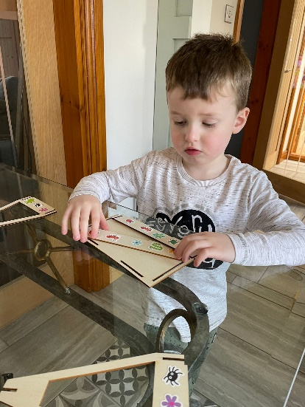
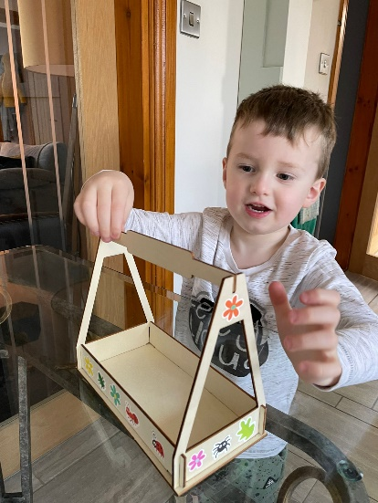
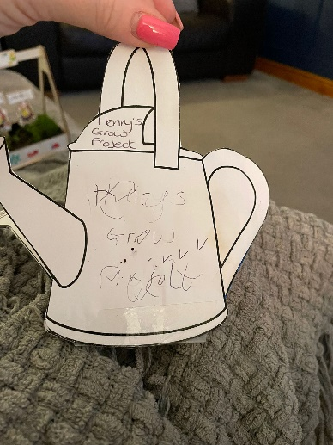
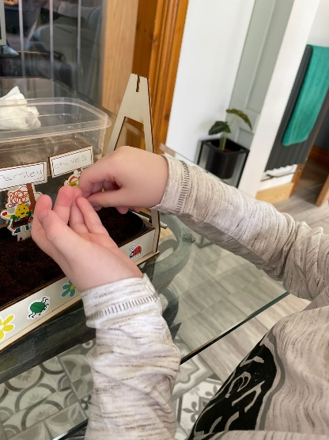
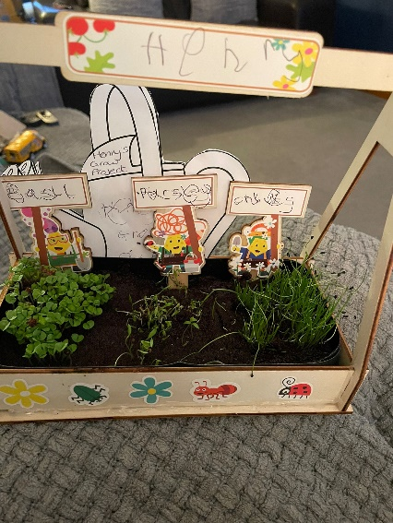
Early Years Winner
Henry G
Henry has created a herb garden. He planted the seeds and has been watering it and observing the growth. He has created diary to document the growth.

Slide 27
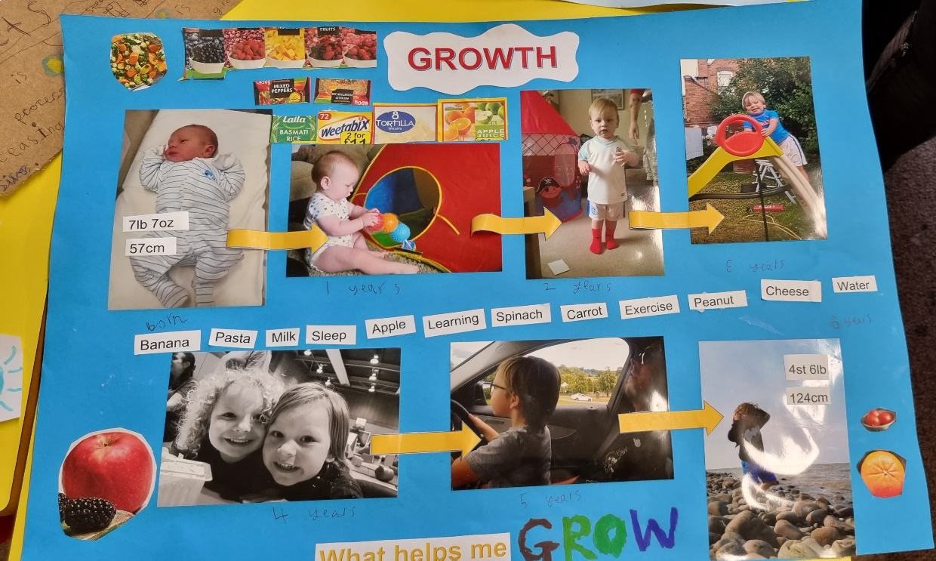
Year 1 and 2
Winner
Seb C
Seb has created a growth chart to show how he has grown from a baby to a child. He has included all the things that have helped him grow!

Slide 28
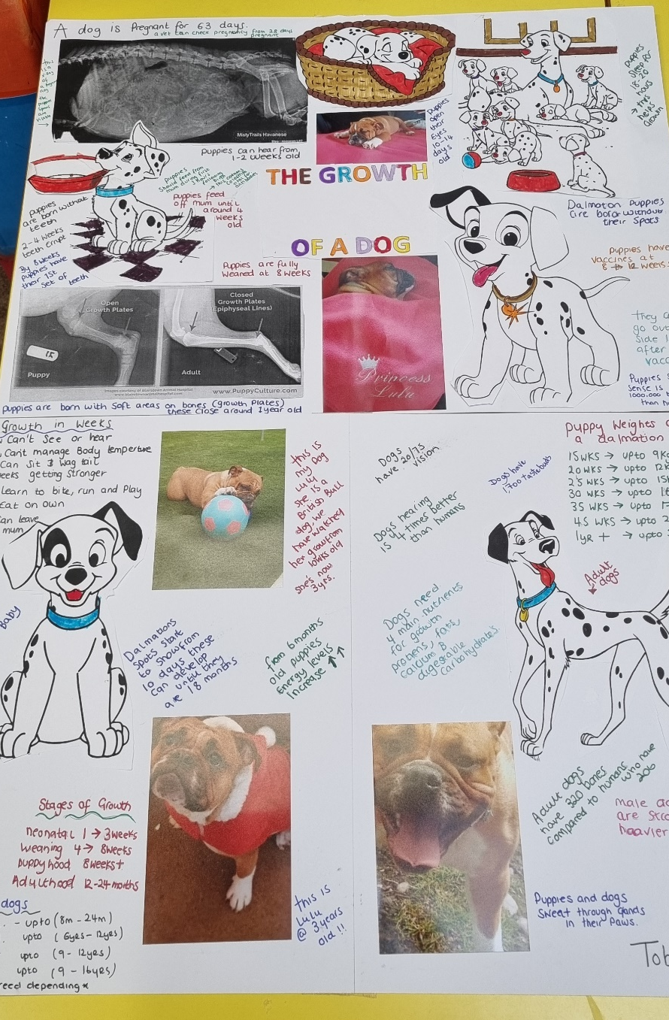
Year 3 and 4
Winner
Tobias
Tobias has created a fact sheet explaining the growth of his puppy. He has included a range of facts and images.

Slide 29
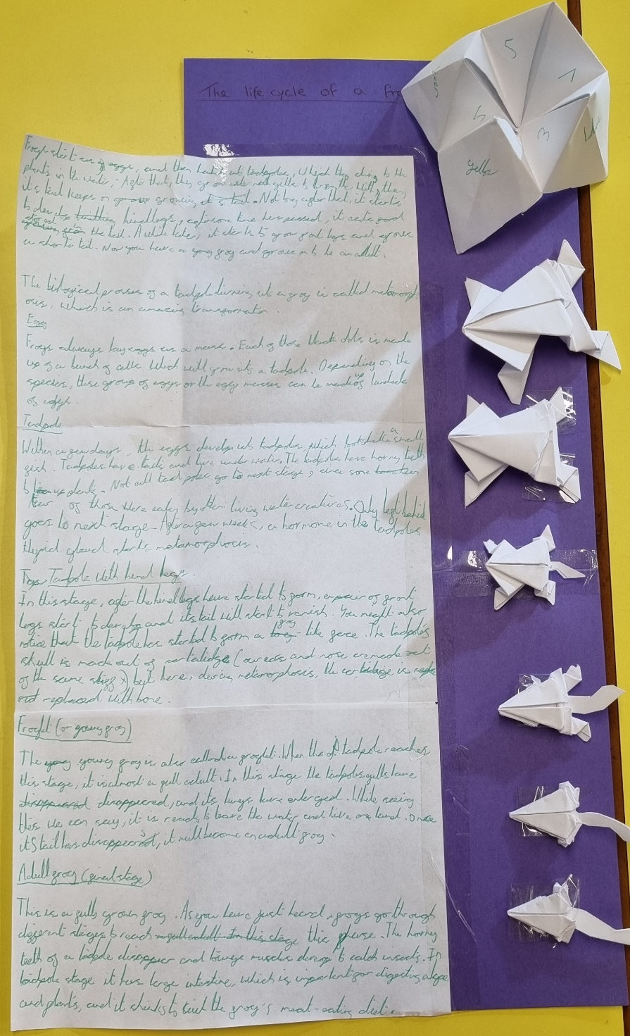
Year 5 and 6
Winner
Reilly
Reilly has created an amazing poster to show case the life cycle of a frog. He has created an origami frog to show each stage of it’s life and has added a fantastic description to go with it.

Slide 30
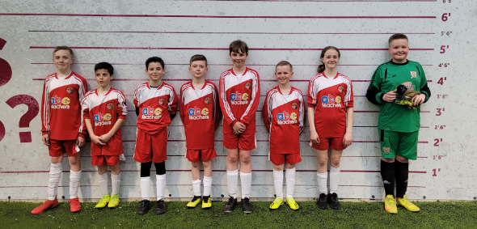
Thank you to the children that represented Woodlands at the football tournament on Tuesday. You were a credit to the school and showed your passion and excellence for football. We are proud of you all.
Miss Fisher and Miss Volante

