Slide 1
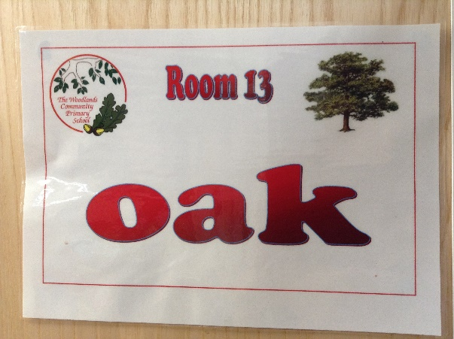
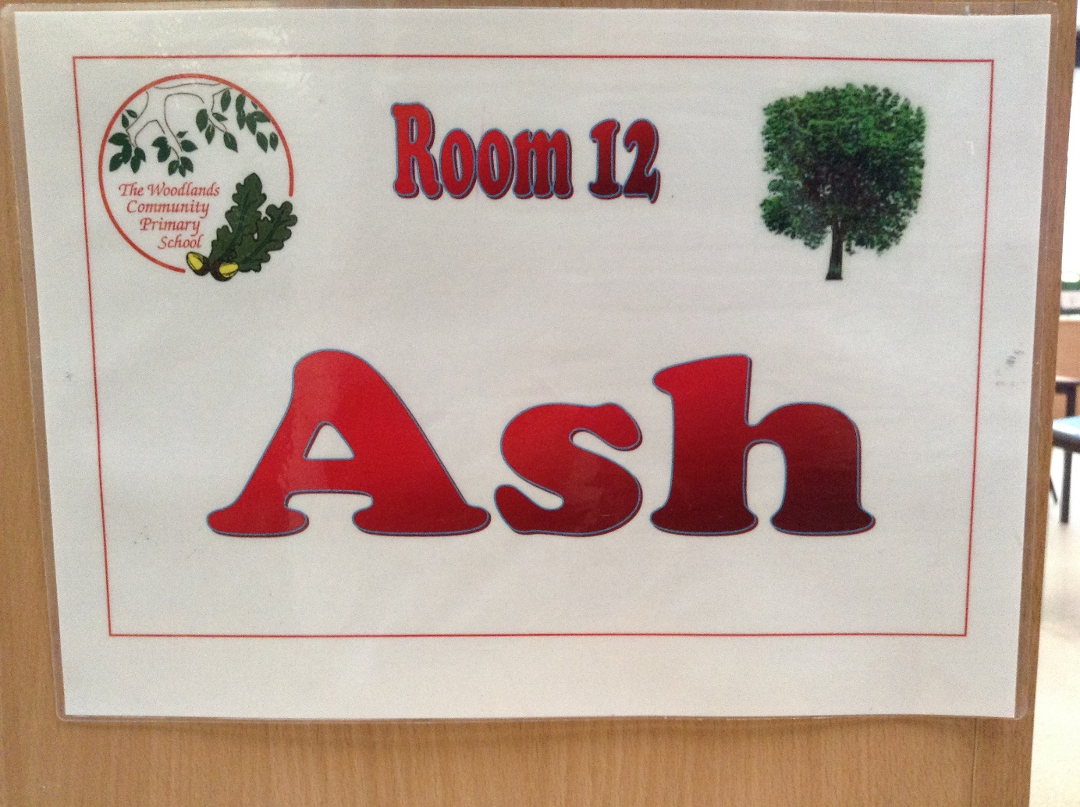
Welcome to Reception
September
2020
Mrs Laffan and Miss Bailey

Slide 2
Teacher Profile:
Mrs Laffan
Welcome to Oak!
I am really looking forward to being your teacher next year.
Facts about me:
I am the Assistant Head, leading the Early Years, KS1 and Art.
I have been teaching at the Woodlands for 19 years.
My favourite subject is art.
I support West Bromwich Albion and have a season ticket to watch them.
I love spending time with my family, swimming and teaching dance.

Slide 3
Teacher Profile:
Miss Bailey
Welcome to Ash!
I am really looking forward to meeting you in September!
Facts about me:
I have been teaching in Reception for six years.
I have been teaching at the Woodlands for one year and lead Computing.
My favourite subject is Maths.
I enjoy reading, going to the gym and going to the cinema.
I am a big Harry Potter fan.
I love to spend time with my family and friends.

Slide 4
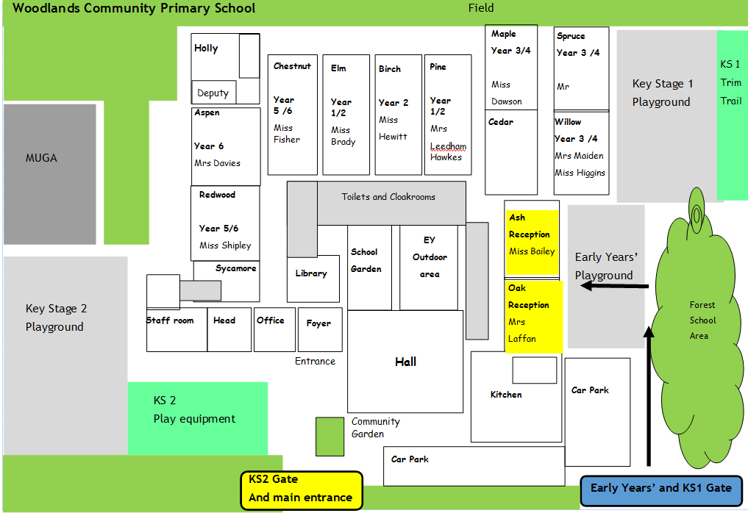
School Map
(Map is saved in Transition Book folder. Highlight your classroom in yellow and paste a picture of it here)
Reception classrooms are here!
Here is the map of our school site:

Slide 5
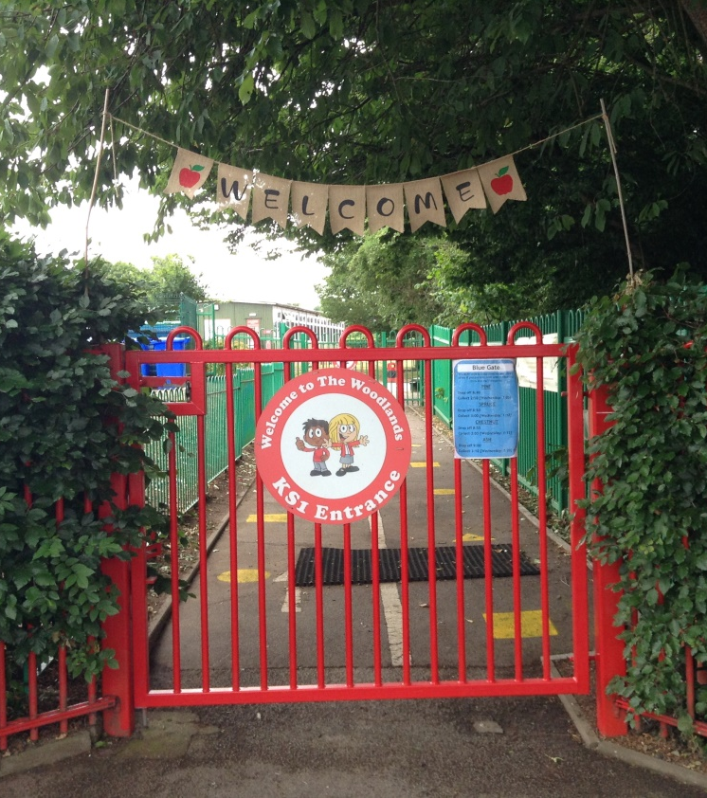
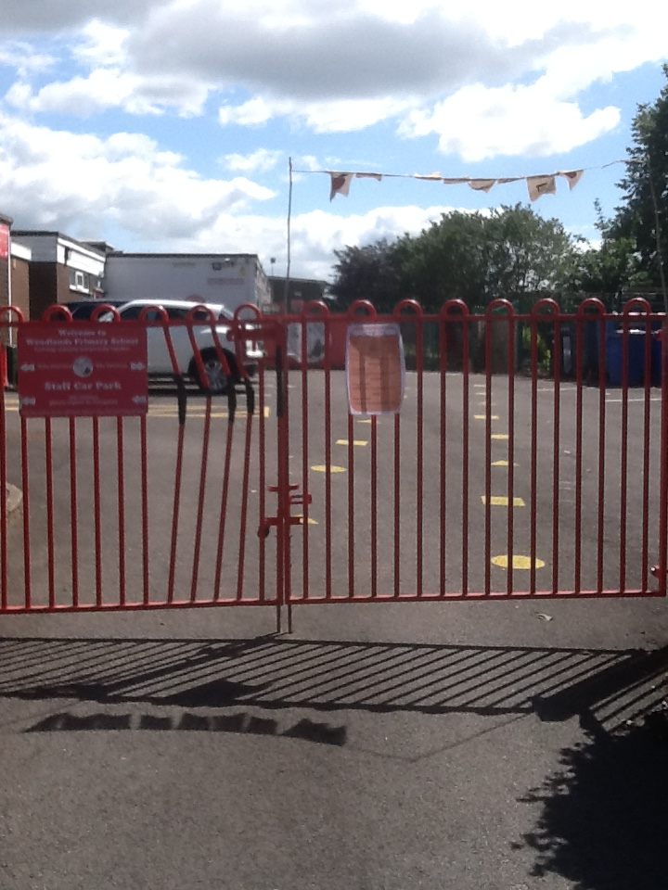
Welcome to Reception
Orange group will come into school through this entrance / gate:

Slide 6
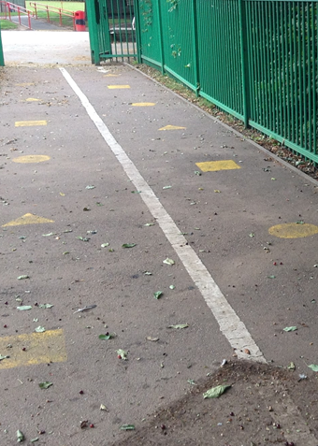
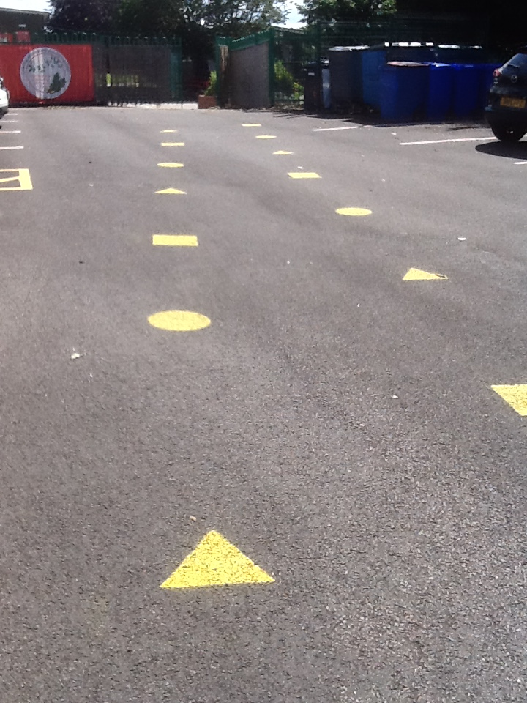
Welcome to Reception!
Blue group follow this path to enter the school building:

Slide 7
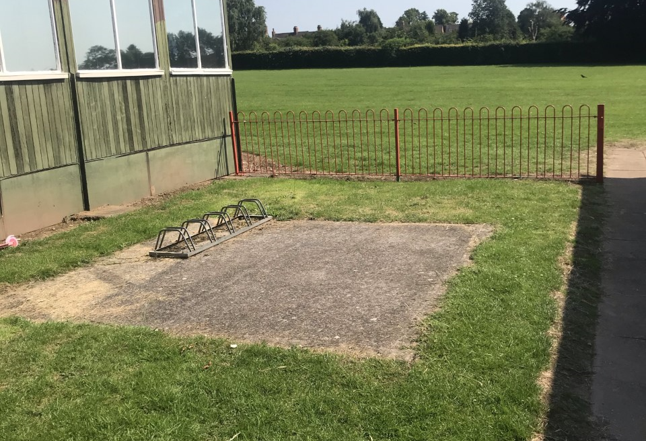
Welcome to Reception!

Slide 8
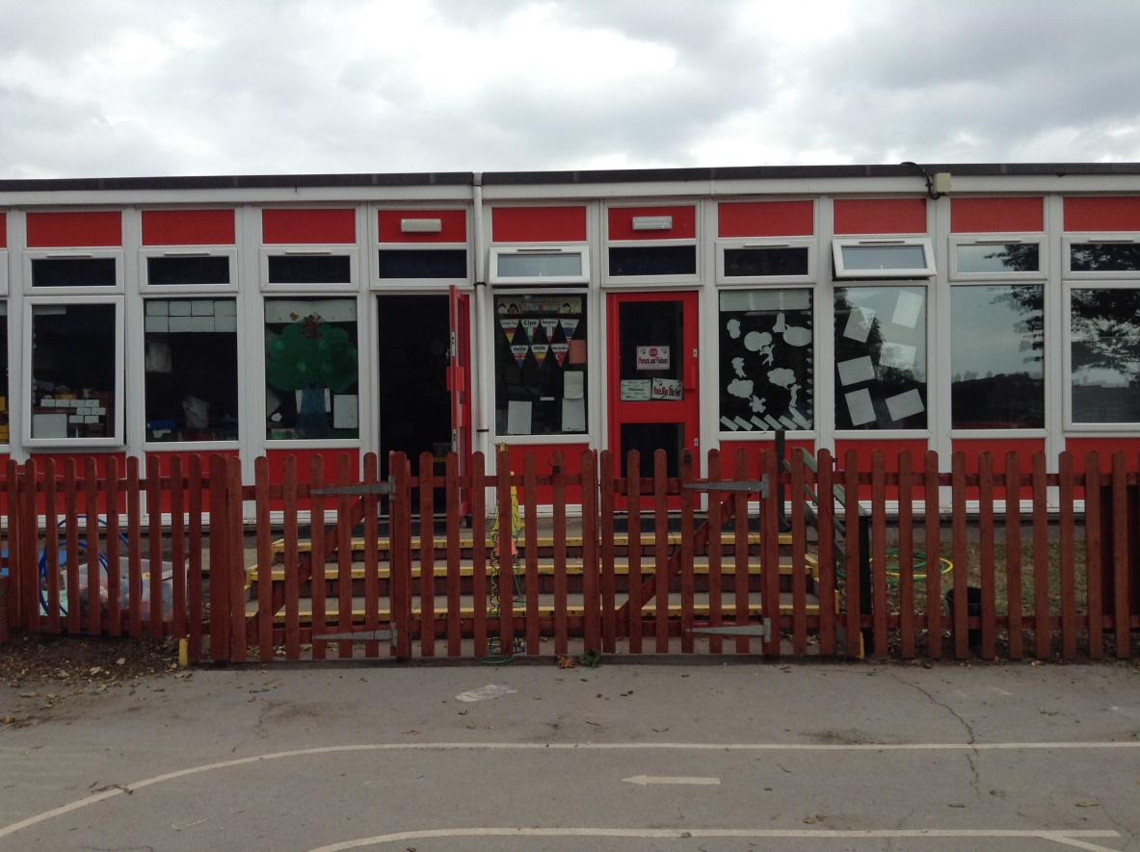
Welcome to Reception!
Blue Group
Orange Group

Slide 9
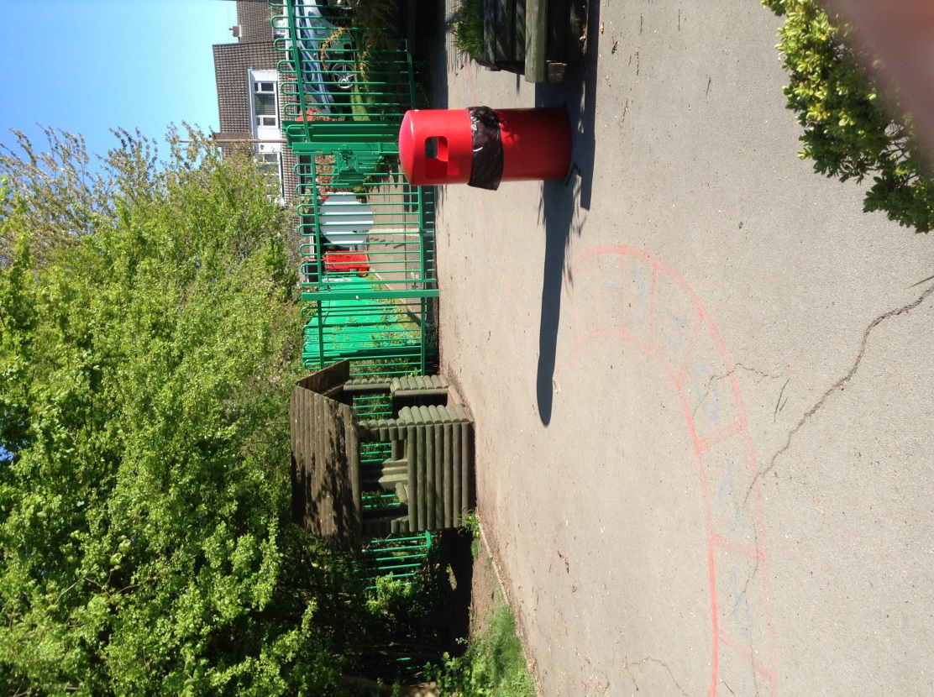
Play time!

Slide 10
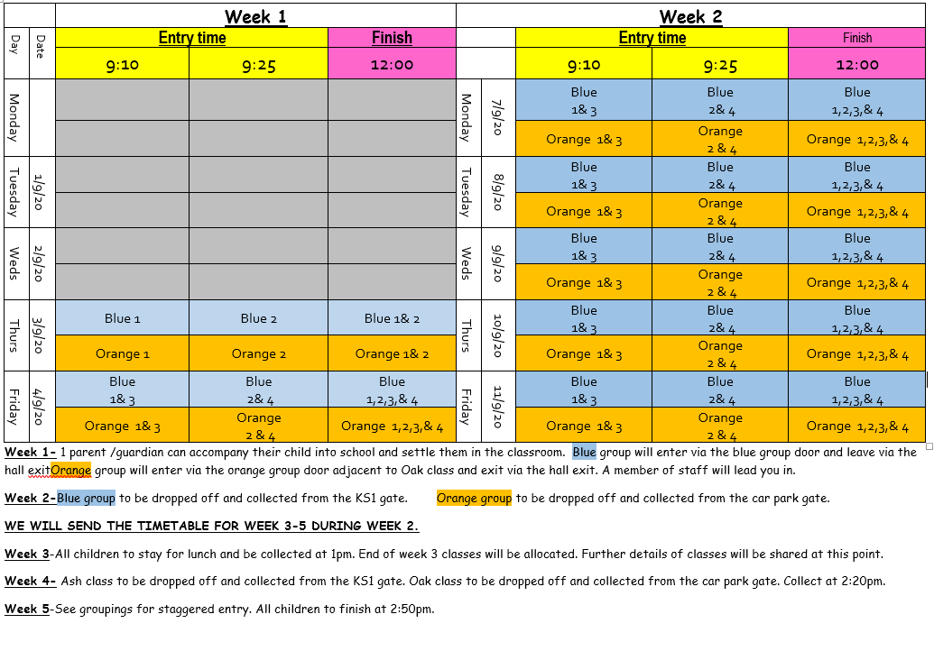
Transition Timetable
After careful consideration of pupil welfare and due to COVID19 restricting our normal induction programme, we have put together a timetable to support the children into Reception over a number of weeks.
This will help your child to get to know the adults, peers and new setting. Your child will explore both classrooms, meeting all staff and peers within Reception for the first few weeks before we allocate a class to them.
You will be notified of their class at the end of week 3.

Slide 11
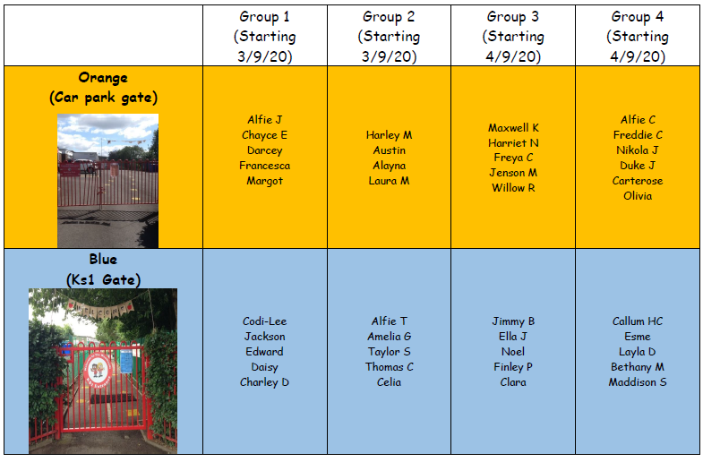
Reception groups
Please note your child’s designated group, entry gate and drop off/collection times.
If you can’t find your child’s name please contact school immediately on 01827 429020
It is essential you arrive promptly for your child’s entry time.
If you have any questions please email Mrs Laffan at reception@woodlands.staffs.sch.uk
Or contact school on 01827 429020

Slide 12
Learning Overview: Autumn 1
We will send out a learning overview once the children have settled in to school.
Our topic will be Magnificent Me!

Slide 13
Houses:
Here are our school houses, named after important people from Tamworth’s history.
You will still be in the same house as last year – when you win team points, they all contribute to your team effort!
We will be voting for our new Year 6 House Leaders in September.

Slide 14
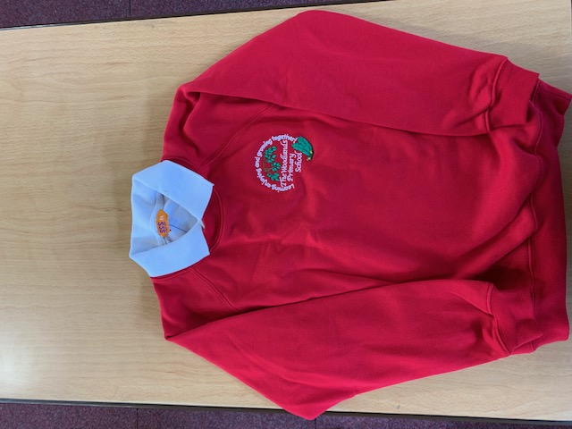
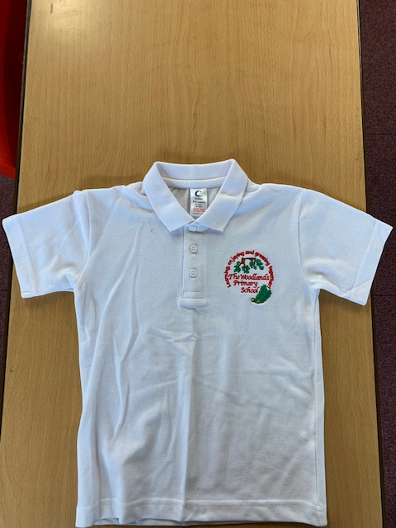
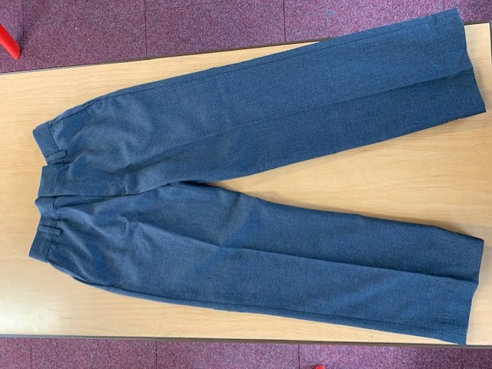
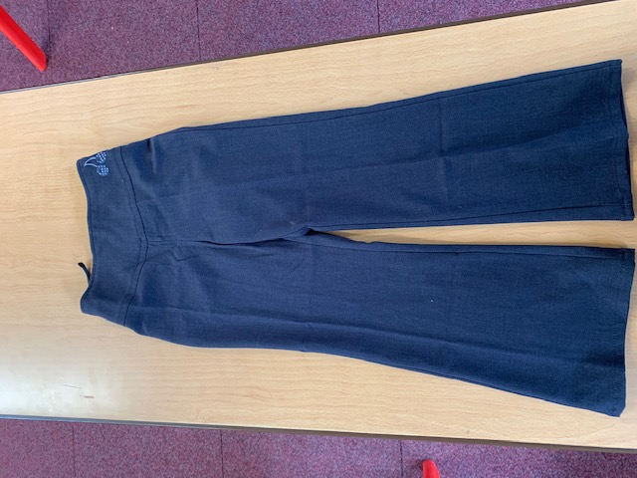
Uniform:
(Picture of school uniform)
Please wear full school uniform every day.
Please make sure each item of uniform is clearly labelled with your name.
Please wear sensible school shoes – no trainers please.

Slide 15
PE Kit:
Please make sure you have your PE kit in school on the days you have PE.
Please make sure each item of kit is clearly labelled with your name.
Please don’t wear earrings on PE days.
If you have long hair, please tie it back on PE days.
Outdoor Kit
White T Shirt
Black jumper/tracksuit top. (No hood)
Black Tracksuit bottoms /Joggers.
Trainers
Indoor Kit
White T Shirt
Black/Navy shorts

Slide 16
Every day, please bring:
A water bottle with your name on
Your coat
A healthy snack (If required) No chocolate or sweets.
A school book bag to hold all your belongings. (Only flat book bags permitted)

Slide 17
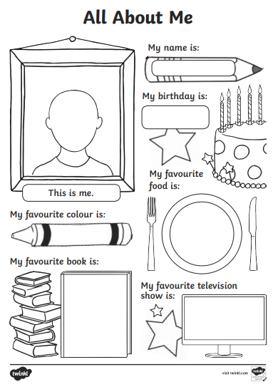
Please send us your ‘All About Me’ profiles !

Slide 18
Have a lovely summer and see you soon!
Mrs Laffan and Miss Bailey ☺

