Slide 1



Wow Assembly:
Friday 9th October

Slide 2
Phrase of the Week:
Mistakes are the porthole to discovery!

Slide 3
Scientists of the Week!
Birch – Kody
Pine – Orla
Elm –Ezmai H
Willow – Esme
Redwood – Liam H

Slide 4
Weekly Team Points!
Peel | Ethelfleda | Grazier | Offa
280
267
241
192

Slide 5
Elm
Cody S
For
A super effort in maths, using circles to find the answer pictorially. Cody was so resilient!
Miss Brady 09.10.20

Slide 6
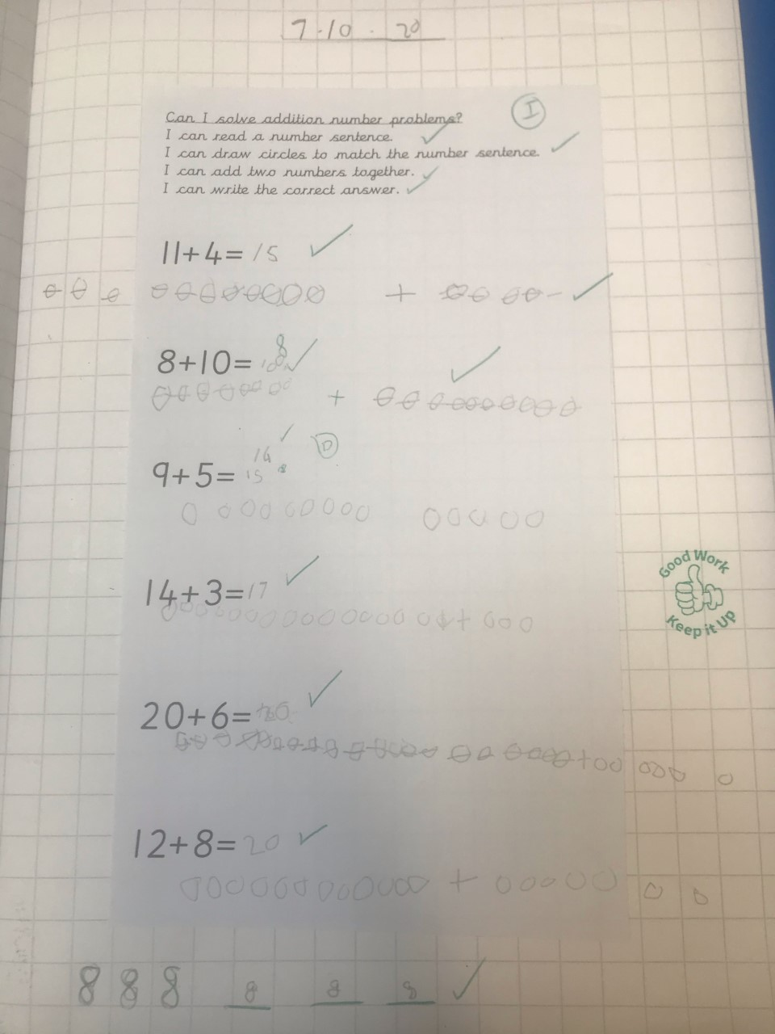
Elm Wow Work

Slide 7
Birch
Alexi-Grace
For
Making super links in Maths. Alexi has used her number bonds to ten knowledge to help her solve problems up to 20 ☺
Miss Hewitt 09.10.20

Slide 8
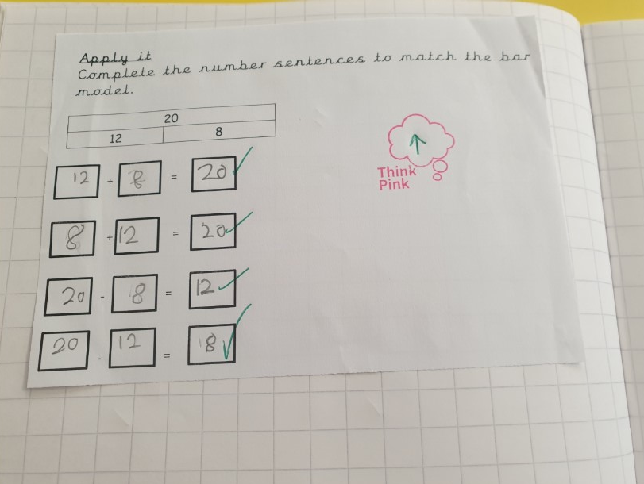
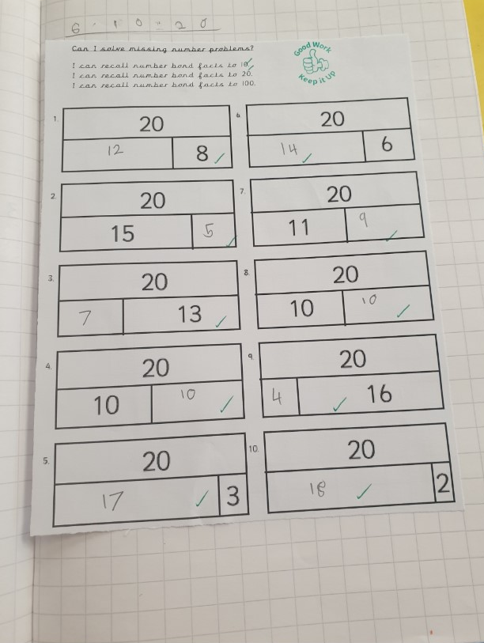
Birch Wow Work

Slide 9
Pine
Freddie S
For independently creating number bonds to 5 using numicon and then writing the matching number sentences.
Mrs Leedham-Hawkes 9.10.20

Slide 10
Pine Wow Work

Slide 11
Maple
Mollie
For fantastic work in maths. Mollie has been adding tens and hundreds to three digit numbers. She knows the place value of each digit in the number and can use this knowledge when adding. She independently completed additional work at home. Well done!
Miss Dawson 09.10.20

Slide 12
Maple Wow Work

Slide 13
Willow
Sophie
For her amazing Christmas art!
Mrs Maiden and Miss Higgins 09.10.20

Slide 14
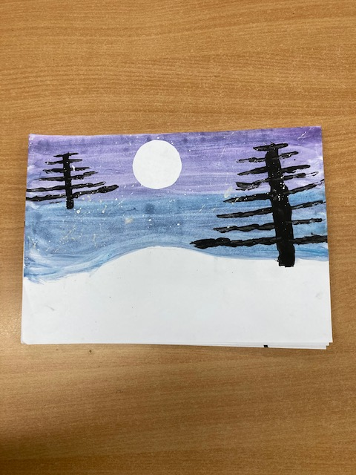
WillowWow Work
Sophie worked hard to create a beautiful snowy scene.
We looked at tones of colour and she applied this beautifully.
Well done Soph ☺

Slide 15
Spruce
Frankie
For erseverance with his maths this week.
Mr Tennuci 11.09.20

Slide 16
Chestnut
Charley
For great independence and tackling some tricky problems in Maths. Well Done Charley. Keep it up!
Miss Fisher 09.10.20

Slide 17
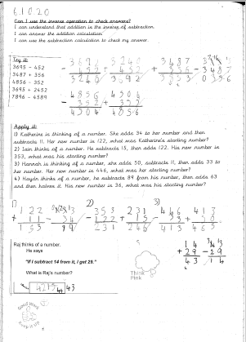
Chestnut Wow Work

Slide 18
Aspen
Ethan
For his great attitude to learning.
Mrs Davies 09.10.20

Slide 19
Aspen Wow Work
Ethan continues to show a great attitude and enthusiasm for learning.
He remains on task, questions to find out more and always wants to impress.
Keep it up!

Slide 20
Redwood
Ruby W.
For exceptional effort and resilience in Maths
Miss Shipley 09.10.20

Slide 21
Redwood Wow Work
Ruby has blown me away with her hard work and determination, this week. She has passed her times table test, mastered multiples, figured out factors and pushed on with primes. I could not be prouder of what she has achieved.
Well done Ruby!

Slide 22


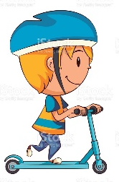



Whole school
434
12
45
1
148
301

Slide 23
Winning Class – Reception and KS1
54
3
8
0
7
17
ELM

Slide 24
Winning Class – Year 3/4
48
2
0
28
0
17
Willow

Slide 25
Winning Class Year 5/6
82
0
0
0
13
19
Aspen

Slide 26
Next Week’s
Phrase of the Week:
A big journey begins with a small step!

