Slide 1



Wow Assembly:
Friday 11th September

Slide 2
Phrase of the Week:
Difficult roads often lead to beautiful destinations. Do not quit!

Slide 3
Green Cards!
Aspen- Faith, Emily
Redwood – Lewis, Jimi

Slide 4
Scientists of the Week!
Pine – Freddie H
Elm – Izaiah B
Redwood – Caeden F
Chestnut – Charlie A

Slide 5
Weekly Team Points!
Peel | Ethelfleda | Grazier | Offa
112
168
157
93

Slide 6
Elm
Ezmai H
For
An amazing return to school. Beautiful handwriting forming, and Ezmai is working so hard. Well done Ez keep it up!
Miss Brady 11.09.20

Slide 7
Birch
Ellie
For
Showing an amazing attitude to learning in everything that she does! Keep it up Els!
Miss Hewitt 11.09.20

Slide 8
Pine
Daisy
For an amazing recount of our morning tea with the Queen to celebrate Hook Day.
Mrs Leedham-Hawkes 11.09.20

Slide 9
Pine Wow Work

Slide 10
Maple
Kai
For working independently in Science to make predictions about whether different items are magnetic.
Miss Dawson 11.09.20

Slide 11
Maple Wow Work

Slide 12
Willow
Riley WP
For trying so hard with all that he does – it’s so lovely to see you so positive and focused on your learning! ☺
Mrs Maiden and Miss Higgins 11.09.20

Slide 13
Willow Wow Work
Riley worked really hard, listening well in every lesson!
Riley said,
“I love this work!” in English.
Riley suggested some really good ideas when talking about our emotions.
Riley has worked really hard on using past tense verbs and conjunctions.

Slide 14
Spruce
Amelia
For
Brilliant work on her mental maths this week,
showing an ability in recalling facts quickly!
Mr Tennuci 11.09.20

Slide 15
Chestnut
Jack Churchill
For a great start to his maths learning showing his understanding of place value.
Miss Fisher 11.09.20

Slide 16
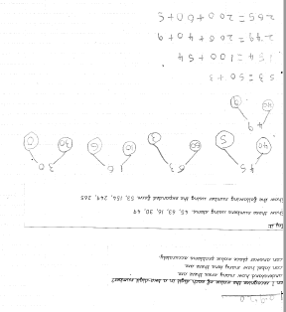
Chestnut Wow Work

Slide 17
Aspen
Miley
For superb learning behaviour.
Mrs Davies 11.09.20

Slide 18
Aspen Wow Work
Miley consistently shows superb learning behaviour and always gives 100%.
She responds immediately, sits up, equips herself for learning and asks questions.
Keep it up Miley!

Slide 19
Redwood
Liam G.
For showing amazing communication and teamwork skills during our Beast Creator Writing!
Miss Shipley 11.09.20

Slide 20
Next Week’s
Phrase of the Week:
Winners don’t quit: quitters don’t win!

