Slide 1



Wow Assembly:
Friday 18th September

Slide 2
Phrase of the Week:
Winners don’t quit: quitters don’t win!

Slide 3
Green Cards!
Brooke H- Elm
Ronnie BJ- Elm

Slide 4
Our Class Leaders 2020!
Birch: Elyza
Elm: Mikey S
Pine: Poppy
Maple: Oliver
Willow: Emma
Spruce: Freya
Redwood: Ruby C
Chestnut: Olivia
Aspen: Millie
Well done everyone! ☺

Slide 5
Scientists of the Week!
Birch – Betsy and Ruby
Pine – Daniel
Elm – Robyn
Redwood – Jimi C
Chestnut – Alfie S
Aspen- Eloise
Willow –Alfie
Maple – Oliver

Slide 6
Weekly Team Points!
Peel | Ethelfleda | Grazier | Offa
 |  | 213
277
246
151

Slide 7
Elm
Finley H
For
An amazing effort in our Commando Joe mission1 where Finley showed super teamwork and amazing communication skills. Well done Fin!
Miss Brady 18.09.20

Slide 8

Elm Wow Work

Slide 9
Birch
Nevaeh
For
Nevaeh has written a fantastic character description. She has tried really hard to reduce the size of her handwriting and has included some amazing similes. Well done Nevaeh!
Miss Hewitt 18.09.20

Slide 10
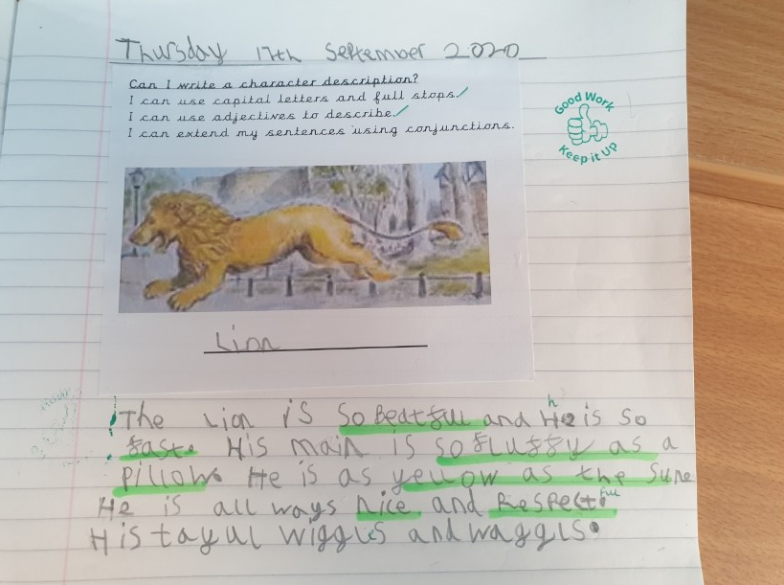
Birch Wow Work

Slide 11
Pine
Lilly
For superb number ordering and presentation within Mathematics. Lilly counted to 20 beautifully and worked independently.
Mrs Leedham-Hawkes 18.09.20

Slide 12
Pine Wow Work

Slide 13
Maple
Lennon
For using paint to create different effects in art.
Miss Dawson 18.09.20

Slide 14
Maple Wow Work

Slide 15
Willow
Jay
For a fabulous setting description using a wide variety of prepositional phrases. Jay used some as sentence starters too!
Well done Jay!!
Mrs Maiden and Miss Higgins 18.09.20

Slide 16
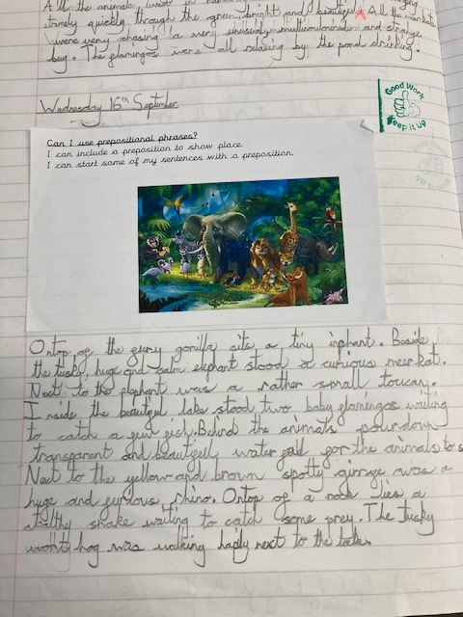
WillowWow Work

Slide 17
Spruce
Cian
For hard work and challenging himself this week, especially in Maths!
Mr Tennuci 18.09.20

Slide 18
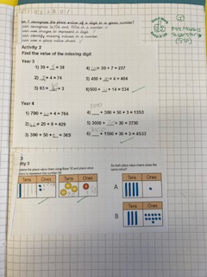
Spruce Wow Work

Slide 19
Chestnut
Amelia M
For fantastic descriptive writing for the setting. You have used some brilliant vocabulary.
Miss Fisher 18.09.20

Slide 20
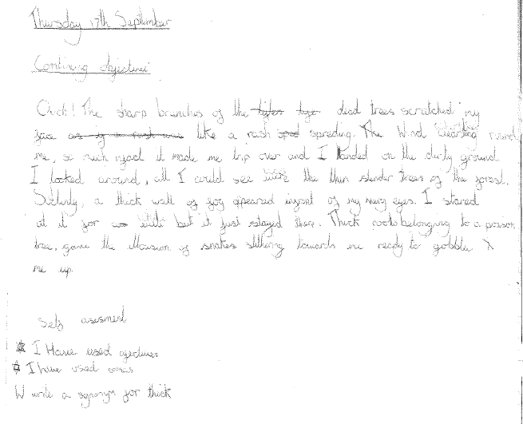
Chestnut Wow Work

Slide 21
Aspen
Madison
For her consistent use of stunning language choices in her writing.
Go girl!
Mrs Davies 18.09.20

Slide 22
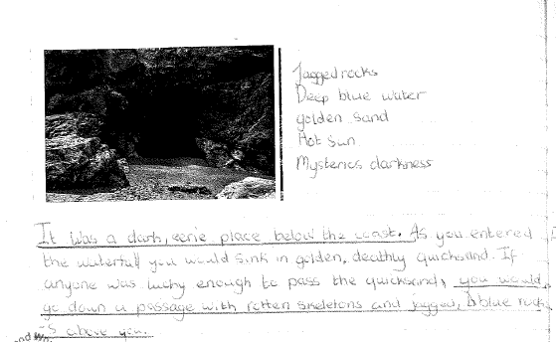
Aspen Wow Work

Slide 23
Redwood
Hollie
For excellent effort in Maths, working with Roman Numerals!
Miss Shipley 18.09.20

Slide 24
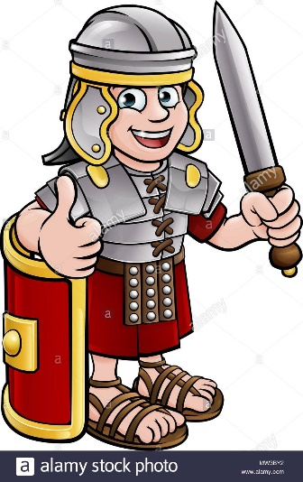
Redwood Wow Work
Hollie has worked really hard this week and shown real resilience and self-awareness as she has developed her knowledge and understanding. Hollie has been working independently and has talked about what she has learnt during the lesson.
Well done Hollie! I am very proud of you and can’t wait to see what you do next.

Slide 25
Next Week’s
Phrase of the Week:
Do what is right, not what is easy!

