Slide 1
Wow Assembly:
Friday 24th September

Slide 2
Green Cards!
Austin Fletcher – Elm
Layla Day – Elm
Felicity-Birch
Leo-Birch
Alfie S - Chestnut
Amelia B - Chestnut
Aimee J - Chestnut
Charlie A - Chestnut
Olivia L - Chestnut
Amelia M - Chestnut

Slide 3
Scientists of the Week!
Birch – Evelyn
Pine – Nikola
Elm – Ella
Willow – Oscar
Spruce – Kai
Maple –
Redwood – Joe
Chestnut –
Aspen- Cian

Slide 4
Weekly Team Points!
Peel | Ethelfleda | Grazier | Offa
138 | 122 | 127 | 126

Slide 5
Oak
Casper
For
Super cutting skills and understanding how we grow
And change from baby to adult.
Mrs Laffan 24.09.21

Slide 6
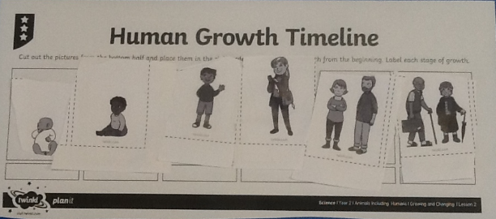
Oak Wow Work

Slide 7
Ash
Travis
For
Super 2d shape picture.
Miss Bailey 24.09.21

Slide 8
Elm
Phillip
For his excellent writing in English this week, using time conjunctions and his phonic understanding to help spell words. Keep up your hard work Phillip ☺
Mr Grice 24.09.2021

Slide 9
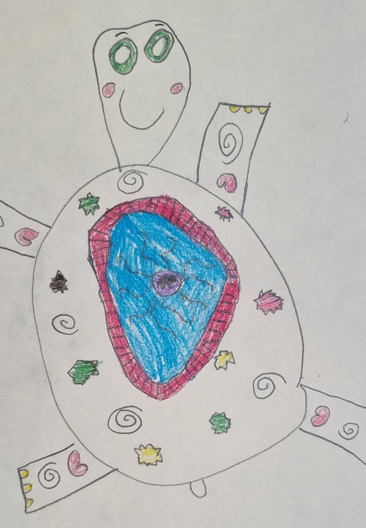
Birch
For
Evelae
Evelae has designed a fantastic clay turtle that she will be making next week. She has really thought about the patterns and textures she would like to create and the equipment she will use. Well done!
Miss Hewitt 24.09.21

Slide 10
Pine
Ellen
For using passion, communication and excellence in reading. Ellen has already had her name put in Pine reading pot 4 times. WOW!
Well done for all of your home reading.
Mrs Leedham-Hawkes 24.09.21

Slide 11
Maple
Ayla
For creating a poster in the style of Emmeline Pankhurst and sharing with us about something that she believes would make a difference to the world.
Miss Dawson 24.09.2021

Slide 12
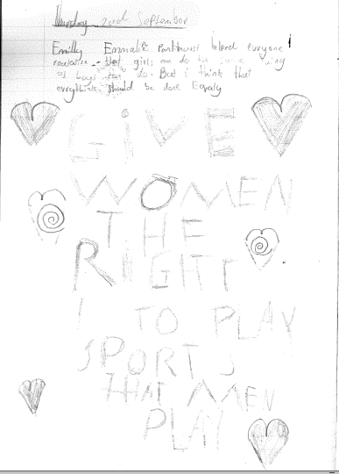
Maple

Slide 13
Willow
Liam
For putting great effort in his Guided Reading. You have worked really hard when predicting what is going to happen next in our story. Well Done.
Miss Fisher 24.09.21

Slide 14
Spruce
Tarron
For using prior learning to help him when counting in 50’s. Well done Tarron !
Mr Draper 24.09.21

Slide 15
Chestnut
Jake
For
showing a desire and want to improve himself through asking questions about his work and wanting more challenge.
Mr Tennuci 24.09.21

Slide 16
Aspen
Roxy
For
Applying a new method in Maths and persevering with problem solving questions!
Mrs Read & Mrs Cox 24.09.21

Slide 17
Redwood
Jax
For outstanding effort and resilience in Maths. I am so proud and impressed by how Jax has challenged himself this week.
Miss Shipley 24.09.21

Slide 18
Next Week’s
Phrase of the Week:

