Slide 1


Slide 3

1 a) 3 7 11 _____ _____
b) What is the rule for this sequence?
2 a) 22 _____ 8 1
b) What is the rule for this sequence?
3) 8.9 $+$ 0.4 $=$
4) 20.3 $−$ 0.7 $=$

Slide 4
1 a) 3 7 11 _____ _____
b) What is the rule for this sequence?
2 a) 22 _____ 8 1
b) What is the rule for this sequence?
3) 8.9 $+$ 0.4 $=$
4) 20.3 $−$ 0.7 $=$
15
19
Add 4
15
Subtract 7
9.3
19.6

Slide 6

5
10
15
20
25
1st term
2nd term
3rd term
4th term
5th term
What does ‘term’ mean?
Have a think

Slide 7


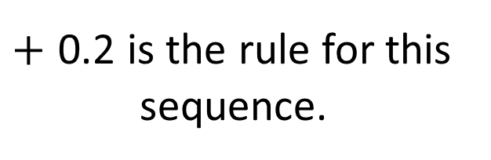
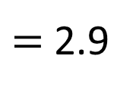
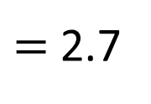
Ones | Tenths
$=$ 2.7
$+$ 0.2 is the rule for this
sequence.
Ones | Tenths
$=$ 2.9
Have a think
What is the next term in this sequence?

Slide 8

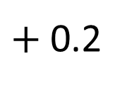
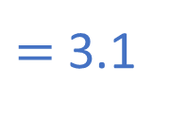
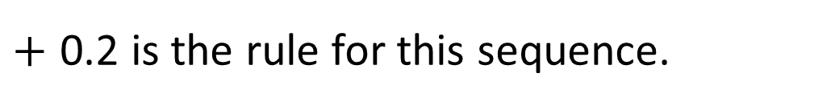
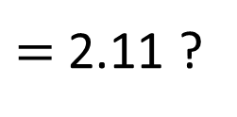
Ones | Tenths
Ones | Tenths
$=$ 2.7
$+$ 0.2
Ones | Tenths
$=$ 2.11 ?
$=$ 3.1
$=$ 2.9
2 and 1 tenth
and 1 hundredth
$+$ 0.2 is the rule for this sequence.

Slide 9
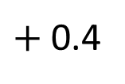
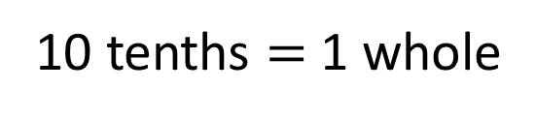
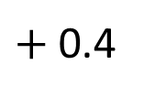
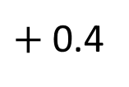
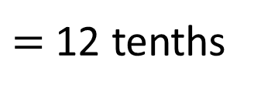
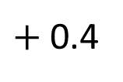
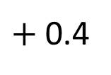
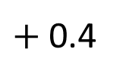
$+$ 0.4
$+$ 0.4
$+$ 0.4
$+$ 0.4
$+$ 0.4
$+$ 0.4
16
16.4
16.8
16.12
17.2
17.6
18
18.4
$=$ 12 tenths
10 tenths $=$ 1 whole
Are the terms increasing or decreasing in value?
What are the terms increasing by?
Have a think
As the sequence is increasing, I need to add ____ to work out the next term.
0.4

Slide 10
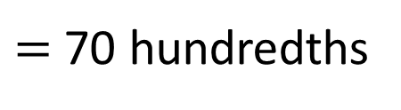
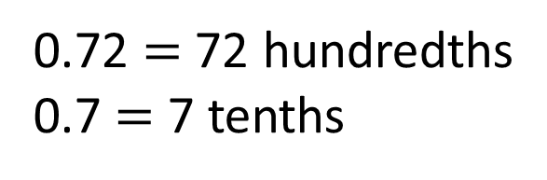
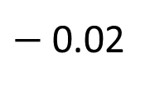
?
$−$ 0.02
13.72
0
13.7
13.68
13.66
13.64
13.62
13.6
0.72 $=$ 72 hundredths
0.7 $=$ 7 tenths
$=$ 70 hundredths

Slide 11
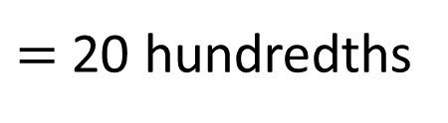
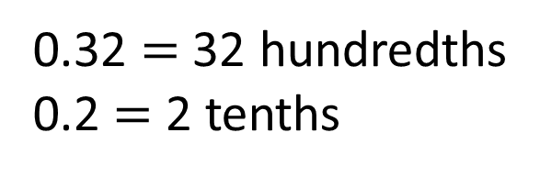
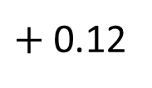
Complete the number line.
?
$+$ 0.12
10.2
0
10.32
10.44
10.56
10.68
10.8
10.92
Are the terms increasing or decreasing in value?
What are the terms increasing by?
0.32 $=$ 32 hundredths
0.2 $=$ 2 tenths
$=$ 20 hundredths
Have a think

Slide 12
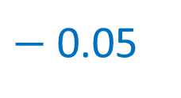
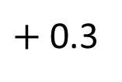
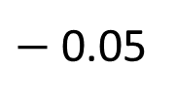
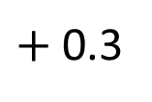
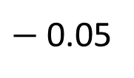
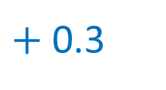
Write the rule for each sequence.
$+$ 0.3
$+$ 0.3
Add 0.3
0.4, 0.7, 1, 1.3, 1.6
$+$ 0.3
$−$ 0.05
$−$ 0.05
Subtract 0.05
3.45, 3.4 , 3.35, 3.3 , 3.25
0
0
$−$ 0.05
Have a think

Slide 13
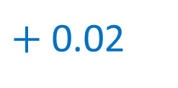
Write the rule and the next two numbers in the sequence.
3.34 | 3.36 | 3.38 | 3.4
3.42
3.44
$+$ 0.02
As the sequence is increasing, I need to add ____ to work out the next term.
0.02

Slide 14
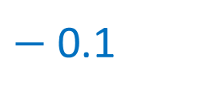
Write the rule and the next two numbers in the sequence.
12.18 | 12.08 | 11.98 | 11.88
11.78
11.68
$−$ 0.1
Did you use the same strategy as your partner?
What would be the 10th term?
Have a think

Slide 15
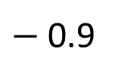
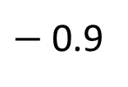
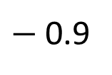
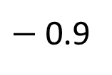
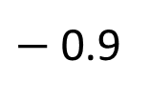
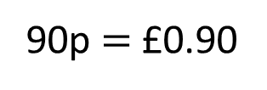
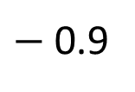
Amir gets £5 in pocket money.
Every day, he spends 90p on fruit.
How many days will Amir’s pocket money last?
5 days
$−$ 0.9
$−$ 0.9
$−$ 0.9
$−$ 0.9
$−$ 0.9
$−$ 0.9
4.1
3.2
2.3
1.4
0.5
5
 | Day 1 | Day 2 | Day 3 | Day 4 | Day 5 | Day 6
90p $=$ £0.90
Have a think

Slide 16
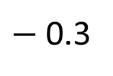
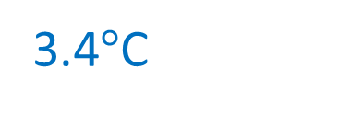
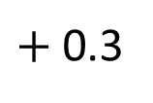
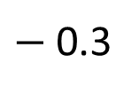
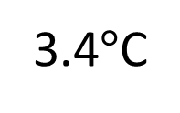
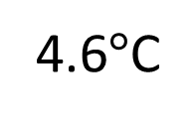
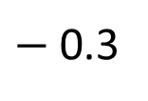
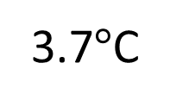
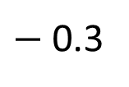
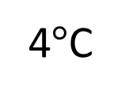
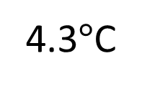
The temperature increases by three tenths of a degree Celsius each day for 10 days.
On day 5, the temperature is 4.6 degrees Celsius.
What was the temperature on day 1?
3.4$°$C
Day | 1 | 2 | 3 | 4 | 5
Temp.
3.4$°$C
3.7$°$C
4$°$C
4.3$°$C
4.6$°$C
$+$ 0.3
$−$ 0.3
$−$0.3
$−$ 0.3
$−$ 0.3
Have a think

Slide 17



Slide 18
Have a go at questions

Slide 19
I do
You do

Slide 20
















Rosie
Alex
Amir
Whitney
Ron
Dexter
Annie
Tommy
Mo
Jack
Eva
Teddy
Max
Kim
Jo
Sam

Slide 21


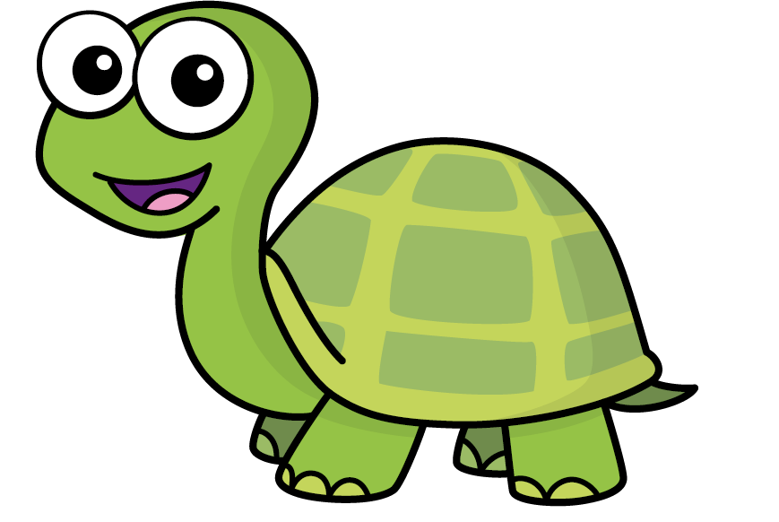
Speech bubble text – replace with any character head.
Speech bubble text – replace with any character head.
Bee
Diddy
Tiny

Slide 22
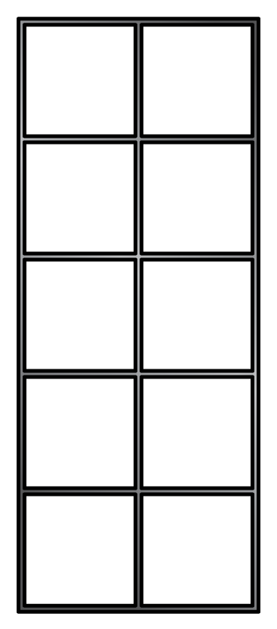





















M | HTh | TTh | Th | H | T | O | Tth | Hth | Thth
100
40 | 60
Millions | Thousands |  |  | Ones
O | H | T | O | H | T | O

Slide 23









































Slide 24


























































