Slide 1



Wow Assembly:
Friday 23rdOctober

Slide 2
Phrase of the Week:
Understanding is deeper than knowledge; there are many who know you but few who understand you.

Slide 3
Green Cards!
Neveah– Birch
Margot – Ash
Caeden - Redwood

Slide 4
Weekly Team Points!
Peel | Ethelfleda | Grazier | Offa
140
146
74
123

Slide 5
Elm
Jaeden G
For
Working incredibly hard at anything he puts his mind to. He produced a great piece of maths work this week where Jaeden used resilience to find the missing number using a number line.
Miss Brady 11.09.20

Slide 6
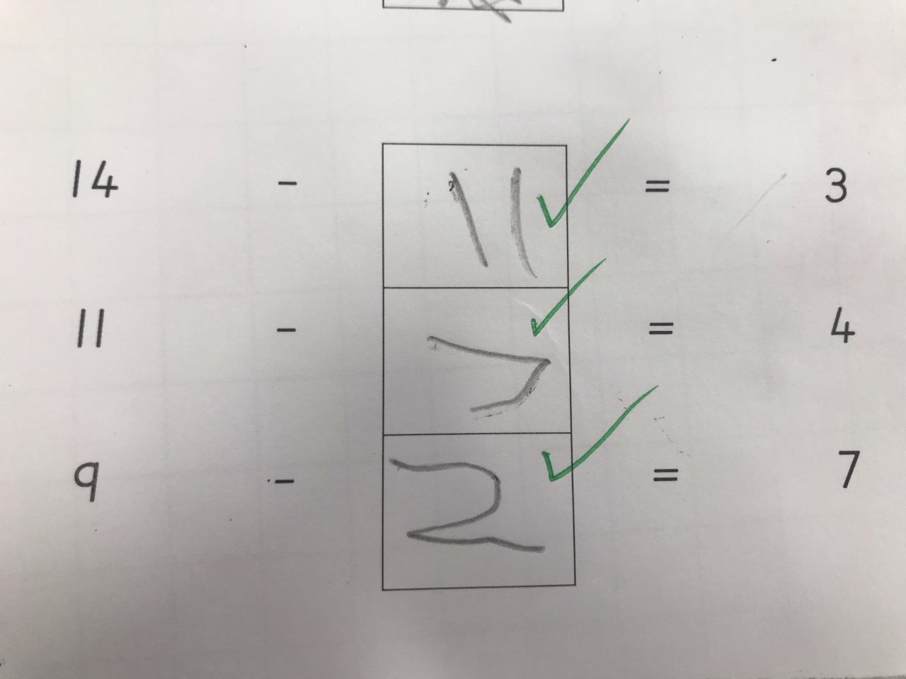
Elm Wow Work

Slide 7
Birch
Issac
For
Always challenging himself in every subject. Issac has written a super list and has used commas to separate items. Well done Issac! Keep up the hard work ☺
Miss Hewitt 22.10.20

Slide 8
Pine
Freddie. H
For using resilience to solve addition and subtraction missing number problems using a number line.
Mrs Leedham-Hawkes 22.10.20

Slide 9
Pine Wow Work

Slide 10
Maple
Sophie M
For her independent fact file about the Wright Brothers.
Miss Dawson 23.10.2020

Slide 11
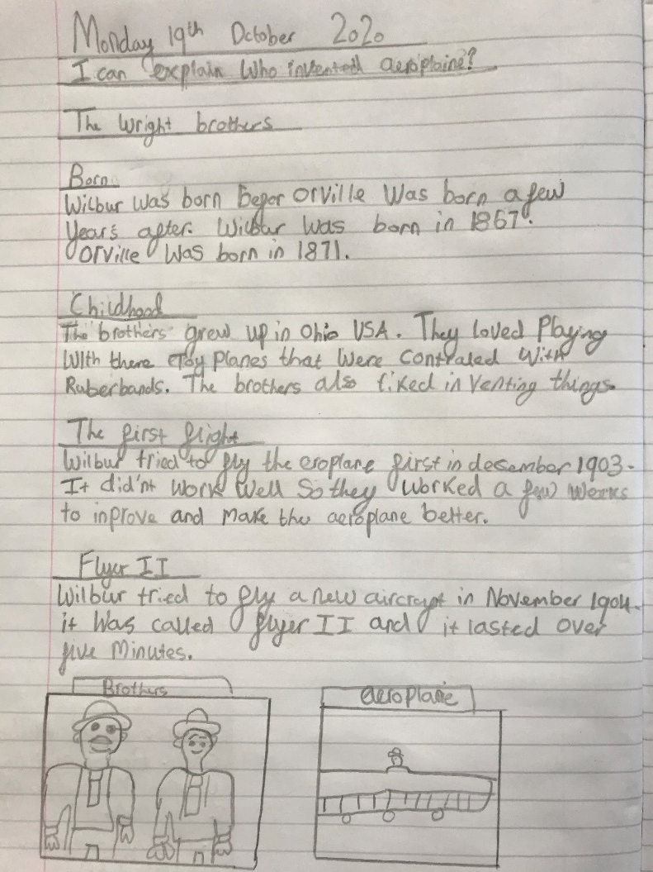
Maple Wow Work

Slide 12
Spruce
Anaya
For
Amazing descriptive language in your writing.
Mr Tennuci 11.09.20

Slide 13
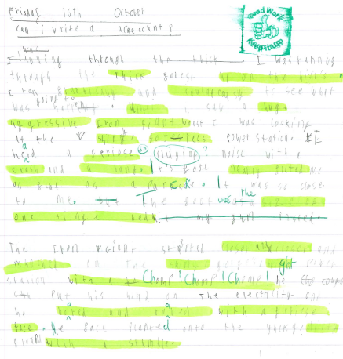
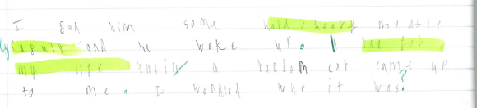
Spruce Wow Work

Slide 14
Chestnut
Alessia
For fantastic improvement in her handwriting. I am really impressed with how much effort you are putting in. Well Done!
Miss Fisher 11.09.20

Slide 15
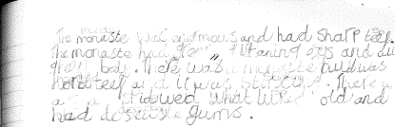

Chestnut Wow Work

Slide 16
Aspen
Natalia
For writing a superb narrative poem.
Mrs Davies 22.10.20

Slide 17
Aspen Wow Work
Natalia showed excellence when writing her narrative poem. Super language choices and figurative language. Go girl!

Slide 18
Redwood
Liam H
For outstanding passion and effort in his poetry
Miss Shipley 11.09.20

Slide 19
Next Week’s
Phrase of the Week:
It’s not what happens to you, but how you react to it that counts.

Slide 20


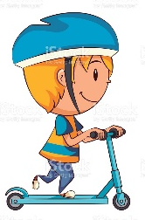


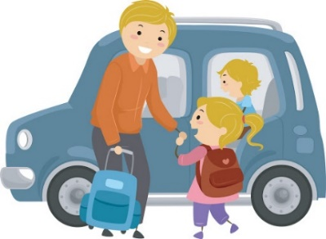
Whole school
478
33
63
4
156
231

Slide 21
Winning Class – Reception and KS1
55
2
7
0
23
23
BIRCH

Slide 22
Winning Class – Year 3/4
46
3
7
9
1
36
Maple

Slide 23
Winning Class Year 5/6
57
2
12
0
18
9
Chestnut

