Slide 1



Wow Assembly:
Friday 12th June

Slide 2
Phrase of the Week:
Anyone that has not made a mistake has not done anything new.

Slide 3
Green Cards!
Freddie – Ash
Millie – Willow
Charley – Willow

Slide 4
Scientists of the Week!
Oak –Eli
Ash – Ronnie
Cedar - Lilly
Willow – Jimi
Spruce – Oscar
Birch – Sid
Pine – Orla
Elm – Tyler
Redwood – Josh
Chestnut – Evie
Aspen- Klaudiusz

Slide 5
Weekly Team Points!
Peel | Ethelfleda | Grazier | Offa
78
93
139
79

Slide 6
Oak
Idris
For
Excellent ‘doubling’ work in maths.
Mrs Laffan 12.06.20

Slide 7
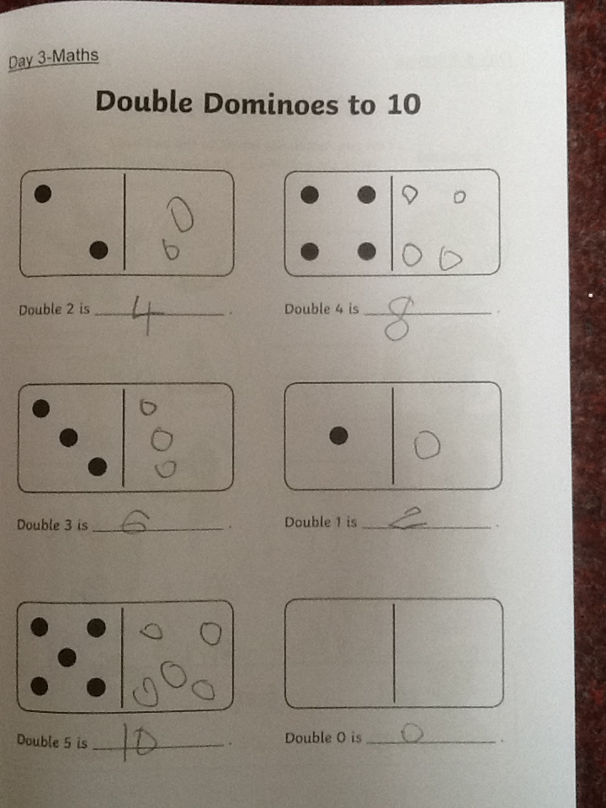
Oak Wow Work

Slide 8
Ash
Isaac
For super independent writing!
Miss Bailey 12.06.20

Slide 9
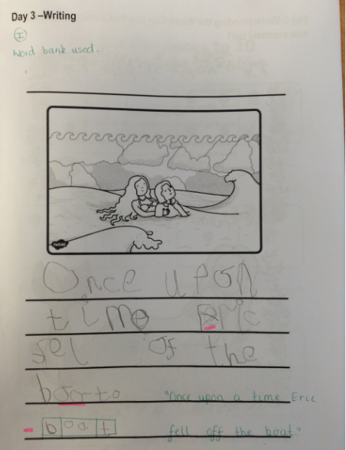
Ash Wow Work

Slide 10
Cedar
Nina
For working independently to read words and apply her phonic knowledge accurately.
Mrs Scott 12.06.20

Slide 11
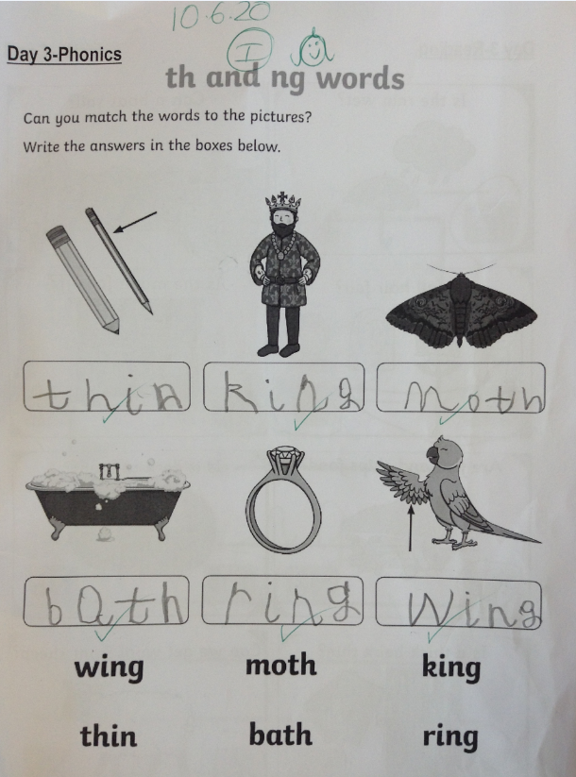
Cedar Wow Work

Slide 12
Pine
Ava
For completing number bonds to 10 accurately and independently. Ava also challenged herself to create number bonds to 20.
Mrs Leedham-Hawkes 12.06.20

Slide 13
Pine Wow Work

Slide 14
Elm
Issac
For
For an amazing first week back. So positive, helpful and hard working! Well done Issac!
Miss Brady 12.06.20

Slide 15
Birch
Faith
For settling back into school fantastically and producing a super piece of science work. Faith was able to sort animals into her own choose groups and explain her choices.
Miss Hewitt 12.06.20

Slide 16
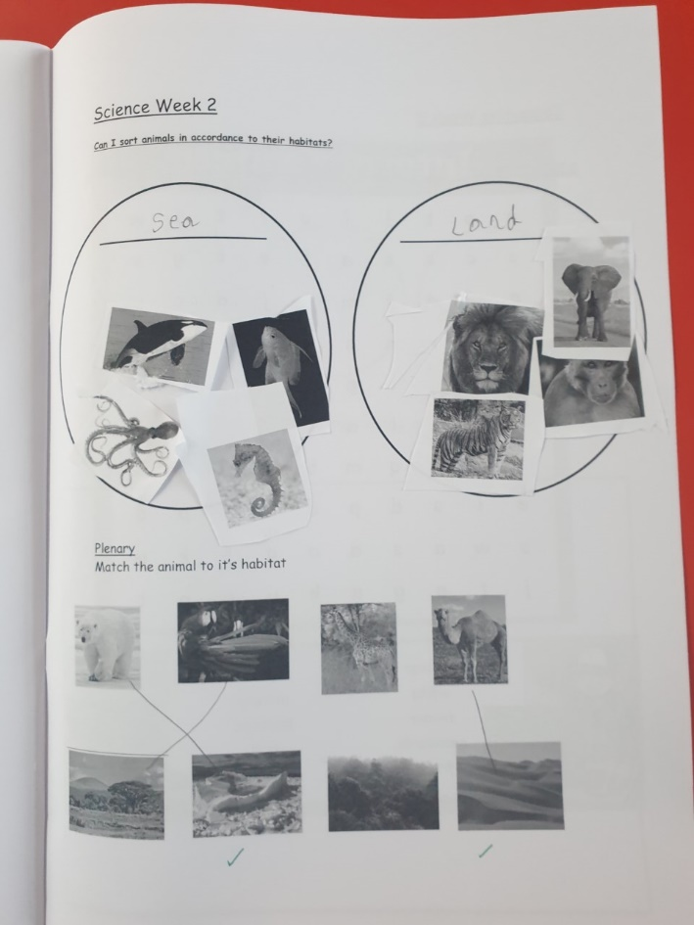
Birch Wow Work

Slide 17
Chestnut
Ollie
For his perseverance and attitude
towards his learning.
Miss Fisher 12.06.20

Slide 18
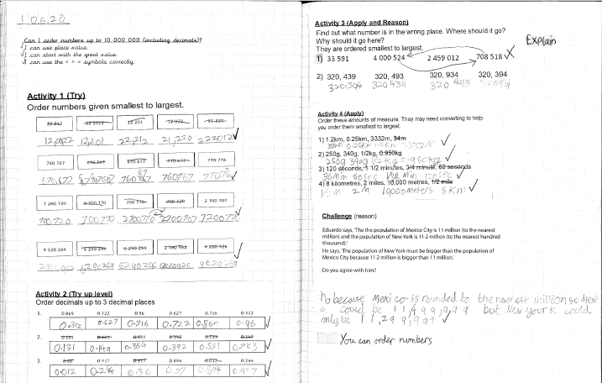
Chestnut Wow Work

Slide 19
Willow
Beau
For her perseverance in Maths. Well Done!
Miss Higgins & Mrs Pritchard 12.06.20

Slide 20
Willow Wow Work
Beau has persevered this week to master a new skill of long multiplication ☺
We are so, so proud of you!! Well done!

Slide 21
Spruce
Alex
For
Fantastic work in maths. Working independently to complete all tasks.
Miss Dawson 12.06.2020

Slide 22
Spruce Wow Work

Slide 23
Aspen:
Bethany
For showing excellence and passion towards all learning.
Mrs Maiden and Mrs Davies 12.06.20

Slide 24
Aspen Wow Work
Bethany has astounded us with her super questioning, facts and attitude towards all learning. Go girl!

Slide 25
Redwood
Josh
For
Good understanding of what makes a healthy meal, reflecting on his own dietary needs during lockdown and recognising what the food groups provide us.
Mr Tennuci 12.06.20

Slide 26
Next Week’s
Phrase of the Week:
Just because something doesn’t go as you planned, it doesn’t
mean it is useless.

