Slide 1
Wow Assembly:
Friday 6th November

Slide 2
Phrase of the Week:
It’s not what happens to you, but how you react to it that counts.

Slide 3
Green Cards!
Roux – Willow
Jay – Willow
Abbie- Willow
Isabel-Birch
Harvey - Maple

Slide 4
Scientists of the Week!
Pine – Callum
Elm – Ronnie
Ash – Sonny
Redwood – Ziva
Chestnut - Karina
Aspen- Elsie- Rae
Willow – Jake
Maple – Emily

Slide 5
Weekly Team Points!
Peel | Ethelfleda | Grazier | Offa
192
197
186
171

Slide 6
Oak
Alfie
For
Fantastic firework art.
Mrs Laffan 06 /11 /20

Slide 7
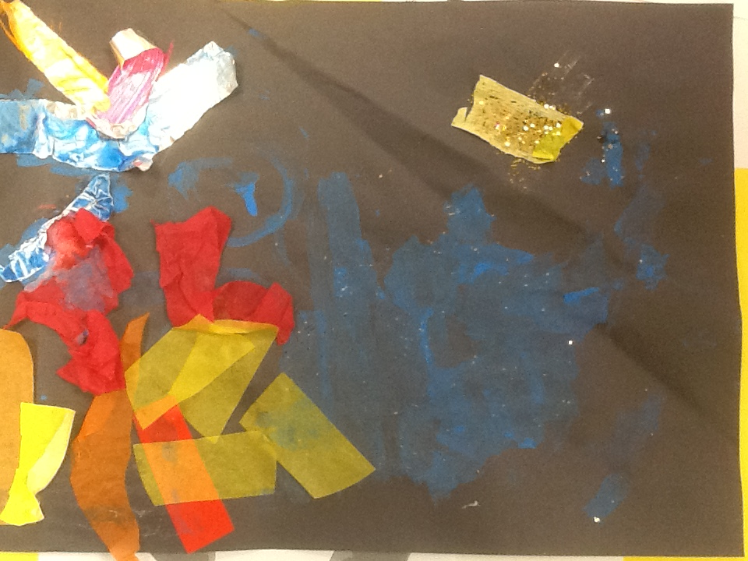
Oak Wow Work

Slide 8
Ash
Austin
For showing excellence in painting a penguin.
Miss Bailey 06/11/20

Slide 9
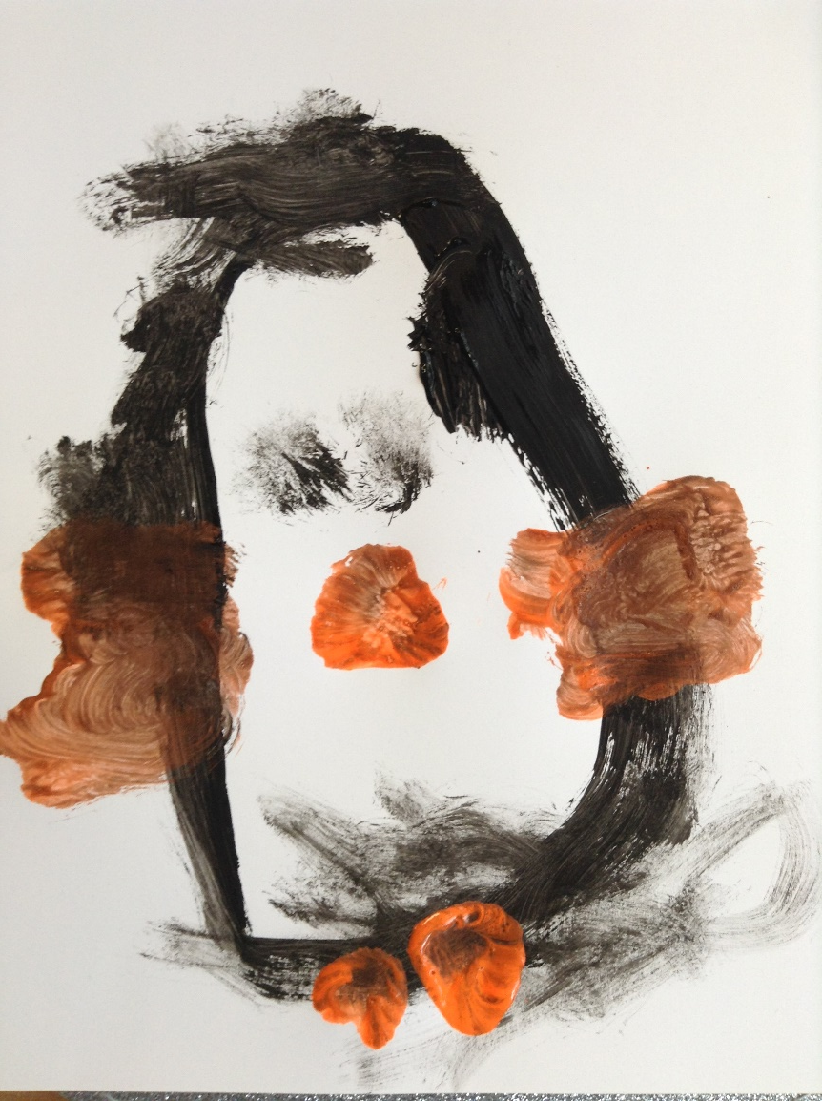
Ash Wow Work

Slide 10
Elm
Robyn Q
For
A superb start to your retell of ‘The Sword in the Stone’. You tried super hard and used story language!
Miss Brady 05 /11/20

Slide 11
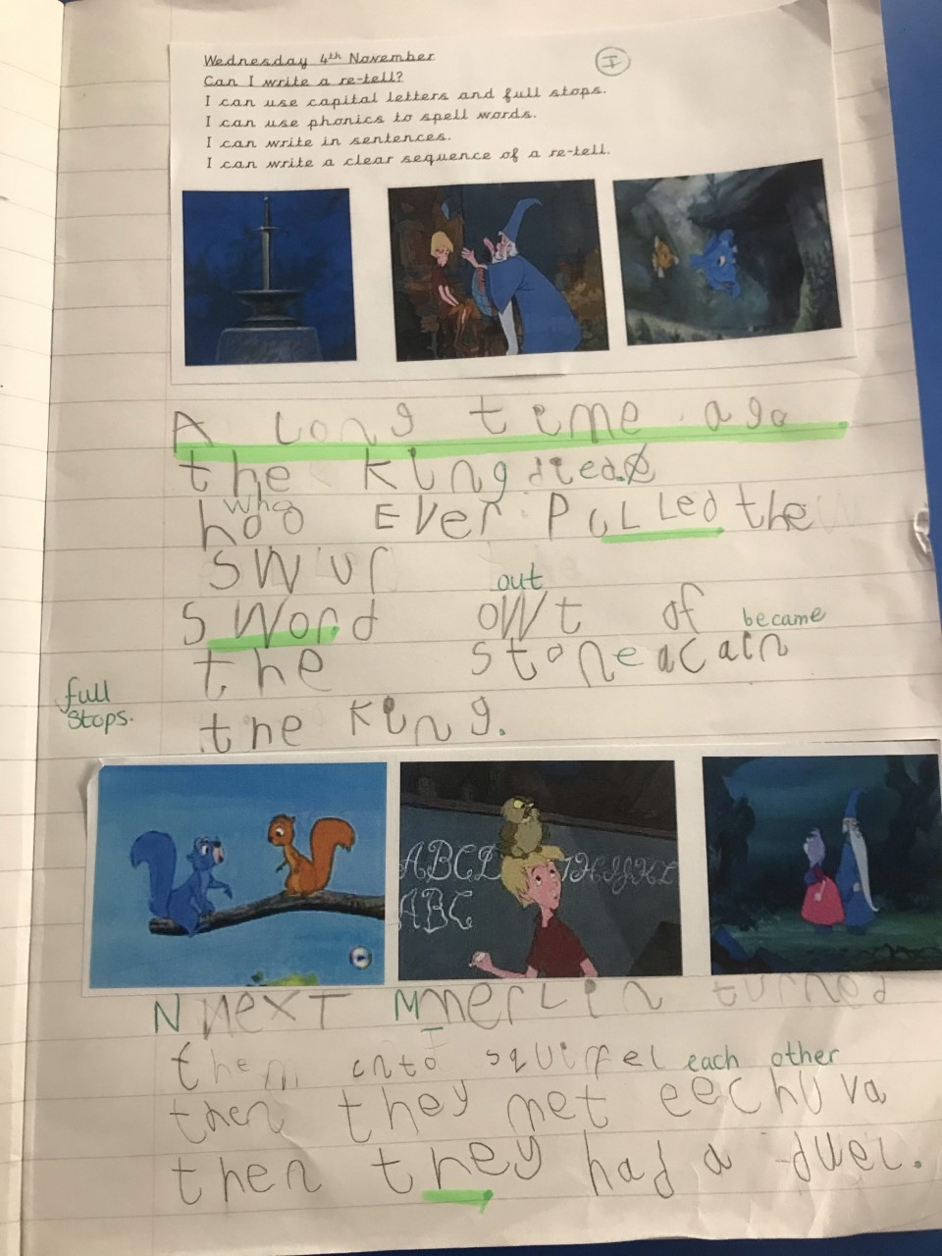
Elm Wow Work

Slide 12
Birch
Kody
For
A super effort in Art. Kody tried hard to create tone and texture using pencil when drawing a self portrait.
Miss Hewitt 06/11 /20

Slide 13
Birch Wow Work

Slide 14
Pine
Tarron
For using excellence and superb fine motor skills within an RE lesson to create a beautiful poppy wreath.
Mrs Leedham-Hawkes 06/11 /20

Slide 15
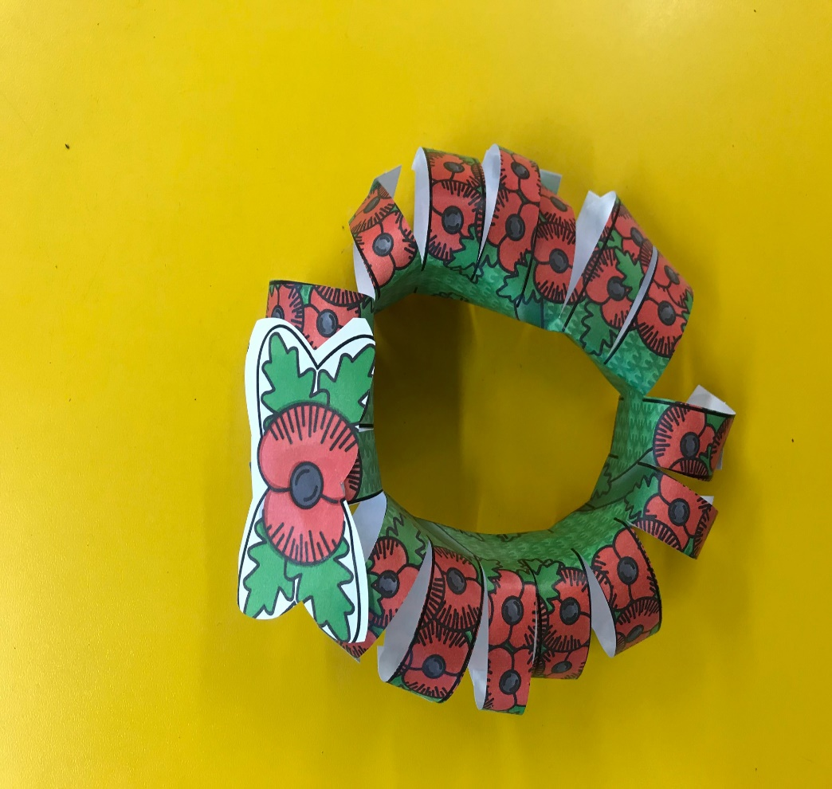
Pine Wow Work

Slide 16
Maple
Harvey
For working independently and completing all folder work.
Well done!
Miss Dawson 06 /11 /20

Slide 17
Maple Wow Work

Slide 18
Willow
Harry
For his amazing Maths work on fractions this week ☺
Mrs Maiden and Miss Higgins 06 / 11 /20

Slide 19
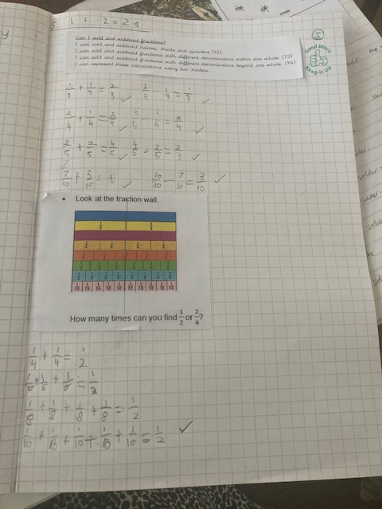
WillowWow Work
Harry has worked super hard on his maths work this week.
Harry could independently add and subtract fractions up to on whole.
Well done! Keep it up!!

Slide 20
Spruce
Eva
For
Showing a brilliant understanding of fractions
Mr Tennuci 6/11/20

Slide 21
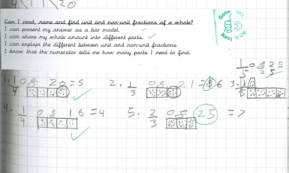
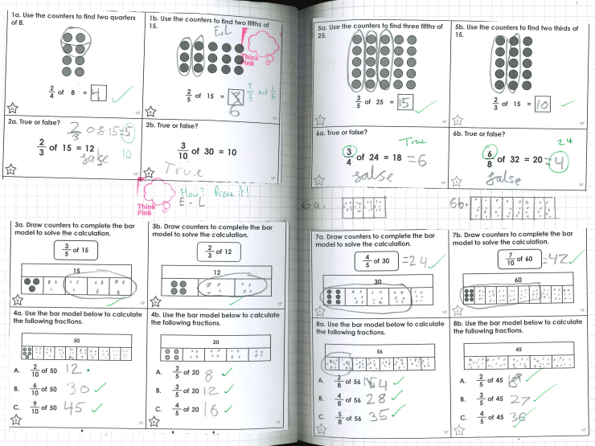
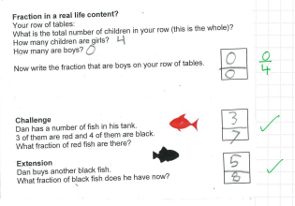
Spruce Wow Work

Slide 22
Chestnut
Jake M
For showing passion for our new learning about WW1.
Miss Fisher 6/11/20

Slide 23
Aspen
Ava
For showing excellence when calculating with decimals.
Go girl!
Mrs Davies 6 /11 /20

Slide 24
Aspen Wow Work

Slide 25
Redwood
Max
For outstanding teamwork and communication in PE
Miss Shipley 05 /11 /20

Slide 26
Next Week’s
Phrase of the Week:
I can accept failure but I cannot accept not trying!

