Slide 1
Wow Assembly:
Friday 11th March

Slide 2
Green Cards!
Ash – Gracie David- Maple
Pine – Jaycee Mollie - Maple
Evelyn-Birch
Felicity- Birch
Poppy- Birch
Phillip – Elm
Celia – Elm
Thomas – Elm
Codi-Lee – Elm
Leo - Willow

Slide 3
Scientists of the Week!
Oak –Louie
Ash – Jaxon
Birch – Remy
Pine – Liylie
Elm – Codi-Lee
Willow – Scarlet
Spruce – Elyza
Maple – Mollie B
Redwood – Evelyn E
Chestnut –
Aspen- Cian

Slide 4
Weekly Team Points!
Peel | Ethelfleda | Grazier | Offa
308 | 314 | 275 | 275

Slide 5
Oak
Stanley
For
Super instructions for planting a bean.
Mrs Laffan 11.03.22

Slide 6
Ash
Isaac
For great work to identify words that rhyme and find the odd word out.
Miss Bailey and Mrs Salt 11.03.22

Slide 7
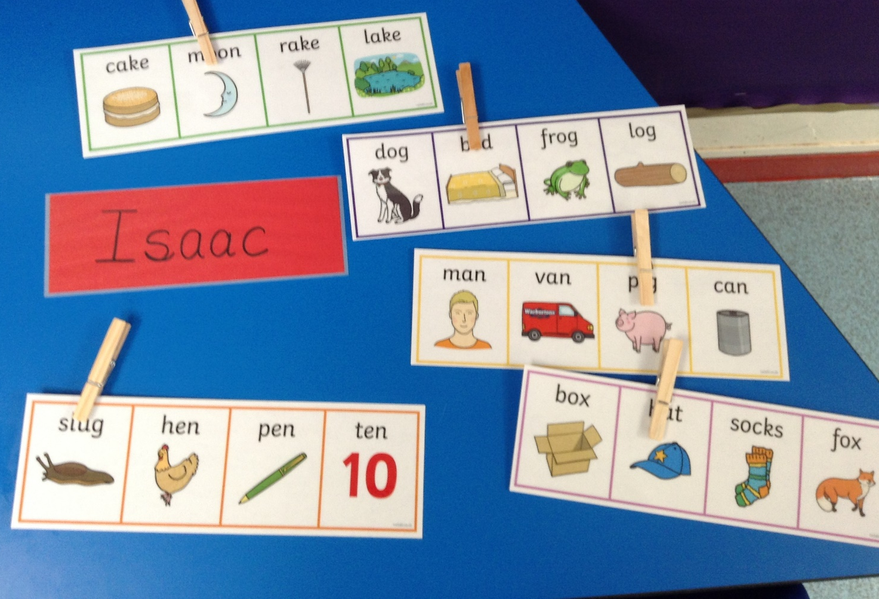
Ash Wow Work

Slide 8
Elm
Finley
For his excellent measuring this week. Finley was able to compare sticks in the forest area and measure the length of objects using bears and cubes!
Well done Finley!
Mr Grice 11.03.2022

Slide 9
Birch
For
Lilly
Lilly has shown resilience in maths this week. She has worked hard to learn the names of 2D shapes and their properties. She is able to group shapes in accordance to their properties and explain how she has done it! Well done Lil!
Miss Hewitt 11.03.22

Slide 10
Pine
Noel
For using passion and excellence in PE throwing a beanbag using an underarm throw. Well done ☺
Mrs Leedham-Hawkes 11.03.22

Slide 11
Maple
Malakai
For an amazing week solving different calculations including fractions.
Miss Dawson 10.03.2022

Slide 12
Willow
Elizabeth
For showing passion and enthusiasm in Design and Technology.
Miss Fisher 10.03.22

Slide 13
Spruce
Tobias
For making a real effort across the curriculum Tobias has worked hard in all subjects, even when he has found them tricky. Keep it up, Tobias!
Mr Draper 10.03.33

Slide 14
Chestnut
Mimi
Fantastic setting description and great use of the features used from this week.
Mr Tennuci 11.03.22

Slide 15
Aspen
Annalia
For amazing effort and showing wonderful map skills within Geography.
Mrs Read & Miss Bennett 11.03.22

Slide 16
Redwood
Gracie-Rose
For super effort and application of writing skills she has practised in Writing Club. Gracie is doing a great job of applying them in her own work.
Miss Shipley 11.03.22

