Slide 1
Wow Assembly:
Friday 25th September

Slide 2
Phrase of the Week:
Do what is right, not what is easy!

Slide 3
Green Cards!
Elyza– Birch

Slide 4
Scientists of the Week!
Birch – Kara
Pine – Lily-Belle
Elm – Ted
Redwood – Ruby W
Chestnut - Jax
Aspen- Wallis
Willow – Roux

Slide 5
Weekly Team Points!
Peel | Ethelfleda | Grazier | Offa
145
191
187
160

Slide 6
Elm
Brooke H
For
A absolutely superb narrative piece of writing! Keep up the hard work Brooke, you’re doing amazing!
Miss Brady 11.09.20

Slide 7
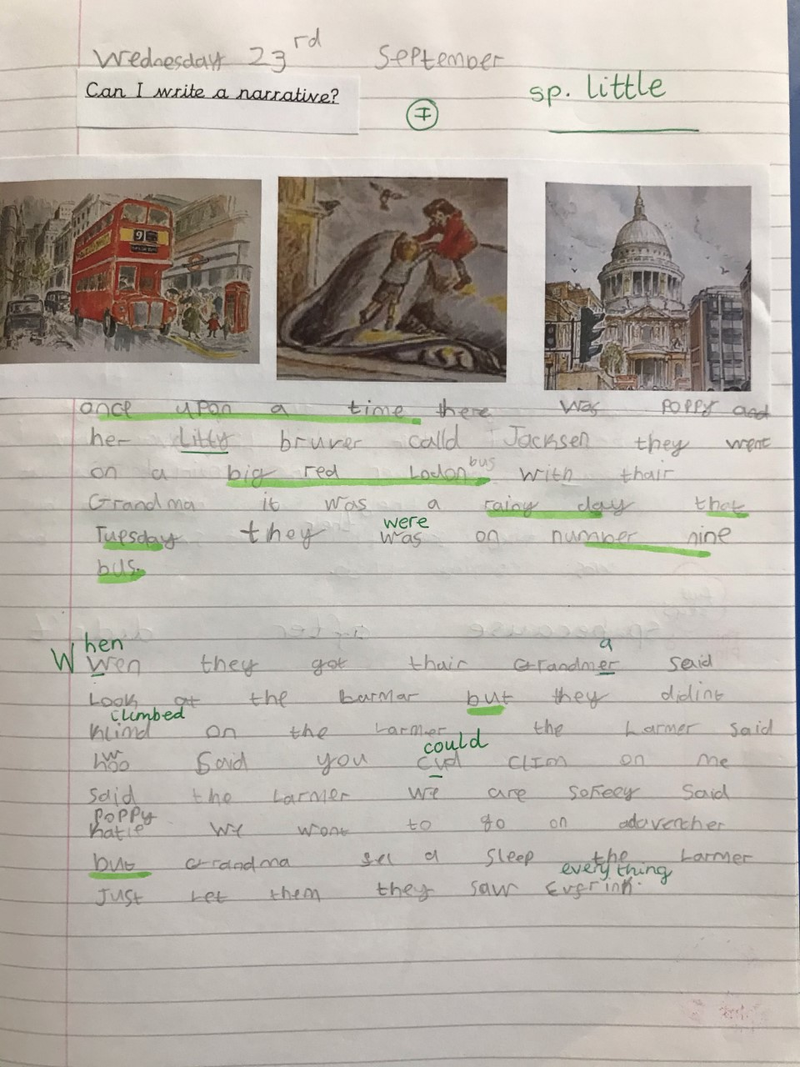
Elm Wow Work

Slide 8
Birch
Shavain
For
Super maths work. Shavain always challenges himself within maths and has worked hard at home to help to pass his 2 and 10 times tables ☺
Miss Hewitt 25.09.20

Slide 9
Pine
Evelae
For excellence in PE using her feet to dribble a ball and stop it within a Football lesson. Well done!
Mrs Leedham-Hawkes 25.09.2020

Slide 10
Maple
Phoebe
For always working to the best of her ability, being kind to others and helping in the classroom.
Miss Dawson 25.09.2020

Slide 11
Maple Wow Work
Phoebe is a pleasure to have in Maple. She always works to the best of her ability and is kind to others. Thank you Phoebe.

Slide 12
Willow
Evelyn
For her fantastic maths work this week! You have blown us away with how well you have applied your addition and subtraction knowledge. Well done ☺
Mrs Maiden and Miss Higgins 24.09.20

Slide 13
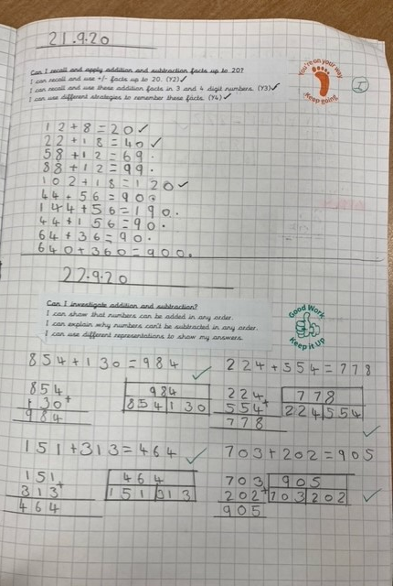
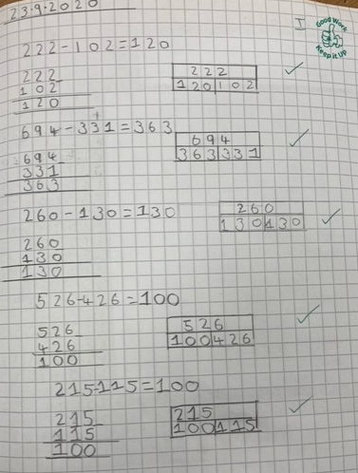
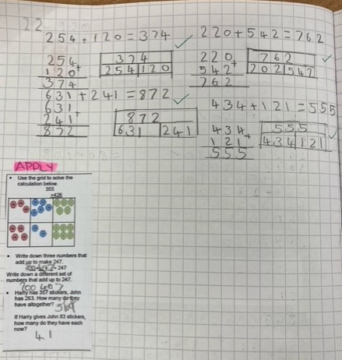
WillowWow Work

Slide 14
Spruce
Frankie
For
Being super quick at recalling his number facts to 20
Mr Tennuci 11.09.20

Slide 15
Chestnut
Charlie A
For fantastic work in Roman Numerals.
Well done Charlie!
Miss Fisher 11.09.20

Slide 16
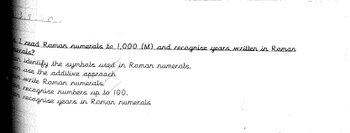
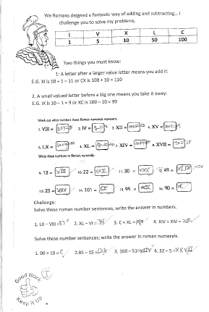
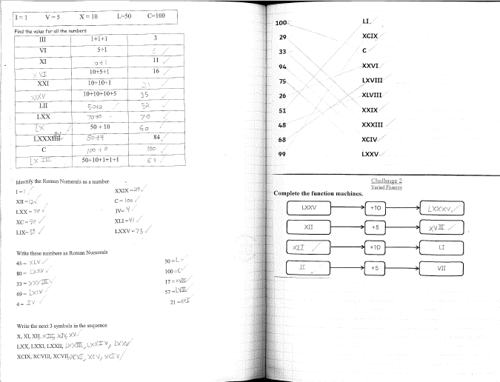
Chestnut Wow Work

Slide 17
Aspen
Joe Wall-White
For superb calculating and problem solving with Roman Numerals.
Mrs Davies 11.09.20

Slide 18
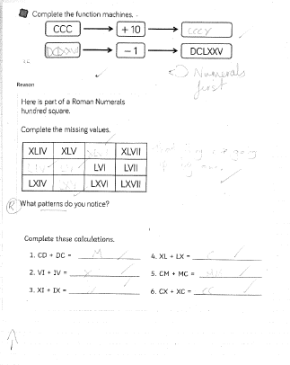
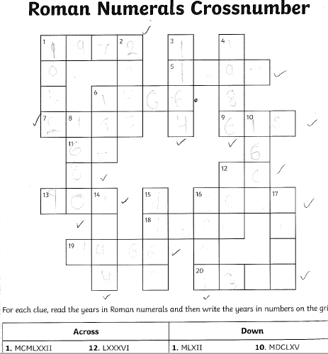
Aspen Wow Work

Slide 19
Redwood
Thomas L
For amazing effort and resilience in Maths
Miss Shipley 11.09.20

Slide 20
Redwood Wow Work
Thomas has amazed us all this week with his fantastic approach to learning and wonderful problem solving skills. He has shown that he is able to work with increasingly bigger numbers and will not back down from a challenge.
Well done, Tom, for all your wonderful work, effort and resilience. Keep it up!

Slide 21
Next Week’s
Phrase of the Week:
Success is a journey, not a destination!

