Slide 1
Wow Assembly:
Friday 16th September

Slide 2
Weekly Team Points!
Peel | Ethelfleda | Grazier | Offa
195 | 213 | 191 | 236

Slide 3
Scientists of the Week!
Oak –
Ash –
Birch – Esme Hill
Pine – Alaina
Elm – Brody
Willow – Ryan G
Spruce – Tobias
Maple –
Redwood –
Chestnut –
Aspen- Jake

Slide 4
Elm
Bethany
For great observational skills in science when observing signs of Autumn. Bethany found some great leaves and acorns in the woodland and was able to share what she could see when we looked at the objects under a microscope!
Mr Grice 16.09.2022

Slide 5
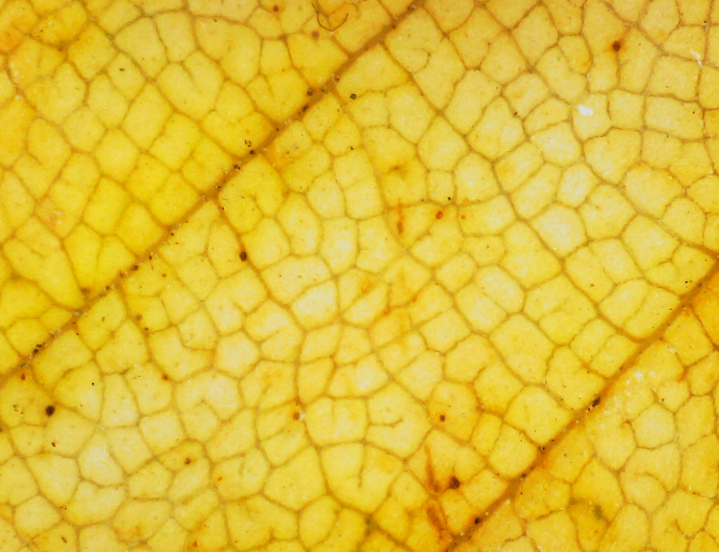
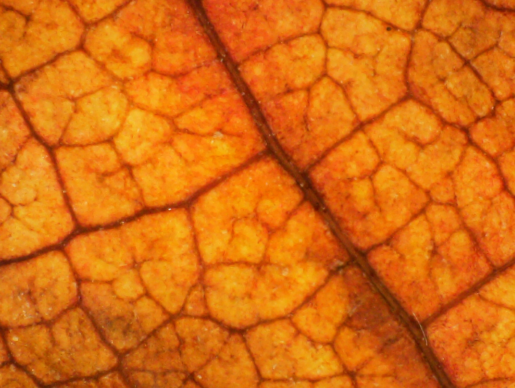
Look at what we could see under the microscope!

Slide 6
Birch
Nikola
For wonderful use of colour blending use different art media! Nikola creatively explored artistic techniques! Well done, wonderful art work!
Miss Pye 16.09.22

Slide 7
Pine
Jimmy
For his knowledge and curiosity during Science this week. Jimmy can explain in detail the four seasons including the weather and festivals that we experience during each. Well done Jimmy ☺
Miss Bailey & Miss Higgins 16.09.22

Slide 8
Maple
Callum A-B
Callum has worked extremely hard this week and has attempted tasks without support, becoming much more independent. Well done Callum!
Miss Dawson 16.09.2022

Slide 9
Willow
Cleo
For using excellent teamwork and communication, all week, when working in small groups or with a shoulder partner
Miss Shipley 16.09.22

Slide 10
Spruce
Elizabeth Curtis-Clark
For
Amazing effort and striving for excellence in English learning this week.
Mrs Read & Mrs Davies 8.9.22

Slide 11
Chestnut
Phoebe
For showing a fantastic hardworking attitude towards every subject throughout the day. I believe she is a model example of how we learn and keep improving ourselves.
Mr Tennuci 16.09.22

Slide 12
Aspen
Emma
For using excellence to determine word classes
Within complex clauses in English.
Well done ☺
Miss Volante and Mrs Leedham-Hawkes 16.09.22

Slide 13
Redwood
Phoebe
A fantastic piece of descriptive writing,
Incorporating links to texts and features of writing that we looked at this week.
Mrs Gill 16.09.22

