Slide 1
Wow Assembly:
Friday ^{20th} May

Slide 2
Phrase of the Week:
If it doesn’t challenge you, it won’t change you.

Slide 3
Green Cards!
Ash – Isabelle
Maple- Max
Ayla
Finley
Birch- Veer
Ryan
Elm –
Layla
Charley
Clara
Daisy
Celia
Adam

Slide 4
Scientists of the Week!
Oak – Jenson
Ash – Cole
Birch – Tymon
Pine – Laura
Elm – Thomas
Willow – Isabella
Spruce – Ezmai
Maple – Amelia
Redwood – Charlie W
Chestnut – Cody
Aspen- Cian

Slide 5
Weekly Team Points!
Peel | Ethelfleda | Grazier | Offa
342 | 332 | 335 | 336

Slide 6
Oak
Lola
For
Writing three wishes for the genie.
Mrs Laffan 13.05.22

Slide 7
Ash
Angie
For showing great understanding when answering worded Math’s questions.
Miss Bailey and Mrs Salt 20.05.22

Slide 8
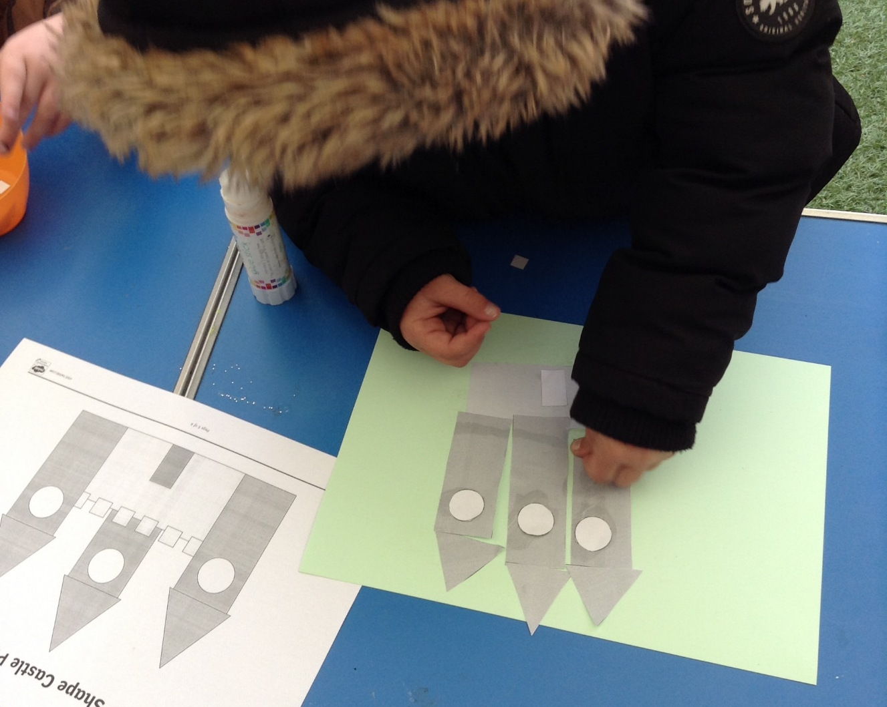
Ash Wow Work

Slide 9
Elm
Duke
For displaying resilience when building his Tudor House. Duke persevered when trying to secure his roof to his house! Great Work Duke, I can see you becoming an architect! ☺
Mr Grice 20.05.2022

Slide 10
Birch
For
Year 2
For having a positive attitude to their quizzes and trying their hardest. We are so proud of all of you! ☺
Miss Hewitt 20.05.22

Slide 11
Pine
Alfie
For using resilience for getting changed in PE. Alfie got changed independently in 2 minutes and 35 seconds. WOW.
Mrs Leedham-Hawkes 20.05.22

Slide 12
Maple
Kai
For showing a mature and sensible attitude and supporting his peers when needed.
Miss Dawson 19.05.2022

Slide 13
Willow
Liam
For using different methods in Maths when adding money. Keep up the great work.
Miss Fisher 19.05.22

Slide 14
Spruce
Kara
For her confidence and communication skills when telling the time!
Miss Volante 20.05.22

Slide 15
Chestnut
Emily
For demonstrating a wonderful ,positive attitude in her English this week. She showed a desire to persevere when at times she had some difficulties and sought out help to overcome these.
Mr Tennuci 20.05.22

Slide 16
Aspen
Avie
For a positive attitude towards learning in class, showing passion and creativity.
Miss Bennett & Mrs Read 20.05.22

Slide 17
Redwood
Charley W
For fantastic attitude to learning in Maths. Well done for taking on some really tricky challenges and staying resilient all week.
Miss Shipley 20.05.22

Slide 18
Next Week’s
Phrase of the Week:
“It’s worth remembering that it is often the small steps, not the giant leaps, that bring about the most lasting change.” Queen Elizabeth

