Slide 1
Wow Assembly:
Friday 10th July

Slide 2
Phrase of the Week:
With ordinary talent and extraordinary perseverance,
many things are achievable.

Slide 3
Birch
Alex P.
For writing a super story about his trip to the zoo
Miss Shipley 10.07.2020

Slide 4
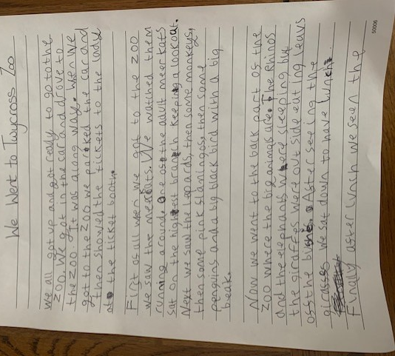

Slide 5
Willow
Jay W.
For excellent attitude to learning and trying his best all the time
Miss Shipley 26.06.2020

Slide 6
Willow
Ray G.
For super effort this week and trying out some new activities
Miss Shipley 10.07.2020

Slide 7
Spruce
Charlie S.
For amazing work on his own projects whilst at home
Miss Shipley 10.07.2020

Slide 8
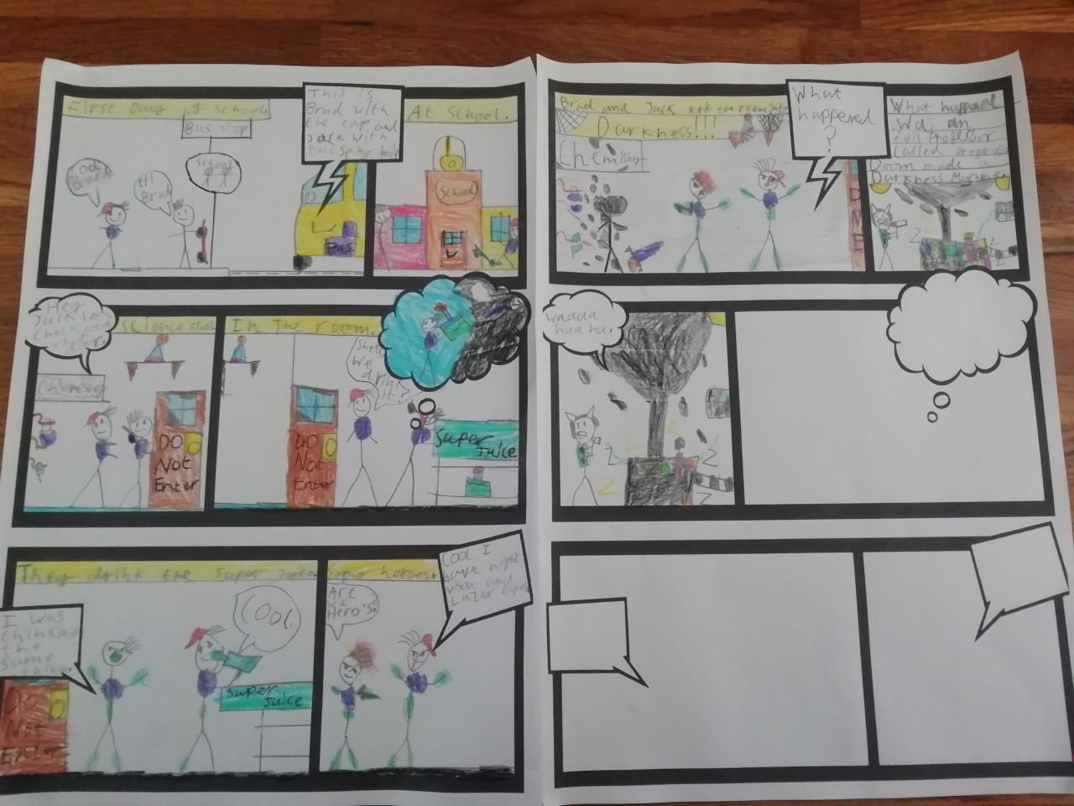

Slide 9
Spruce
Amber R.
For super imagination and using wonderful, adventurous language
Miss Shipley 10.07.2020

Slide 11
Maple
Molly R.
For amazing work with weights and measures when making cookies
Miss Shipley 10.07.2020

Slide 12
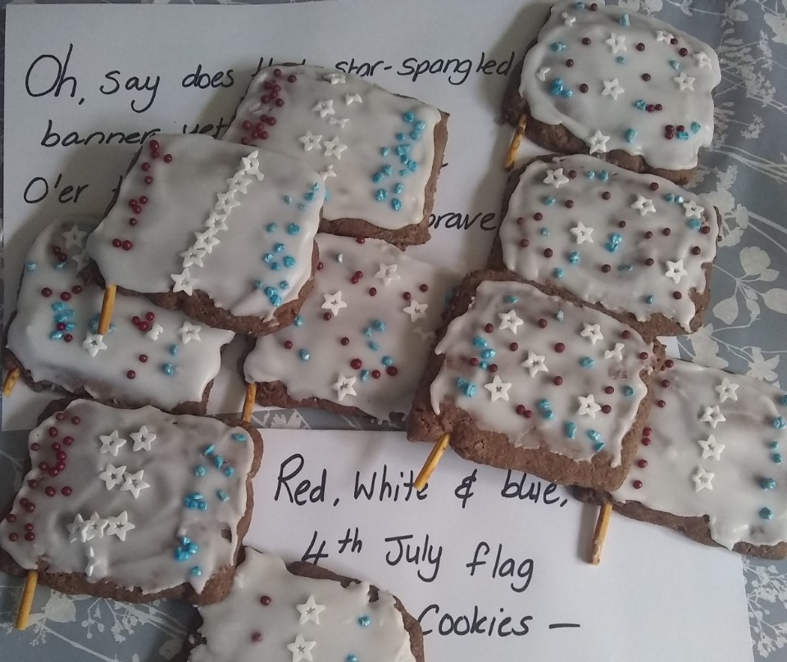

Slide 13
Chestnut
Amy T.
For outstanding design and textiles skills.
Miss Shipley 10.07.2020

Slide 14
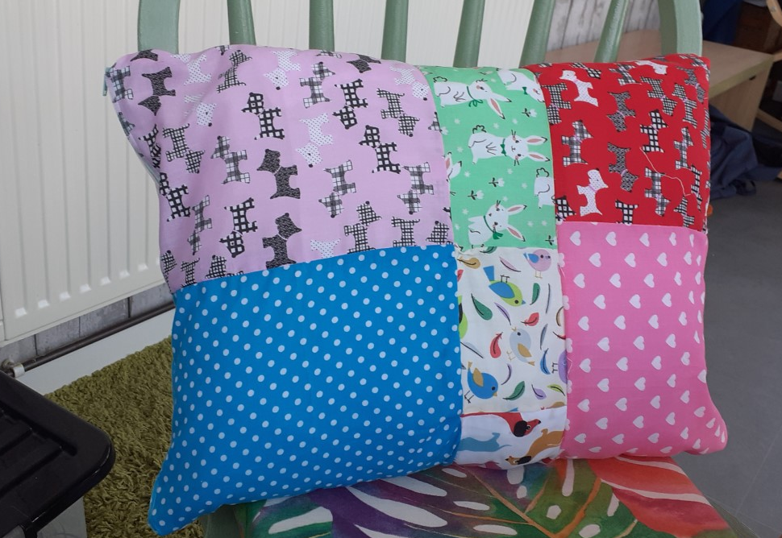

Slide 15
Chestnut
Natalia K.
For her wonderful attitude to learning and mastering new skills
Miss Shipley 10.07.2020

Slide 16
Redwood
Eloise H.
For wonderful dedication and attention to detail in her art work.
Miss Shipley 10.07.2020

Slide 17
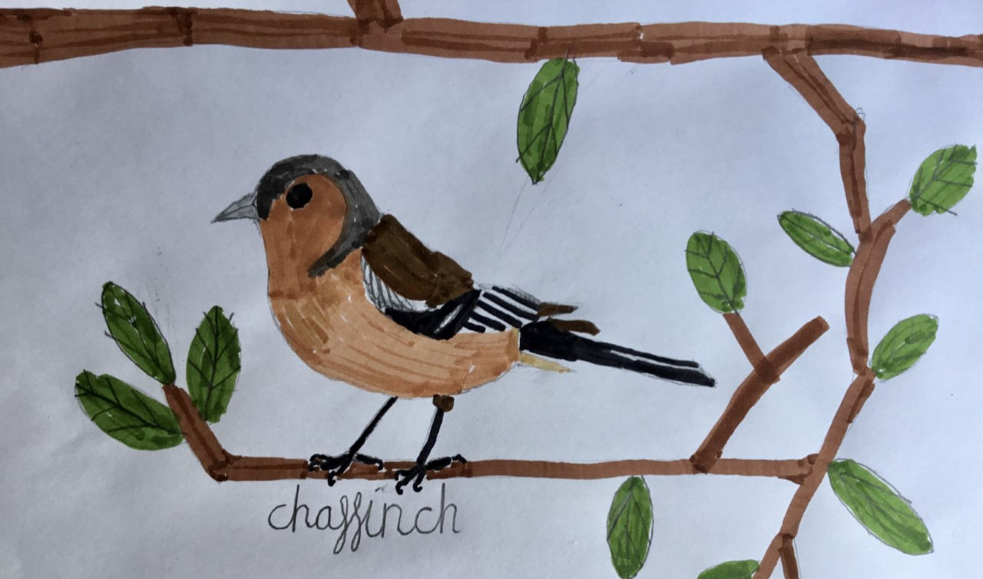

Slide 18
Well done to EVERYONE for all of your outstanding effort and hard work whilst we have been learning from home.
Have a wonderful summer!

