Slide 1



Wow Assembly:
Friday 3rd July

Slide 2
Phrase of the Week:
A ship is safe in the harbour, but that is not what it is built for.

Slide 3
Green Cards!
First name – class
Ronnie – Ash
Rocco - Oak
Sophie – Redwood
Rebecca – Redwood
Emily – Redwood
Archie - Redwood

Slide 4
Scientists of the Week!
Oak –Ryan
Ash - Ronnie
Cedar - Finley
Birch – Isabel
Pine – Kara S
Elm – (Not yet chosen, science today)
Willow –Emily
Spruce –Angel L
Maple – Jimi
Holly -
Redwood – Rebecca
Chestnut – Evie
Aspen- Lola

Slide 5
Weekly Team Points!
Peel | Ethelfleda | Grazier | Offa
183
164
163
162

Slide 6
Oak
Felicity
For
Super independent writing and a positive attitude to all learning.
Mrs Laffan 03.07.20

Slide 7
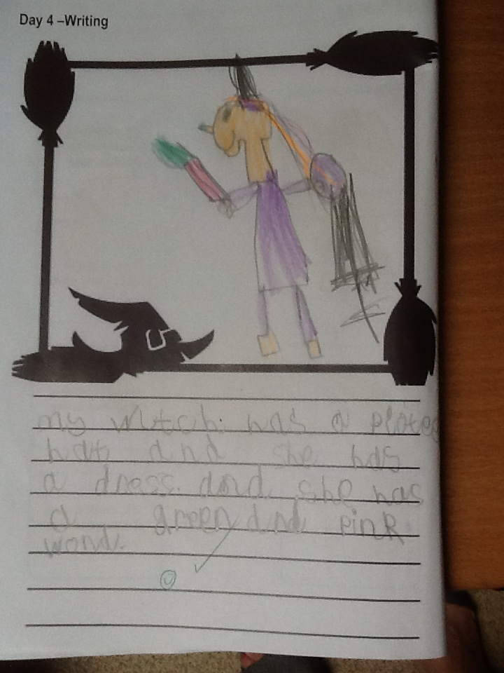
Oak Wow Work

Slide 8
Ash
Veer
For super reading and comprehension.
Well done Veer!
Miss Bailey 03.07.20

Slide 9
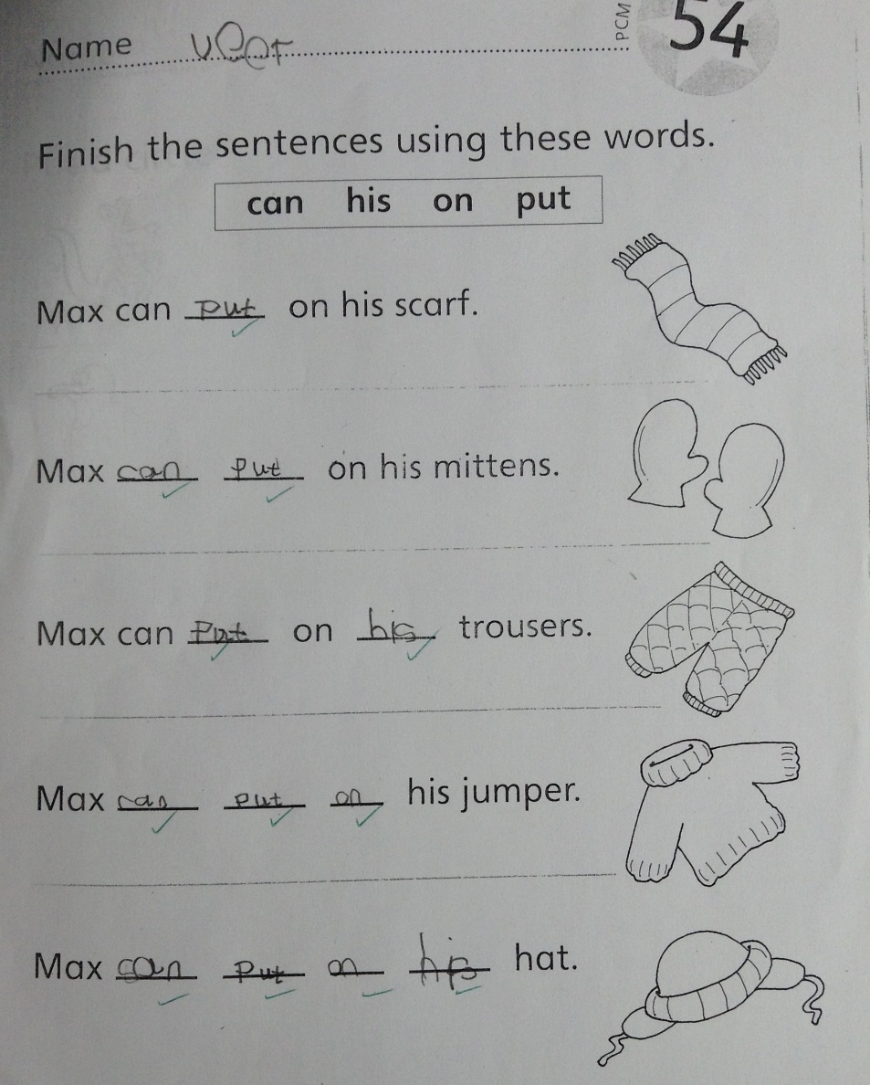
Ash Wow Work

Slide 10
Cedar
Daniel
For settling back into school and making positive contributions to our group.
Well done Daniel!
Mrs Scott 03.07.20

Slide 11
Pine
Harley W
For locating mountains and comparing hills and mountains in our topic work. Well done!
Mrs Leedham-Hawkes 03.07.20

Slide 12
Pine Wow Work

Slide 13
Elm
Lucy-Mae
For having such a positive attitude to learning, being resilient and persevering to find the answers to some tricky maths challenges!
Miss Brady 03.07.20

Slide 14
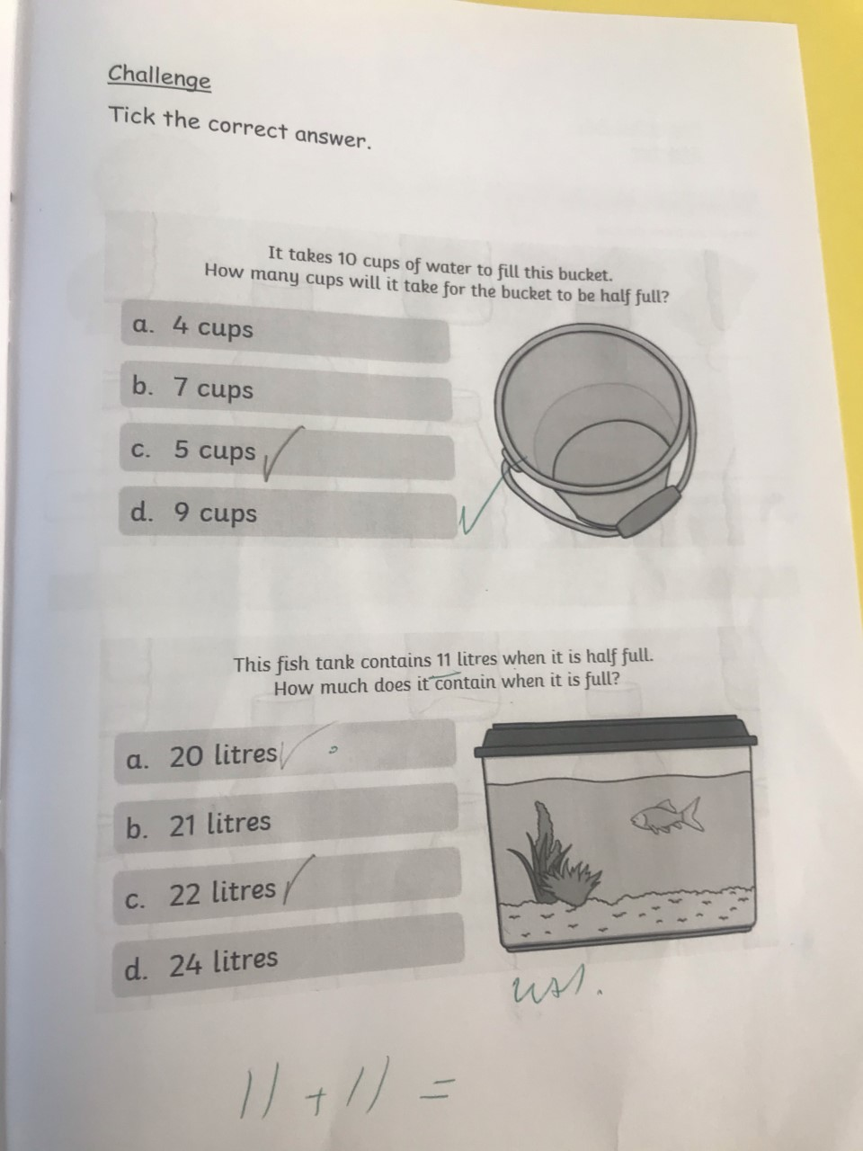
Elm Wow Work

Slide 15
Birch
Finley
For
Trying extremely hard to improve his handwriting and always giving 110% in everything he does!
Miss Hewitt 03.07.20

Slide 16
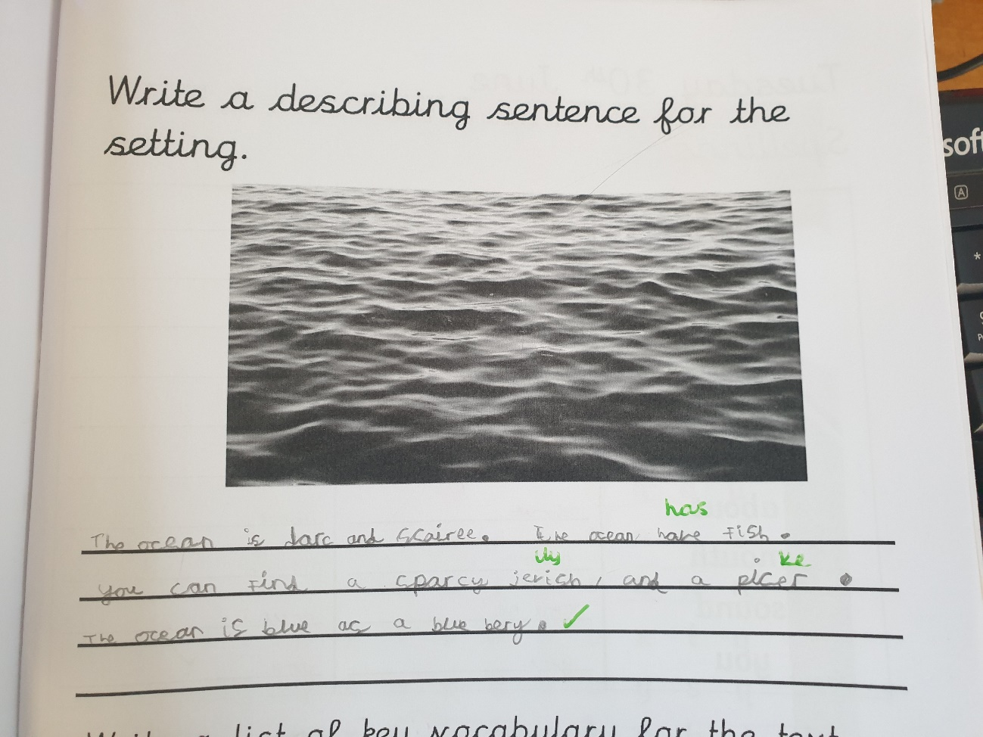
Birch Wow Work

Slide 17
Willow
Summer
For English.
What a fabulous letter you have written to persuade the judge following our verbal classroom debate.
You can definitely stand your ground Summer!! Well done☺
Miss Higgins 03.07.20

Slide 18
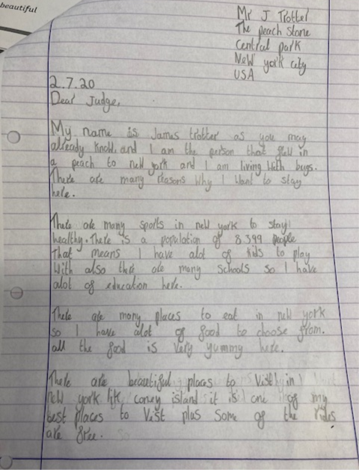
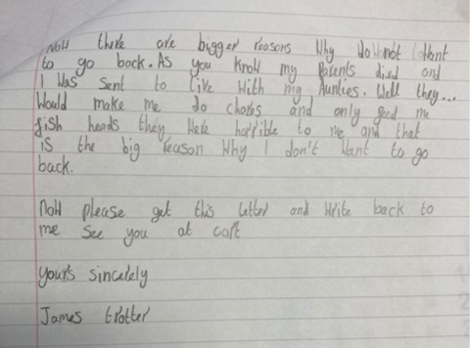
Willow Wow Work

Slide 19
Spruce
Freya
For
Writing a letter from Wilbur the cat.
Miss Dawson 03.07.2020

Slide 20
Spruce Wow Work
Dear Meow,
How are you? How was your holiday? I live with a clumsy witch called Winnie. She treads on my back and it really hurts. We went to the beach with Winnie and she lost her broom. Then I got wet then we went home. Winnie turned the whole garden into a pool. I loved it I even got to go in with Winnie on a float. Home is the best then the beach.
Lots of Love
Wilbur

Slide 21
Maple
Ziva
For having an amazing attitude to learning, working independently and challenging herself this week, especially in Maths. We’re really proud of you Ziva! ☺
Mrs Maiden and Mrs Pritchard 03.07.2020

Slide 22
Maple Wow Work
Well
done
Ziva!

Slide 23
Holly Wow Work
Amira
For
Creating brilliant ideas for describing character which were extremely original and including them in her writing to create an entertain read!
Mr Tennuci 03.07.20

Slide 24
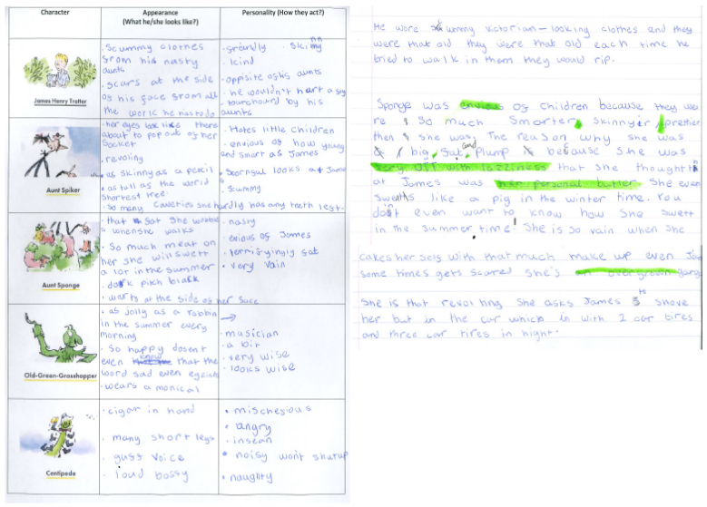
Holly Wow Work

Slide 25
Chestnut
Irwin
For fantastic knowledge and understanding of our topic on Henry VIII.
Miss Fisher 03.07.20

Slide 26
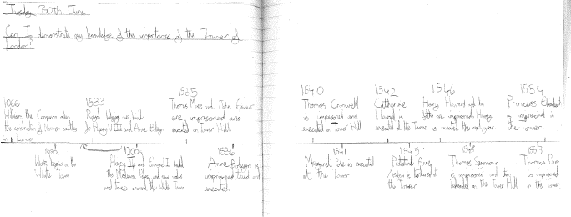
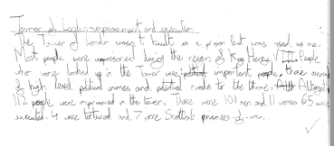
Chestnut Wow Work

Slide 27
Aspen:
Nikola
For superb perseverance and excellence in statistics. Nikola even managed to create her own pie chart using her knowledge of fractions. Go girl!
Mrs Davies 03.07.20

Slide 28
Redwood
Saahil
For amazing work during the hot seating session. Great role play of the executioner.
Mrs Goodman 03.07.20

Slide 29
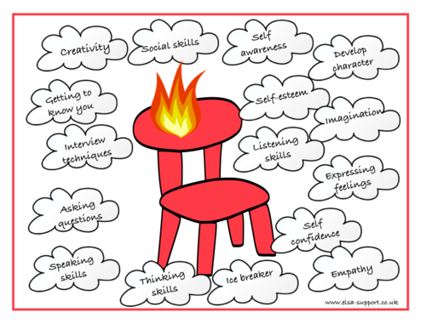
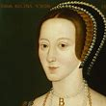
Redwood Wow Work

Slide 30
Next Week’s
Phrase of the Week:
With ordinary talent and extraordinary perseverance,
many things are achievable.

