Slide 1
Welcome to Redwood!
September
2022
Mrs S Gill

Slide 2
Teacher Profile:
Mrs Gill
Welcome to Redwood!
I can’t wait to join you in Redwood Class next year. We are going to have an amazing time.☺
Facts about me:
As you can see from the picture, I love Disney, especially Donald Duck. My favourite Disney films are Tangled and Encanto.
I am a musician, play lots of instruments and love Take That. I enjoy listening to music and will often burst into song. If you join me at Young Voices you’ll see what I mean.
I especially love teaching science, history, English and maths. I particularly like finding out new things about space. I met Tim Peake a couple of years ago too!

Slide 3
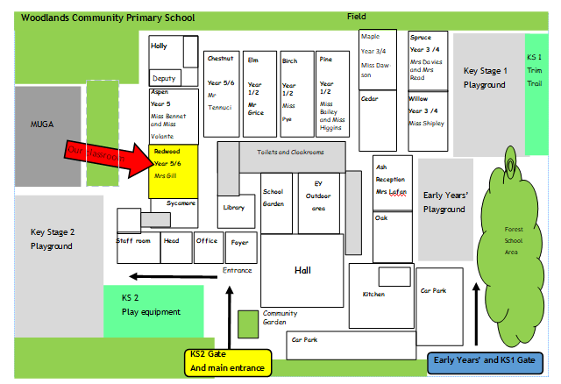
School Map
Here is the map of our school site:

Slide 4
Welcome to Redwood!

Slide 5
Welcome to Redwood!
Starting in autumn, gates and classes will open at 8:35am and register will start at 8:45am.
Learning ends and gates will open at 3:15pm. Children will leave school at 3:20pm

Slide 6
Welcome to Redwood!

Slide 7
Welcome to Redwood!

Slide 8
Welcome to Redwood!

Slide 9
Welcome to Redwood!

Slide 10
Welcome to Redwood!

Slide 11
Welcome to Redwood!

Slide 12
Break time!

Slide 13
Break time!

Slide 14
Break time!

Slide 15
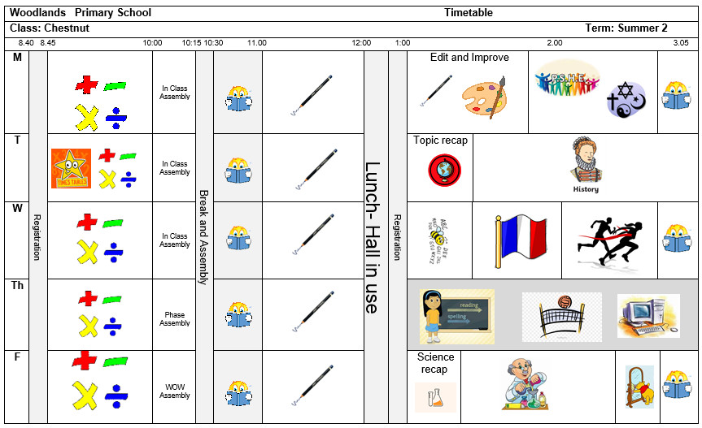
Timetable
Our timetable will look like this! We have Math, Reading and English every morning and our other subjects in the afternoons.

Slide 16
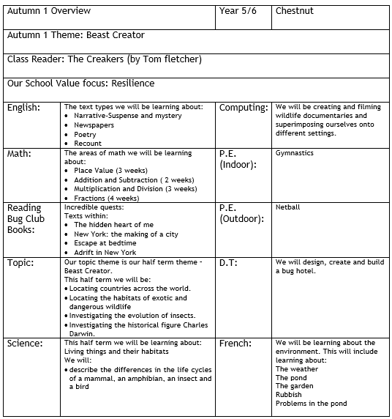
Learning Overview: Autumn 1
Here is an overview of what we will be learning during the first half term!

Slide 17
Houses:
Here are our school houses, named after important people from Tamworth’s history.
You will still be in the same house as last year – when you win team points, they all contribute to your team effort!
We will be voting for our new Year 6 House Leaders in September.

Slide 18
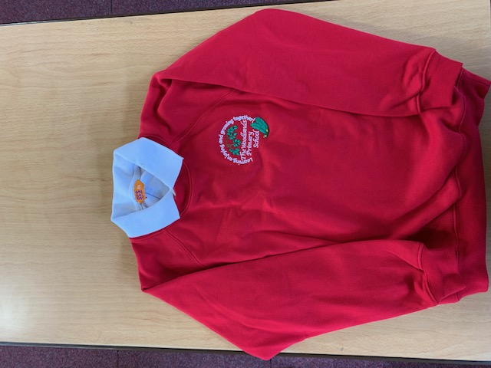
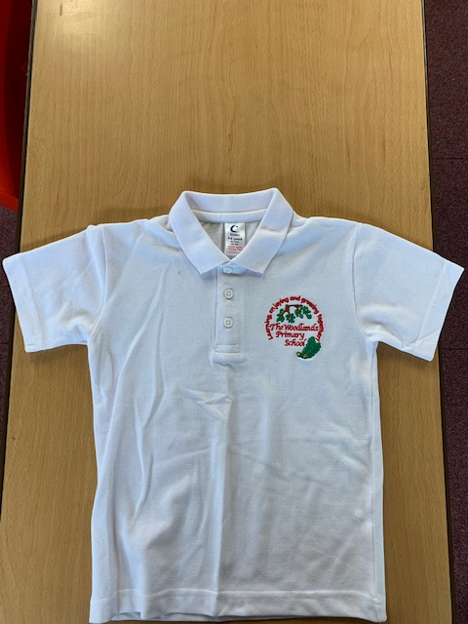
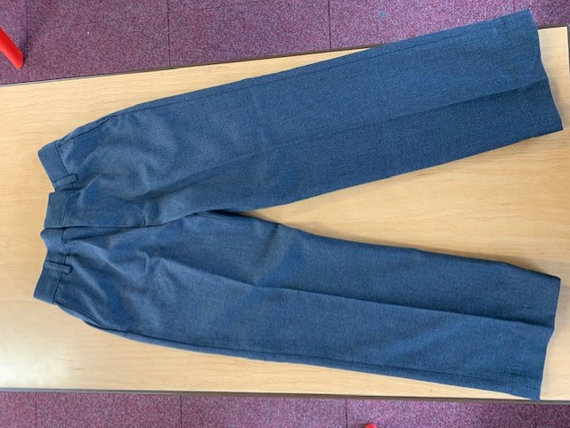
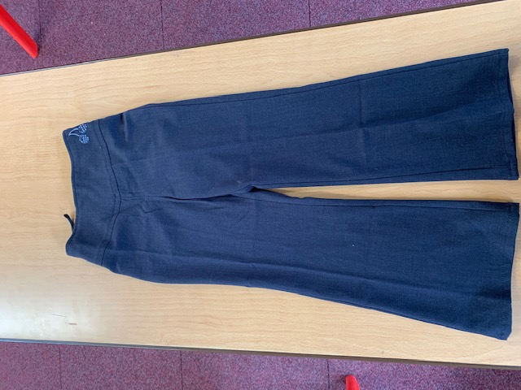
Uniform:
Please wear full school uniform every day.
Please make sure each item of uniform is clearly labelled with your name.
Please wear sensible school shoes – no trainers please.

Slide 19
PE Kit:
Please make sure you have your PE kit in school on the days you have PE.
Please make sure each item of kit is clearly labelled with your name.
Please don’t wear earrings on PE days.
If you have long hair, please tie it back on PE days.
Outdoor Kit
White T Shirt
Black jumper/tracksuit top. (No hood)
Black Tracksuit bottoms /Joggers.
Trainers
Indoor Kit
White T Shirt
Black/Navy shorts

Slide 20
Every day, please bring:
A water bottle with your name on
Your coat
Your reading book
Your reading diary
A school bag to hold all your belongings

Slide 21
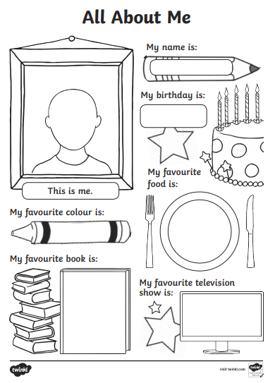
Please send us your ‘All About Me’ profiles !

