Slide 1
Wow Assembly:
Friday 19th June

Slide 2
Phrase of the Week:
Just because something doesn’t go as you planned, it doesn’t
mean it is useless.

Slide 3
Green Cards!
Tobias - Elm
Emily - Willow
Wilson -Willow
Casper - Ash
Anna-Lee
Noah

Slide 4
Scientists of the Week!
Oak –Seb
Ash – Casper
Cedar - Neve
Willow –
Spruce –
Birch –
Pine –Ella
Elm – Lucy-Mae
Redwood –
Chestnut – Ned
Aspen- Ben

Slide 5
Weekly Team Points!
Peel | Ethelfleda | Grazier | Offa
104
127
182
116

Slide 6
Oak
Evelae
For
Settling back in really well and for her fantastic writing. Keep it up! ☺
Mrs Laffan 19.06.20

Slide 7
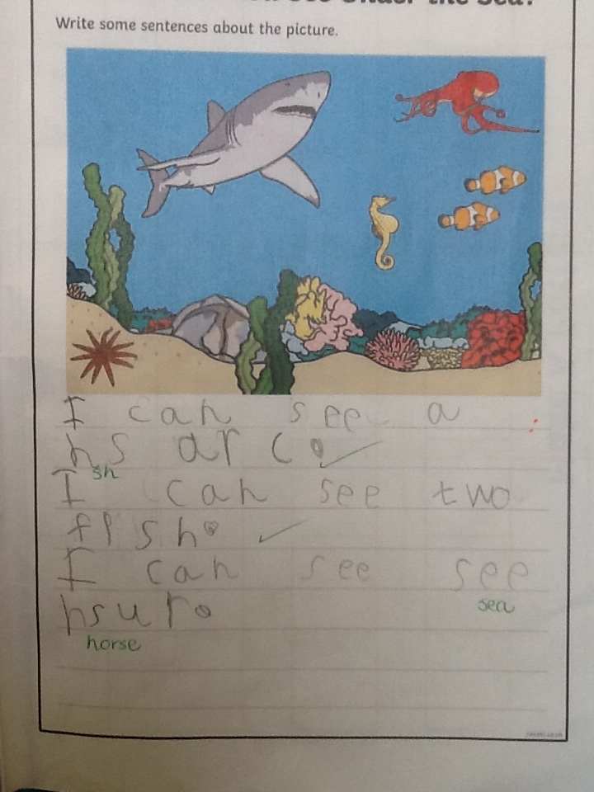
Oak Wow Work

Slide 8
Ash
Sophia
For super independent maths work. She was able to create her own repeating patterns using pictures. Sophia challenged herself to make some harder patterns and succeeded.
Well done Sophia!
Miss Bailey 19.06.20

Slide 9
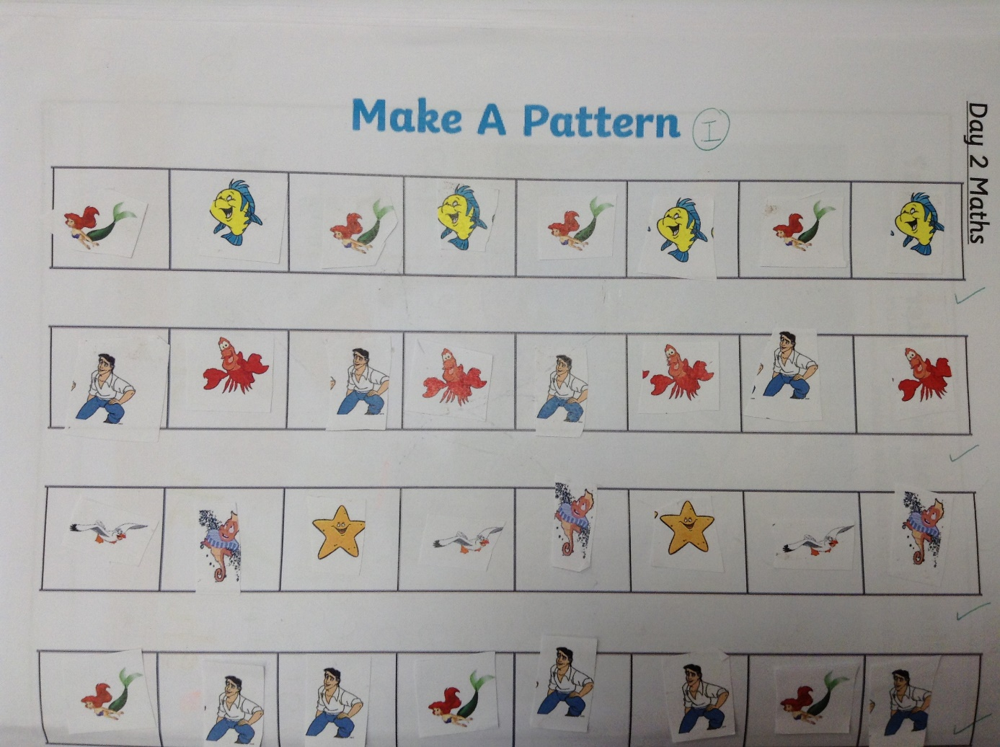
Ash Wow Work

Slide 10
Cedar
Amelia
For super phonics work. She was able to hear and identify the initial sounds to match the picture.
Well done Amelia!
Mrs Scott 19.06.20

Slide 11
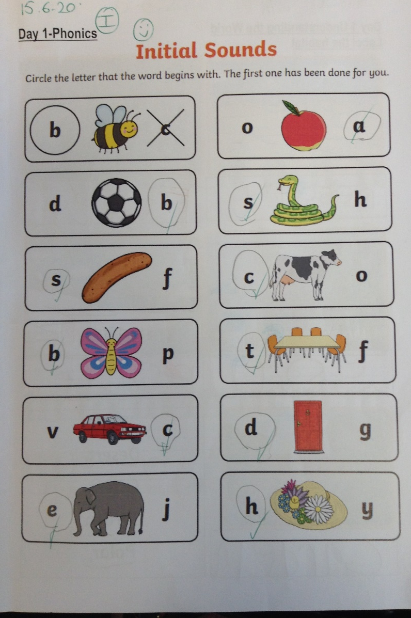
Cedar Wow Work

Slide 12
Pine
Cleo
For excellent research and note taking in English.
Mrs Leedham-Hawkes 19.06.20

Slide 13
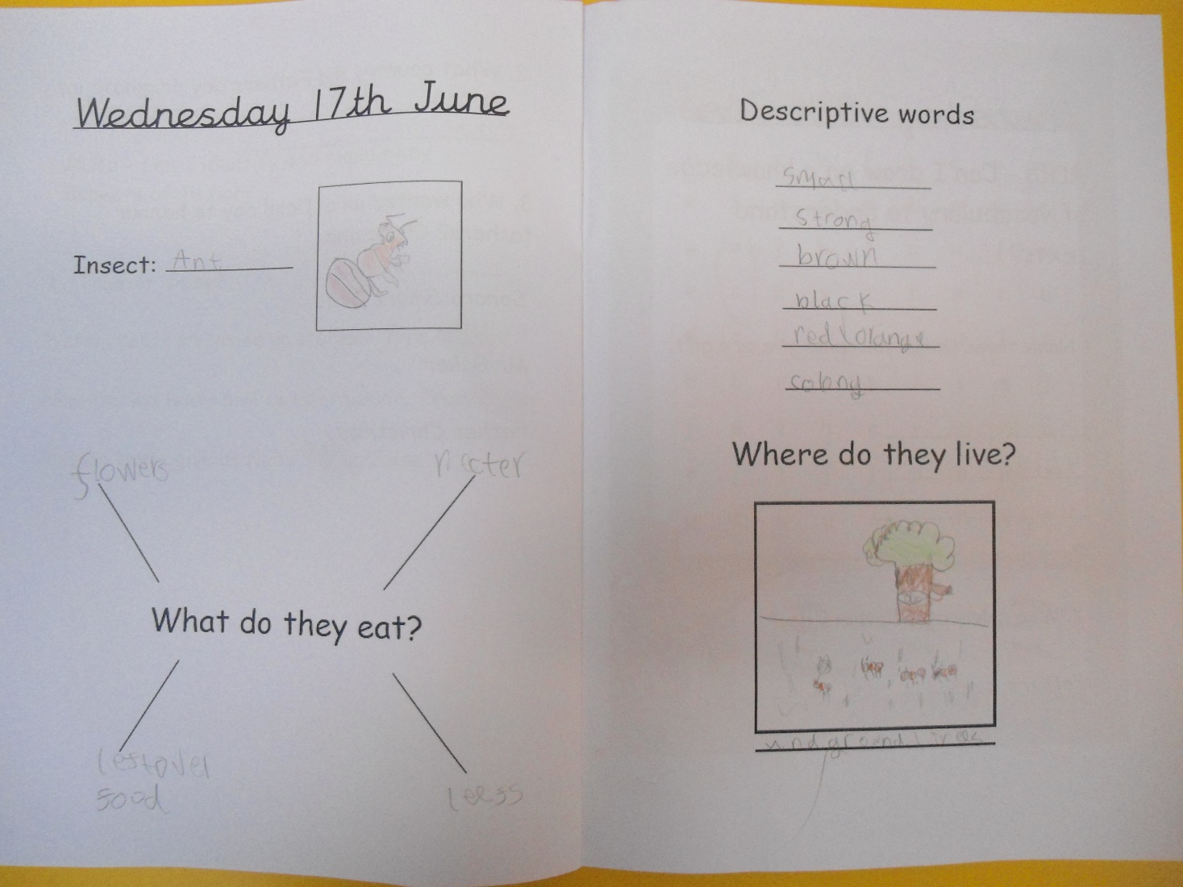
Pine Wow Work

Slide 14
Elm
Cody
For
Trying hard and persevering through his maths work independently. Well done Cody!
Miss Brady 19.06.20

Slide 15
Elm Wow Work

Slide 16
Birch
Ruby
For coming back to school with a fantastic attitude and producing a superb piece of written work.
Miss Hewitt 19.06.20

Slide 17
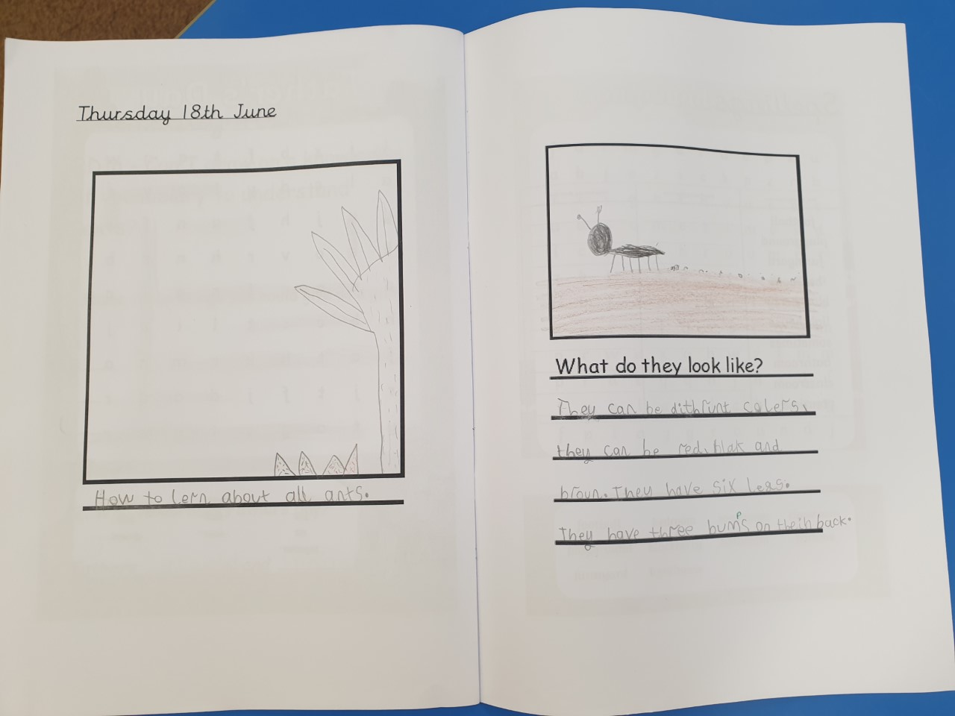
Birch Wow Work

Slide 18
Willow
Faith
For AMAZING art work ☺
Faith has created some fabulous art work over the week. Her sketching skills are awesome. Well done Faith!!
Miss Higgins 19.06.20

Slide 19
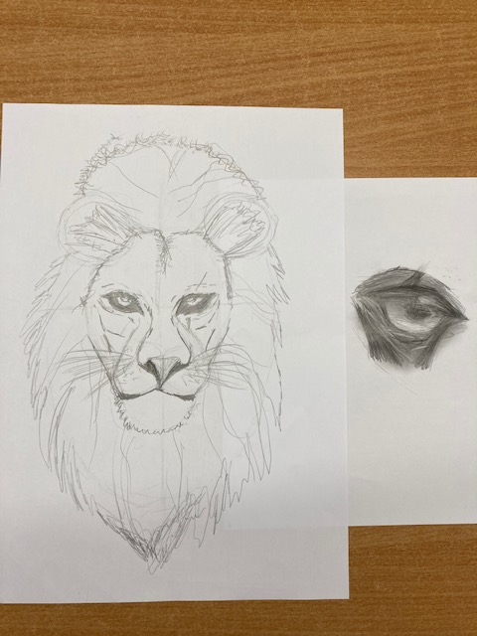
Willow Wow Work

Slide 20
Spruce
Harry
For working really hard and persevering to complete his maths work.
Miss Dawson 19.06.2020

Slide 21
Spruce Wow Work

Slide 22
Maple
Alfie S
For settling back into school so quickly and being a mature and sensible member of our bubble!
Mrs Maiden 19.06.2020

Slide 23
Maple Wow Work
Alfie has produced some fantastic work in all areas of the curriculum this week but has impressed us most with his Maths and Art – not to mention his dance moves in PE!

Slide 24
Chestnut
Bella
For a wonderful use of sketching techniques to create the Tudor Rose.
Miss Fisher 12.06.20

Slide 25
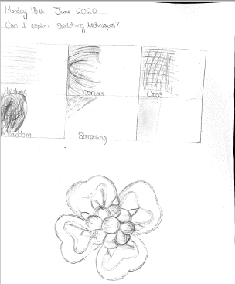
Chestnut Wow Work

Slide 26
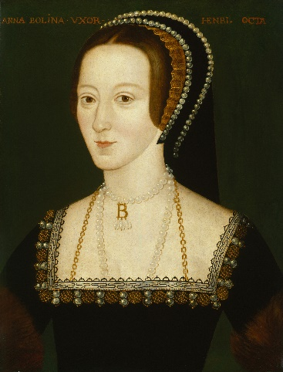
Aspen:
Anna
For her superb knowledge and enthusiasm about The Tudors.
Anna has gone above and beyond to research at home and teach the class new facts.
Mrs Davies 19.06.20

Slide 27
Aspen Wow Work

Slide 28
Redwood
Sophie
For
Excellence in Maths and always showing fantastic perseverance with challenges given.
Mr Tennuci 19.06.20

Slide 29
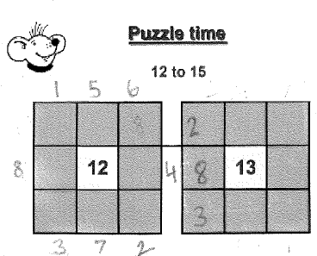
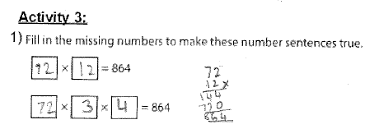
Redwood Wow Work

Slide 30
Next Week’s
Phrase of the Week:
A recipe burned is
a lesson learned.

