Slide 1
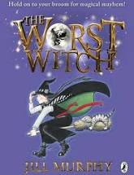
The Worst Witch
By Jill Murphy
Read by Mrs Maiden

