Slide 1
Wow Assembly:
Friday 14th October

Slide 2
Weekly Team Points!
Peel | Ethelfleda | Grazier | Offa
104 | 119 | 111 | 146

Slide 3
Scientists of the Week!
Oak –
Ash –
Birch – Matthew
Pine –
Elm – Ella
Willow – Cleo
Spruce – Poppy
Maple –
Redwood – Sophia
Chestnut –
Aspen- Amber

Slide 4
Green Cards!
Olivia – Pine Sinead- Pine
Brandon – Redwood
Avie – Redwood
Toriey – Redwood
Evelyn – Redwood
Malakai – Redwood
Amber – Aspen
Violet – Aspen
Riley WP - Aspen

Slide 5
Ash
Jack W
For a positive attitude to learning and creating a repeating pattern using natural resources.
Mrs Laffan 14.10.2022

Slide 6
Elm
Brody
For excellent resilience during our Forest day!
Brody persevered to make Mr Grice an excellent Royal bed. It was so comfy… fit for a King!
Mr Grice 14.10.2022

Slide 7
Birch
Liylie Ibbotson
For wonderful creativity and skill in Art!
Liylie has selected the right colours and used great brush strokes to paint a wonderful re-creation of Van Gogh’s Starry Night. Her artwork looks very impressive, well done!
Miss Pye 14.10.22

Slide 8
Pine
Gracie
Gracie has had a fantastic week with his maths learning. She has worked really hard in maths to compare numbers confidently and was able to say “ten is greater than six”.
Miss Bailey & Miss Higgins 14.10.22

Slide 9
Maple
Ollie T.
In our Religious and World views’ lessons, Ollie always shows a mature approach and answers questions after careful consideration. He has identified the meaning of symbols and items that are important to the Christian and Jewish faiths and has compared some of these items.
Miss Dawson 07.10.2022

Slide 10
Willow
Ryan G.
For demonstrating amazing communication and listening skills during our obstacle course on Forest Day
Miss Shipley 14.10.22

Slide 11
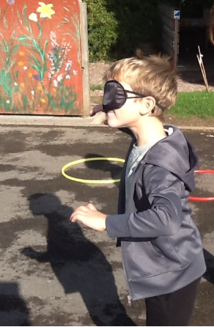

Slide 12
Spruce
Faith
For
Being a fabulous role model in our class. Demonstrating excellent behaviour and attitude to her learning at all times. Super star!
Mrs Read & Mrs Davies 14.10.22

Slide 13
Chestnut
Tobias
Tobias has come across some difficulties within his maths and English this week, but he has been proactive and sort out support when he needed it. This has benefitted him well and help him develop his understanding of new areas of learning.
Mr Tennuci 14.10.22

Slide 14
Aspen
Frankie
For excellent mathematical skills in number.
Miss Harvey and Miss Volante 14.10.22

Slide 15
Redwood
Lily Cm
Amazing resilience in her maths learning.
Mrs Gill 14.10.22

