Slide 1

Welcome to Maple!
September
2020
Miss Dawson

Slide 2
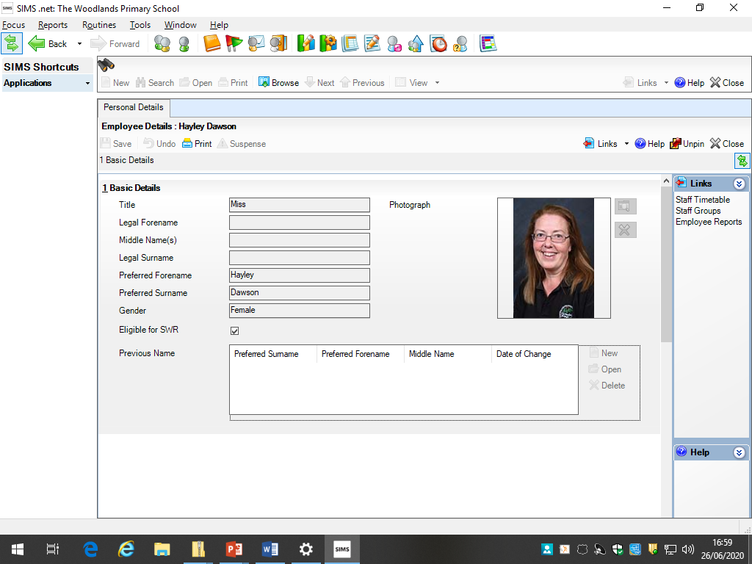
Teacher Profile:
Miss Dawson
Welcome to Maple!
I am really looking forward to welcoming the year 4s back (I have missed you all) and meeting the new year 3s. I cant wait to be your new teacher! ☺
Facts about me:
I love to sing although I don’t sound very good!!
I love to read and my favourite subject is Maths.

Slide 3
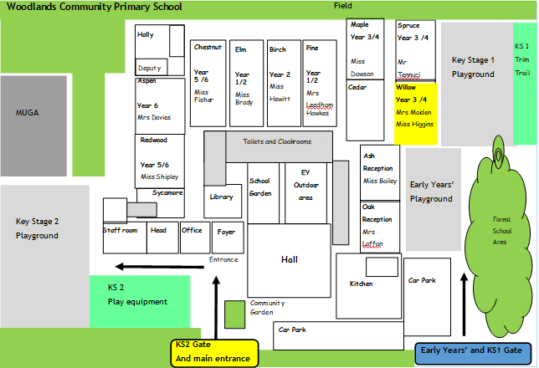
School Map
Your classroom is here!
Here is the map of our school site:

Slide 4
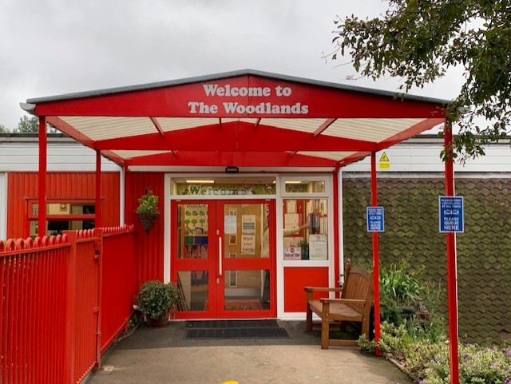
Welcome to Maple!

Slide 5
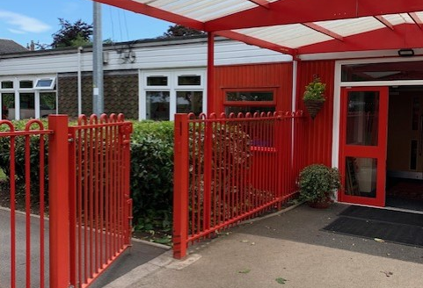
Welcome to Maple!

Slide 6
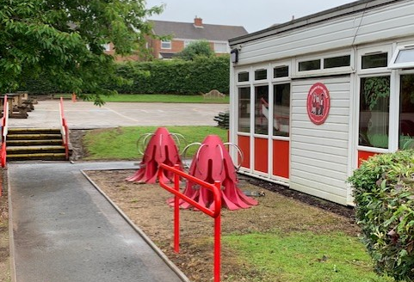
Welcome to Maple!

Slide 7
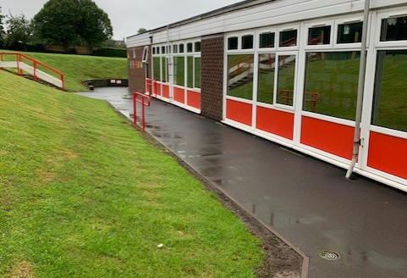
Welcome to Maple!

Slide 8
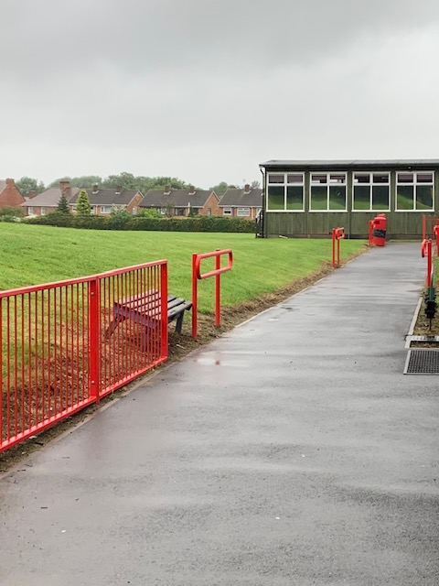
Welcome to Maple!

Slide 9
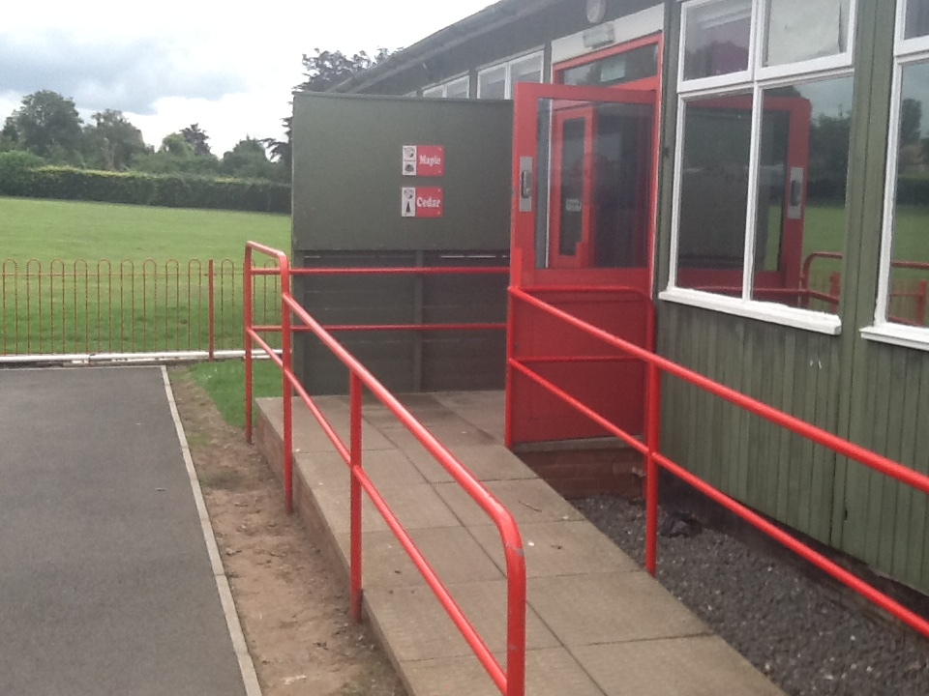
Welcome to Maple!
Come into your classroom through this entrance:

Slide 10
Welcome to Maple !
Come on in !

Slide 11
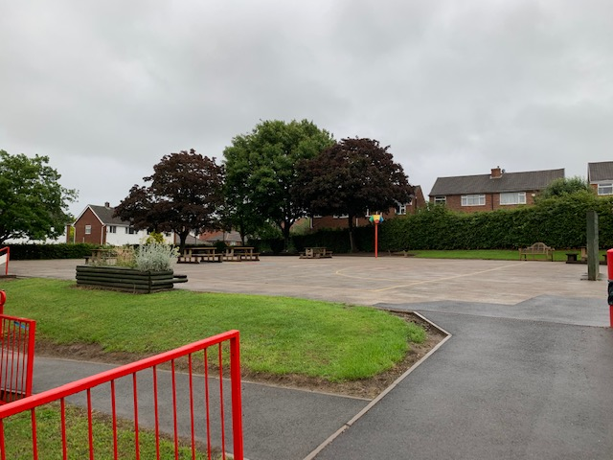
Play time!

Slide 12
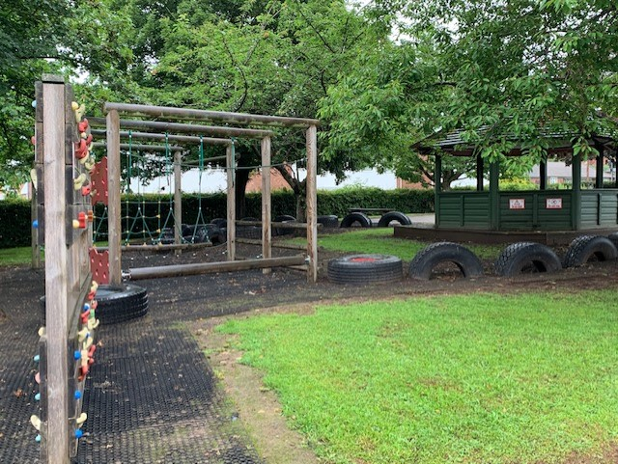
Play time!

Slide 13
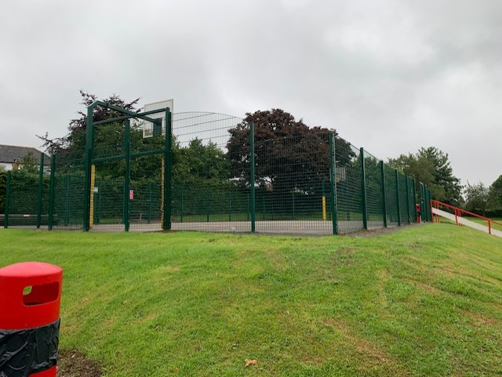
Play time!

Slide 14






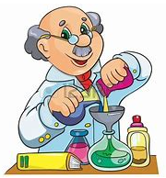

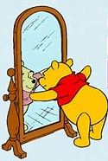




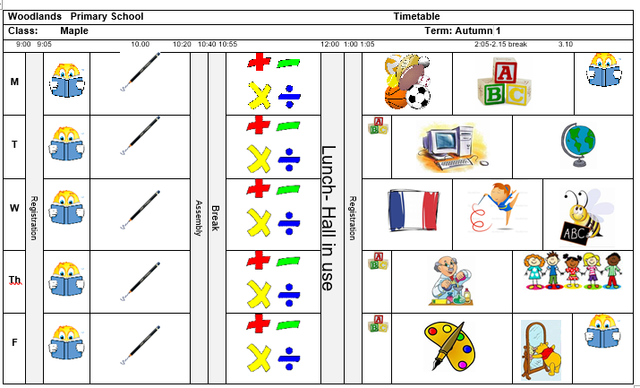
Timetable:
Our timetable will look like this! We have Guided Reading, English and Maths every morning and our other subjects in the afternoons.

Slide 15
(Insert picture of parent overview, adapted from Aut 1 MTP)
Here is an overview of what we will be learning during the first half term!

Slide 16
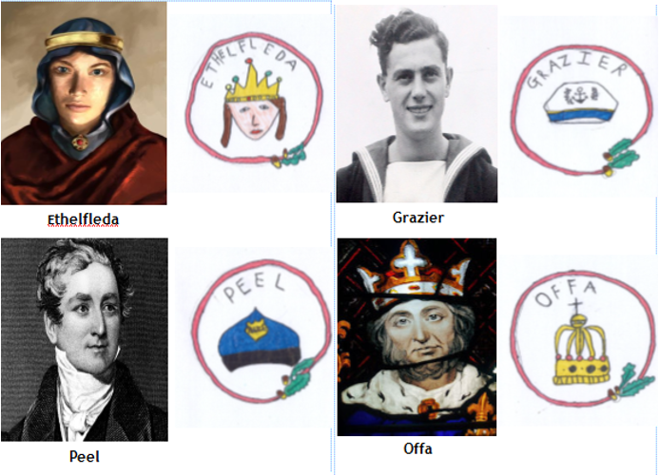
Houses:
Here are our school houses, named after important people from Tamworth’s history.
You will still be in the same house as last year – when you win team points, they all contribute to your team effort!
We will be voting for our new Year 6 House Leaders in September.

Slide 17
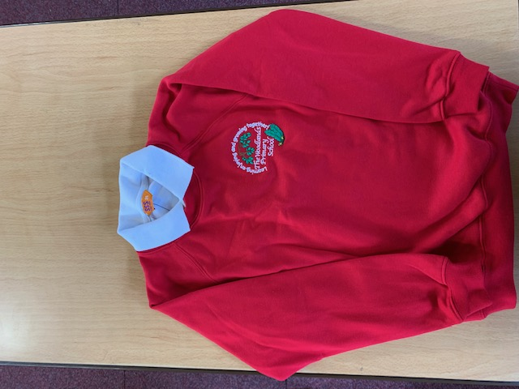
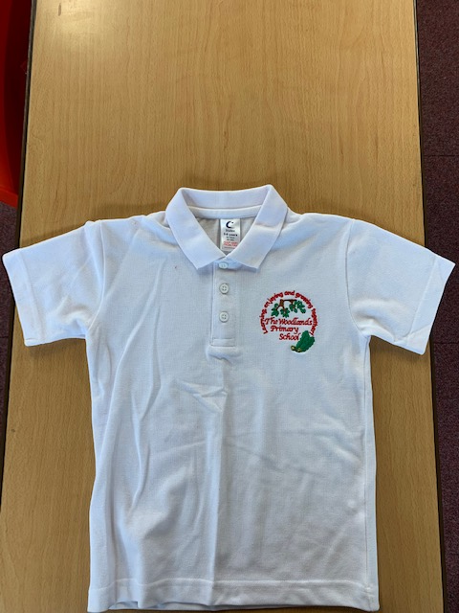
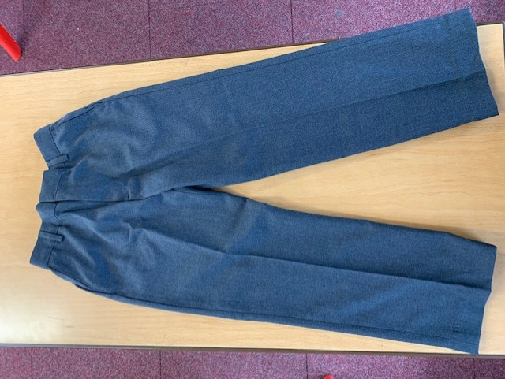
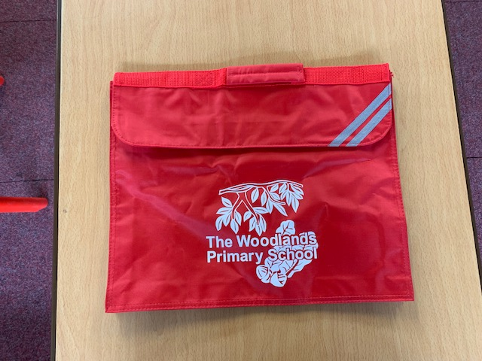
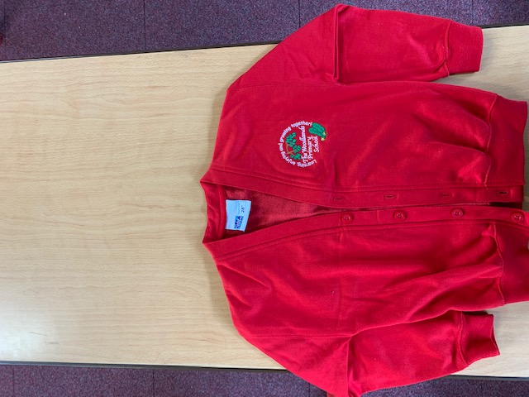
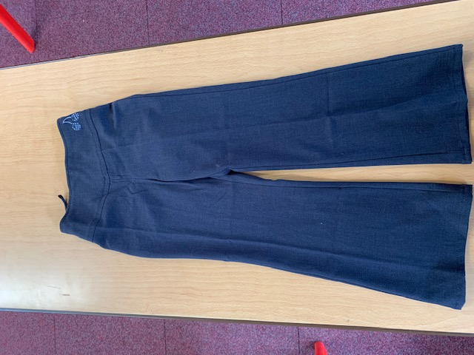
Uniform:
(Picture of school uniform)
Please wear full school uniform every day.
Please make sure each item of uniform is clearly labelled with your name.
Please wear sensible school shoes – no trainers please.

Slide 18
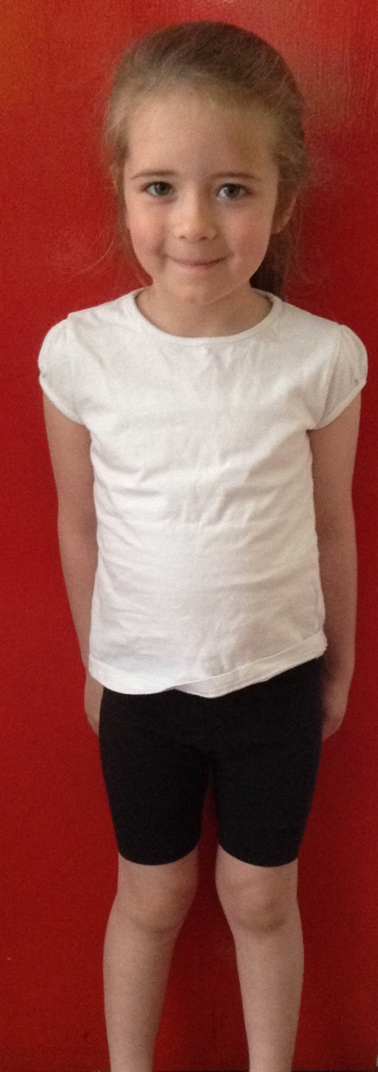
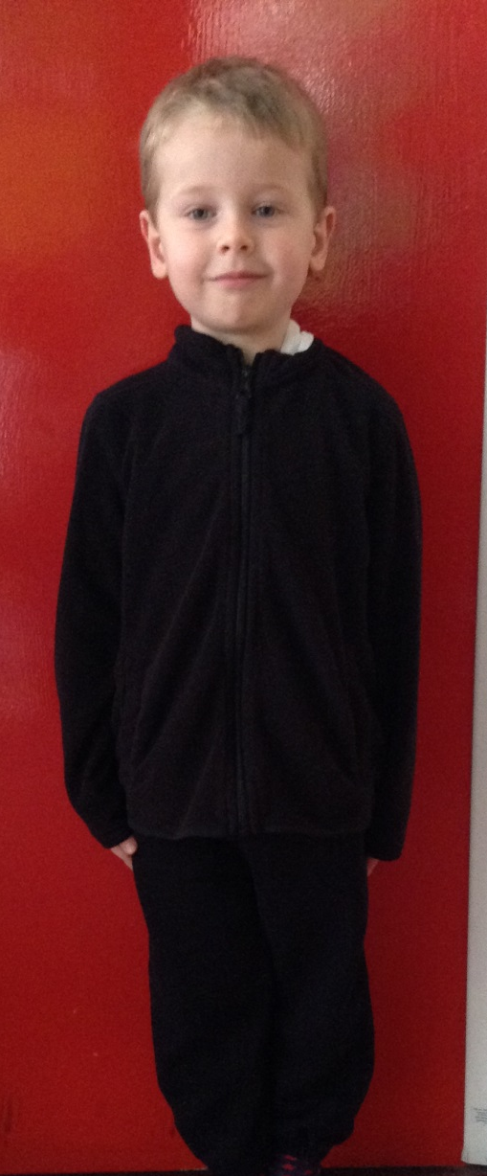
PE Kit:
Please make sure you have your PE kit in school on the days you have PE.
Please make sure each item of kit is clearly labelled with your name.
Please don’t wear earrings on PE days.
If you have long hair, please tie it back on PE days.
Outdoor Kit
White T Shirt
Black jumper/tracksuit top. (No hood)
Black Tracksuit bottoms /Joggers.
Trainers
Indoor Kit
White T Shirt
Black/Navy shorts

Slide 19
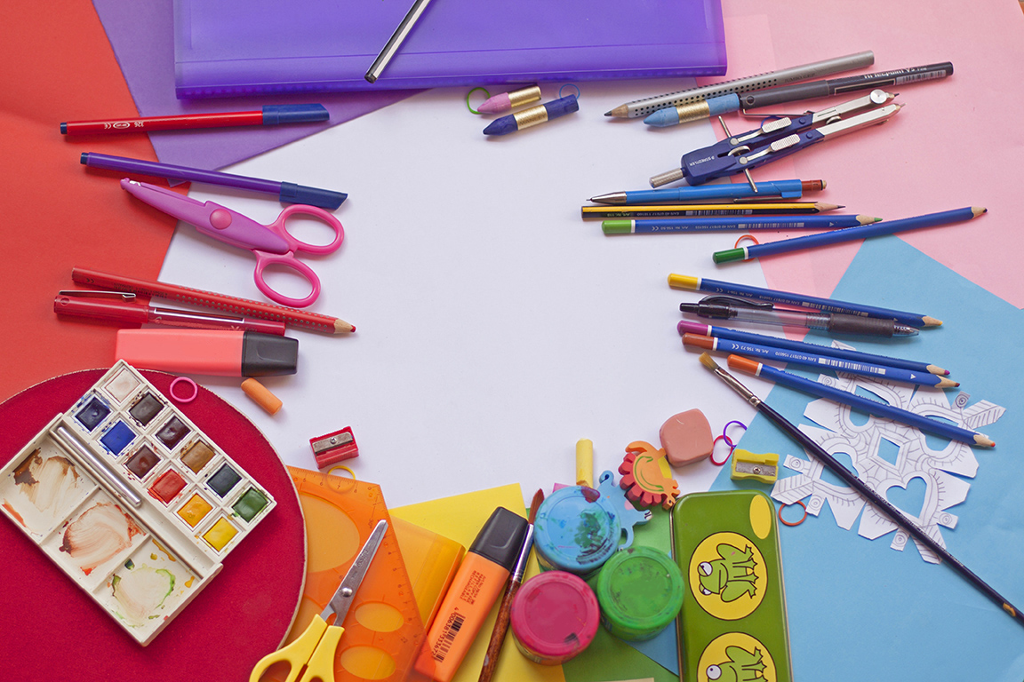
Every day, please bring:
A water bottle with your name on
Your coat
Your reading book
Your reading diary
A school bag to hold all your belongings

Slide 20
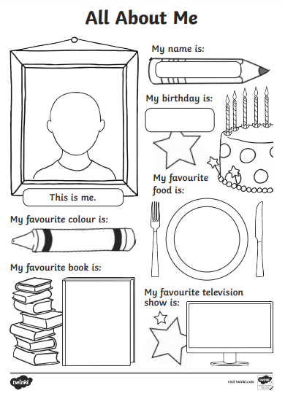
Please send us your
‘All About Me’ profiles !

Slide 21
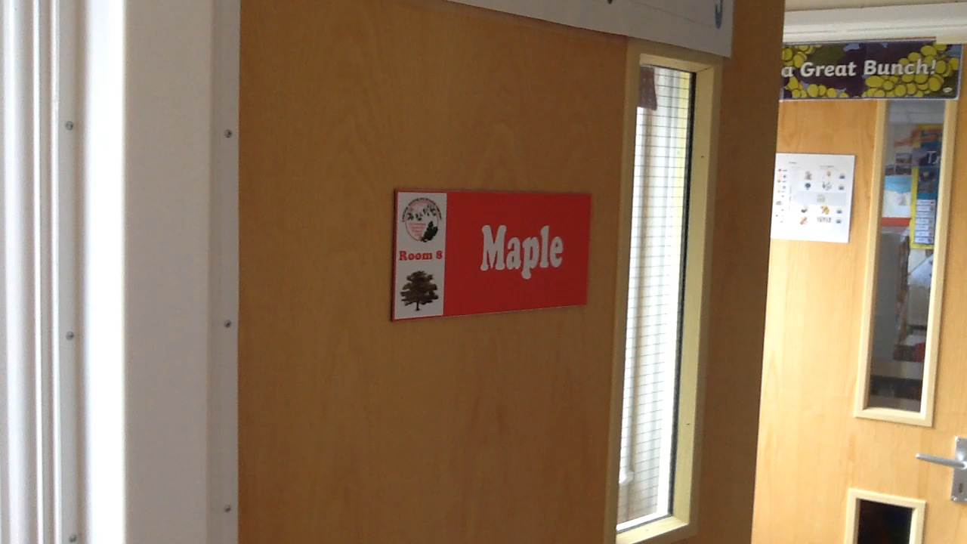
Have a lovely summer!
See you soon!

