Slide 1
Wow Assembly:
Friday 2nd July

Slide 2
Phrase of the Week:
Education is the most powerful weapon that you can use to change the world.

Slide 3
Green Cards!
First name – class

Slide 4
Scientists of the Week!
Oak –Laura
Ash – Clara
Birch – Ollie and Tyler
Pine – Ava
Elm –
Willow – Roux
Spruce – Malakai
Maple –
Redwood – Dylan
Chestnut - Lily
Aspen- Faith

Slide 5
Weekly Team Points!
Peel | Ethelfleda | Grazier | Offa
162
158
178
177

Slide 6
Oak
Harley
For
Sorting the landmarks in his local area and the famous landmarks in Australia.
Mrs Laffan 2.7.21

Slide 7
Ash
Margot
For
Resilience and excellent focus in Mrs Laffan’s phonics group. Margot is applying her phase 3 and 4 knowledge to read longer words.
Mrs Cox 2.07.21

Slide 8
Elm
(First name)
For
Miss Brady 04.09.20

Slide 9
Elm Wow Work

Slide 10
Birch
Iyla
For
Writing a fantastic Pirate postcard with descriptive language. Iyla tried extremely hard with her presentation too.
Miss Hewitt 02.07.21

Slide 11
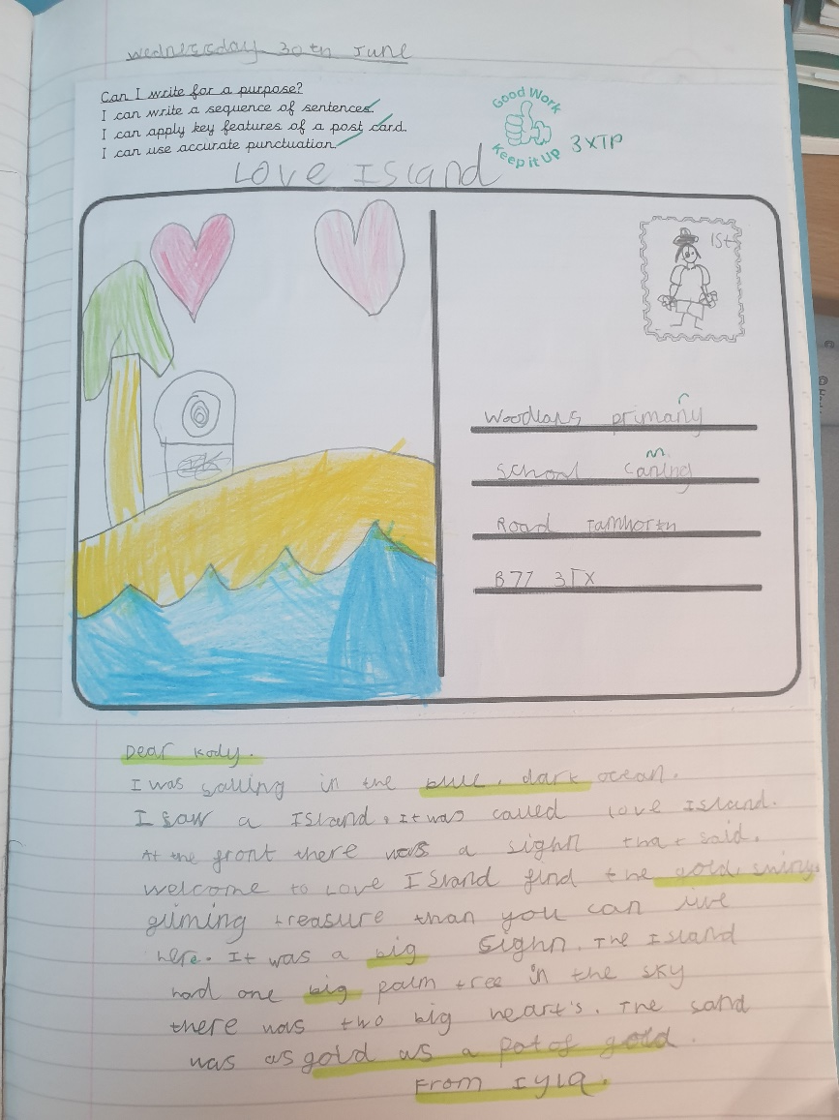
Birch Wow Work

Slide 12
Pine
Lilly
For amazing home learning this week. Lilly has worked so hard at home, showing amazing resilience. Well done Lilly ☺
Mrs Leedham-Hawkes 2.07.21

Slide 13
Maple
(First name)
For
Miss Dawson 04.09.20

Slide 14
Maple Wow Work

Slide 15
Willow
Evelyn, Esme and Lilly
For their teamwork in DT over the past couple of lessons.
Mrs Read and Miss Higgins 02.07.21

Slide 16
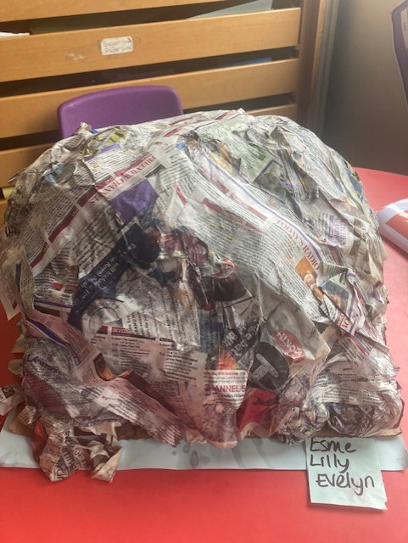
Willow Wow Work
The girls have worked so well together to make this fantastic Paper Mache Mountain.
We cannot wait to see the finished result once its painted.
Well done girlies ☺
Proof that TEAMWORK, really does make the dream work!

Slide 17
Spruce
Eva Longmore
For demonstrating a great understanding of using a written method for division including using remainders.
Mr Tennuci 2.7.20

Slide 18
Chestnut
Charlie H
For showing excellence in Maths. Charlie has been working hard identifying a range of fraction, decimal and percentage equivalence. Keep up the great work.
Miss Fisher 2.07.21

Slide 19
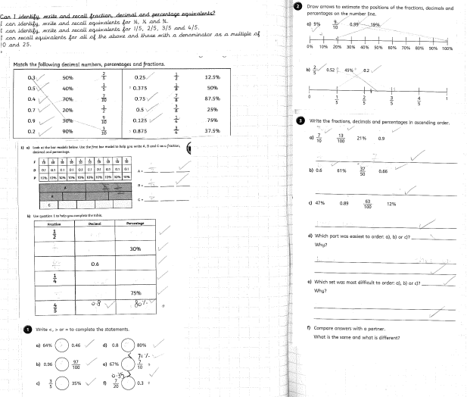
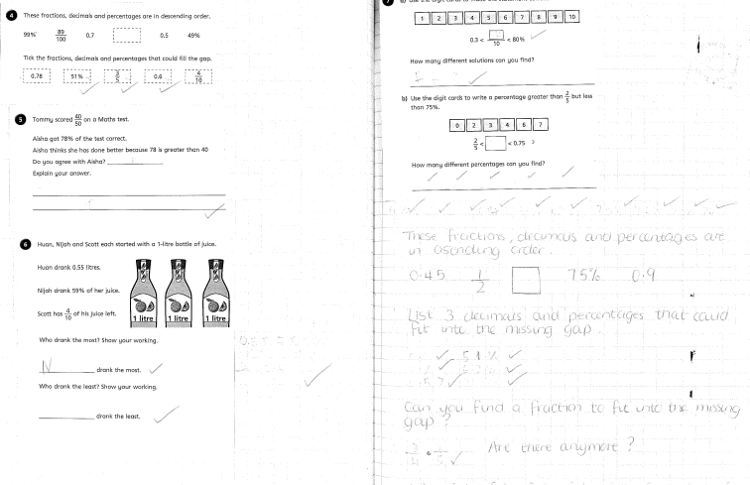
Chestnut Wow Work

Slide 20
Aspen
Eloise H
For wonderful teamwork and communication in her role as referee during our handball matches.
Miss Volante 02.07.2021

Slide 21
Redwood
Lauren
For showing amazing resilience during our assessments and trying her best in every lesson.
Miss Shipley 02.07.2021

Slide 22
Next Week’s
Phrase of the Week:
We rise by lifting others

