Slide 1
Wow Assembly:
10th December 2021

Slide 2
Phrase of the Week:

Slide 3
Green Cards!
Amelia M –
Aimee J –
Reilly –
Jayden –
Lauren –
Lexie - Ash
Noah – Ash
Harriet – Pine
Theo-Birch

Slide 4
Scientists of the Week!
Oak – George
Ash –
Birch – Tymon
Pine – Freddie.S
Elm – Adam
Willow –
Spruce –
Maple –
Redwood – Liam V
Chestnut – Alfie S
Aspen- Tobias

Slide 5
Weekly Team Points!
Peel | Ethelfleda | Grazier | Offa
216 | 219 | 230 | 213

Slide 6
Oak
Henry
For perservering to complete an activity. Henry completed a snowman cutting out activity.
Mrs Laffan 10.12.21

Slide 7
Ash
Gracie
For
Producing great work in D&T
Miss Bailey and Mrs Salt 10.12.21

Slide 8
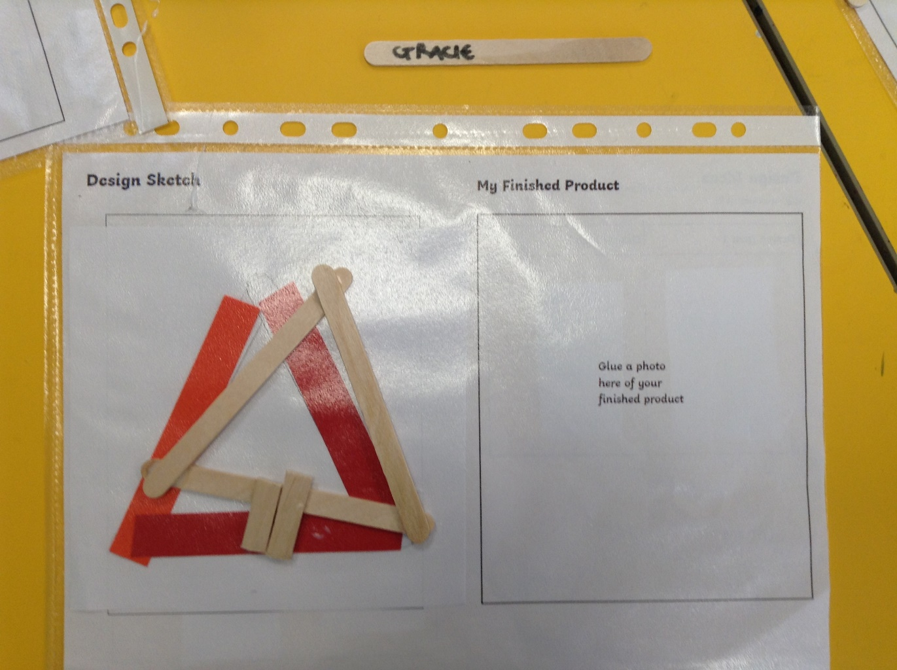
Ash Wow Work

Slide 9
Elm
Ella
For always being resilient and putting in so much effort in all of her work. Ella worked especially hard during our DT day to create an excellent biscuit box!
Well done Ella.
Mr Grice 10.12.2021

Slide 10
Birch
Freddie
For
A super attitude to learning. Freddie has made fantastic progress this term in his reading and maths. He has a super attitude to learning and this is showing in the work he produces. Well done Freddie!
Miss Hewitt 10.12.21

Slide 11
Pine
Taylor
For using self-awareness to follow instructions to make a reindeer gingerbread biscuit.
Mrs Leedham-Hawkes 10.12.21

Slide 12
Maple
Erin S.
Fantastic sewing. Erin was amazing at threading a needle and she supported others when they needed help. You were such a big help Erin.
Thank you!
Miss Dawson 10.12.2021

Slide 13
Willow
Alex
For showing perseverance when completing his sewing. He was not phased when the thread came out of the needle and continued to rethread it to complete his activity.
Miss Fisher 10.12.2021

Slide 14
Spruce
Faith
For showing great patience when sewing her stocking. You helped others in a kind and caring way.
Mr Draper 10.12.2021

Slide 15
Chestnut
Alfie
For his constant desire to better himself in all lessons. Alfie will always give his best and will seek advice to ensure he is doing the correct thing in lessons and will always try to find ways to improve his work.
Well done Alfie!
Mr Tennuci 10.12.21

Slide 16
Aspen
Oliver A
For always showing a ‘can do’ attitude when approaching new learning. This shone through this week during our D&T project – well done ☺
Mrs Read & Mrs Cox 10.12.21

Slide 17
Redwood
Isla L
For showing amazing resilience during all of the assessments, especially in her reading paper
Miss Shipley 10.12.21

Slide 18
Next Week’s
Phrase of the Week:

