Slide 1
Welcome to Spruce!
September
2020
Mr Tennuci

Slide 2
Teacher Profile:
Mr Tennuci
Welcome to Spruce!
I’m really looking forward to teaching you next year.
Facts about me
I’m a year 3/4 teacher but have taught lots of other year groups.
I originally come from the south of England, south of London.
I love movies from the 1980s (it wasn’t that long ago!) and anything to do with Star Wars and the Marvel superheroes.
When I’m not in school, I’m usually entertaining my own three children. I also play in a band, playing either the guitar or bass guitar. Just don’t ask me to do any singing.

Slide 3
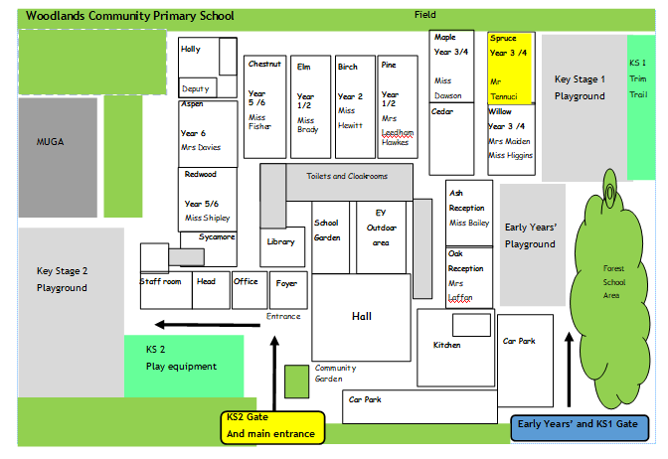
School Map
Your classroom is here!
Here is the map of our school site:

Slide 4
Welcome to Spruce!

Slide 5
Welcome to Spruce!

Slide 6
Welcome to Spruce!

Slide 7
Welcome to Spruce!

Slide 8
Welcome to Spruce!

Slide 9
Welcome to Spruce!
Come into your classroom through this entrance:

Slide 10
Welcome to Spruce!
Come on in !

Slide 11
Play time!

Slide 12
Play time!

Slide 13
Play time!

Slide 14
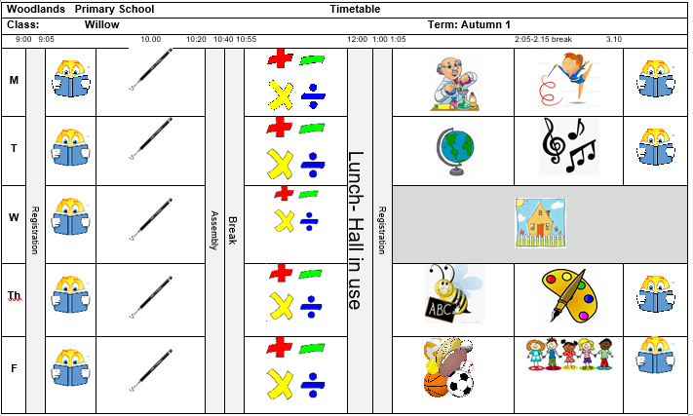
Timetable
Our timetable will look like this! We have Guided Reading, English and Maths every morning and our other subjects in the afternoons.

Slide 15
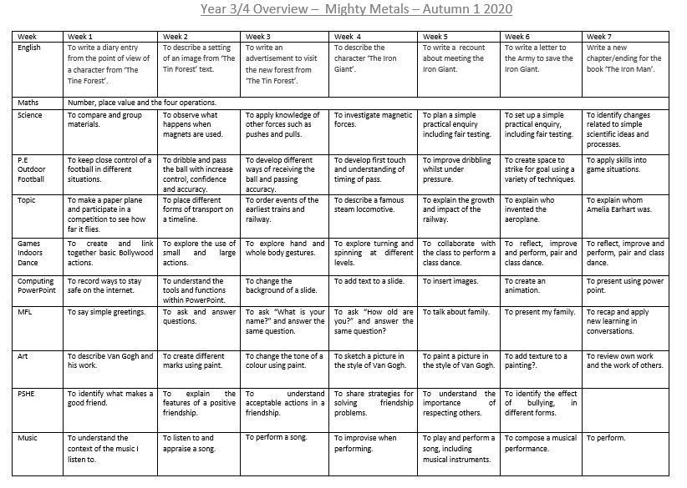
Here is an overview of what we will be learning during the first half term!

Slide 16
Houses:
Here are our school houses, named after important people from Tamworth’s history.
You will still be in the same house as last year – when you win team points, they all contribute to your team effort!
We will be voting for our new Year 6 House Leaders in September.

Slide 17
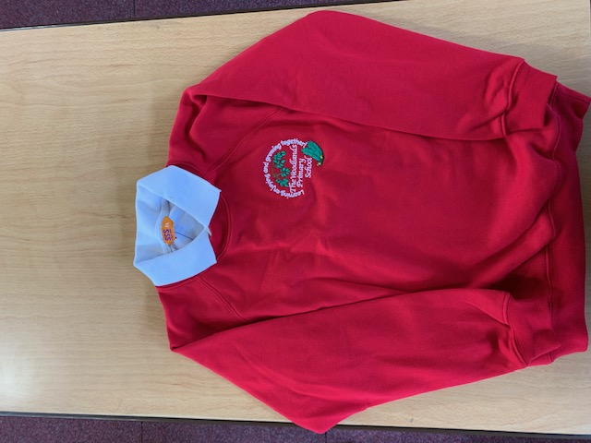
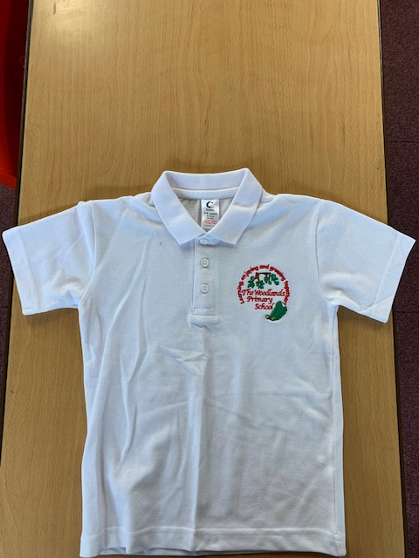
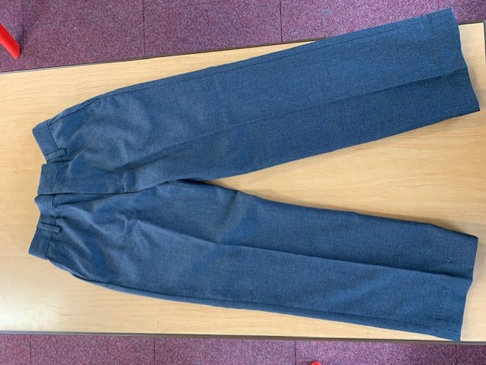
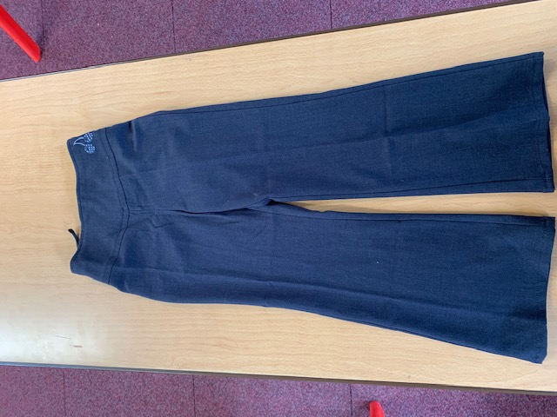
Uniform:
Please wear full school uniform every day.
Please make sure each item of uniform is clearly labelled with your name.
Please wear sensible school shoes – no trainers please.

Slide 18
PE Kit:
Please make sure you have your PE kit in school on the days you have PE.
Please make sure each item of kit is clearly labelled with your name.
Please don’t wear earrings on PE days.
If you have long hair, please tie it back on PE days.
Outdoor Kit
White T Shirt
Black jumper/tracksuit top. (No hood)
Black Tracksuit bottoms /Joggers.
Trainers
Indoor Kit
White T Shirt
Black/Navy shorts

Slide 19
Every day, please bring:
A water bottle with your name on
Your coat
Your reading book
Your reading diary
A school bag to hold all your belongings

Slide 20
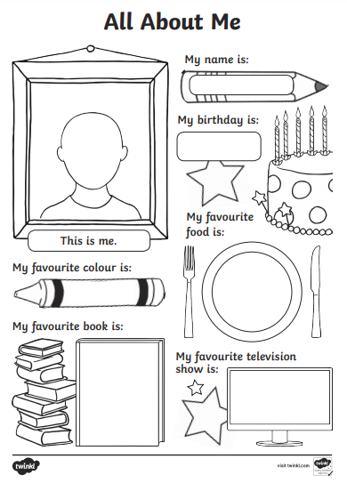
Please send us your ‘All About Me’ profiles !

Slide 21
Have a lovely summer! See you soon ! ☺

