Slide 1
Wow Assembly:
Friday 17th July

Slide 2
Phrase of the Week:
You get the best out of others when you give the best of yourself.

Slide 3
Green Cards!
Birch-Ollie Aspen- Nikola, Ewan, Noah, Lila and Anna
Birch-Ayla
Birch-Iyla
Robyn – Ash
Charley - Maple
Charlie - Maple
Grace - Maple

Slide 4
Scientists of the Week!
Oak –Sienna
Ash – Remey-Lei
Cedar - Lucas
Birch – Finley
Pine – Lucy
Elm –Mikey
Maple – Alfie-Ray

Slide 5
Weekly Team Points!
Peel | Ethelfleda | Grazier | Offa
160
156
201
123

Slide 6
Oak
Seb
For
Following instructions to draw a fantastic crab.
Mrs Laffan 17.07.20

Slide 7
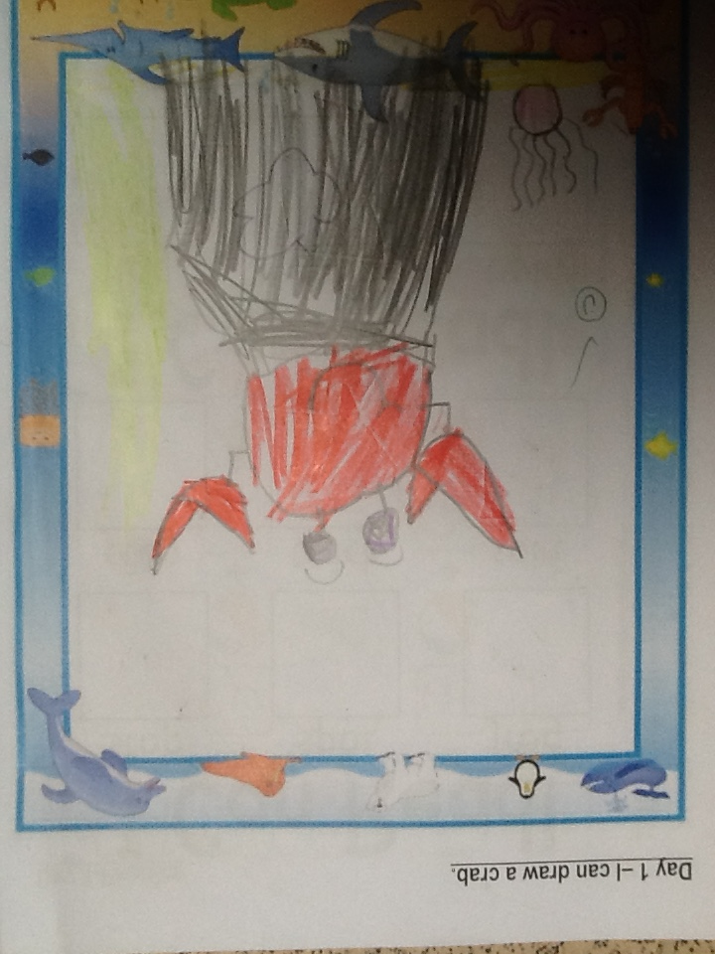
Oak Wow Work

Slide 8
Ash
Sophia
For her amazing drawing of a minion.
Well done Sophia!
Miss Bailey 17.07.20

Slide 9
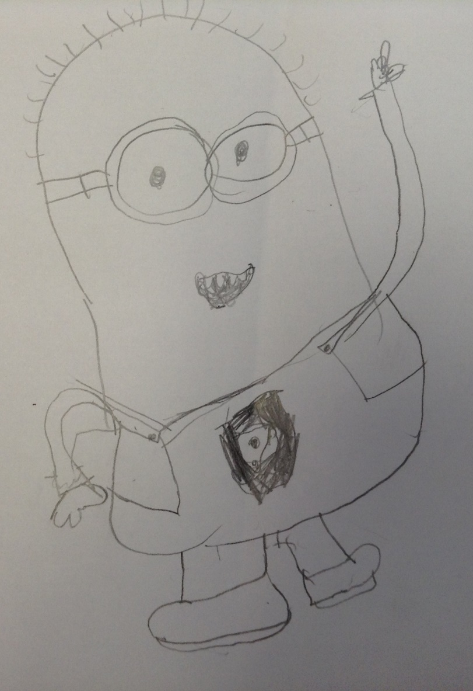
Ash Wow Work

Slide 10
Cedar
Evelyn
For reading and matching the rhyming words.
Well done Evelyn!
Mrs Scott 17.07.20

Slide 11
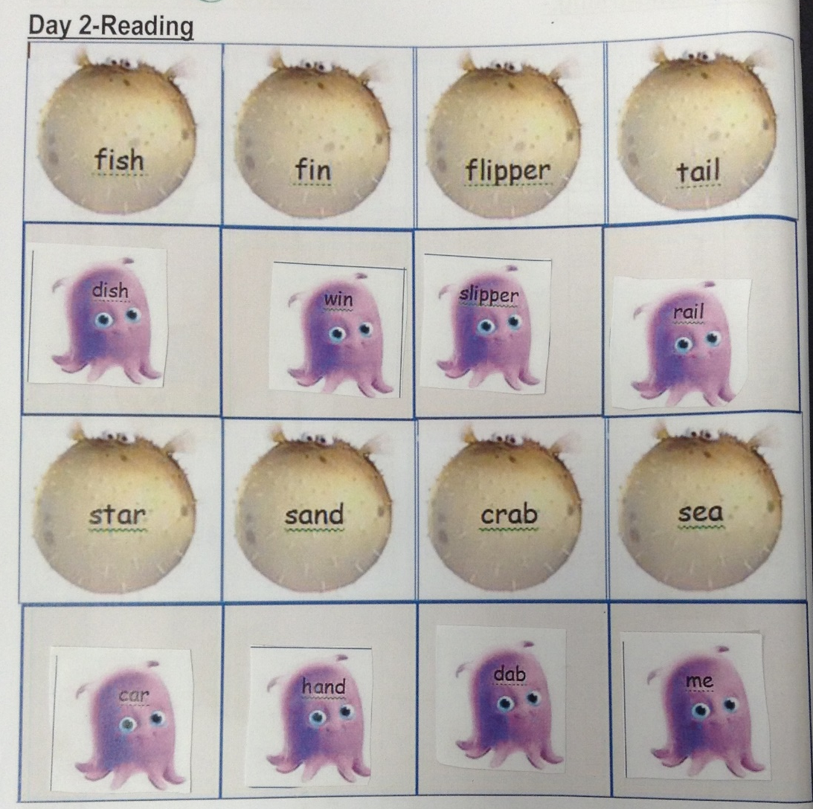
Cedar Wow Work

Slide 12
Pine
Pine Bubble
For being so thoughtful, well-behaved, kind and hard working over the past 7 weeks. It has been a pleasure to teach you. Well done ☺
Mrs Leedham-Hawkes 17.07.20

Slide 13
Elm
Riley WP
For
A fantastic few weeks of learning. A positive attitude and always having a smile!
Miss Brady 17.07.20

Slide 14
Birch
Brooke
For always trying her hardest and never giving up!
Miss Hewitt 17.07.20

Slide 15
Spruce
Alex
For
Writing, designing and illustrating his own ‘Winnie the Witch’ book.
Miss Dawson 17.07.2020

Slide 16
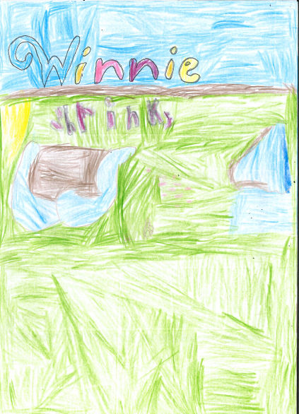
Spruce Wow Work

Slide 17
Holly
Eppie Samuels
For
Awesome newspaper writing showing she is definitely ready for Year 3 next year!
Mr Tennuci 17.07.2020

Slide 18
Maple
Natalia
For amazing work this week, especially in Maths. It has been lovely to watch your confidence grow ☺
Mrs Maiden and Mrs Pritchard 17.07.2020

Slide 19
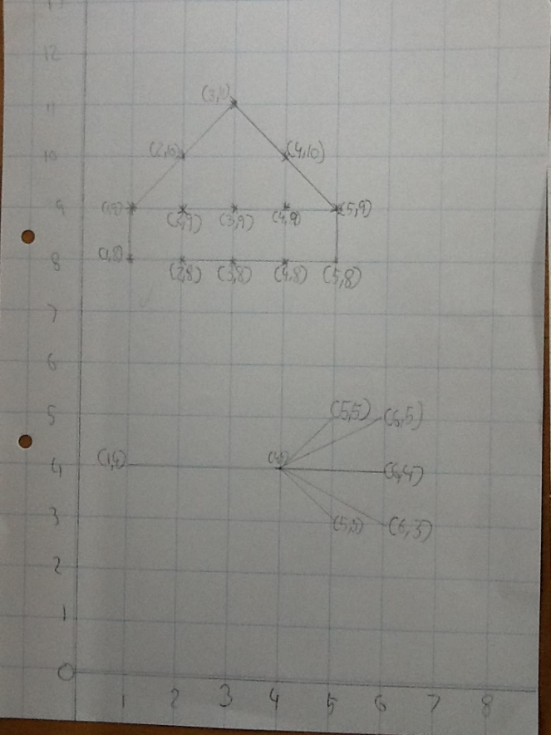
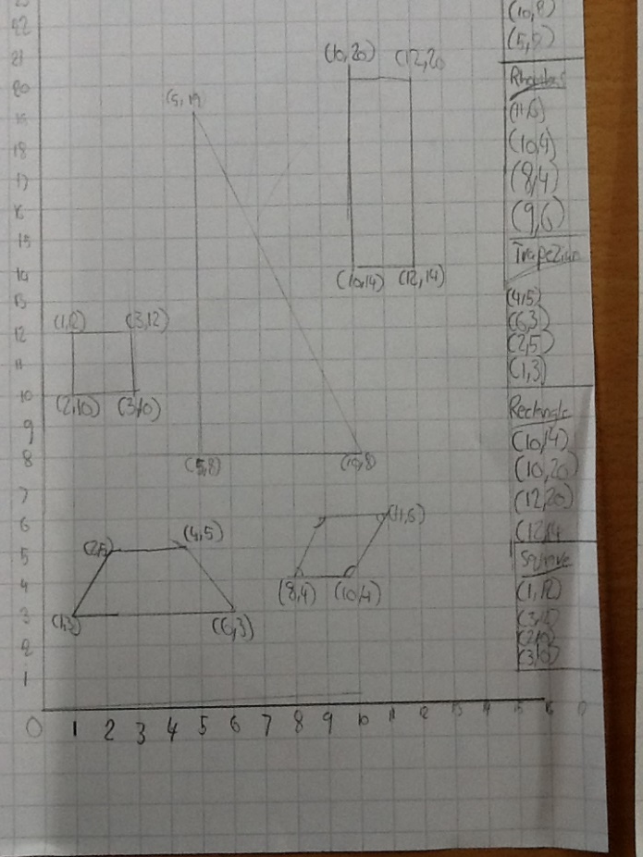
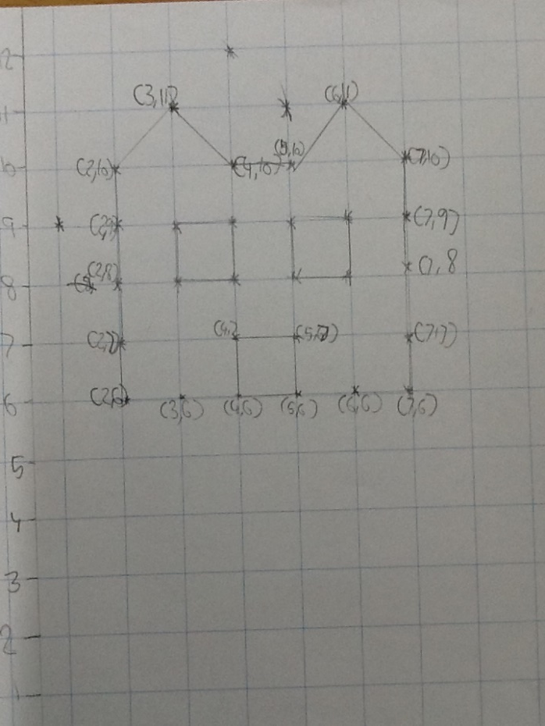
Maple Wow Work

Slide 20
Chestnut
Chestnut Bubble
For being an absolute pleasure to teach.
It has been fantastic to spend the last seven weeks in your company.
Thank you for the laughs. I will miss you.
Miss Fisher 17.07.20

Slide 21
Aspen:
All of Aspen Bubble
For being an absolute pleasure to teach.
It has been a joy to spend the rest of your year 6 time with you. Thank you for the fun, laughter and learning.
You are awesome.
Mrs Davies 17.07.20

Slide 22
Redwood
All of the Redwood bubble
For being absolutely amazing right up to the end and becoming wonderful individuals
Miss Shipley 17.07.20

Slide 23
Have a lovely summer holiday!
Have fun, stay safe and see you in September! ☺

