Slide 1
Welcome to Elm Class!
September
2022
Mr Grice

Slide 2
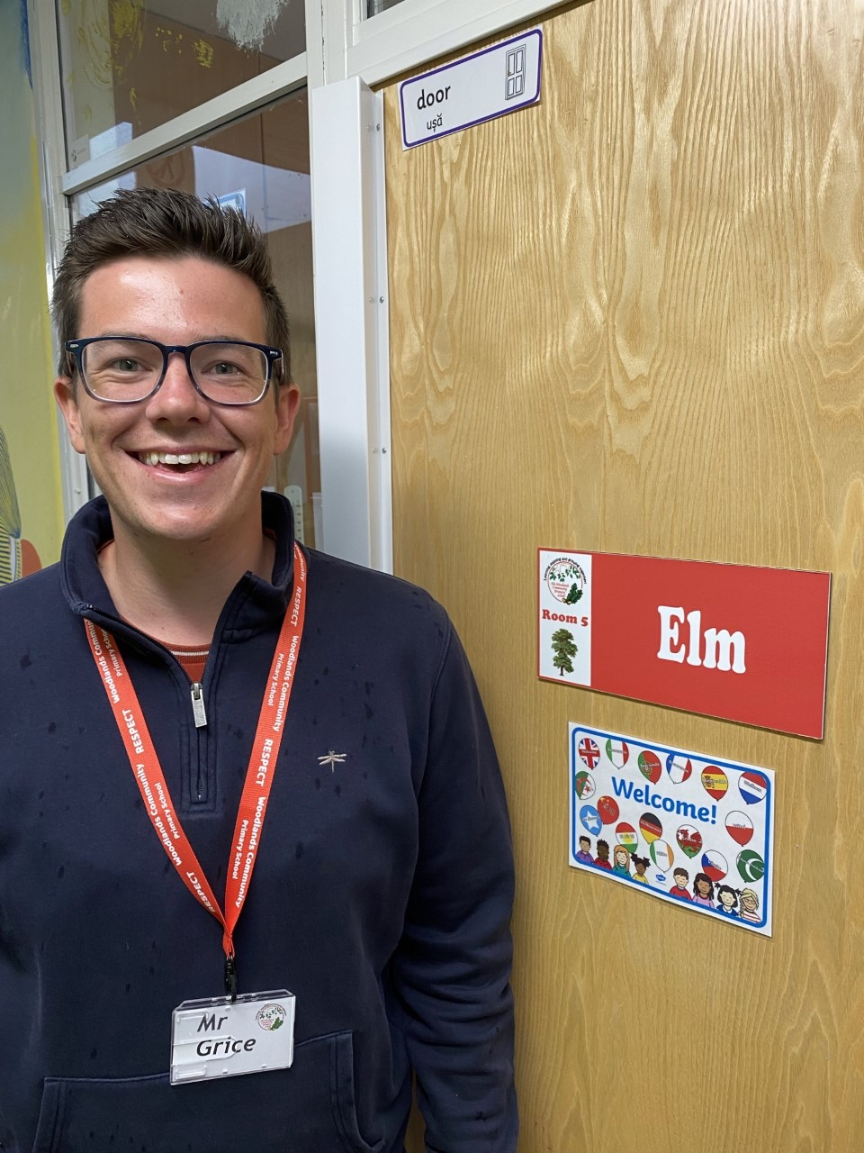
Teacher Profile:
Mr Grice
I can’t wait to teach you all!
Facts about me:
I have 2 dogs called Meg and Molly, who love to go on long walks!
I love to go on holiday, especially to Yorkshire.
My favourite colour is blue.
My favourite subjects to teach are Science and Guided Reading.

Slide 3
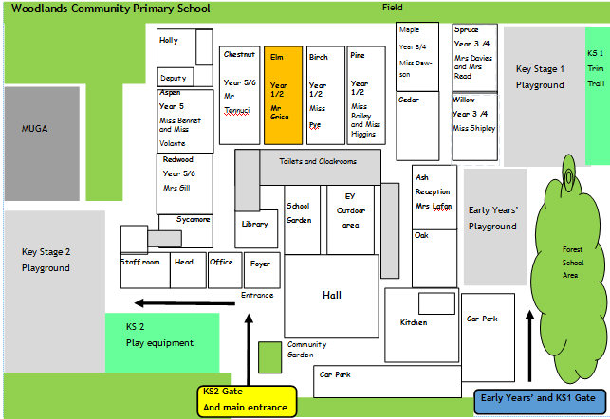
School Map
Your classroom is here!
Here is the map of our school site:

Slide 4
Welcome to Elm!

Slide 5
Welcome to Elm!

Slide 6
Welcome to Elm!

Slide 7
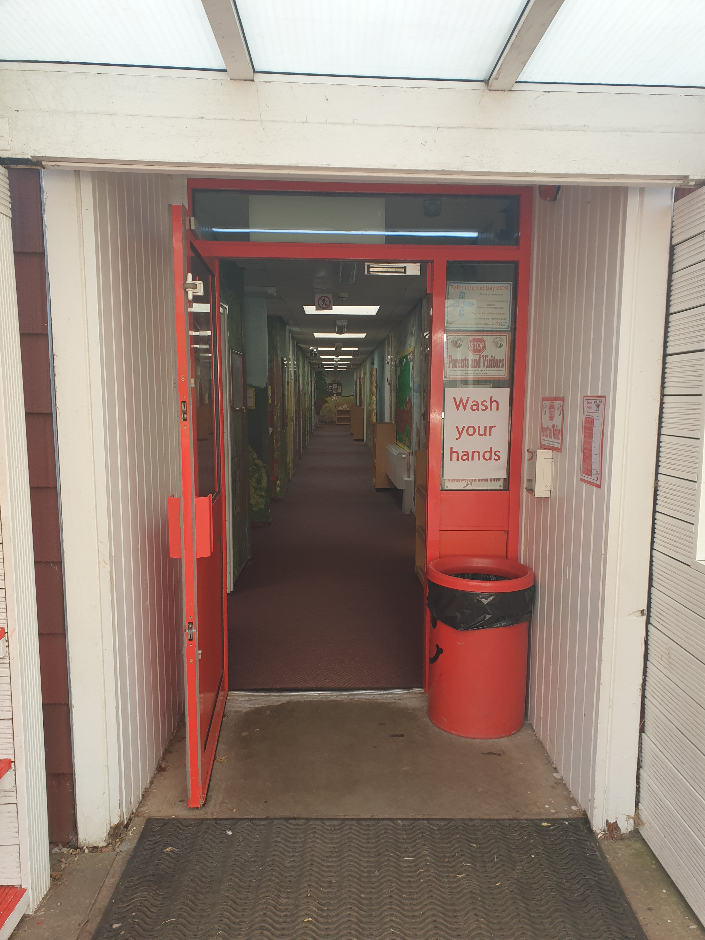
Welcome to Elm!

Slide 8
Play time!

Slide 9
Play time!

Slide 10
Play time!

Slide 11
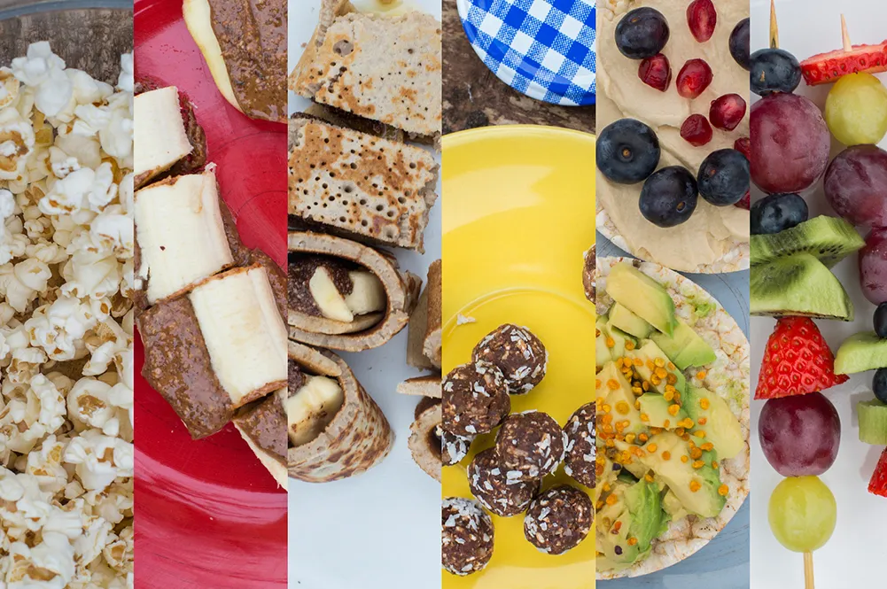
Play time!

Slide 12
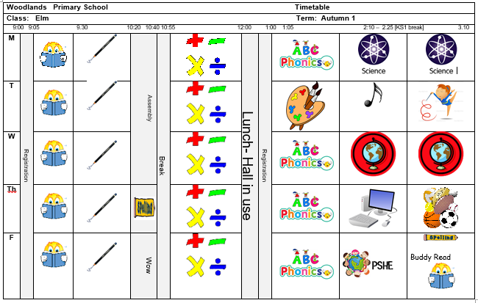
Timetable
Our timetable will look like this! We have Guided Reading, English and Maths every morning and our other subjects in the afternoons.

Slide 13
Houses:
Here are our school houses, named after important people from Tamworth’s history.
You will still be in the same house as last year – when you win team points, they all contribute to your team effort!
We will be voting for our new Year 6 House Leaders in September.

Slide 14
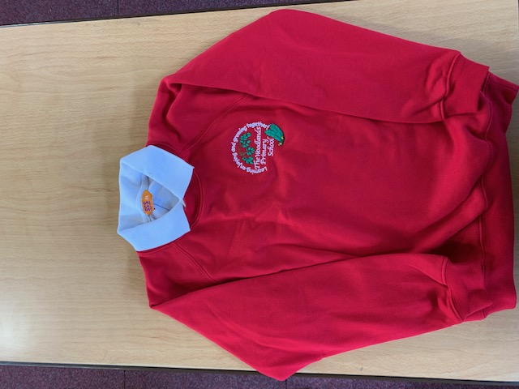
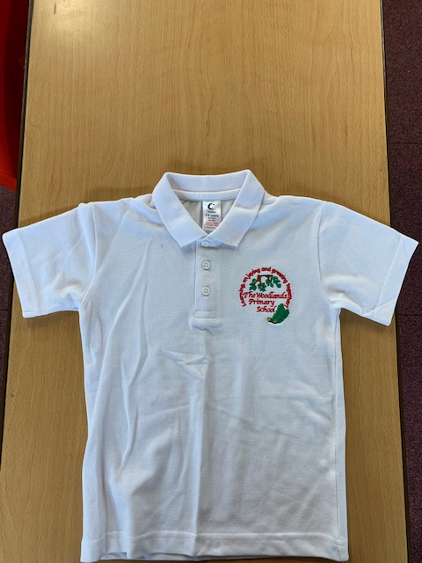
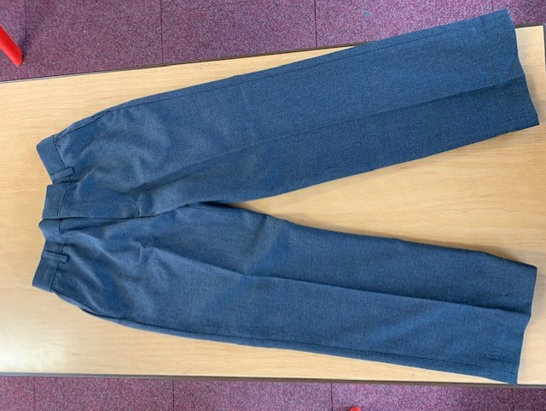
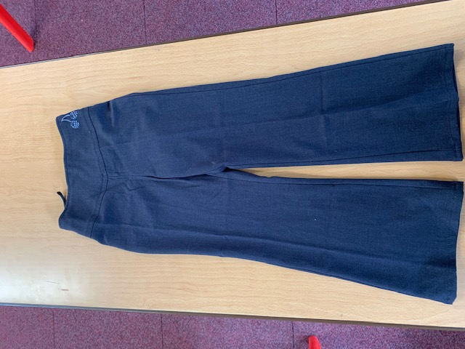
Uniform:
Please wear full school uniform every day.
Please make sure each item of uniform is clearly labelled with your name.
Please wear sensible school shoes – no trainers please.
Leggings are not part of our school uniform.

Slide 15
PE Kit:
Please make sure you have your PE kit in school on the days you have PE.
Please make sure each item of kit is clearly labelled with your name.
Please don’t wear earrings on PE days.
If you have long hair, please tie it back on PE days.
Hoodies are not permitted for PE.
Outdoor Kit
White T Shirt
Black jumper/tracksuit top. (No hood)
Black Tracksuit bottoms /Joggers.
Trainers
Indoor Kit
White T Shirt
Black/Navy shorts

Slide 16
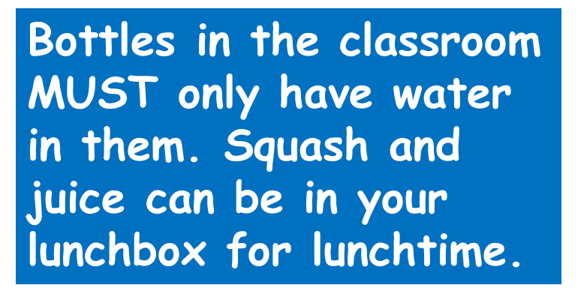
Every day, please bring:
A water bottle with your name on
Your coat
Your reading book
Your reading diary
A school bag to hold all your belongings

Slide 17
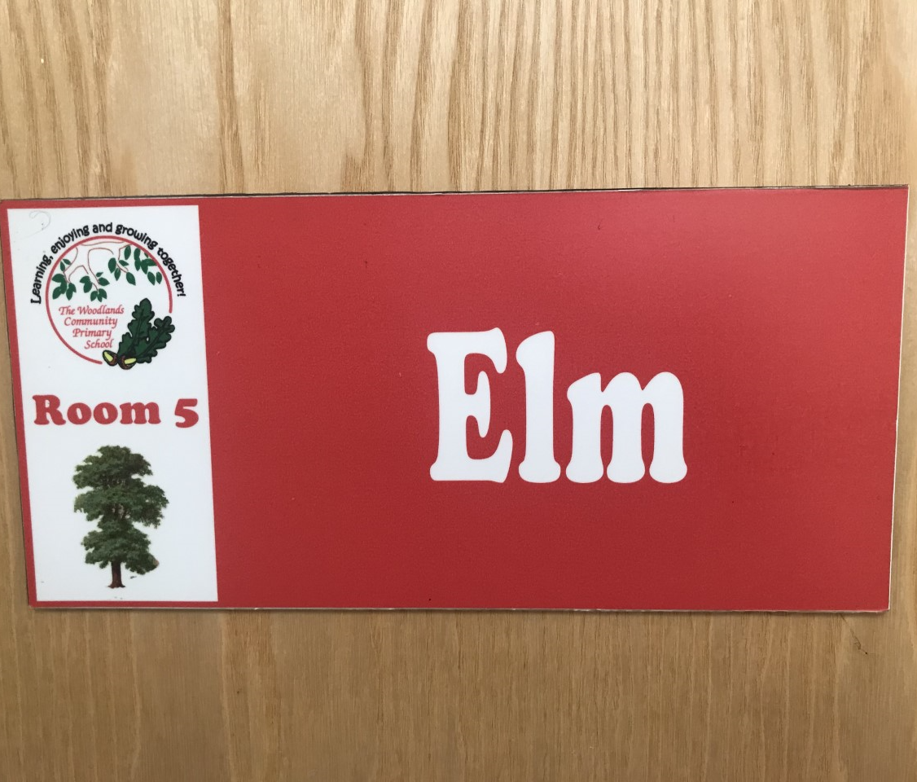
Have a lovely summer and see you soon!
Mr Grice ☺

