Slide 1
Wow Assembly:
Friday 8th October

Slide 2
Green Cards!
Annalia – Aspen
Amber – Aspen
Caeden – Redwood
Gracie – Redwood
Isla – Redwood
Riley – Redwood
Max – Maple
Finley- Maple
Poppy - Maple
Ellie – Redwood
Charley S. – Redwood
Vinny – Pine
Amelia – Elm
Phoebe x 2 (WOW) – Maple
Malakai – Maple
Harri – Maple
Lennon – Maple
Wiki – Chestnut
Amelia M – Chestnut
Mimi S - Chestnut
Aimee J. – Chestnut
Tarron- Spruce

Slide 3
Scientists of the Week!
Birch – Isabellla
Pine – Harley
Elm – Phillip
Willow – Phoebe
Spruce – Lucy-Mae
Maple –
Redwood – Millie
Chestnut – Zac
Aspen- Emma

Slide 4
Weekly Team Points!
Peel | Ethelfleda | Grazier | Offa
193 | 202 | 238 | 192

Slide 5
Oak
Harry
For
Harry listened carefully to the sounds in his writing to write some matching letters correctly..
Mrs Laffan 08/10/21

Slide 6
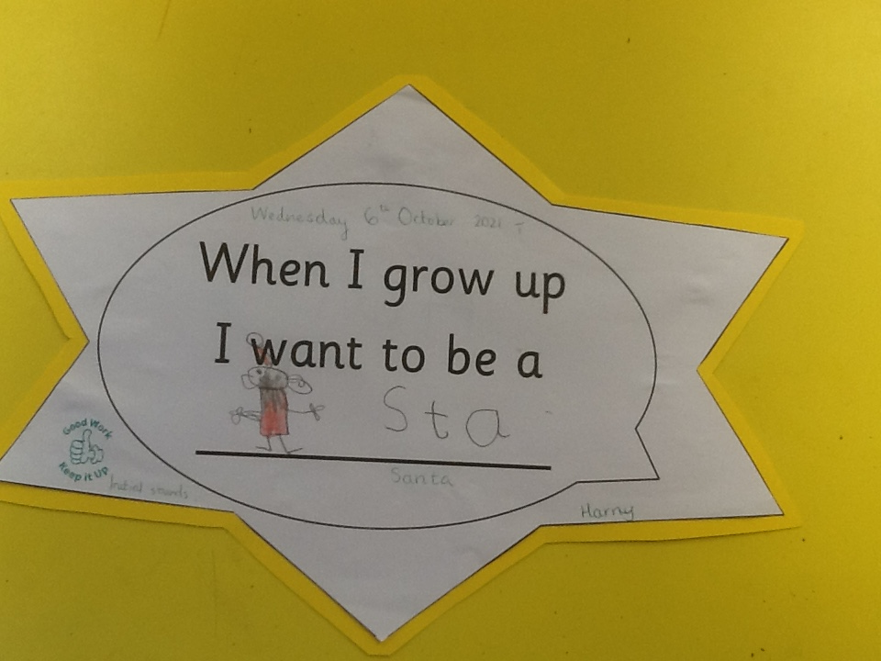
Oak Wow Work

Slide 7
Ash
Angie
For
Angie worked carefully to paint the squirrel, creating an Autumn picture using the natural resources.
Miss Bailey Mrs Salt 8.10.21

Slide 8
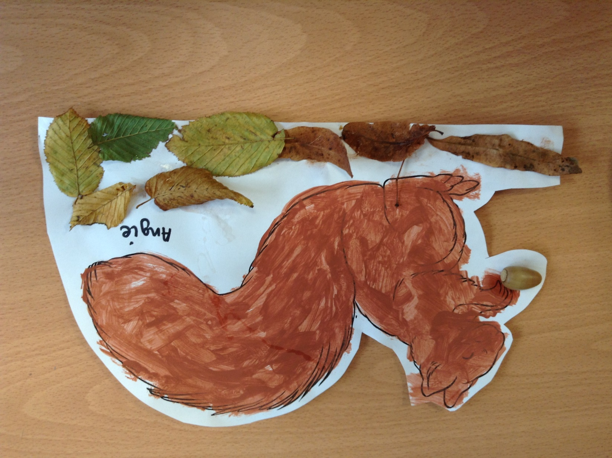
Ash Wow Work

Slide 9
Elm
Carla
for completing a great challenge in Maths, explaining that the concept of part-whole modelling links to addition and subtraction. Carla was able to identify that two parts add together to make a whole. Well done!
Mr Grice 08/10/2021

Slide 10
Birch
Paddy
For
Paddy has been working extremely hard to improve the pace and quality of his writing. This week he has written a fantastic retell and has had beautiful presentation ☺
Miss Hewitt 08.10.21

Slide 11
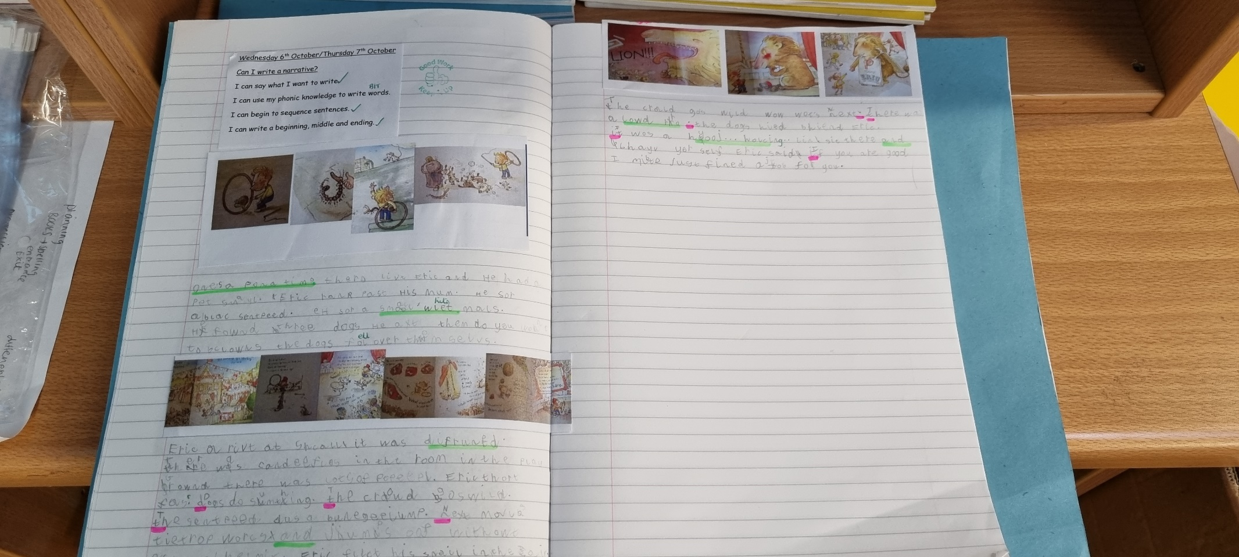
Birch Wow Work

Slide 12
Pine
Freya
For completing amazing reading at home, Freya is challenging herself with comprehension and is becoming such a fluent reader!
Mrs Leedham-Hawkes 8.10.21

Slide 13
Maple
Finley
For amazing work in maths. Finley has been adding hundreds to a three digit number and solving problems based on addition and subtraction. Great work Finley!
Miss Dawson 08.10.2021

Slide 14
Willow
Keira
For wonderful work in Art. For using great colour and trying out different slogans to include in your final piece. Well Done
Miss Fisher 1.10.21

Slide 15
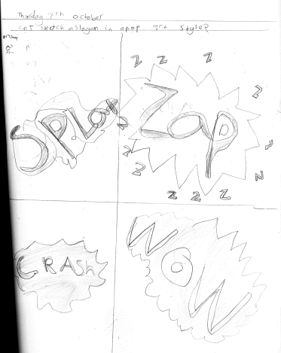
Willow

Slide 16
Spruce
Isabel
For consistent effort and resilience in all lessons, as well as a beautiful project that you have produced about your hero.
Mr Draper 08.10.21

Slide 17
Chestnut
Ray
For
Showing perseverance in his maths this week. He took on advice well, considered what needed to be checked and corrected and has finished the week with a much better and embedded understanding of hi learning.
Mr Tennuci 8.10.21

Slide 18
Aspen
Lilly Cotterill
For
Developing her resilience and beginning to ask for help when she is struggling – well done Lilly!
Mrs Read & Mrs Cox 08.10.21

Slide 19
Redwood
Ziva
For excellent teamwork and communication during our Forest Day and in the classroom – keep up the super work
Miss Shipley 01.10.21

Slide 20
Woodlands Eco Leaders
2021-2022

Slide 21
Year 1 and 2
Birch- Lilly
Pine- Carterose
Elm- Ronnie

Slide 22
Year 3 and 4
Maple- Freya
Spruce- Brooke
Willow- Roux

Slide 23
Year 5 and 6
Redwood- Bella T
Aspen- Emma B
Chestnut- Aimee J

Slide 24
Next Week’s
Phrase of the Week:
Mistakes are proof that you are trying.

