Slide 1
Wow Assembly:
Friday 19th June 2020

Slide 2
Phrase of the Week:
Just because something doesn’t go as you planned, it doesn’t
mean it is useless.

Slide 3
As this is the first week of our Distance Learners WOW assembly I have added a couple of extra people who have been hard at work. Just like in school, we want to share and celebrate all of your achievements so please let us know what you are learning at home!

Slide 4
Oak
Harrison C.
For
Amazing investigations into circuits and electricity
Miss Shipley 19.06.20

Slide 5
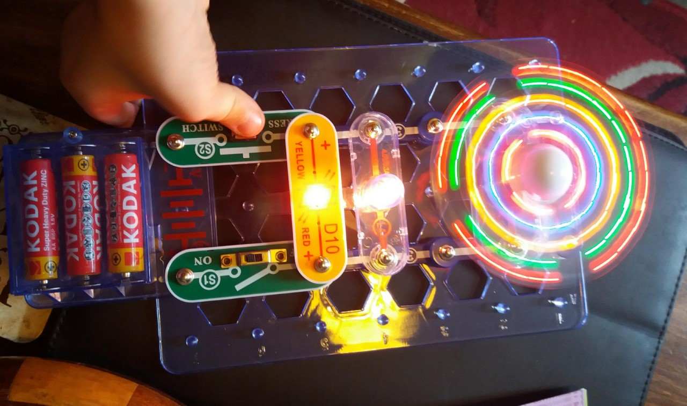

Slide 6
Pine
Brandon M.
For amazing resilience with his home learning!
Miss Shipley 12.06.20

Slide 7
Birch
Oliver B.
For a super attitude to home learning even when it gets tricky!
Miss Shipley 12.06.20

Slide 8
Chestnut
Lacey H-C.
For outstanding achievements and dedication to art lessons at home!
Miss Shipley 12.06.20

Slide 9
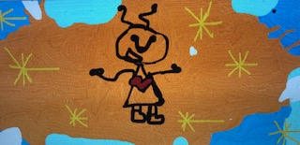

Slide 10
Willow
Jay W.
For becoming a super pen-pal to his Great-Grandma and writing to her all the time!
Miss Shipley 19.06.20

Slide 11
Willow
Violet T.
For outstanding effort with ALL her home learning and getting 100% on the Education City activities!
Miss Shipley 19.06.20

Slide 12
Spruce
Aimee J.
For outstanding effort in Science and amazing presentation of her work!
Miss Shipley 19.06.2020

Slide 13
Spruce
Charlie S.
For amazing perseverance in maths and with the Gold Award!
Miss Shipley 19.06.2020

Slide 14
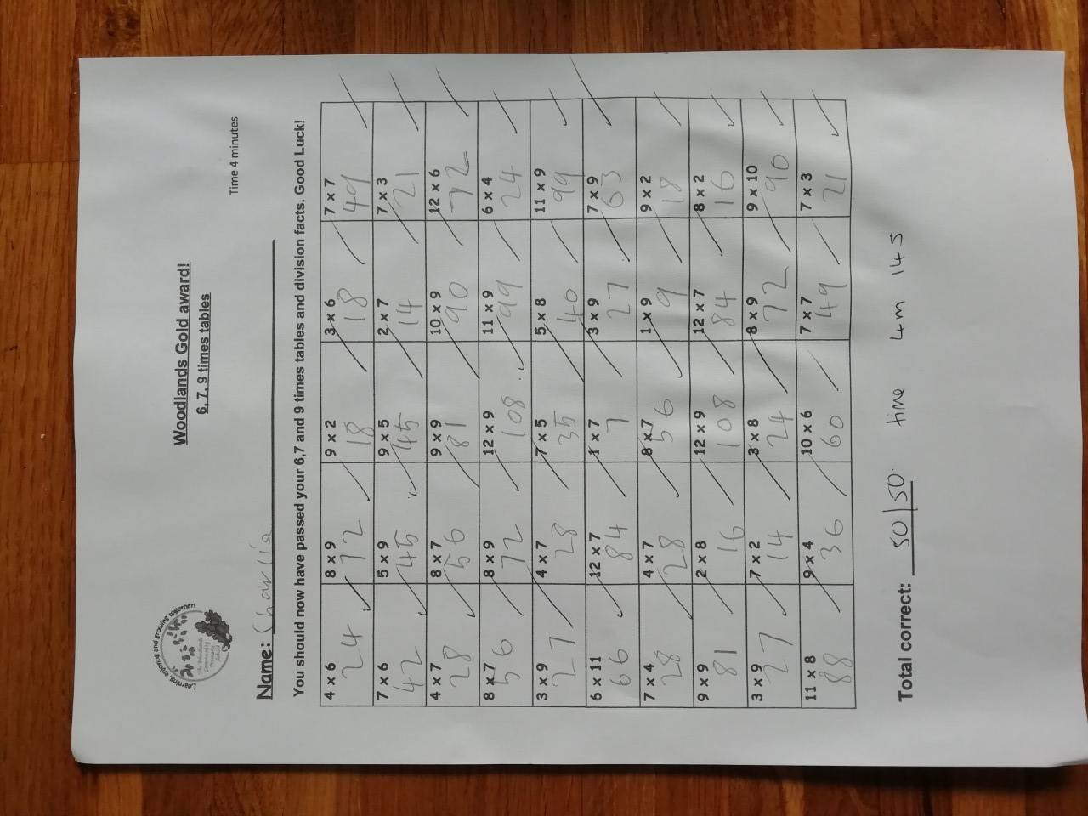

Slide 15
Redwood
Ava P.
For excellence and resilience in her dancing.
Miss Shipley 12.06.20

Slide 16
A massive congratulations to all of our Home Learning WOW Workers. It has been wonderful to see and hear about so many exciting projects and lessons this week. We can’t wait to see what you do next week and share some more WOW work with our Woodlands’ friends.

