Slide 1
Wow Assembly:
Friday 21st April

Slide 2
Weekly Team Points!
Peel | Ethelfleda | Grazier | Offa
445 | 451 | 435 | 469

Slide 3
Scientists of the Week!
Ash-Explorer of the Week:-Addison
Birch – Lyla
Elm – Olivia
Pine –
Redwood – Malakai
Chestnut – Tobias
Aspen- Jaxson
Willow –Josh Spruce – Alexi-Grace
Maple – Sid

Slide 4
Green Cards!
Amber – ASPEN
Alex P – ASPEN
Seyi – Spruce
Emily – Spruce
Angel - Redwood

Slide 5
Ash
Lillie-Jan
For her creative ideas in Drawing club and wonderful vocabulary.☺
Mrs Laffan 21.4.2023

Slide 6
Elm
Finley
For a great attitude towards learning whilst our real life heroes visited our school. Finley listened carefully to the police and enjoyed interacting with the officers! Great work Finley!
Mr Grice 21.04.2023

Slide 7
Birch
Louie
Louie has been an amazing member of Birch and has always been enthusiastic about the work we have done. It has been great to see him grow and flourish, especially in his Maths work. Good Luck in your new school, Louie!
Miss Smart 23.03.2022

Slide 8
Pine
Clara
For her growing confidence and the hard effort she puts into her work, well done!
Miss Bailey & Mrs Salt 21.04.2023

Slide 9
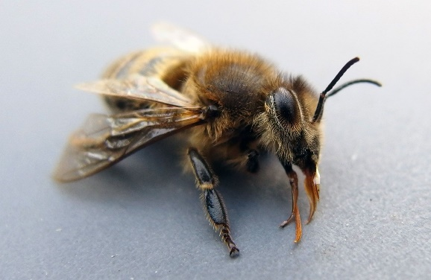
Maple
Elyza F
For sharing lots of interesting facts about bees.
Miss Dawson 21.04.2023

Slide 10
Willow
Felicity
For always showing compassion, kindness and empathy towards others
Miss Shipley 21.04.2023

Slide 11
Spruce
Iyla
For excellent expanded noun phrases to describe our school.
Mrs Read & Mrs Davies 19.4.2023.

Slide 12
Chestnut
Oscar
I have been extremely impressed with Oscar’s efforts and enthusiasm with English this week. He has used ideas from his own reading t inform his ideas he has been creating for his setting description and has really engaged with his learning because of this , this week. Well done Oscar!
Mr Tennuci 21.4.23

Slide 13
Aspen
Alex L
For showing a super attitude in all learning, especially Maths!
Mrs Cox and Miss Bennett 21.04.23

Slide 14
Redwood
Isla
Showing great resilience to learning, in all subjects.
She doesn’t let anything stand in her way.
Mrs Gill 21.04.2023

